Slide 1
Chapter 3: Colonization of the “New World

Slide 2
Why colonize?
Why would a nation decide that they want to move beyond their borders and settle in a foreign place?
Why would individuals want to move to an unknown foreign land?

Slide 3
Nations and People Explored Because:
Italian Monopoly\Northwest Passage
Age of Exploration: New Inventions
Industry\Economics: New Markets and Natural Resources
Renaissance: Fame and Fortune
Reformation\Counter Reformation
Monarchy\Middle Ages\Primogeniture
Penal Colonies
Catholicism
Mercantilism
Land Finite Commodity

Slide 4
What countries decided to face those obstacles and head to the New World?
Spain - the 1st
“1492 Columbus sailed the ocean blue…”
Catholicism, gold, silver, and men
Mixing of ethnicities
France
Begin to settle in the late 1500s
Trading posts
England
Begin to settle in the early 1600s
Establish settlements, families

Slide 5
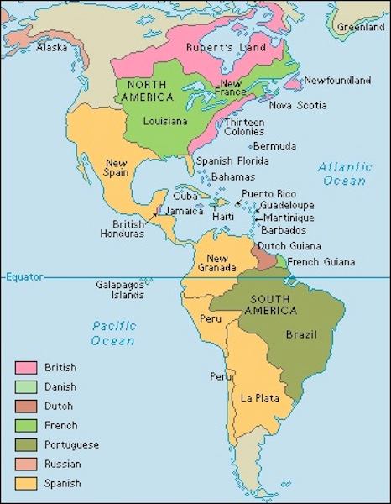
Where did those countries
settle?
Spain - American West, Central America, South America
Portugal - South America Brazil
France - Canada, Midwest
England - Northern Canada, East Coast
And a few others

Slide 6
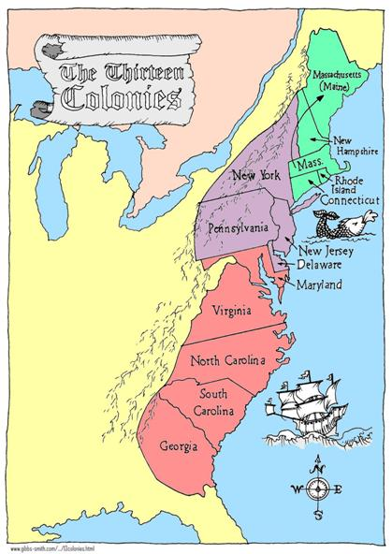
The 13 American colonies
Charter Colonies - a granted charter to the colonial government establishing the rules under which the colony was to be governed
Proprietary Colonies - royal charters given as favors to individuals who then did as they saw fit with the land
Royal Colonies - governor appointed by crown

Slide 7
New England colonies
Ethnic - English, Puritan Farmers\Families
Religion - Puritans - strict and gloomy, Not Very Tolerant
Towns - common area, bigger population
Gov’t - town meetings, voting, a voice, high degree of self government
Econ - whaling\fishing, lumber, small farms, merchants, craftsman, boatbuilding, long distance trading
Environs - rocky, hilly, forests, poor soil, long winters
Educ - read the Bible, set up public education
Slavery - free blacks, very few slave

Slide 8
Middle colonies
Ethnics - Quakers, Dutch, French, Germans, Scot-Irish, Diversity
Religion - Quakers, Catholics, Jews, Protestant, Tolerance
Town - Seaports
Gov’t - town meetings and county gov’t
Econ - mixed, bread basket\smaller farms, livestock, $ crops, trading
Environs - flat land, fertile soil, swift rivers, wide valleys, temperate
Educ - modest amount of schooling, religious based
Slavery - some slaves, Quakers-abolishionsim

Slide 9
Southern colonies
Ethnics - English Aristocracy, Georgia penal colony
Religion - Church of England\Anglican, Maryland Catholic, religion not a major focus
Towns - Seaports
Gov’t - county, sheriffs\justices, appointed by governor, governor appointed by King
Econ - Plantations, staple crops - tobacco\rice
Environs - rich\fertile soil, broad coastal plains, flat
Educ - very little, plantation tutoring
Slavery - basis of economy, largest population, as many or more slaves than free people in some areas

Slide 10
13 colonies
The 13 American colonies were all founded between 1607 (Virginia) and 1752 (Georgia)
Salutary Neglect - the big pond and English Civil War
Next: French Indian War, Pontiac’s Rebellion, Westward Expansion, Great Awakening , Enlightenment, and Royal Colonies

Slide 11
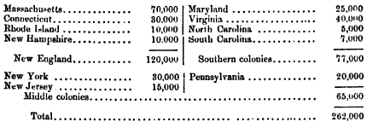
13 colonies
Population in 1700

