Slide 1
Articles of Confederation
Our First Attempt at Creating a National Government

Slide 2
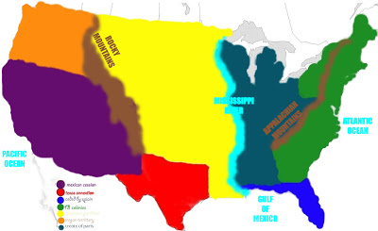

Thirteen Colonies or Are We One Nation?
Factors Encouraging Unity of Colonies:
common English language\culture
single geographic unit
no traditional hostility against one another
cooperated in common effort to win independence from:

Slide 3
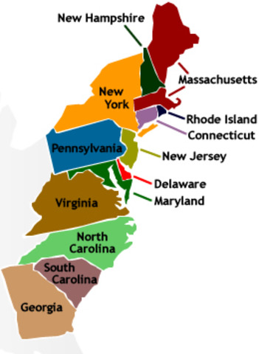

One Nation or Thirteen continues…….
Factors against Unity:
strong loyalties to their individual states
2. large area with poor roads and inadequate transportation to communicate
3. not interdependent economically, traded more with West Indies and Europe
4. no common enemy to unite against
** (1781-1789) U.S. underwent what many historians call a “Critical Period”

Slide 4

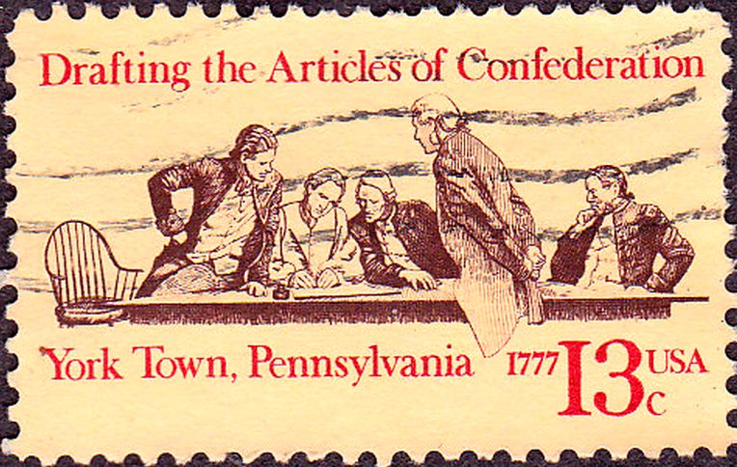
“League of Friendship”
1777 - Articles of Confederation proposed by the Continental Congress
1781 – ratified and the Articles established a National Government
Each state retained “its sovereignty, freedom, and independence.” (State Constitutions more important)
A firm “league of friendship” between the colonies – with a weak central govt.

Slide 5
Weaknesses of the A of C
Central Govt. – Congress a one-house legislature (unicameral)
- delegates from 13 states each casting one vote
2. No chief executive to enforce the laws…WHY???
3. No national courts for disputes between citizens of different states, state courts only
Congress needed a 9/13 vote to enact laws (rarely were there more than 10 states present at one time)
amendments needed unanimous vote

Slide 6
Weaknesses Continue…Lack of
Legislative Power
No national taxes instead request funds from states
Government and states can issue money
No national army instead state militias
Could not control foreign and domestic trade
Lacked respect and effectiveness with foreign leaders

Slide 7
Achievements Under the A of C
Pleased small farmers, frontier settlers, and city workers (Weak govt. didn’t threaten their rights and liberties)
Ended the Revolutionary War
Achieved the Treaty of Paris (1783)
Kept states united in name – if not always in fact
Passed the Land Ordinance of 1785
Passed the Northwest Ordinance of 1787

Slide 8
WHY DOES IT FAIL???
Economic Factors…US in debt for over $50 million after the war!
Weak Central Government…”Nationalist” group forms speaking out against a weak central government (Washington, Madison and Hamilton)
America as a “Model” Country…are we headed to political violence
Annapolis Convention…Fix economic problems…very few states showed…but they all agreed for the need to meet again!!!

