Slide 1
Chapter 12
Reconstruction
1865-1877

Slide 2
Section 1:
Presidential Reconstruction

Slide 3
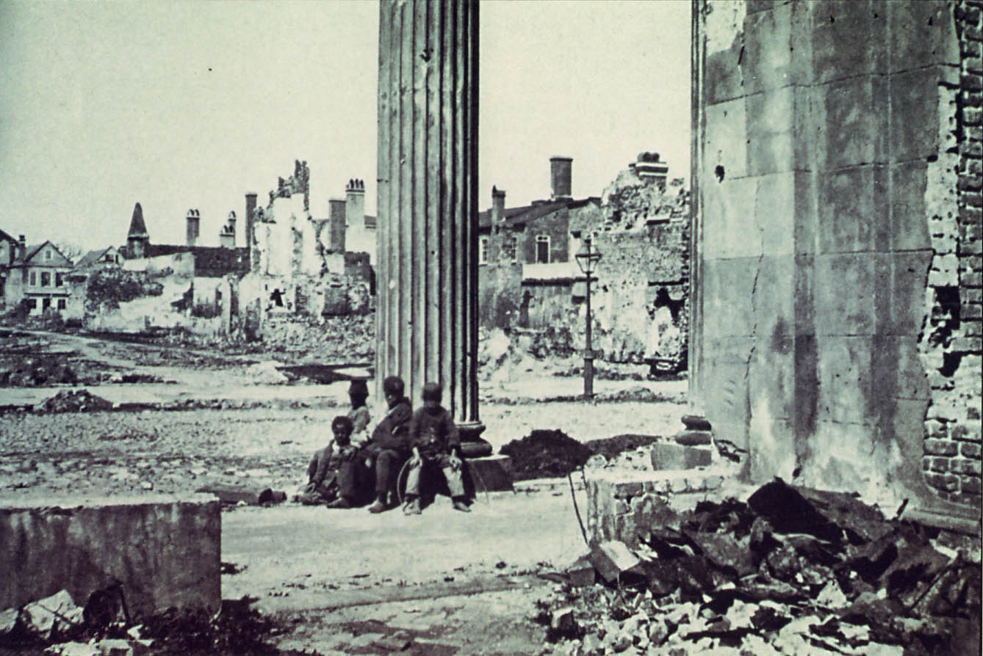
Reconstruction:
program to repair the damage to the South and restore the southern states to the Union

Slide 4
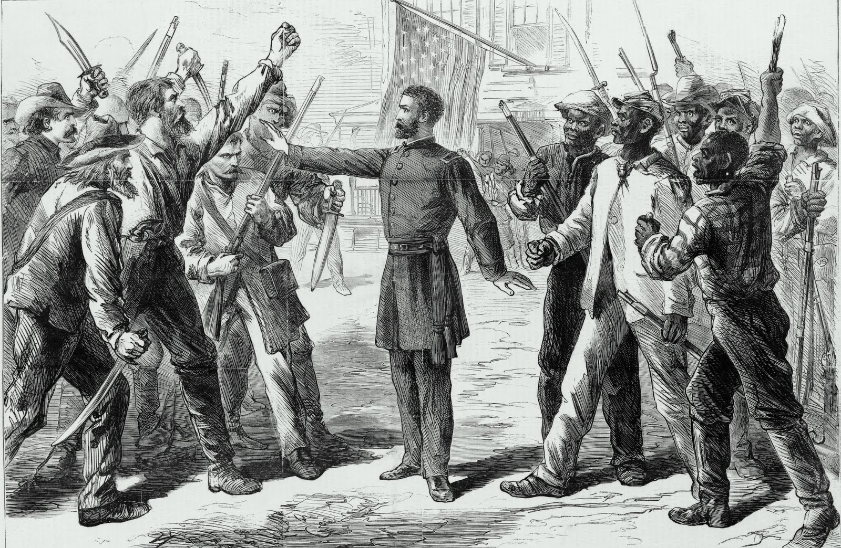
War’s Aftermath in the South:
1. Black Southerners: 4 million freed people starting new lives
2. Plantation Owners: 3 billion in slave labor lost and property destroyed or abandoned
3. Poor White Southerners: many white labors can not find work because of new competition from freedmen

Slide 5
President Lincoln’s Plan
With no roadmap for the future....
Proclamation of Amnesty and Reconstruction (December 8, 1863)
“Pardon” confederates who took oath of allegiance to the Union
Denied “pardons” to highest ranking military, government officers, and southerns who killed African American slaves
States need 10% of the voting population in the 1860 election take an oath of loyalty and established a government
Lincoln didn’t consult Congress regarding Reconstruction…why is that an issue?
*Lincoln faced harsh opposition many believed the goal of Reconstruction should be to totally transform the South and punish contributors to the Confederate cause…

Slide 6
Andrew Johnson
Jacksonian Democrat replaced Lincoln after his assassination
states never legally left the Union
His Reconstruction was far more lenient than Lincoln’s
  1. Pardoned southerners who swore allegiance
  2. Permitted states back into Union without 10 percent requirement
  3. States were required to void secession, abolish slavery, repudiate the Confederate debt
Pardons- 1865 alone- 13,000 southerners

Slide 7
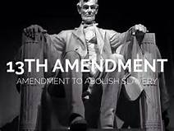
13th Amendment
Ratified in December 1865
1. Neither Slavery nor involuntary servitude, except as punishment for crime whereof the party shall have been duly convicted, shall exist within the United States or any place subject to their jurisdiction
2. CONGRESS shall have power to enforce this article by appropriate legislation
Emancipation proclamation was a war time executive order that freed slaves only in the rebellious south (NOT the border states). War ends, Emancipation Proclamation ends.

Slide 8
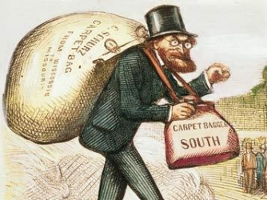
Freedmen’s Bureau (1865)
Relief Agency-Bureau of Refugees, Freedmen, and Abandoned Lands.
Gave out clothing, medical supplies, and meals to war refugees
Northern abolitionists risked their lives to help southern freedmen.
Called “carpetbaggers” by white southern Democrats.

Slide 9
Section 2
Congressional Reconstruction

Slide 10
Purpose:
- Guarantee Stable labor supply now that blacks were emancipated
- Restore pre-emancipation system of race relations
Established all of the following:
1. curfews - could not gather after sunset
2. vagrancy laws - charged and beaten for not working
3. labor contracts - yearly work contracts
4. land restrictions - could not rent or own lands in rural areas
Black Codes

Slide 11
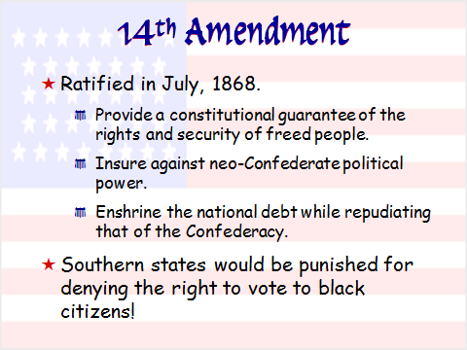

Slide 12
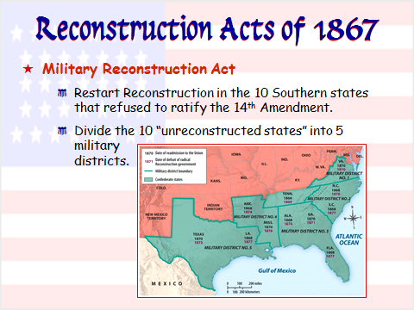

Slide 13
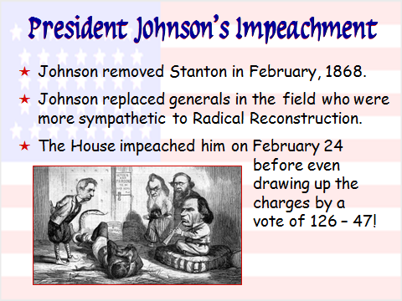

Slide 14
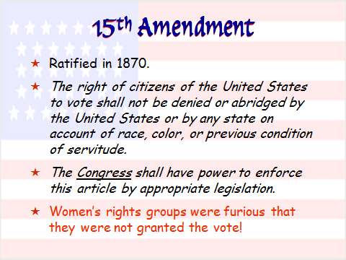

Slide 15
Section 3
Birth of the “New South”

Slide 16
Section 4
End of Reconstruction

Slide 17
Republican Rutherford B. Hayes vs. Democrat Samuel Tilden
Tilden wins the popular vote, electoral college results are so close they both claiming victory!!!
A Commission is set up (mostly republican members) hayes is named the victor…Democrats very upset
Compromise of 1877…Republican Rutherford B Hayes names president and agrees to remove all federal troops from the south southern democrats have complete political control in the south again reconstruction is over!!
Election of 1876/Compromise of 1877

Slide 18
4 Reasons Why Reconstruction Ends
1. Corruption – at all levels of Government
2. Economy – Reconstruction was very expensive/large amounts of debt
3. Violence – Rise of the KKK and anti-freedmen groups/stop them from voting
4. Democrats - return to power in the South

Slide 19
End OF Reconstruction
Successes
Failures
The Union is restored
South’s economy grows and new wealth created in the North
13th, 14th and 15th Amendments
Freedman’s Bureau Created
Southern States adapt a system of mandatory education
Many white southerners remain bitter toward the government
South is very slow to industrialize
South continued to deny African American the right to vote
Many blacks and white southerners were still caught in the cycle of poverty
Continued prejudice and the rise of hate groups against African Americans

