Slide 1
Chapter 10:
The Coming of the
Civil War

Slide 2
Section 1:
Two Nations?

Slide 3
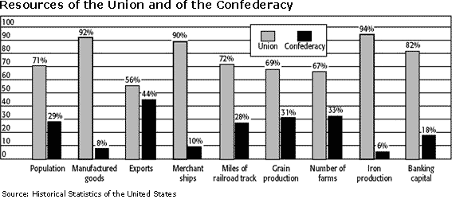
Sectionalism
North
- Diverse Irish\German Immigrants
- Healthy mix of urban, rural, business, and agriculture
South
- Tobacco and Rice
- Slavery

Slide 4
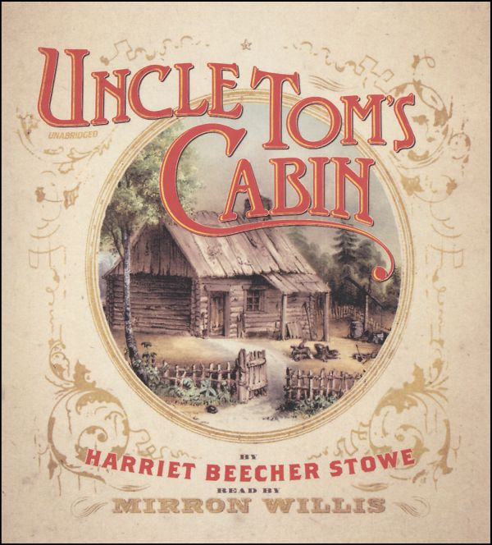
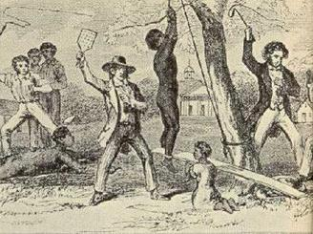
Northern View of Slavery
Against United States Principles
2nd Great Awakening \ Democratic Protestants
Slavery evil but slaves not equal - prejudices
Uncle Tom’s Cabin – Harriet Beecher Stowe
  Exaggerated but North believes it true

Slide 5
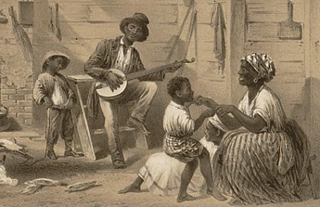
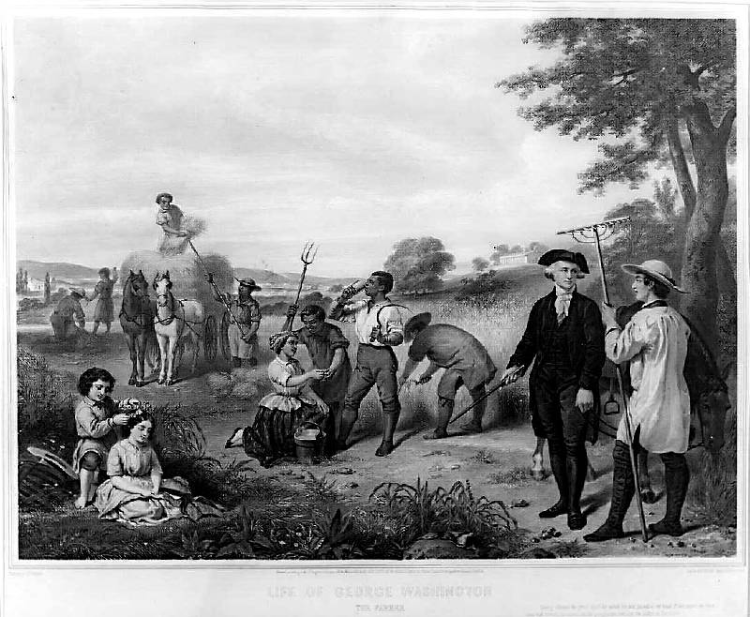
Southern View of Slavery
Planters provided and cared
Revolutionary leaders had slaves
Industry did not care evident by wages and profits

Slide 6
Section 2:
The Mexican War and Slavery Extension

Slide 7
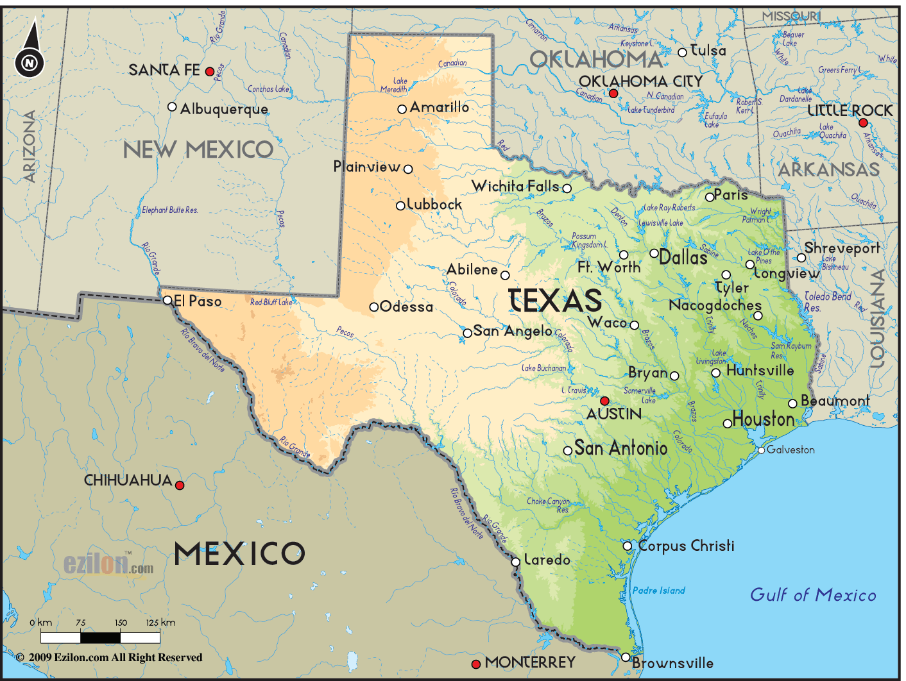
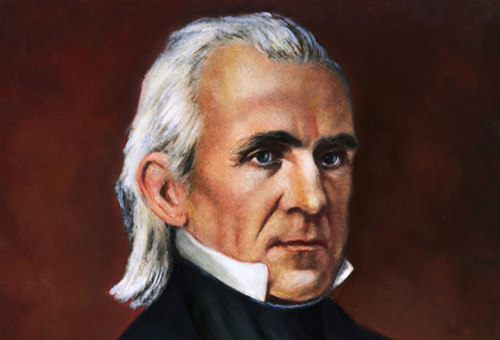

Texas
- Manifest Destiny
- Annexation
- Southern Democrats v. Northern Whigs
- President Tyler 1844 defeated
- President Polk 1845 passes

Slide 8
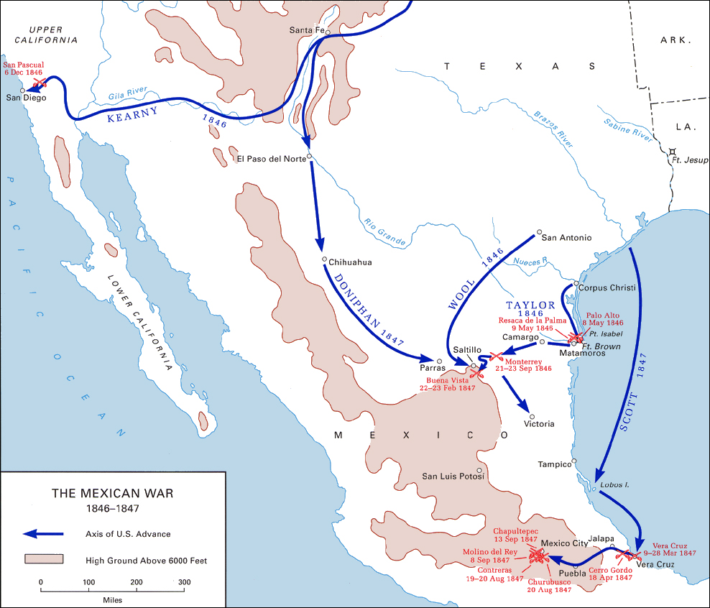
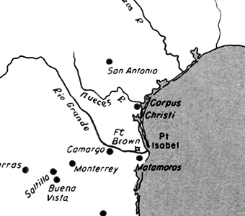
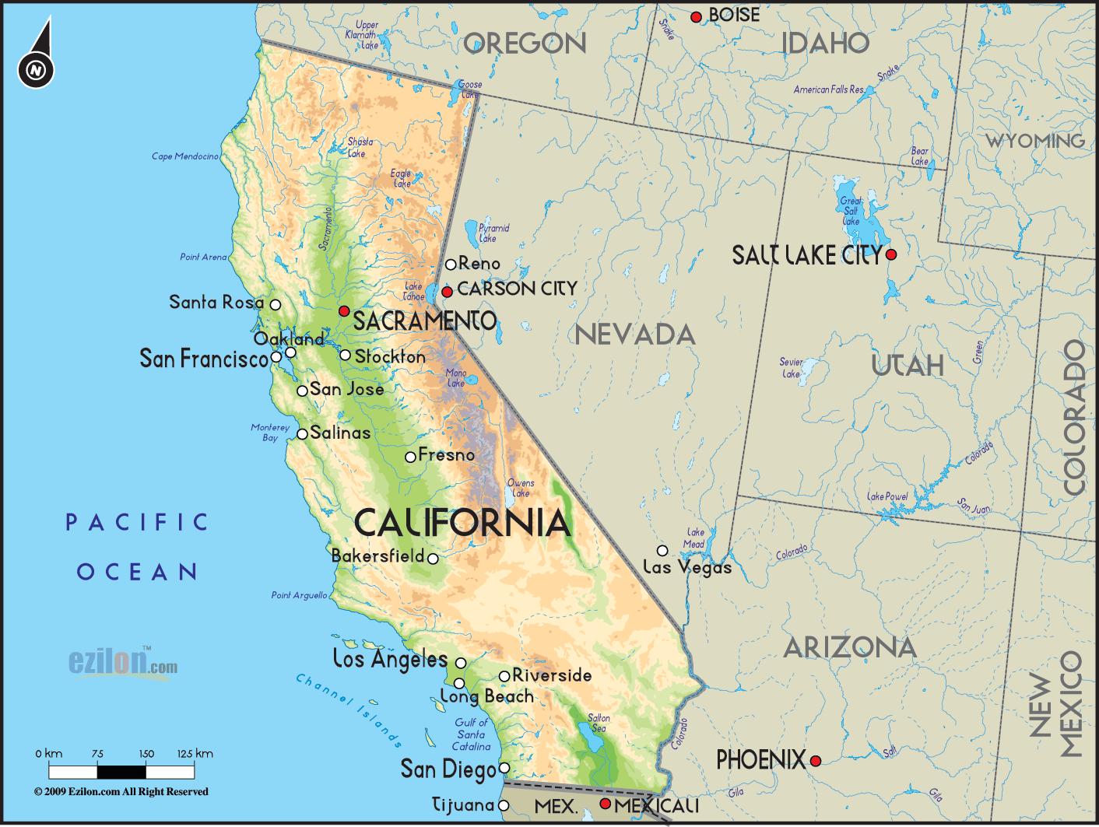
Mexican War
Mexico upset
Rio Grande R. v. Nueces R.
$30 million New Mexico and CA
Gen. Zachary Taylor “invades”
Republic of California
General Winfield Scott captures Mexico City

Slide 9
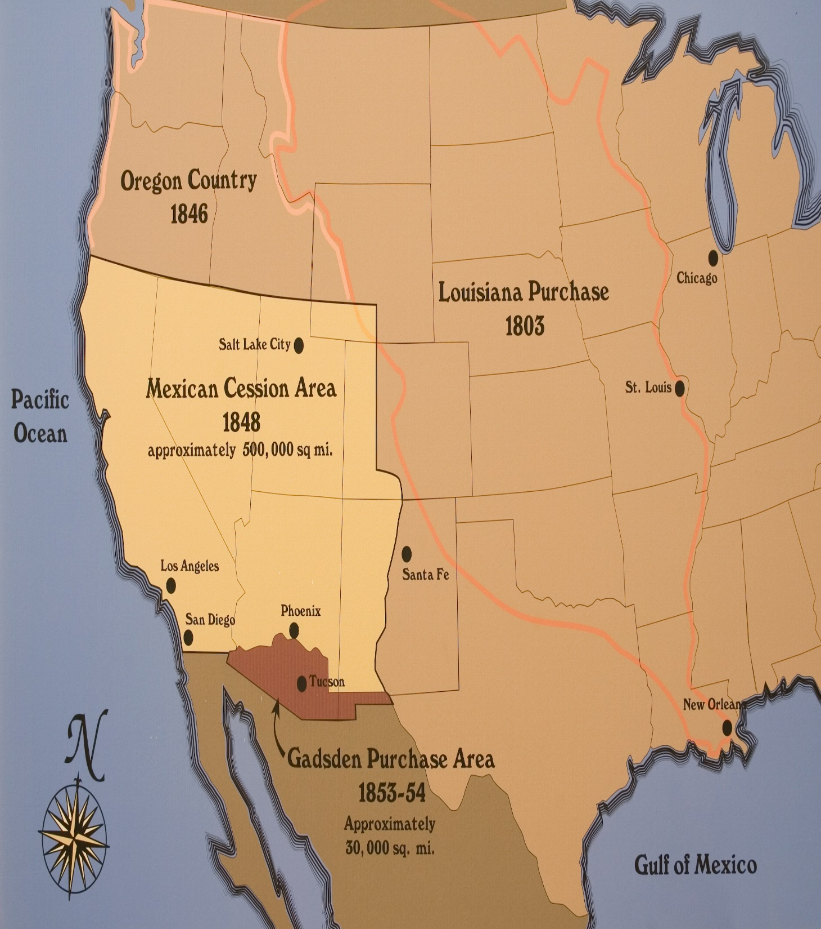
Treaty of Hildalgo
Texas \ Rio Grande River
New Mexico and California
US $15 million paid to Mexico
US $3 million paid to US citizens
Gadsden Purchase $10 million NM & AZ
Boundaries of the continental US

Slide 10
Section 3:
New Political Parties

Slide 11
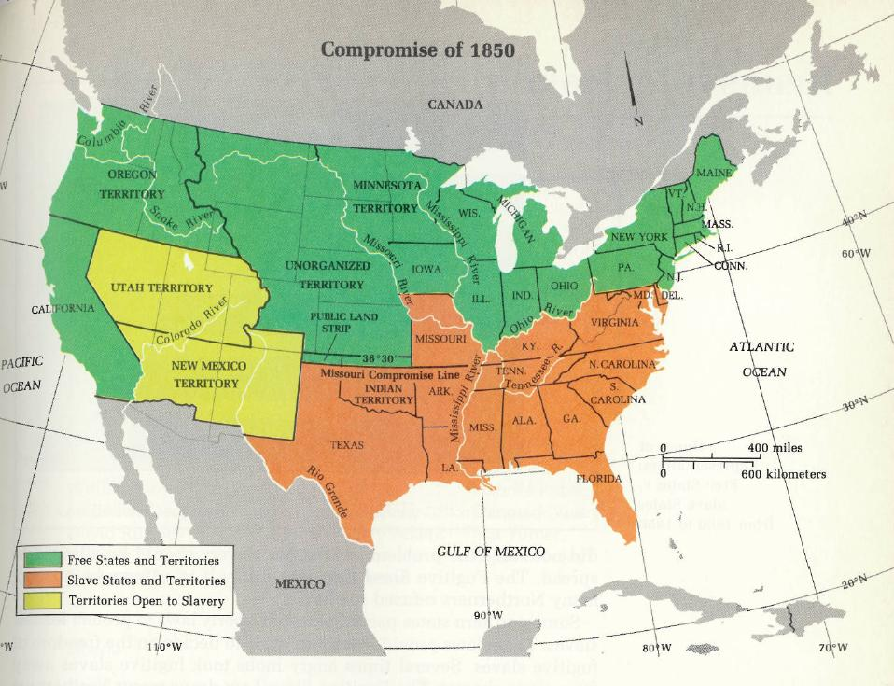
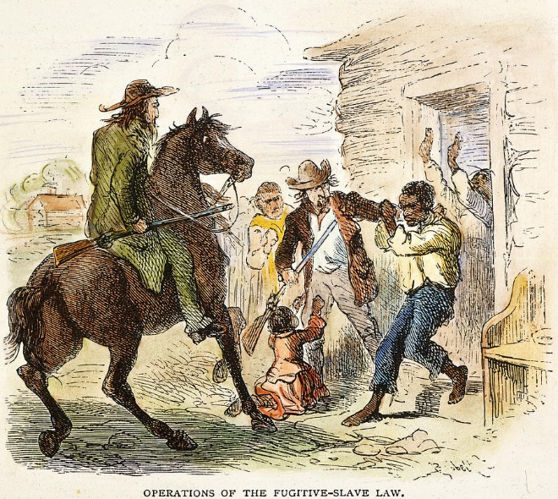
The Compromise 1850 – Senator Clay
- Missouri Compromise no good
- California free state
- NM & UT vote on slavery
- Abolish slave trade, slavery allowed in DC
- TX gives up claims in NM $10 million
- Fugitive Slave Act – return escaped slave

Slide 12
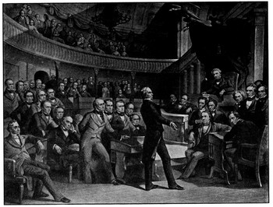
Calhoun v. Webster
Calhoun
- North controls H of R & Electoral College
- Succession to protect liberty & property
- the right to own slaves
Webster
- slavery not practical in NM
- Constitutional must return property\slaves

Slide 13
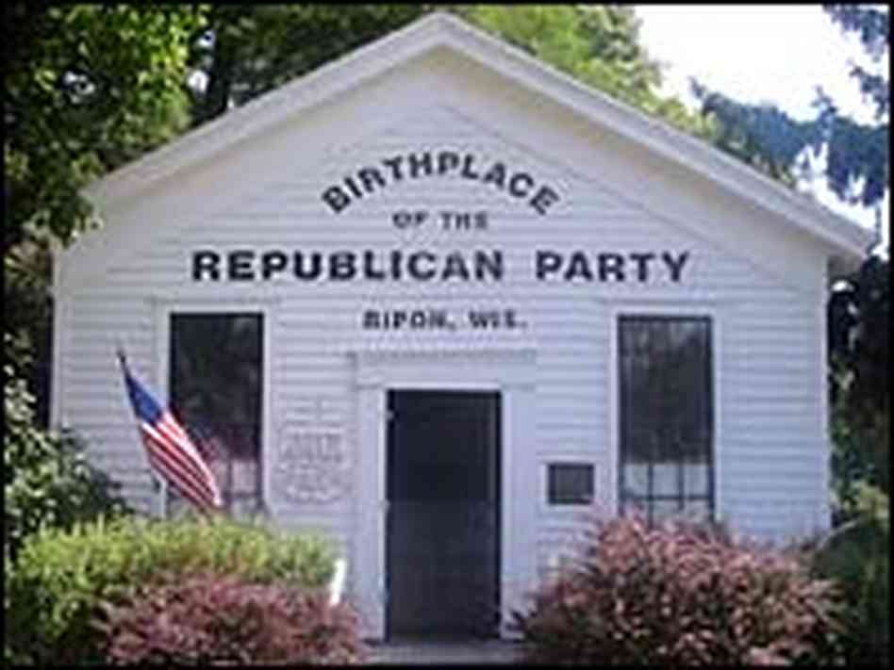
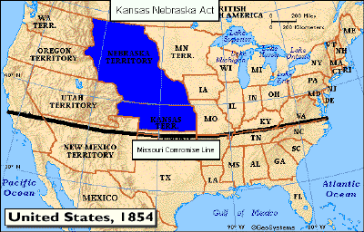
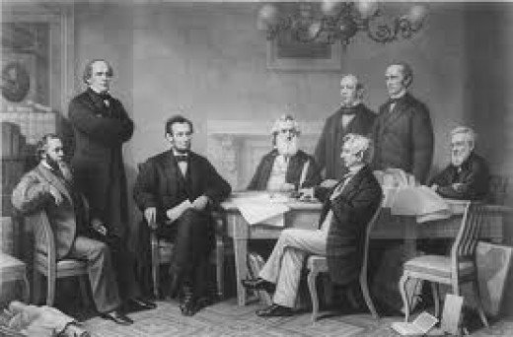
Kansas Nebraska Act
Senator Stephen Douglas of Illinois
- Northern RR to Chicago from KS & NB - $
- Southern Democrats - slavery
- Popular sovereignty KS & NB – everyone happy
- North upset
- Republican Party born – anti slavery

Slide 14
Section 4:
The System Fails

Slide 15
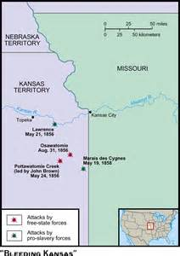
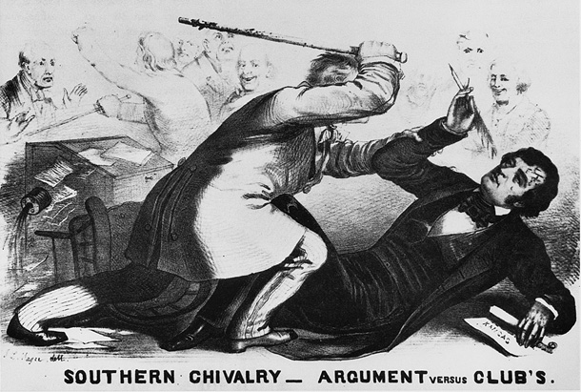
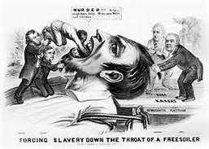
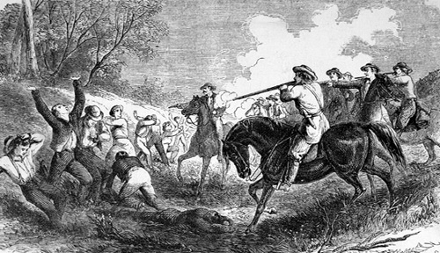
Bleeding Kansas\Summer
Topeka vs. Lecompton
Free Soilers
Lawrence looting
John Brown

Slide 16
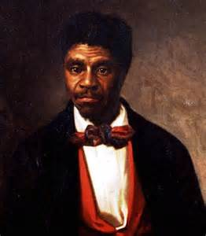
Dred Scott v. Sanford 1857
Dred Scott was a free man from free states and territories
Moves to Missouri and is enslaved
Sues saying he is a free man
Supreme court
  7 to 2 rules against
  Not a citizen and cannot sue
  Not freed from slavery due to residence
  Missouri Compromise unconstitutional
  Slaves are property – 5th Amendment
  Congress had no power to ban slavery

Slide 17
Kansas Lecompton Constitution
Constitution - Proslavery
Majority of people anti slavery
Did not vote on referendum because both options allow slavery
Democrat Pres. Buchanan accepts it
Congress wants revote
Senator Douglas criticizes President
Sent back Kansas rejected slavery
Supreme court however allows slavery

Slide 18
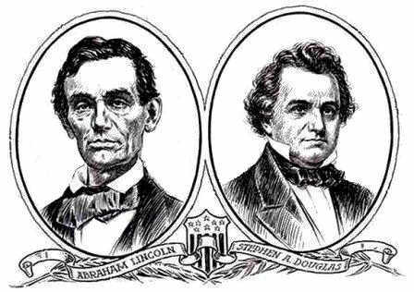
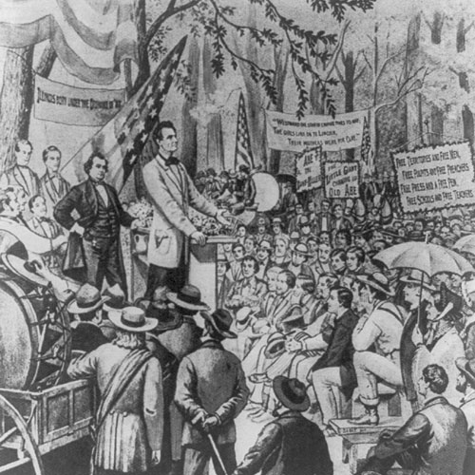
Lincoln Douglas Debates - 1858
Douglas
  Democrat believed popular sovereignty, majority rule even if they decide slavery
Lincoln
  A majority did not have the right to deny a minority their rights to life, liberty, and pursuit of happiness
  Allow it but it will die out
  Blacks and whites NOT equal
  Moral issue

Slide 19
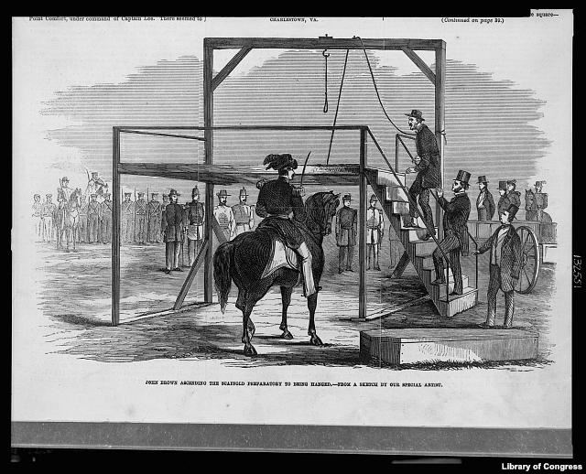
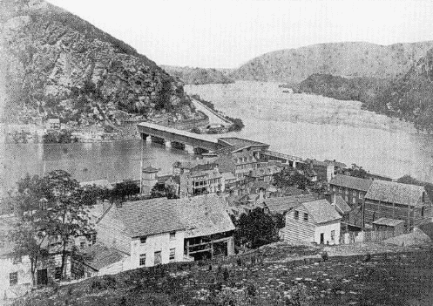
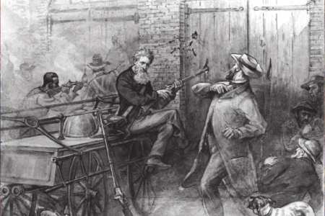
John Brown’s Raid – Oct. 16, 1859
Federal Arsenal at Harpers Ferry, VA
21 men including 5 African Americans
Give guns to slaves to revolt and punish slave owners
Colonel Robert E. Lee puts down attack

Slide 20
Section 5:
A Nation Divided Against Itself

Slide 21
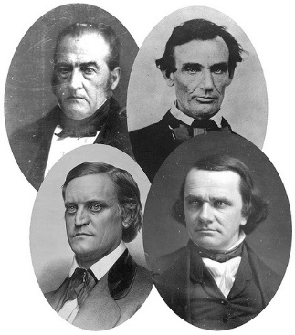
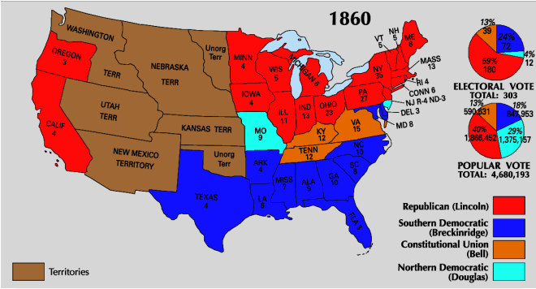
Election 1860
Democratic Party
  South allow slaves – nominate Breckinridge
  North allow states to decide – nominate Douglas
Constitutional Union Party
  Border states – nominate John Bell
Republican
  Nominate Lincoln
Outcome
  President Lincoln
  39% of popular vote
  180 electoral votes
  0 southern electoral votes

Slide 22
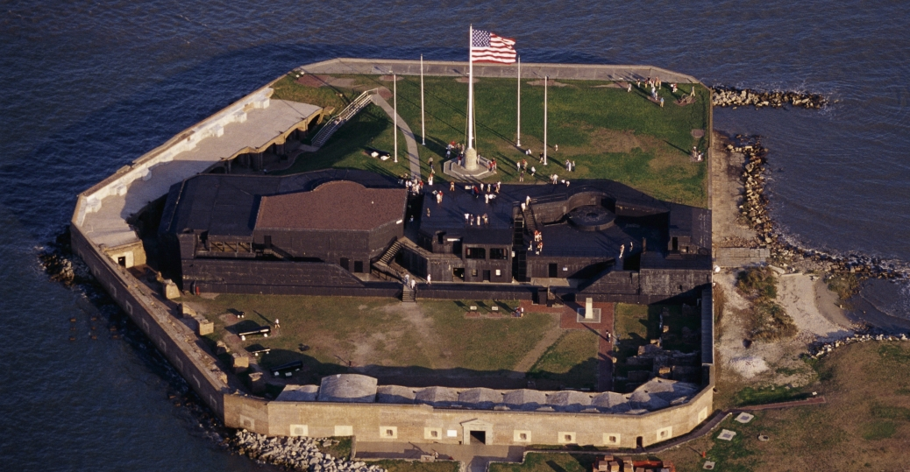
South Secedes – Dec. 20, 1860
Secessionists
  0 electoral votes
  Choose to join thus choose to leave
  Confederate States of America
President Lincoln
  Preservation of the Union
Fort Sumter, Charleston, SC
  Union troops in a southern fort
  Confederates fire on Union supply ships
  Lincoln can’t give in
  April 12, 1861

