Slide 1
Chapter 11
The Civil War

Slide 2
Introduction to the Civil War
North vs. South, Union vs. Confederacy, Blue vs. Grey
Started: April 12, 1861 at Fort Sumter, SC
Ended: June 2nd, 1865 North Victorious
3.1 million soldiers fight with approximately 650,000 deaths in the Civil War

Slide 3
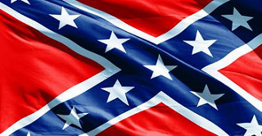
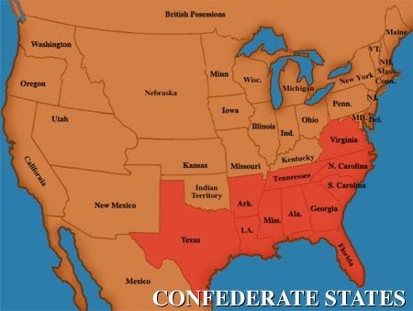

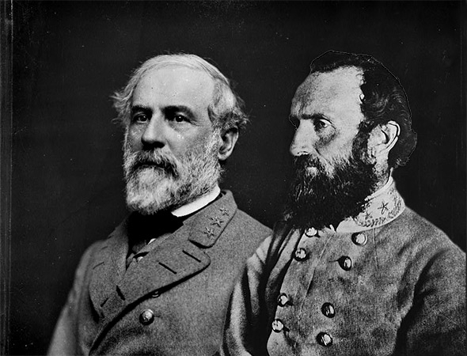
Advantages of the South
1. 11 States
2. A defensive war, knew the terrain and controlled most lines of communication
3. Stronger Generals (Lee and Jackson)
4. Better prepared due to outdoor life style
5. Allies in France and Great Britain

Slide 4

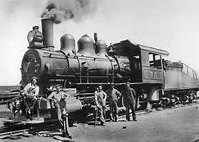
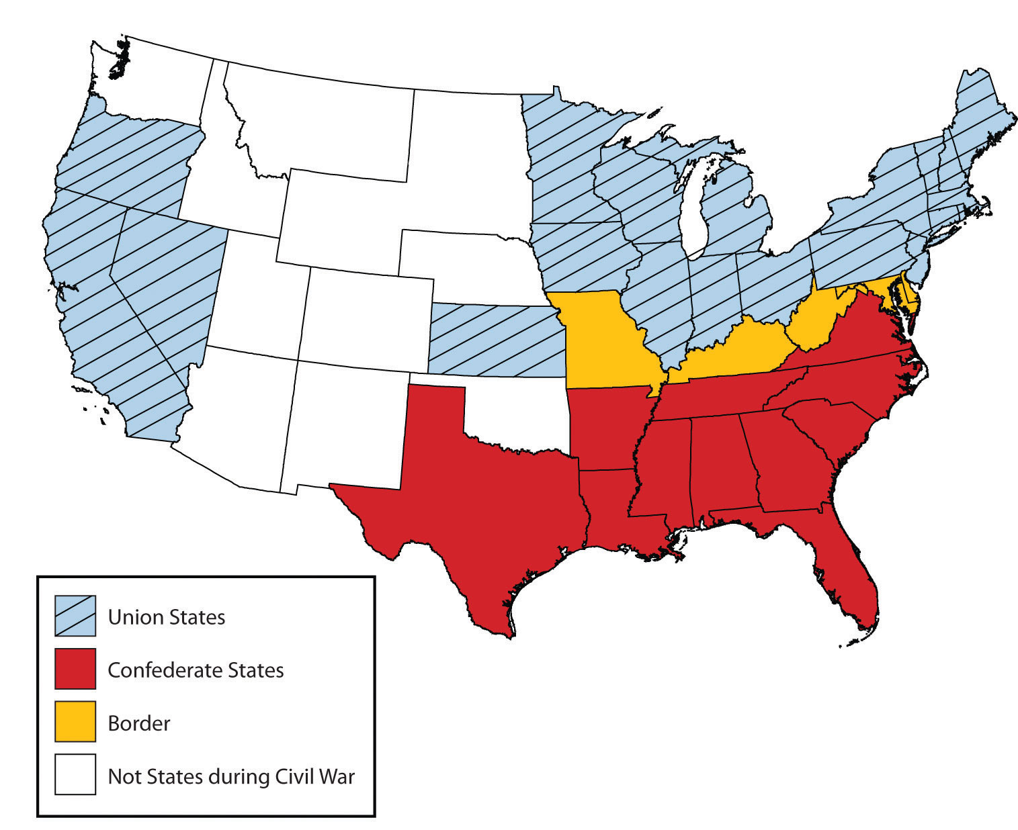
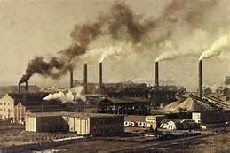
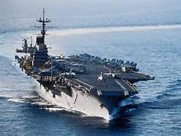
Advantages of the North
1. 19 free states, 4 slaveholding border states.
2. 22 Million vs. 9 million people
3. 90% of manufacturing vs. Souther imports
4. 20,000 miles in RR
5. 75% on the nation’s financial resources
6. Navy and merchant marine

Slide 5
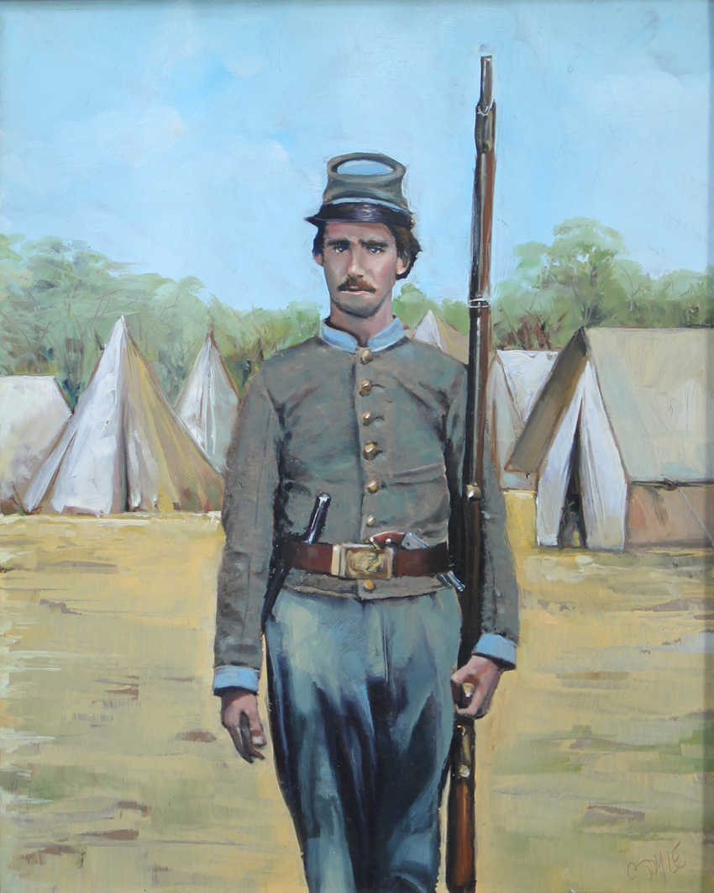
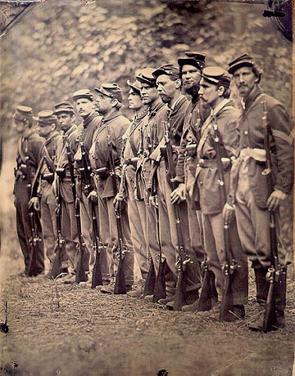
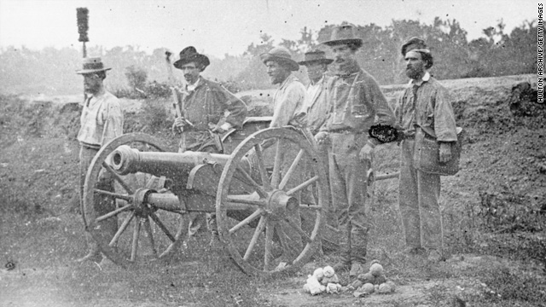
South: Recruiting for Military Service
At first, Confederate armies consisted of volunteers
1862, the South instituted a “draft”
“rich man's war, poor man’s fight”
one million men will serve

Slide 6
North: Recruiting for Military Service
At first, Union army filled with volunteers
Government offered volunteers “cash bounties” to enlist
Led to “bounty jumping”
1863, the North passed a draft law also ($300 to avoid)
Approximately 2 million people served in the Union army

Slide 7
South: Financing the War
difficulty raising money (slaves and Land)
levied taxes, sold bonds and issued paper money with no financial backing
sought loans from Europe with little success
hurt by the North’s Naval Blockade

Slide 8
North: Financing the War
Raised money very easily – sold bonds
imposed excise tax, income tax, and tarrifs
Issued $450 million in paper money
National Banking Act of 1863 (national currency)

Slide 9
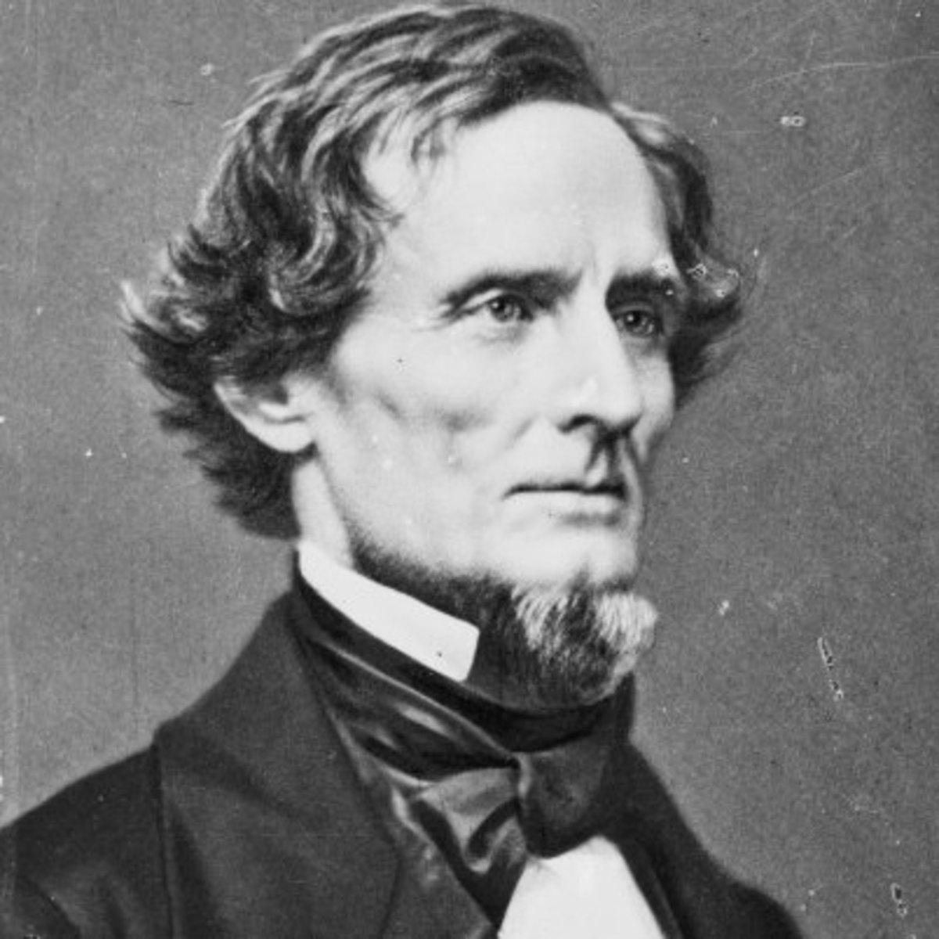
South: Political Matters
Jefferson Davis: Elected President of the Confederacy
Proved to be inflexible, intolerant and no leadership skills
Will get worse as the south moved closer to defeat

Slide 10
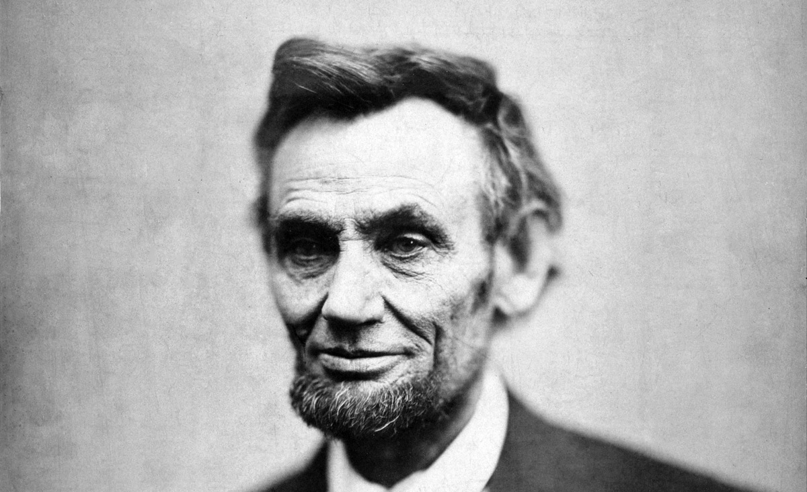
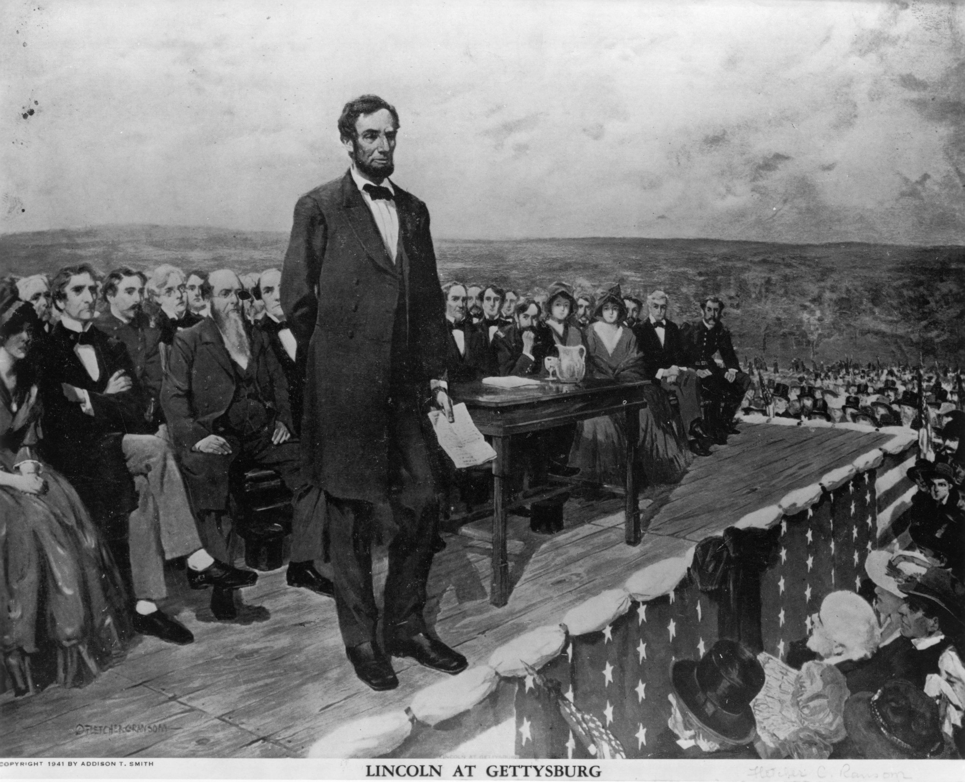
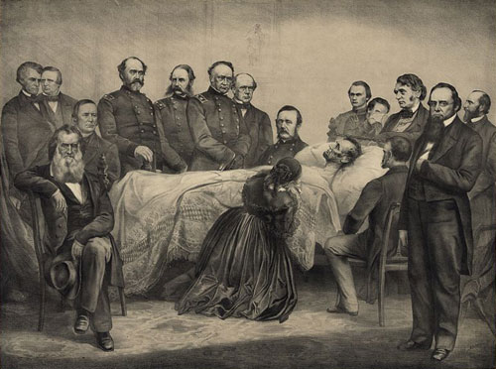
North: Political Matters
Abraham Lincoln: Elected President in 1860 and 1864
“Honest Abe”/One of the top two presidents of all time
Expanded Presidential Powers
Emancipation Proclamation of 1863
Gettysburg Address
Assassinated in April, 1865

