Slide 1
Intro to Islam

Slide 2
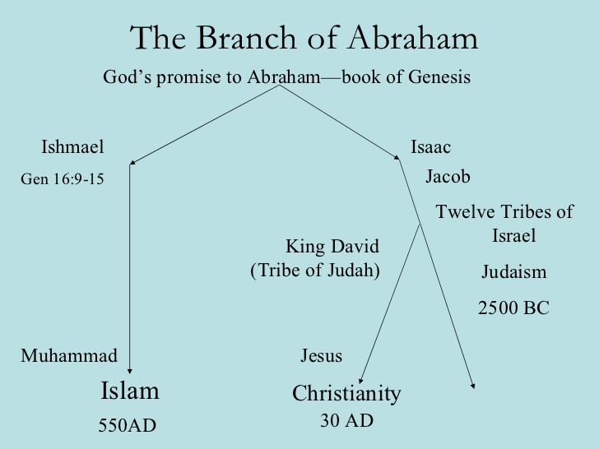
The Basics
Abrahamic religion
Judeo-Christian God- Allah
Qur’an is their Bible/Torah, word of God
Muhammad is the prophet
  Similar to Jesus in the Bible
Mecca and Medina are most important cities

Slide 3
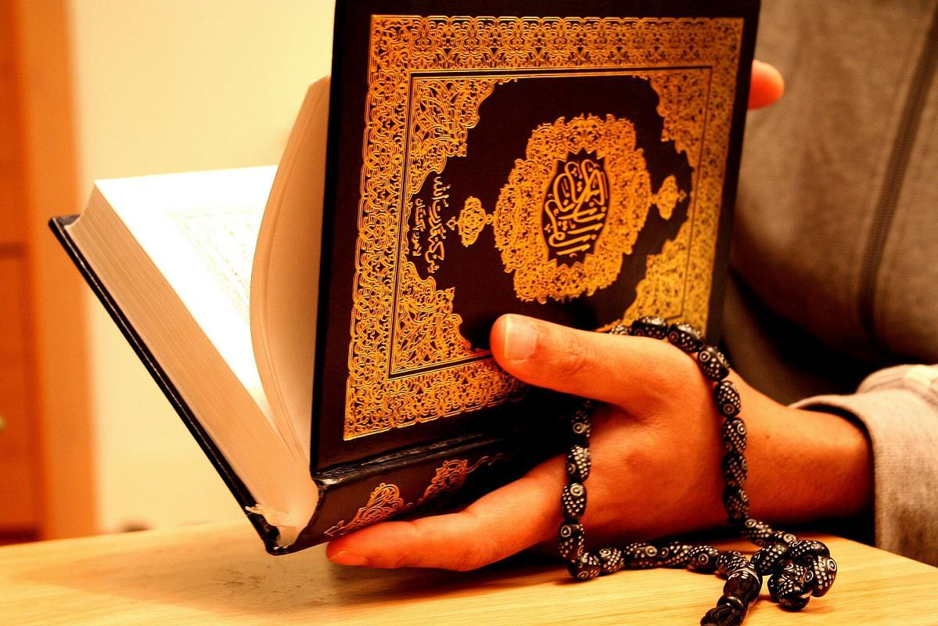
The Qur’an- God’s Last Revelation
Muhammad received his first revelation from the angel Gabriel in the Cave of Hira in 610
622- Hijrah- Muhammad flees Mecca for Medina.
  Beginning of the Muslim calendar (1 A.H.)
Muhammad’s revelations were compiled into the Qur’an after his death.
Muslims believe it contains the word of God.
  114 suras (chapters) written in Arabic.
  In the name of Allah, “the compassionate, the merciful”

Slide 4
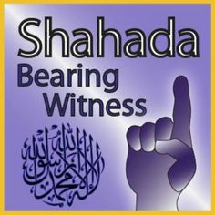
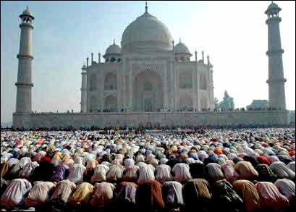
Five Pillars of Islam
The Shahada- testimonial declaration of faith
  There is no god worthy of worship except God, and Muhammad is His Messenger [or Prophet].
The Salat- Mandatory prayer
  5 times each day- Dawn, noon, late afternoon, sunset, before going to bed
  Wash before praying, facing Mecca
  The call to prayer by the muezzin in the minaret
  Pray in the mosque on Friday.

Slide 5
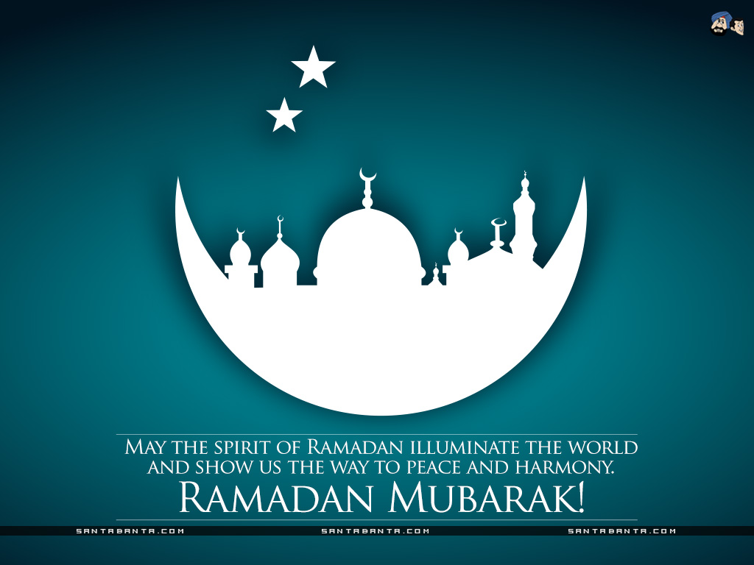
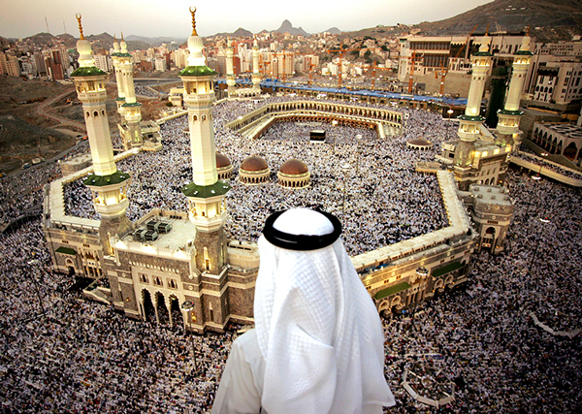
The Zakat- Almsgiving (charitable donations).
  Muslims believe that all things belong to God.
  Zakat means both “purification” and “growth.”
  About 2.5% of your income.
The Sawm- Ramadan fasting
  Considered a method of self-purification.
  No eating or drinking from sunrise to sunset for month.
The Haji- Pilgrimage to Mecca.
  Must be done at least once in a Muslim’s lifetime
  2-3 million Muslims make the pilgrimage every year.

Slide 6
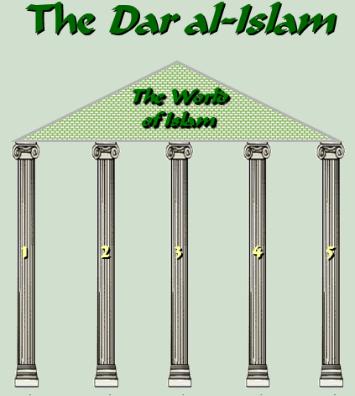

Slide 7
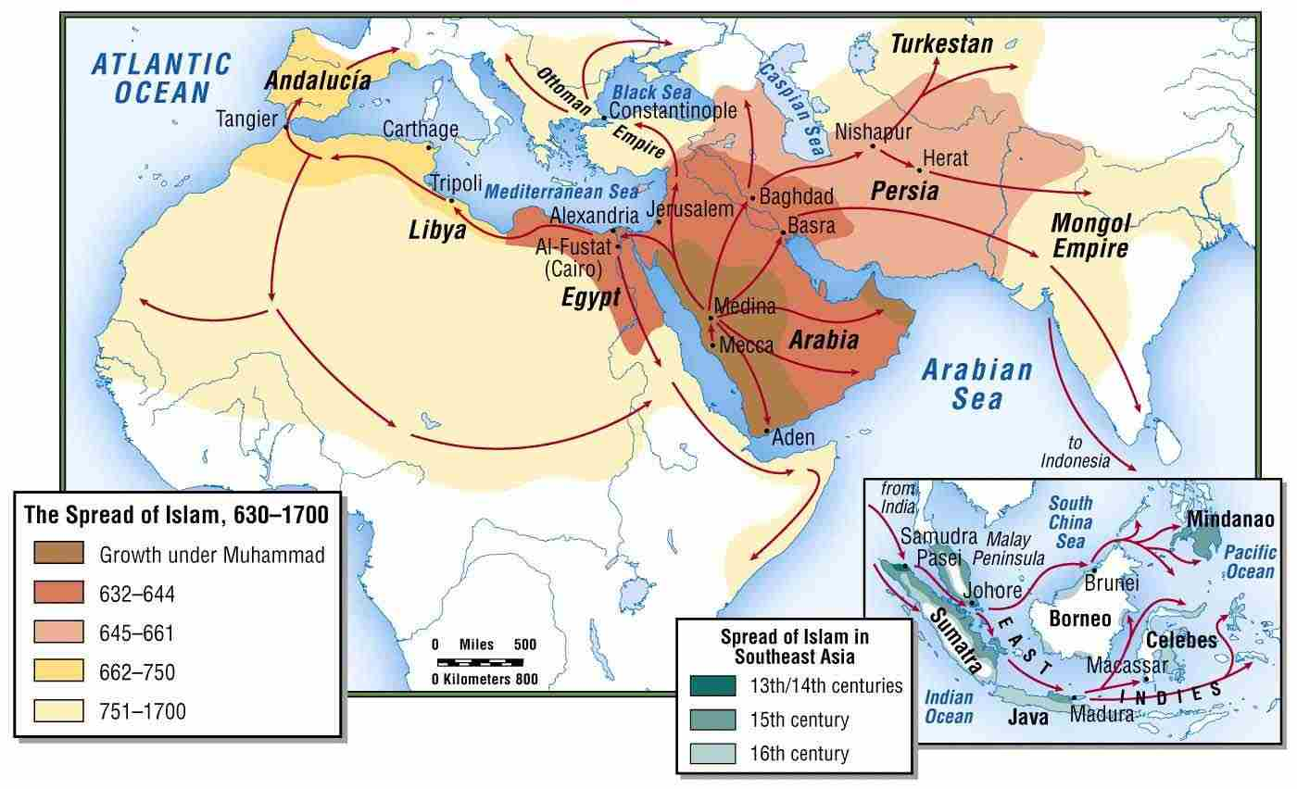
Why Did It Spread After Muhammad?
Easy to learn and practice.
No priesthood.
Teaches equality.
Non-Muslims, who were “Peoples of the Book,” were allowed religious freedom, but paid additional taxes
Easily “portable” nomads & trade routes
Jihad (“Holy War”) against pagans and other non-believers (“infidels”).

Slide 8
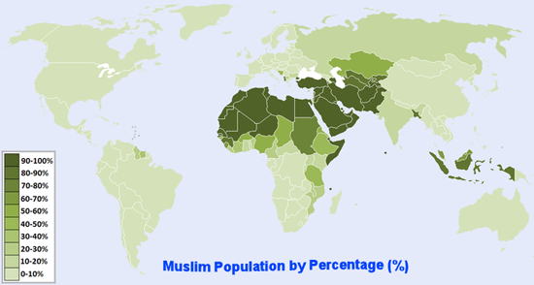
Muslims in World

Slide 9
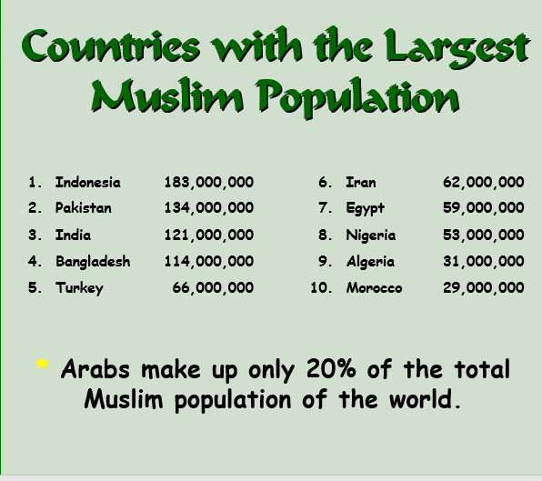

Slide 10
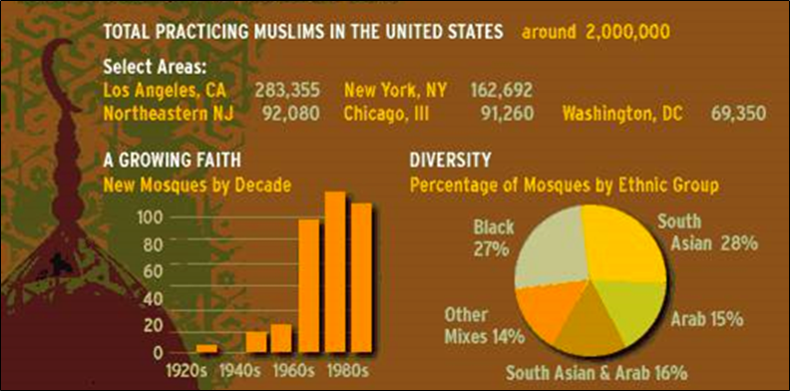
Muslims in America

Slide 11
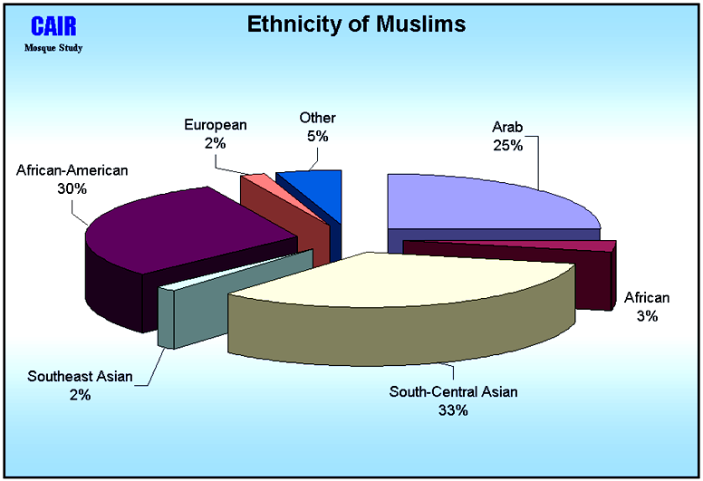
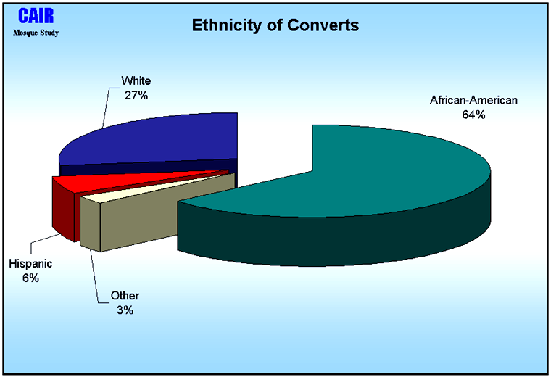

Slide 12
