Slide 1
Renaissance/Reformation Chronology Challenge

Slide 2
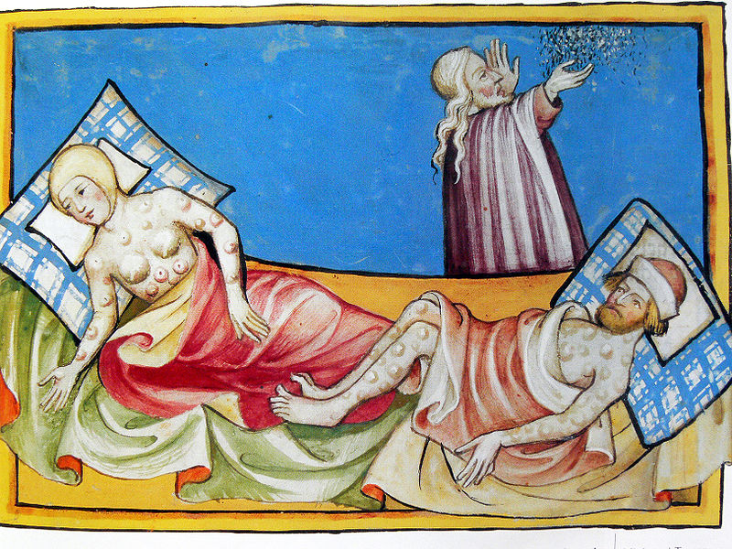
N. Black Death (1347)

Slide 3
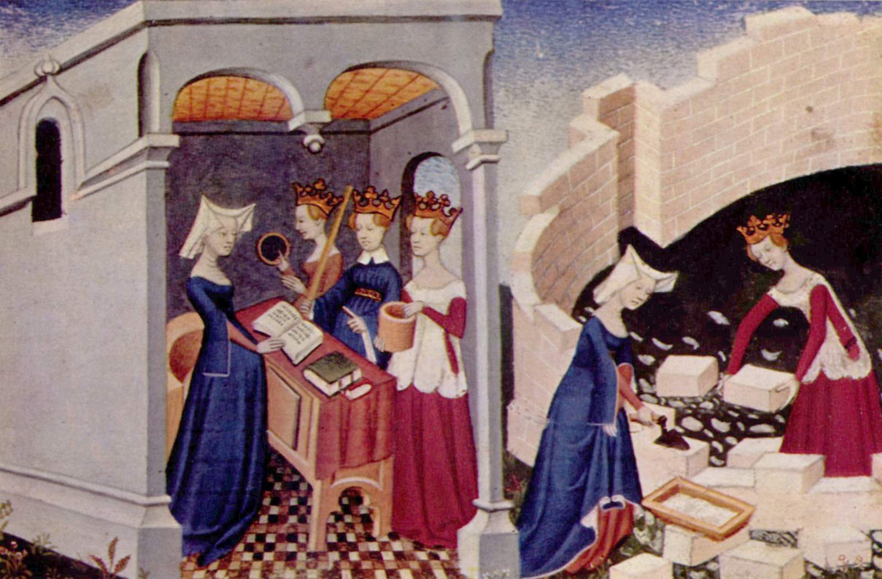
The Book of the City of Ladies by Christine de Pizan (1405)

Slide 4
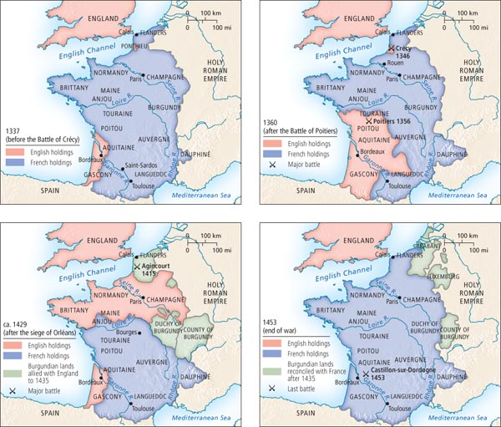
G. End of Hundred
Years’ War (1453)

Slide 5
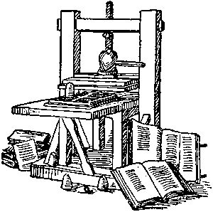
K. Gutenberg and the Printing Press (1455)

Slide 6
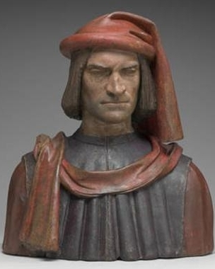
B. Lorenzo de Medici (1469)

Slide 7
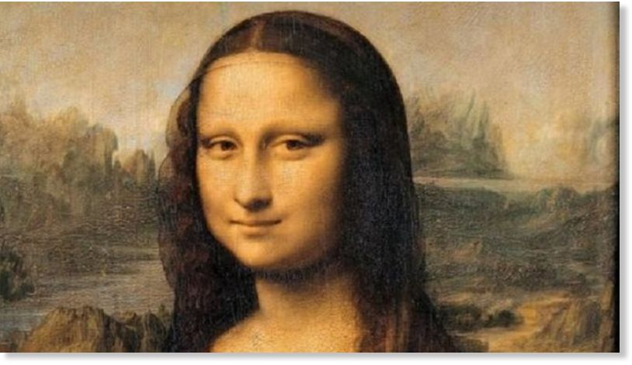
D. Mona Lisa by Leonardo da Vinci (1504)

Slide 8
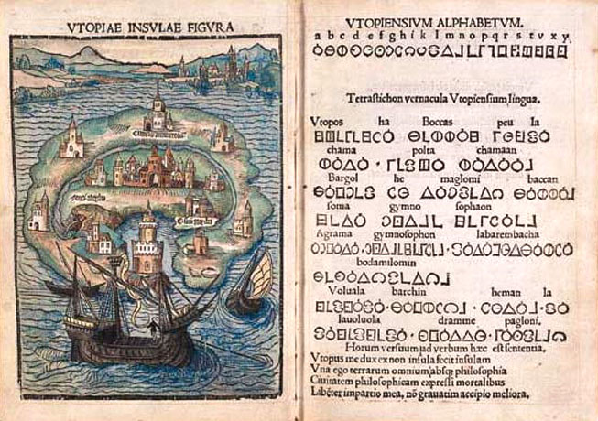
F. Utopia by Thomas More (1516)

Slide 9
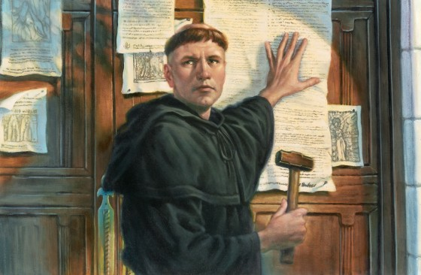
L. Luther’s 95 Theses (1517)

Slide 10
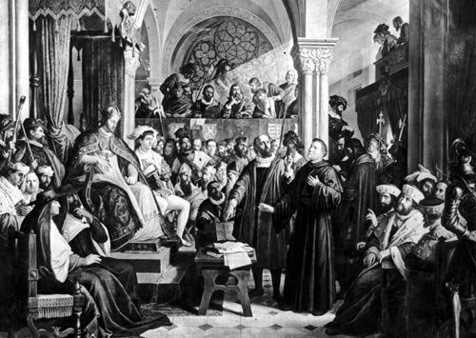
M. Luther and Excommunication (1521)

Slide 11
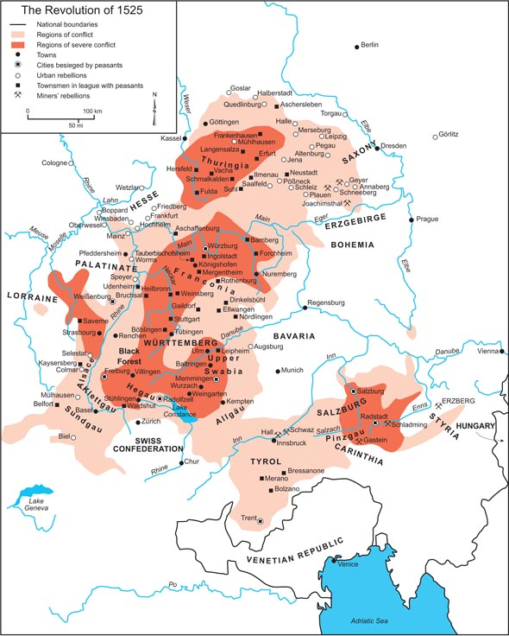
P. German Revolt (1524)

Slide 12
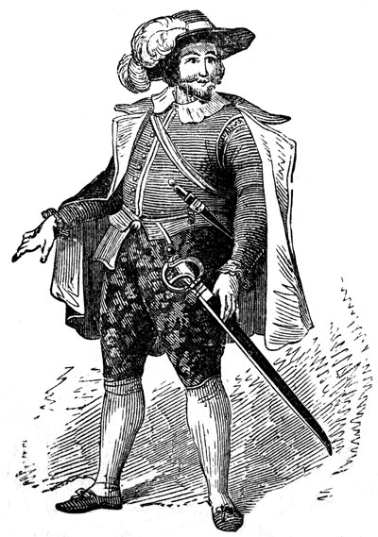
C. The Courtier (1528)

Slide 13

T. The Prince by Machiavelli (1532)

Slide 14
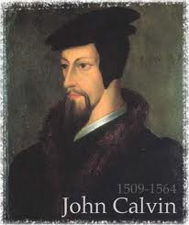
R. Calvinism (1536)

Slide 15

S. Jesuits founded (1540)

Slide 16
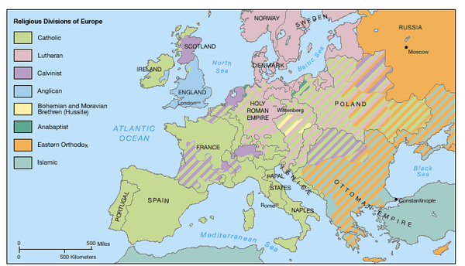
E. Peace of Augsburg (1555)

Slide 17
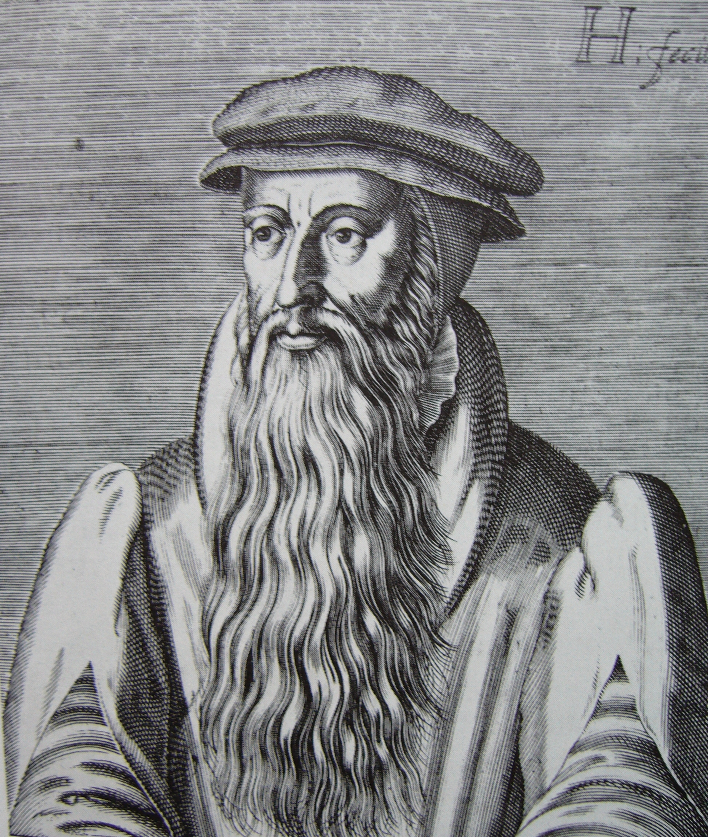
H. Knox and Presbyterians
(1559)

Slide 18
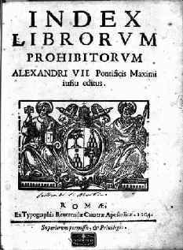
O. Index of Forbidden Books (1559)

Slide 19
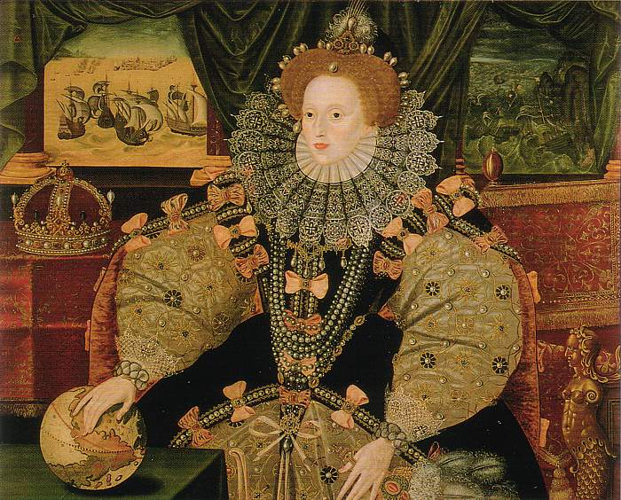
Q. Anglican Church (1559)

Slide 20
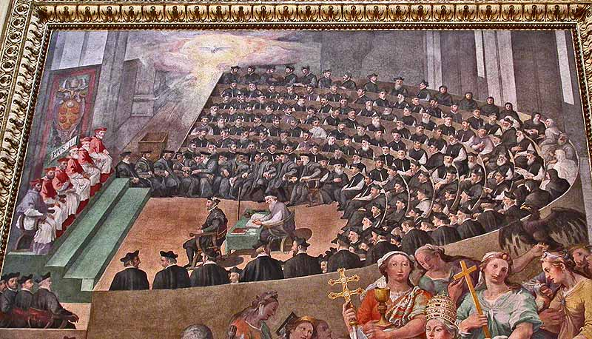
Council of Trent (1563)

Slide 21
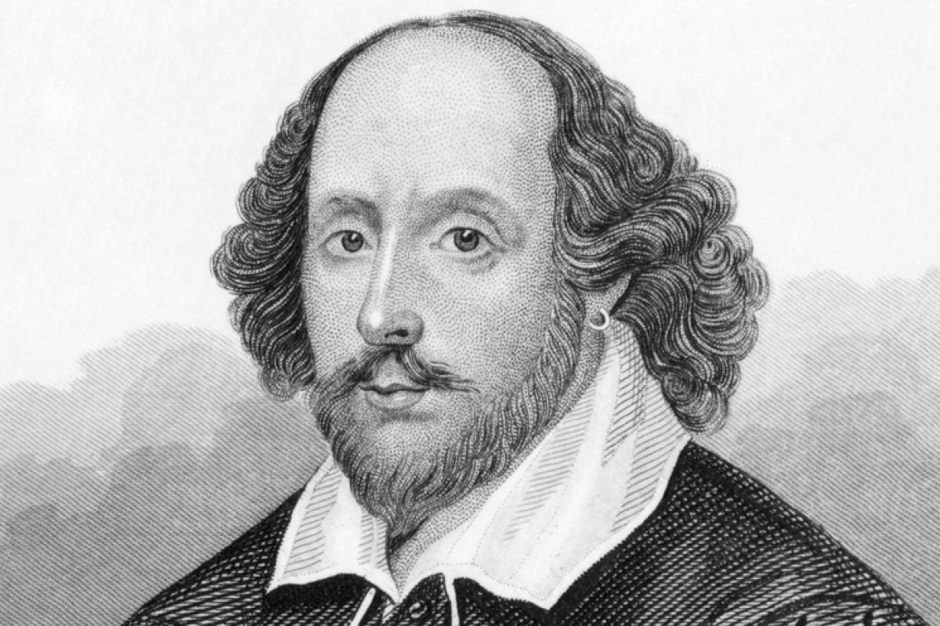
J. Birth of Shakespeare (1564)

