Slide 1
Yalta and Potsdam Conferences

Slide 2
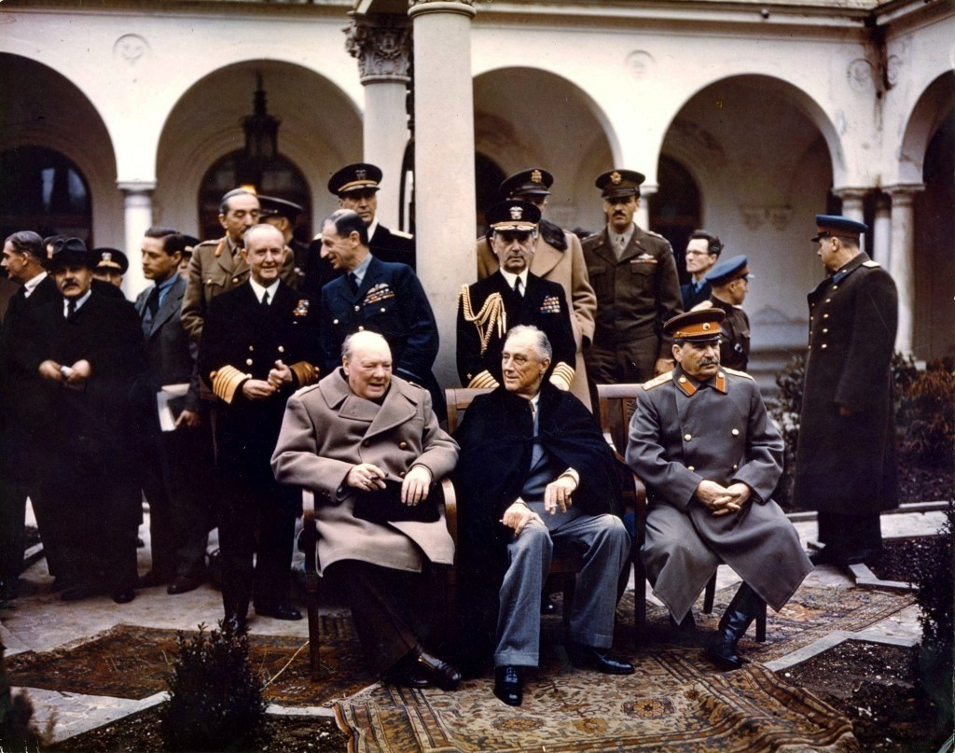
Yalta Conference
(February 1945)
“Big Three” (Churchill of England, Roosevelt of USA, Stalin of USSR)
Key topics
  Unconditional surrender of Axis Powers
  United Nations to keep peace after war
  Russia declare war on Japan (& help USA invade Japan) after Germany surrendered
  Divide Austria, Germany & capital Berlin into 4 occupied zones
  Self-determination in Eastern Europe
    Stalin allowed reluctantly, wanted part of Poland

Slide 3
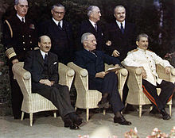
Potsdam Conference
(July/Aug 1945)
Stalin/Churchill & Atlee/Truman
Stalin pressured Eastern European countries to become communist
Truman unhappy with these new pro-Soviet governments; demanded Stalin allow free elections, Stalin refused
Stalin feared they would be anti-Soviet
Atomic Bomb
  ‘Potsdam Declaration’- gave Japan ultimatum: unconditionally surrender or face "prompt and utter destruction"

