Slide 1
Japan and Early WWII
https://www.youtube.com/watch?v=kzH1iaKVsBM
https://www.youtube.com/watch?v=BlUld1yXKRo

Slide 2
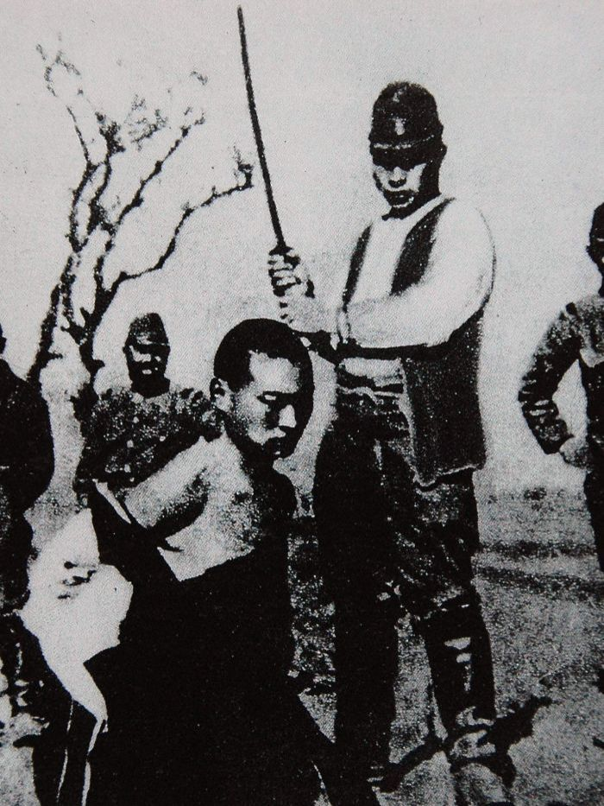
Immediately Before the War
China
  Invaded Manchuria, then much of China
  War with China- civil war suspended
  Rape of Nanking
Southeast Asia
  Southern Expansion Doctrine (1936)
  Took French Indochina, America cut oil exports
Leadership
  Hirohito- Emperor
  Hideki Tojo- Military leader
  Admiral Isoroku Yamamoto- Pearl Harbor
  Tripartite Pact w/Germany and Italy
    “establish and maintain a new order”

Slide 3
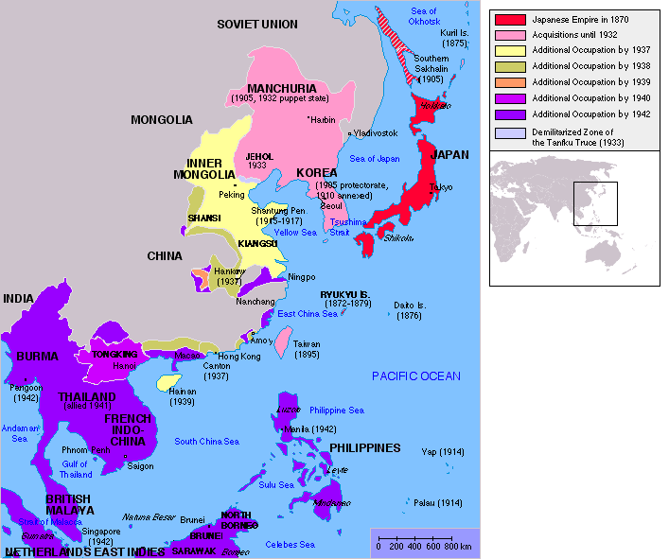

Slide 4
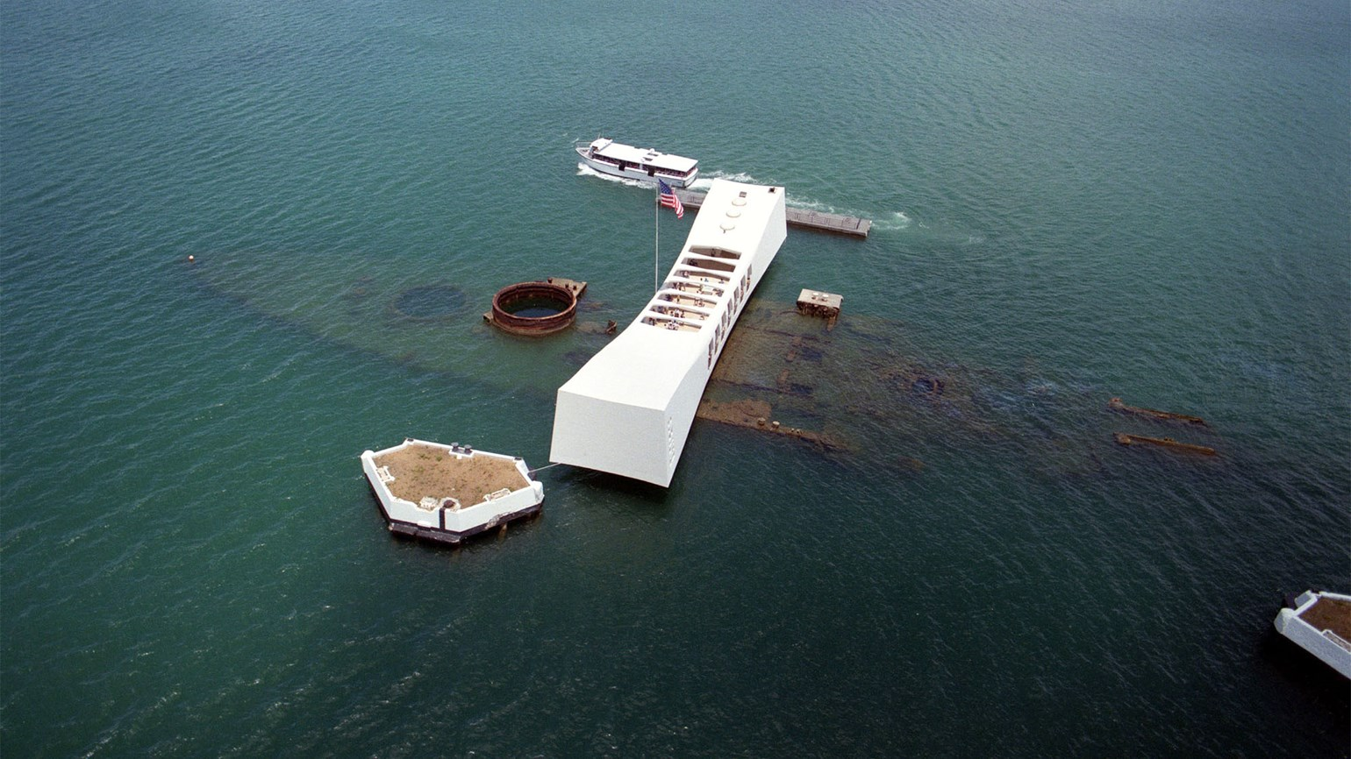
Attack on Pearl Harbor
“A date which will live in infamy”- December 7, 1941
Threat of strategic US navy in Hawaii
Day of attack
  US officials cracked code, had an idea
  19 ships, 8 battleships destroyed
  3400 casualties
Simultaneous attacks
  Hong Kong- GB
  Guam and Wake Island- US
Push for Japanese empire

Slide 5
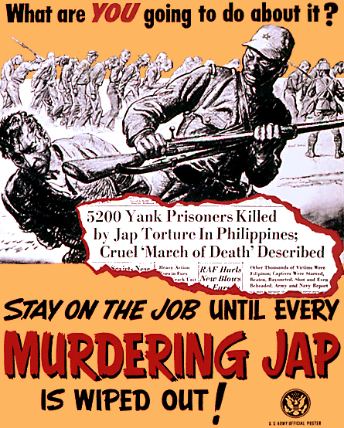
Early Japanese
Successes
Late 1941/Early 1942
  U.S.- Wake Island and Guam
  Philippines- Bataan Peninsula
  British- Hong Kong, Singapore, East Indies, planned for India
“East Asia for the Asiatics”
  Unite Asians against colonial powers
  Asians recognized Japanese were conquerors
Bataan Death March
  Japanese war crime
  Tansport of approx 80,000 Filipino and American POWs
  Brutal treatment led to thousands of casualties over 3 months

Slide 6
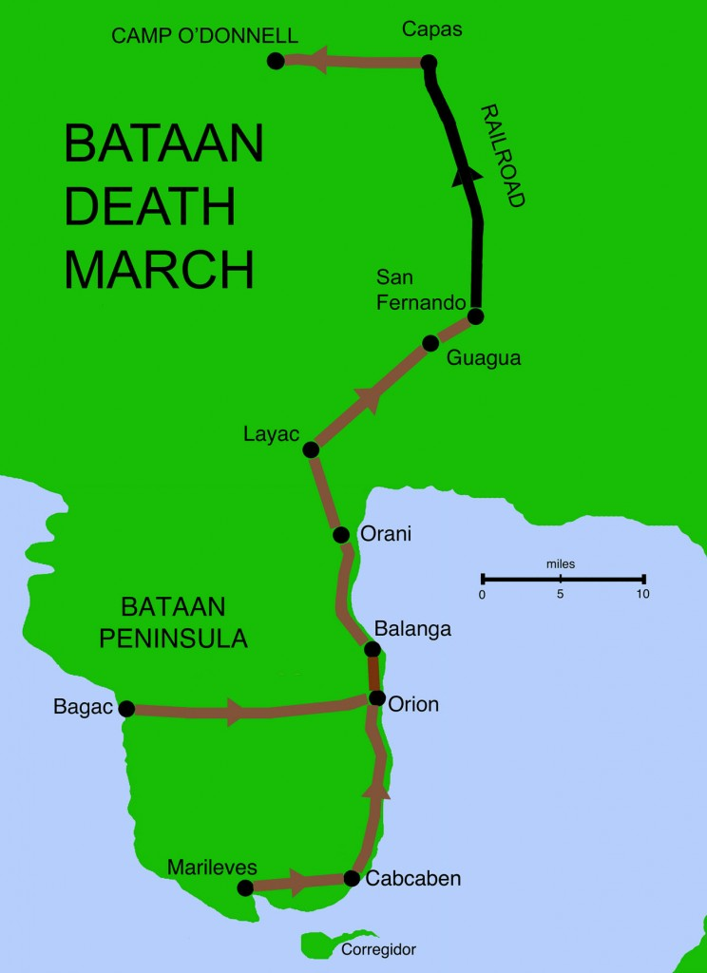

Slide 7
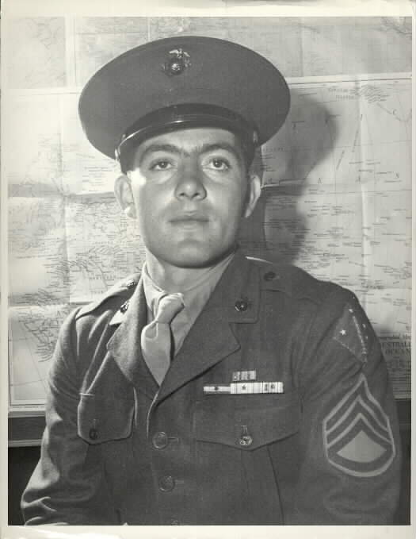
The Allies Strike Back
American response
  Lieutenant Colonel Doolittle bombed Tokyo in April 1942
    Create doubt
Battle of the Coral Sea
  New aerial warfare
  Allied casualties, but halted Japan's advance
Battle of Midway
  Turned the tide of the Pacific war
  Code breakers knew Yamamoto was planning attack
Allied Offensive
  General MacArthur and island-hopping
  6 months of fighting resulted in American victory at Guadalcanal

