Slide 1
Russian Revolution- The Lenin Era

Slide 2
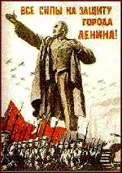
Vladimir Ilyich Lenin
“Father of the Revolution”
Brother killed for plotting to kill czar
Engaging personality, excellent organizer, brilliant thinker
Fled to Western Europe during early 1900s to avoid pressure from Czar
Led the Bolshevik Party from afar
Ultimately led Bolshevik Revolution in 1917
“Peace, Land, and Bread”

Slide 3
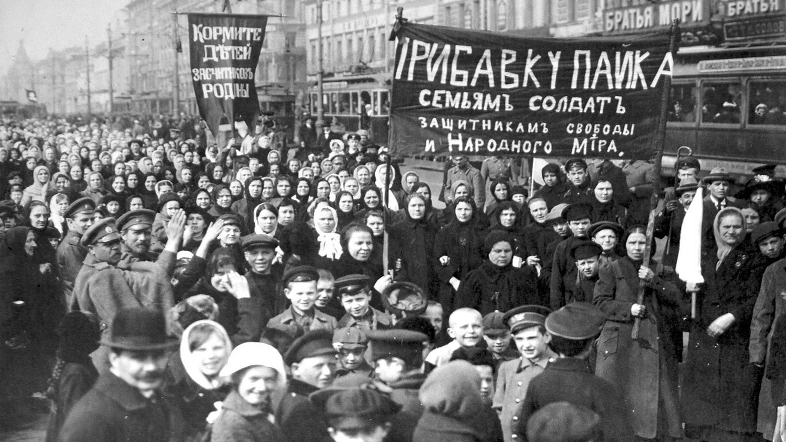
The March Revolution (1917)
Inspired by women textile worker strike in Petrograd
  Soldiers shot at then sided with strikers
Czar Nicholas II forced to abdicate throne
  Executed with family in 1918
  End of Romanov dynasty that ruled for three centuries
Duma set up provisional government
  Alexander Kerensky in charge
  Weak gov’t that kept country in war
  Soviets- local governments
  Germany arranged for Lenin’s return

Slide 4
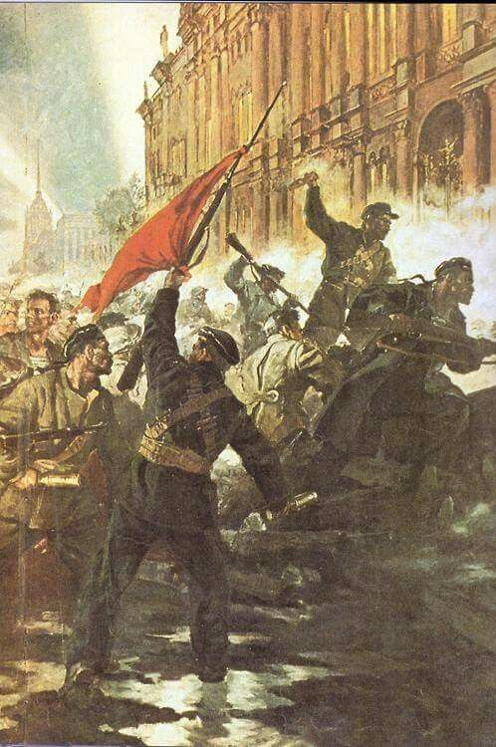
The Bolshevik Revolution
Gained control of the Petrograd soviet
“All power to the soviets” and “Peace, Land, and Bread”
Lenin took action in November 1917
  Bolshevik Red Guards storm Winter Palace
  Arrested provisional gov’t, Kerensky fled
Immediate Action
  Farmland to peasants, factories to workers
  Treaty of Brest-Litovsk- weak for Russia, people upset
  Need to remove threats at home

Slide 5
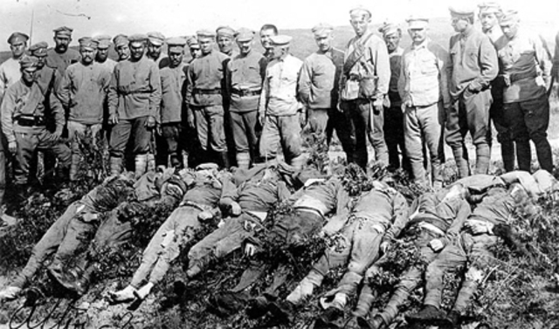
Civil War in Russia
Bolsheviks enemy- White Army
  Diverse in beliefs, unorganized
Civil war occurred from 1918-1921
  Western nations tried to help the White Army, little success
  Leon Trotsky- commanded the Bolshevik Army
  14 million deaths
  Famine and flu
  Won by the Red Army
Ultimately destroyed existing political and social structure
  State-controlled gov’t/society

Slide 6
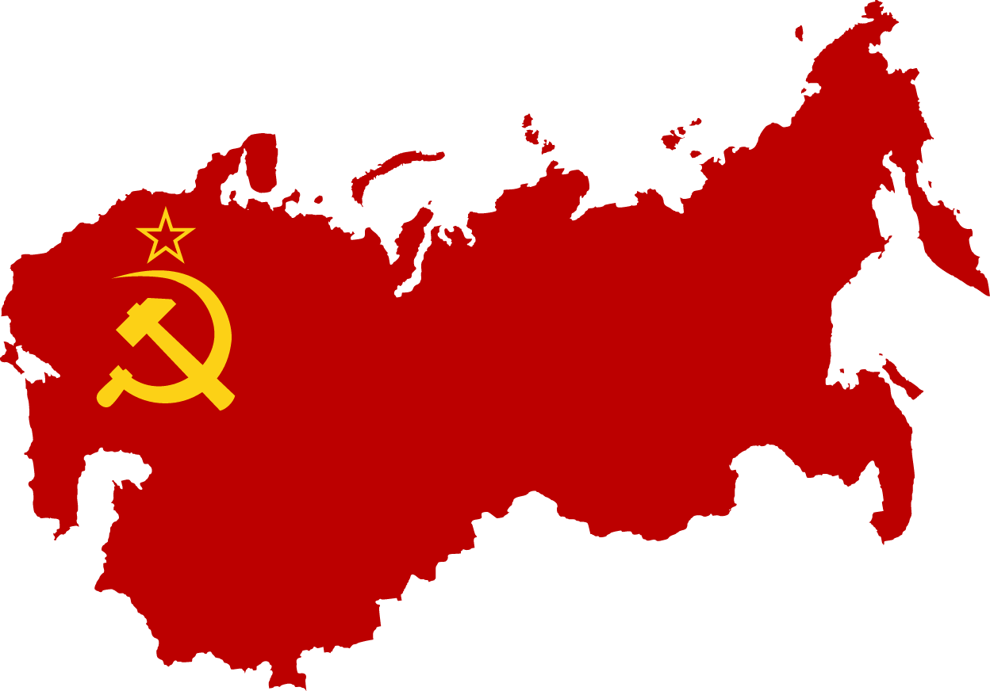
Lenin’s Russia
New Economic Policy
  Meant to fix the broken economy
  State-controlled major industries
  Farmers could sell surplus and some factories were private
Dangers of nationalism
  Wanted to keep it in check
  Central government with smaller self-governing republics underneath
  Bolsheviks became Communist Party
    Classless society- Karl Marx
  Russia became the United Soviet Socialist Republics (USSR)

