Slide 1
The Changing World (1900-1939)

Slide 2
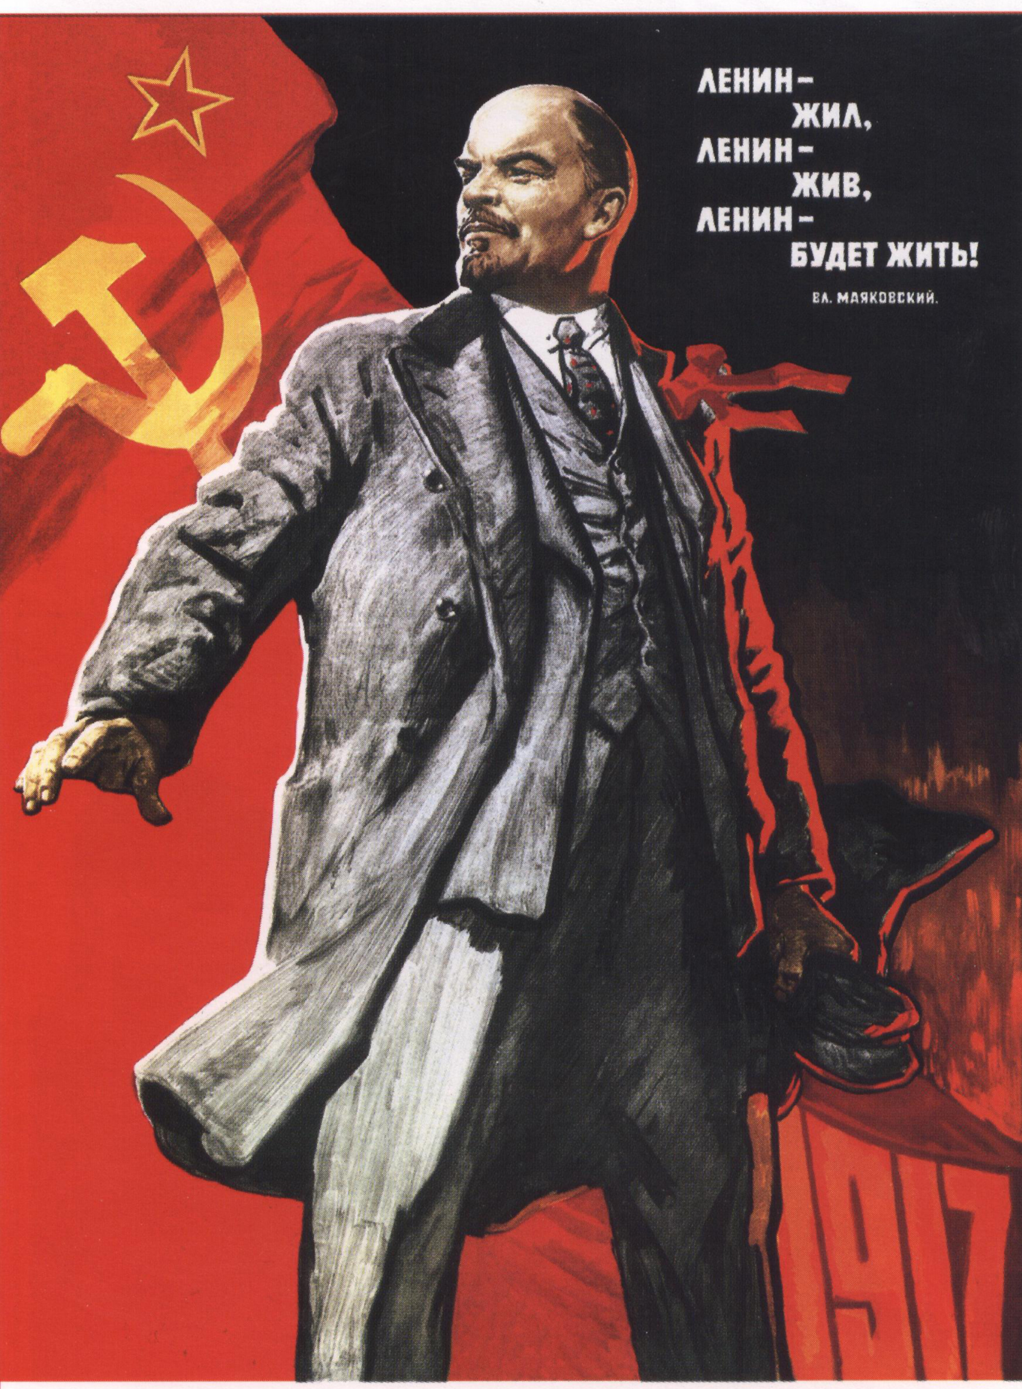
Revolutions and
Nationalism
Revolutions
Widespread social unrest troubled China and Russia in the late 1800s and early 1900s
Citizens will rise up and change governments, first Communist gov’t
New Nations
Following WWI, new boundaries drawn, variety of governments
Ottoman Empire and Austria-Hungary serve as prime examples
Challenges to Empires
Increase of nationalism in colonies
Empires are challenged and lose territories and power
Great Britain and India, China and Asia

Slide 3

Uncertainty in the World
Depression
World economies in shambles after the war, U.S. initially strong
Crash and Depression- U.S. Great Depression affects the whole world
Threatened economic and political systems
Rise of Authoritarian Leaders
Fascism, not communism
Totalitarian dictators rise in the ruins of war and depression
Germany, Italy, and Japan begin to expand and conquer

