Slide 1
Russian Revolution- Czars

Slide 2
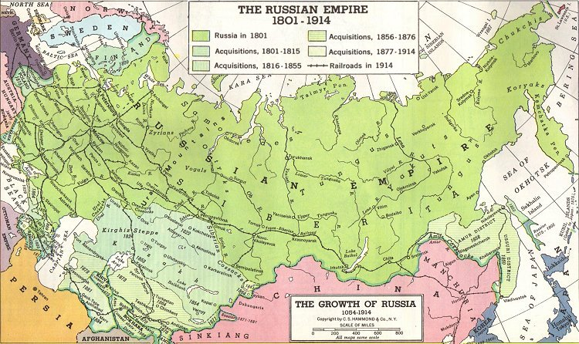
Russia in the 1800s
Largest European country
Diverse population
Limited industrial development
Liberal movements from people met with harshness from Czars
Censorship
Rejected a constitution
“Russification”- assimilation by non-Russians to religion, language, and culture

Slide 3
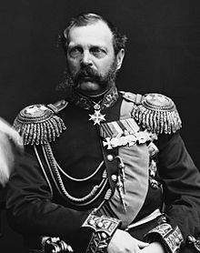
Serfdom in Russia
Serfdom- condition of bondage, no freedom
Serfs lived on land owned by a lord
Lords would offer protection in exchange for labor
Living on the manor was challenging and oppressive
Czar Alexander II (1855-81)
Known as a reform-minded czar
Zemstvos- local councils
Emancipation Edict in 1861 liberated 23 million serfs
Assassinated in 1881 because he was moving too slowly

Slide 4
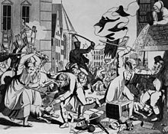
Czarist Repression
Alexander III (1881-94), then Nicholas II (1894-1917)
Overturned liberal reforms
Used extreme censorship, control of religion, spies, and imprisonment/exile
Pogroms- Jewish villages destroyed, people murdered
While this happens, czars are blinded to important changes and problems

Slide 5
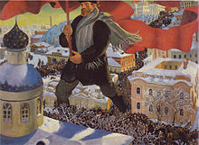
Industrialization
Became steel leader in 19th century
Trans-Siberian-Railroad
Leads to labor problems- conditions, wages, etc.
Workers not allowed unionize
Rise of Marxist thinking- Proletariat
Marxists split- into Mensheviks (moderate majority) and Bolsheviks (radical minority)

Slide 6
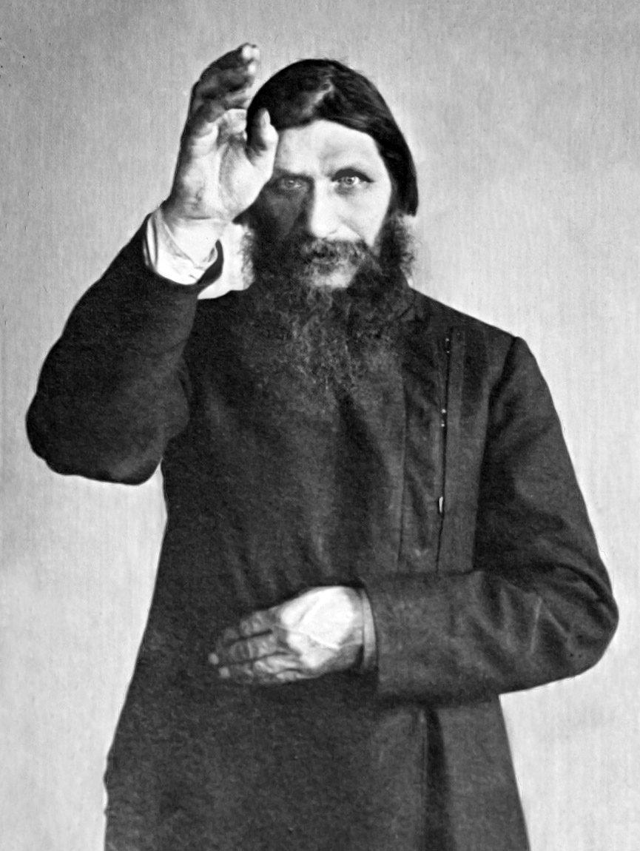
Crises at Home and Abroad (1904-1917)
Russo-Japanese War (1904-5)
Losing battle for Korea and Manchuria
Bloody Sunday (1906)
Workers marched to Winter Palace
Russian troops kill over 1,000
October Revolutions
Nicholas II- October Manifesto
Creation of Duma- elected Parliament, limited power
World War I
Disaster of a war, 4 million casualties
Role of Rasputin put country over edge

