Slide 1
End of WWI

Slide 2
Review of Thursday/Friday

Slide 3
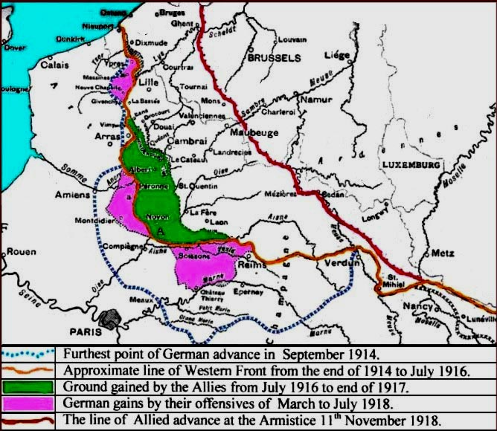
Collapse of the
Central Powers
Second Battle of the Marne (1918)
  Final German offensive (think Lost Battalion) in France
  40 miles away from Paris
  Weakened army + 2 million fresh Americans = Allied victory
Central Powers surrender
  Ottomans surrender with Bulgarians
  Revolution in October removes Austria-Hungary
  German soldiers mutiny and German people turn on Kaiser Wilhelm

Slide 4
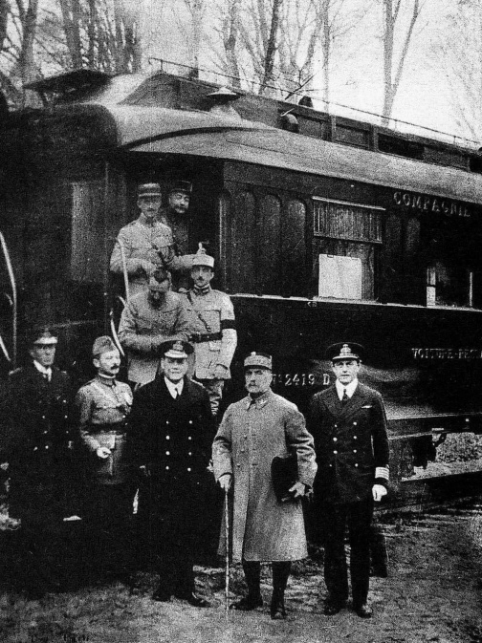
Armistice of 11 November 1918
Armistice- formal agreement to stop fighting
“Eleventh hour of the eleventh day of the eleventh month”
Inspired by Wilson’s 14 Points
Signed in a French railcar by German politicians
  Allies would occupy the Rhineland
  End of military hostilities
  Removal of German troops from fronts
  Surrender of U-Boats and war materials
  Release of Allied POWs, German ones to be released after peace treaty

Slide 5
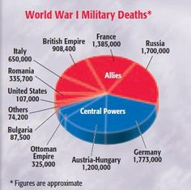
Legacy of WWI
Total global warfare led to extreme death and destruction
  About 17 million dead and 20 million wounded
  Civilians and soldiers, battlefield and hospitals, all countries
Economic drain on resources
  Treasuries of many countries ruined
  Approx. $400 billion cost of war
  Farmland, towns, cities destroyed as well
What next???
  Armistice is NOT a peace treaty
  What should Allies do with defeated Central Powers?

Slide 6
Woodrow Wilson’s
14 Points
Wilson drew up 14 Points in 1918 (war still raging)
Content of Treaty
  1-4: end secret treaties, free seas, free trade, reduce armies
  5: fairness to colonies
  6-13: New borders, self-determination
  14: League of Nations- International peacekeeping organization
In general, he wanted peace for all countries, NOT looking for revenge!
Final Treaty of Versailles was rejected by Wilson
United States did NOT join the League
  Stay out of world affairs
  Republicans stick it to Wilson

Slide 7
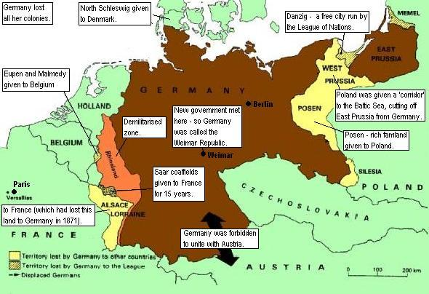
Treaty of Versailles
Paris Peace Conference in January 1919
  Big 4 with no representation for Russia, Germany, and Central Powers
  US wanted peace, GB and F wanted revenge
  Final results in June 1919 (BRAT)
    Germany had to accept the Blame, war-guilt clause
    Germany had to pay Reparations for war damage
    Germany could not have subs, air force and limited army/navy
    Germany lost Territory and mandates were given to Allies by League of Nations

