Slide 1
A ‘World War’

Slide 2
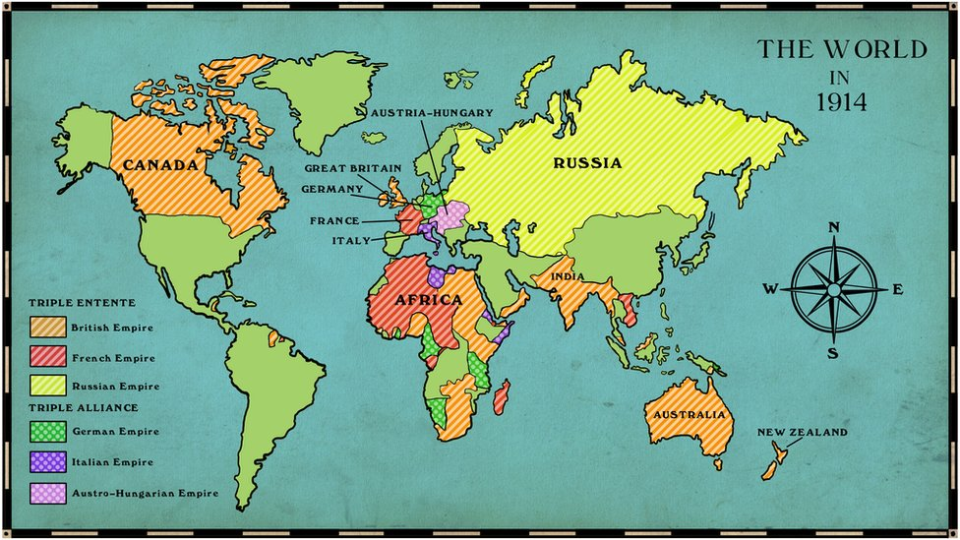
A ‘World’ War
“Terrain of death” (Western) and “front front” (Eastern) were significant parts of a WORLD war
  Stalemates in the trenches led Allies and Central Powers to look elsewhere for victory
  Both sides look for global participants to take war else
  Did not do much to end the slow, painful conflict

Slide 3
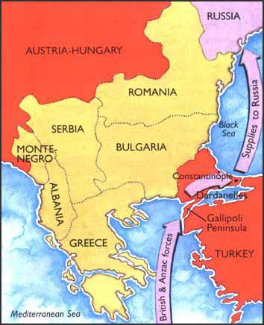
Southern Front
Gallipoli Campaign- failed Allied offensive
  Allies looked to attack Ottoman region known as Dardanelles
  Gateway to Constantinople
  Cut off Ottomans, supply the Russians
  GB, AUS, NZ, F vs. OE, G
  Unplanned trench warfare from Feb to Dec 1915

Slide 4
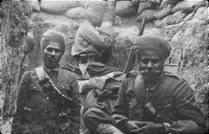
The Colonies
Many European countries have imperial possessions throughout Africa and Asia
Germany loses territories
  Japan attacks and seizes German possessions in Pacific
  Great Britain and France take ___ in Africa
Colonial troops
  Great Britain and France recruit
  Indian troops fought and supplied British forces while Algerian and Asian (Indochina) troops assisted the French… TOTAL WARFARE

Slide 5
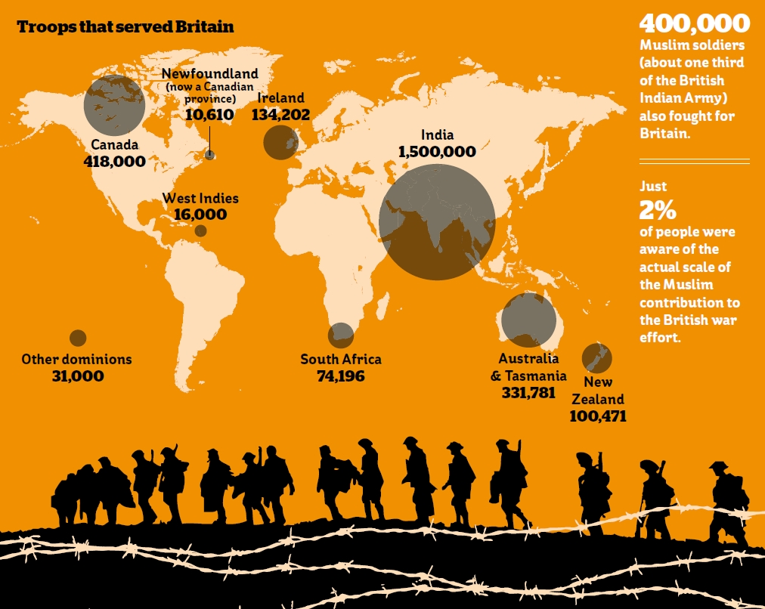

Slide 6
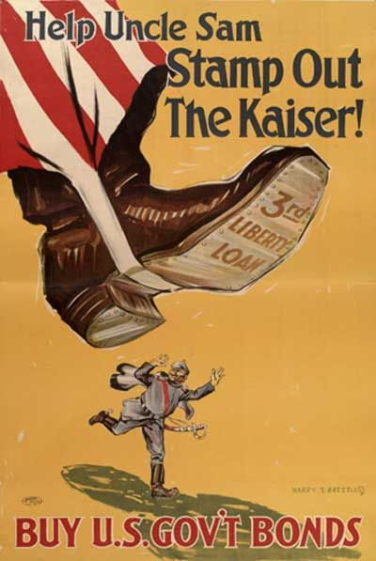
1917 Turning Point-
United States
American Entry
  Unrestricted submarine warfare and German U-Boats
  Lusitania- 128 U.S. citizens
  Zimmerman Telegram
  Already helping Allies, bond w/ England, officially declare war on Germany in April 1917
  FRESH AMERICAN TROOPS!

Slide 7
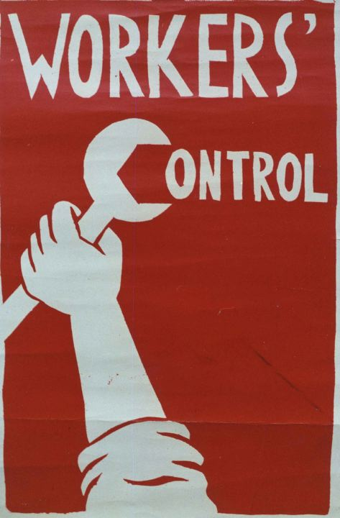
1917 Turning
Point- Russia
War-related problems plague Russia
  Attrition and soldiers, food and fuel shortages
  March 1917- Czar Nicholas stepped down, provision gov’t set up
  Kept fighting, losing army support
Revolution culminates in Vladimir Lenin’s seizure of power in Oct/Nov 1917
  Russians want OUT of war
  Lenin promises to end it when he gains power
  March 1918- Treaty of Brest-Litovsk ends war with Germany
Germany has some hope… One front war!

