Slide 1
World War I

Slide 2
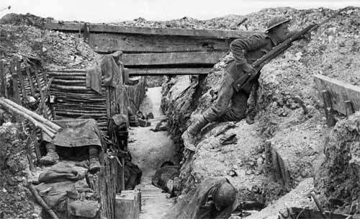
Basics
Who?
  Allied Powers
    Great Britain, France, Russia
    Japan, Italy, and the United States joined later while Russia left
  Central Powers
    Germany, Austria-Hungary, Ottoman Empire
When?
  Started in 1914, peace treaty in 1919
Why?
  MAIN
Where?
  Mainly Europe along the Western and Eastern Fronts

Slide 3
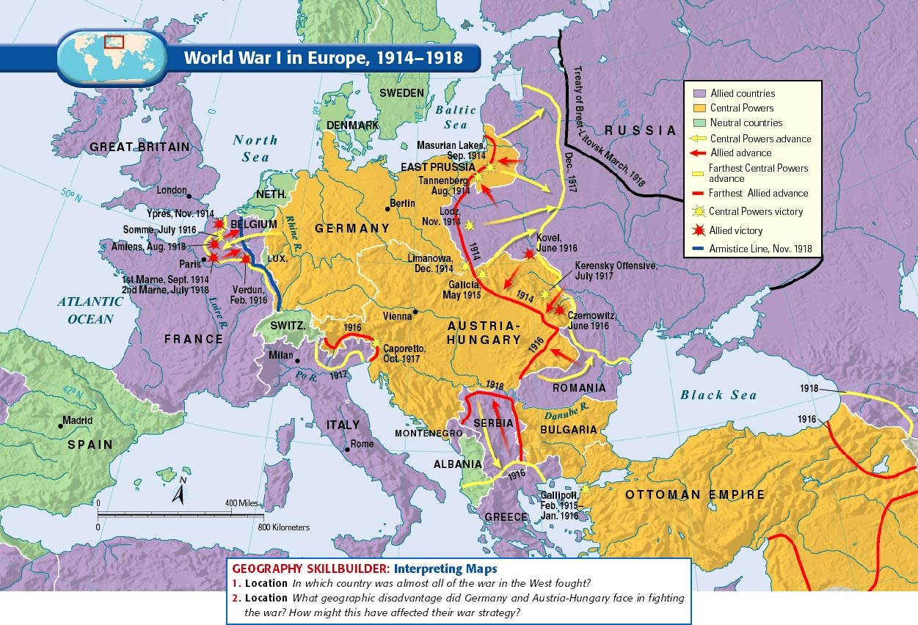

Slide 4
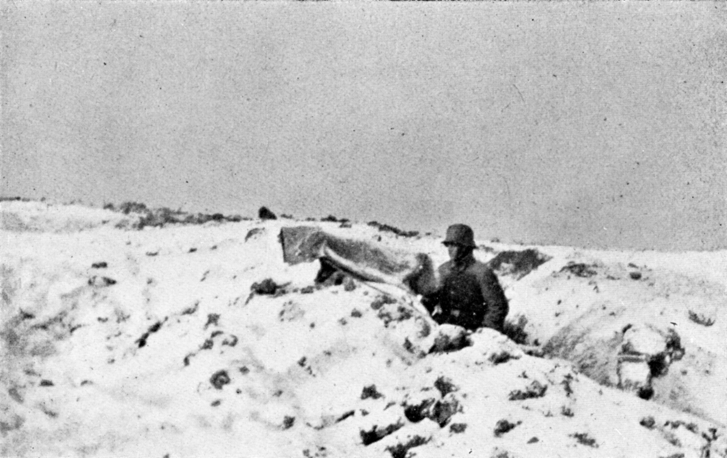
Warfare
Mainly fought between trenches on the Western (France) and Eastern (Russian) Fronts
  West- “terrain of death”, East- “frozen front”
  Trench warfare resulted in massive death tolls, limited change of land possession
  Life in trenches was miserable, no-man’s-land outside of it was worse
  Attrition- constant sustained attacks
Military strategists at a loss
  New technology=more death
  Poison gas, machine guns, tanks, subs
WWI was total war
  Countries devote all resources to war effort, governments took control of economy
  Rationing, propaganda, women pressed into working roles

Slide 5
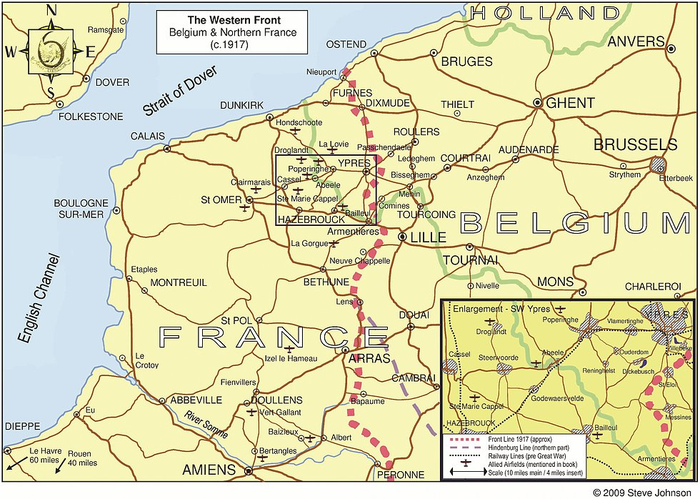
Battles/Conflicts
Thru 1917
Western Front
  1914- First Battle of the Marne
    General Schlieffen wanted to quickly destroy France, then focus on Russia (known to be unorganized and slower), Schlieffen Plan
    French rally outside of Paris led to Allied victory, future stalemate
  1916- Battle of Verdun
    Allies repelled German offensive
    Both sides with over 300k casualties
  1916- Battle of Somme
    French and British offensive that the Germans repelled
    Minimal Allied gains, over 500k casualties

Slide 6
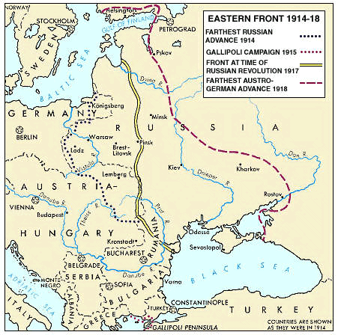
Battle/Conflicts
Thru 1917
Eastern Front
  Mainly Russia/Serbia vs. Germany/Austria-Hungary
  Russian Army
    Huge numbers- constant reinforcements
    Russia is not industrialized and German control of Baltic limited Allied support
    By the end, Russian soldiers and people doubt the czar and government
  1914- Battle of Tannenberg
    Russian offensive destroyed by German counterattack
  1917- Kerensky Offensive
    Last chance Russian offensive
    Internal collapse after initial success, led to defeat

