Slide 1
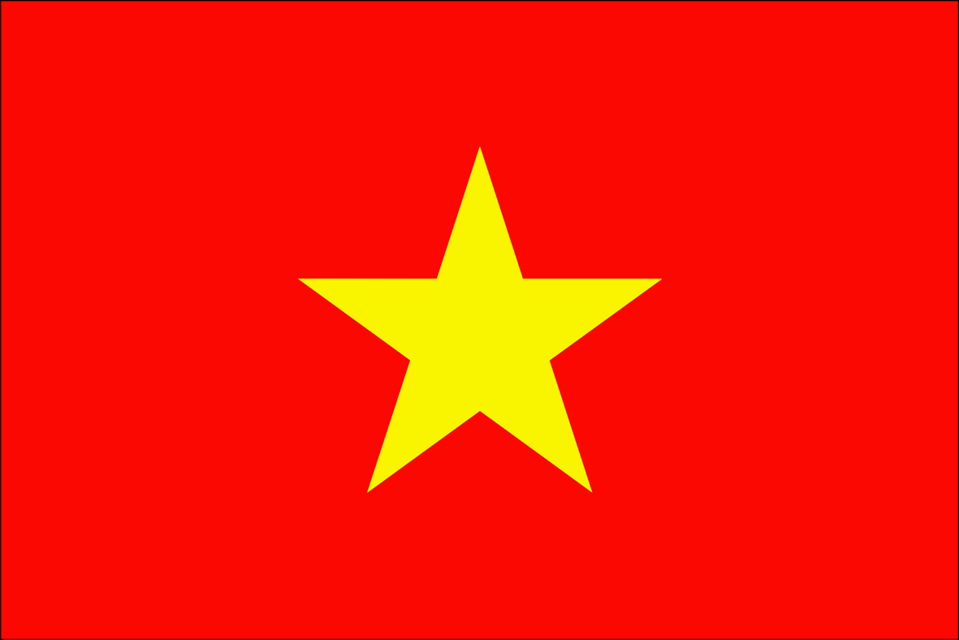
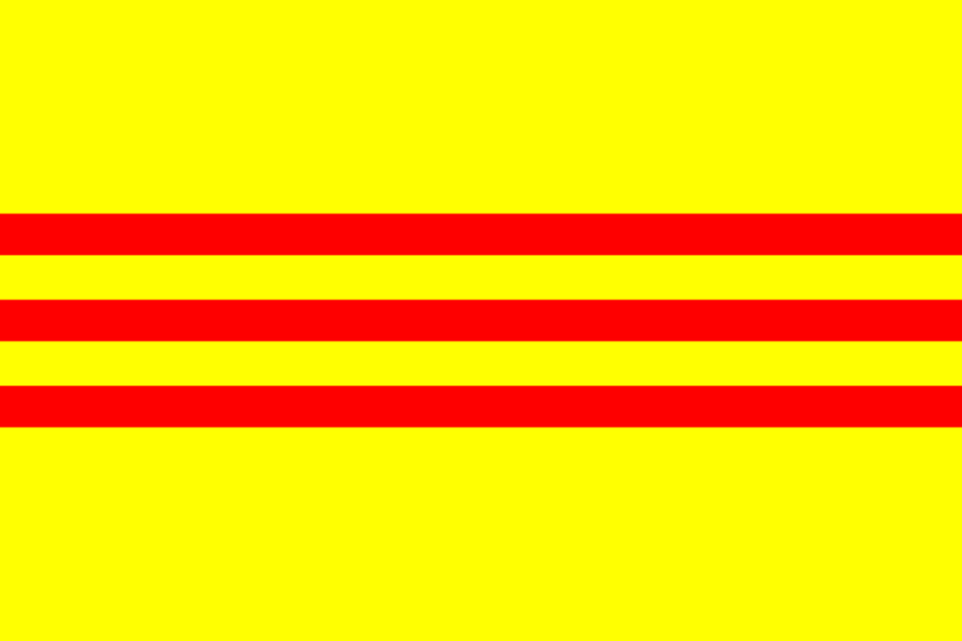
Origins of the Vietnam War

Slide 2
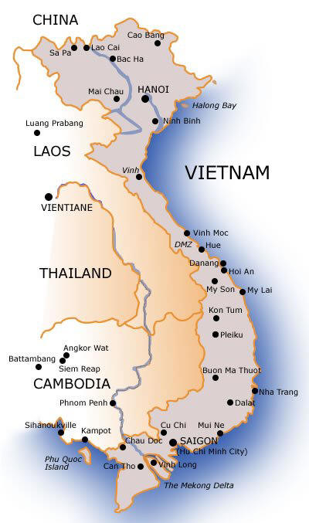
History of Vietnam
Ruled by China from 111 BC until the early 10th century
Independent from 938 AD until the mid 1800’s when it was colonized by France along with the rest of Indochina (Laos, Cambodia)
French rule was very harsh

Slide 3
French Rule
The French administration imposed significant political and cultural changes on Vietnamese society.
A Western-style system of modern education was developed, and Roman Catholicism was propagated widely in Vietnamese society.
Most of the French settlers in Indochina were concentrated in the southern third of Vietnam based around the city of Saigon.

Slide 4
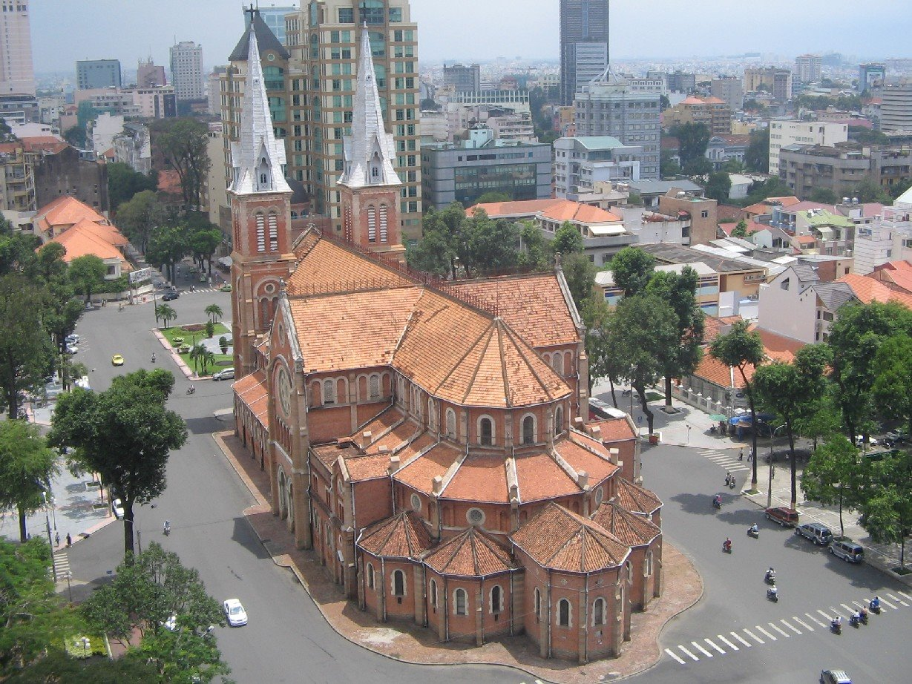
Notre Dame Cathedral, Saigon

Slide 5
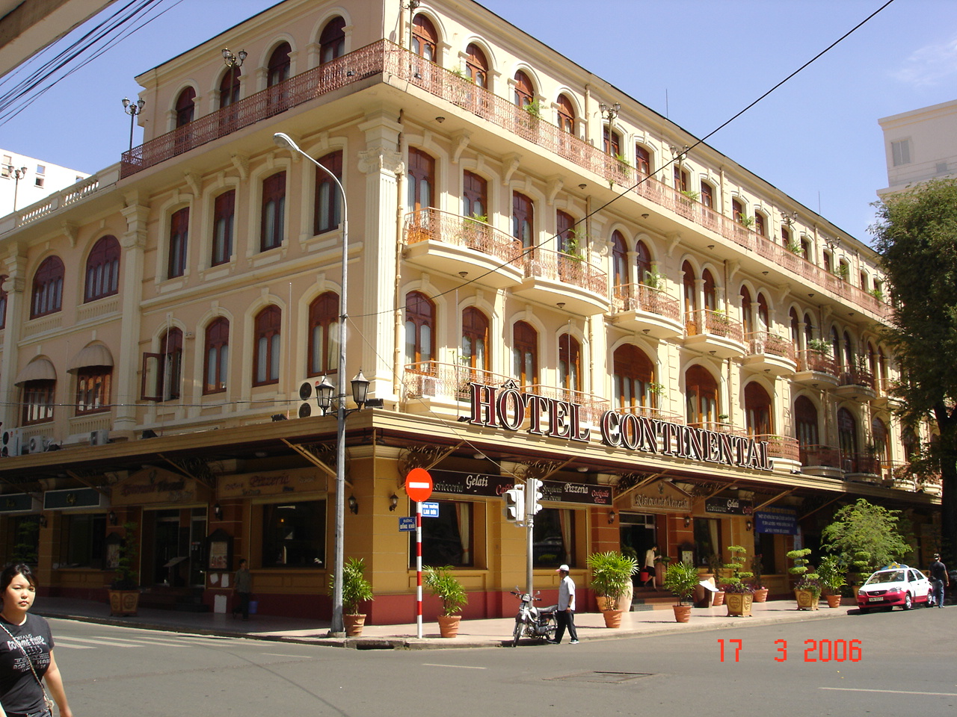
Hotel Continental, Saigon

Slide 6
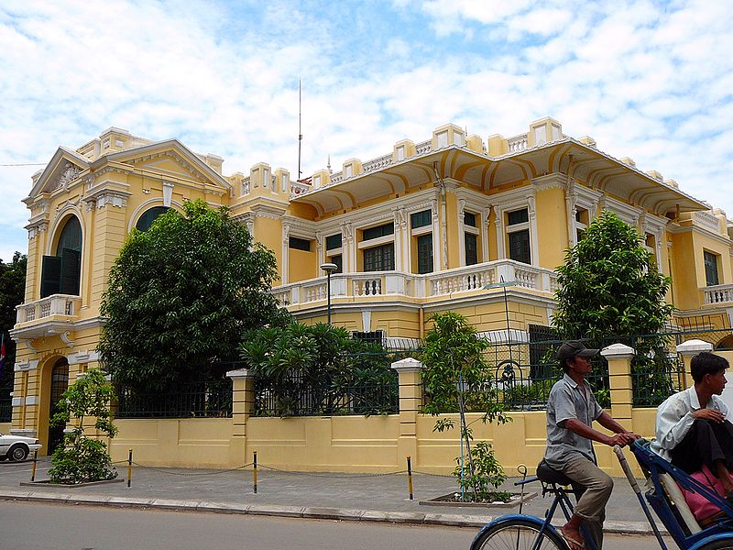
French Colonial Villa, Phnom Penh, Cambodia

Slide 7
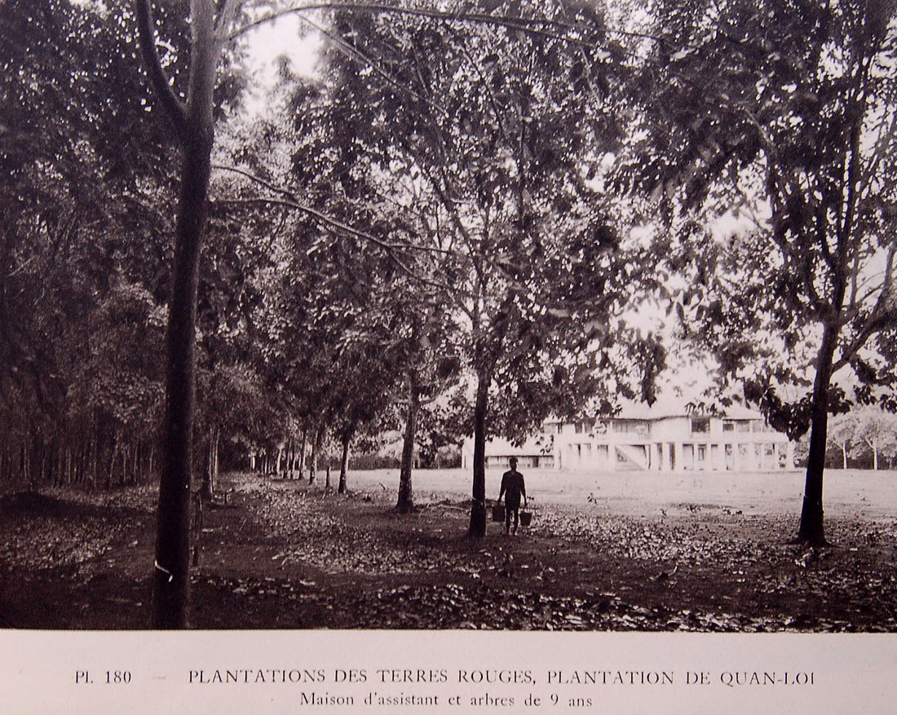

Slide 8

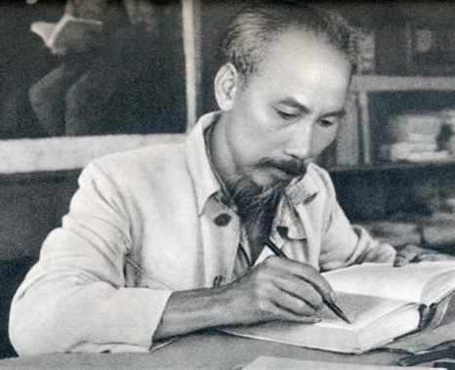
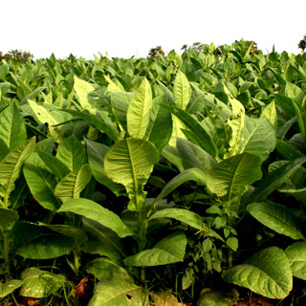
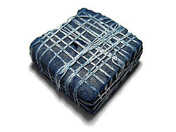

Vietnamese Nationalism
Developing a plantation economy to promote the export of tobacco, indigo, tea and coffee, the French largely ignored increasing calls for Vietnamese self-government and civil rights.
A nationalist political movement soon emerged, with leaders such as Ho Chi Minh fighting or calling for independence.

Slide 9
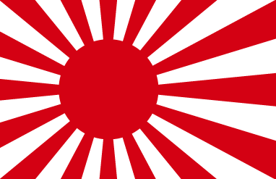
Japanese Occupation
The French maintained control of their colonies until World War II, when the war in the Pacific led to the Japanese invasion of French Indochina in 1941.
With the defeat of France in Europe in 1940, the French were forced to surrender control of French Indochina to Japan.
The natural resources of Vietnam were exploited for the purposes of the Japanese Empire's military campaigns.

Slide 10
The Viet Minh
In 1941, the Viet Minh – a communist and nationalist liberation movement – emerged under the Ho Chi Minh, who sought independence for Vietnam from France and the end of the Japanese occupation.
Following the military defeat of Japan in August 1945, the Viet Minh occupied Hanoi and proclaimed a provisional government, which asserted national independence on 2 September.[

Slide 11
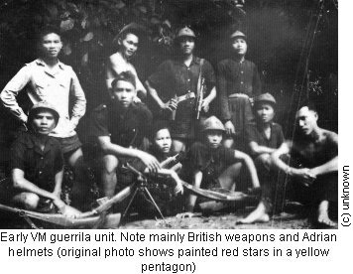

Slide 12
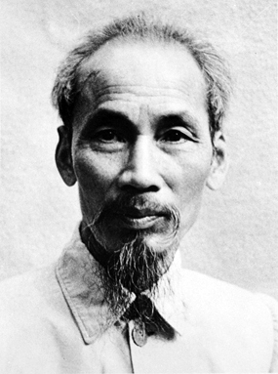
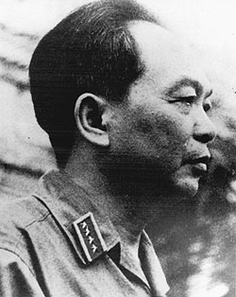
Ho Chi Minh
Vo Nguyen Giap

Slide 13
The French Return
In the same year (1945), France sent troops to pacify the Vietnamese liberation movement and to restore French colonial rule.
On 23 November 1946, French vessels bombarded the port city of Haiphong, and the Viet Minh's guerrilla campaign against French forces began soon after.
The resulting First Indochina War lasted until 20 July 1954.

Slide 14
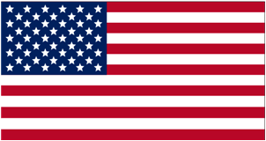
U.S. Involvement
The U.S. supported the decolonization of Asian territory by European countries
However, the U.S. wanted France as an ally against the USSR in the Cold War
President Truman therefore decided to support French rule.
The U.S. contributed $2.6 billion in aid between 1950 and 1954.

Slide 15
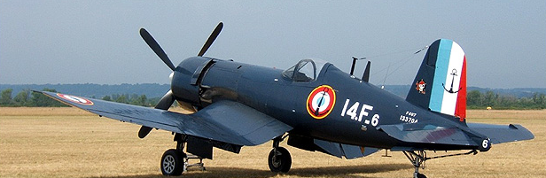
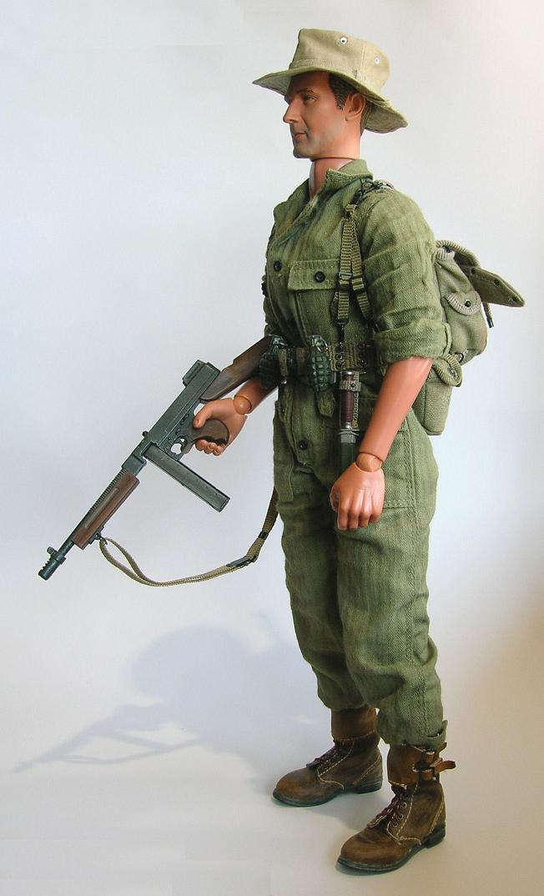
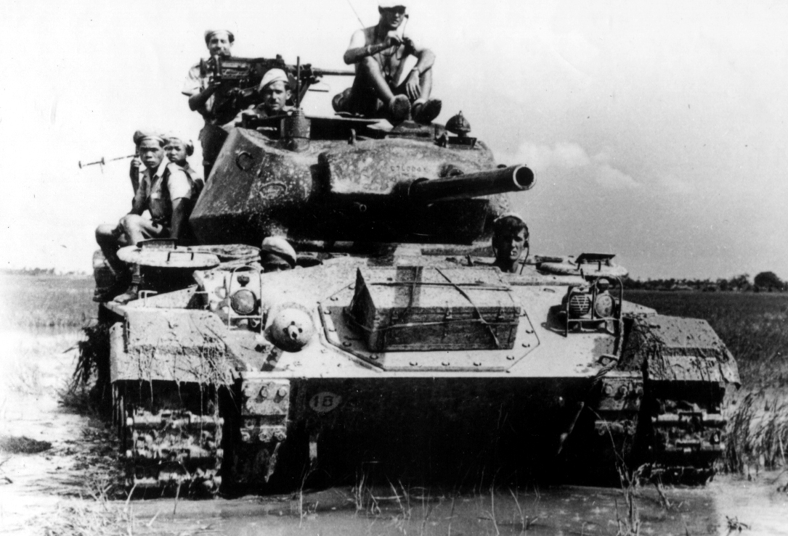
An American Corsair fighter used by the French
French paratrooper with an American Thompson submachine gun
American M24 tank used by the French

Slide 16
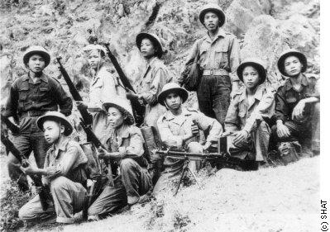
Vietminh Troops

Slide 17
Dien Bien Phu
The French established a major base in the mountains of North Vietnam
The Viet Minh, led by General Giap, surrounded the French garrison
The siege lasted 55 days, with the French suffering over 15,000 casualties
The French were forced to surrender
The next day, France sued for peace

Slide 18
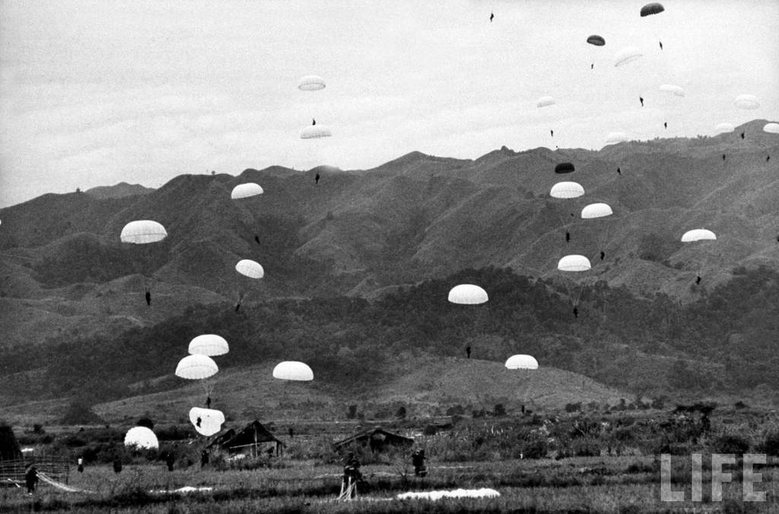
French paratroopers dropping into the valley at Dien Bien Phu. The hills that were later occupied by the Viet Minh and their artillery are visible in back.

Slide 19
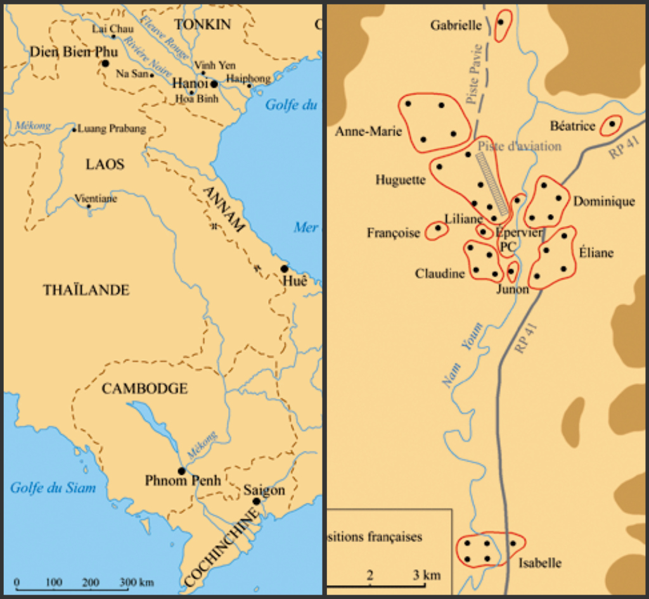
Left: Map of Indochina, showing position of Dien Bien Phu
Right: Map of French positions at Dien Bien Phu
Note: Each French outpost was named after a woman

Slide 20
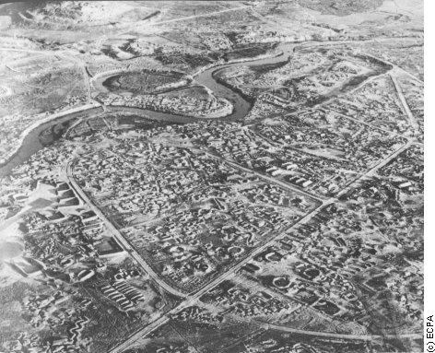

Slide 21
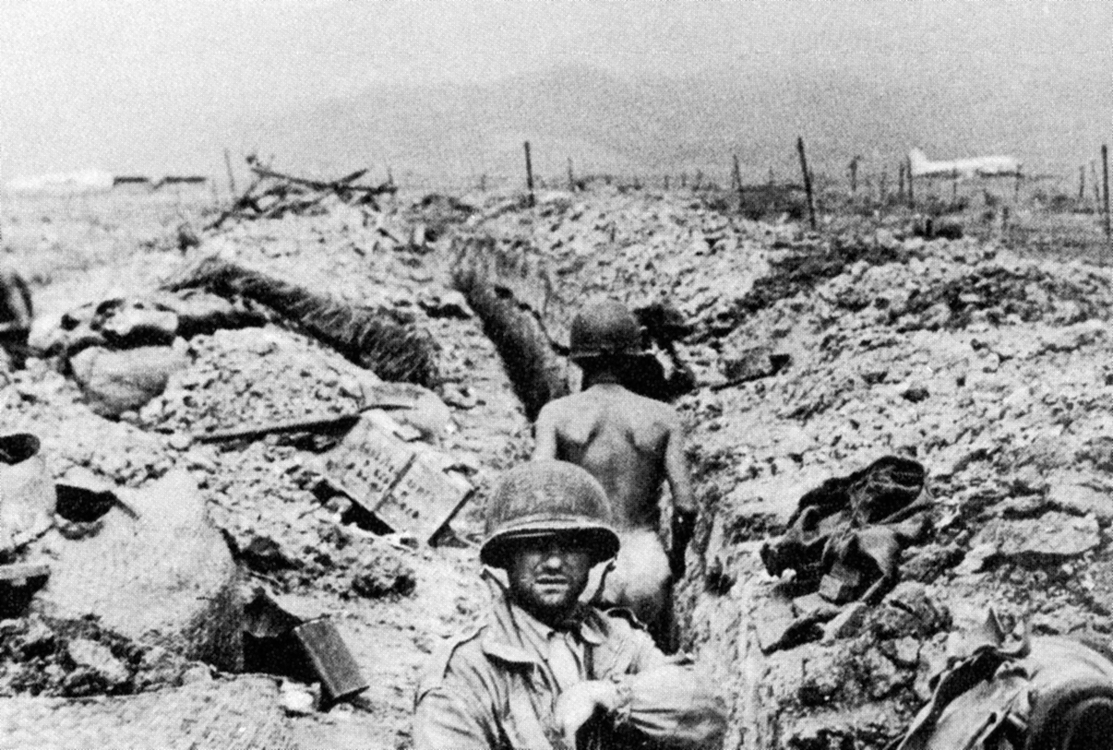
French troops under siege. Note plane in background. Viet Minh field artillery and anti-aircraft artillery soon rendered the airstrip inoperable.

Slide 22
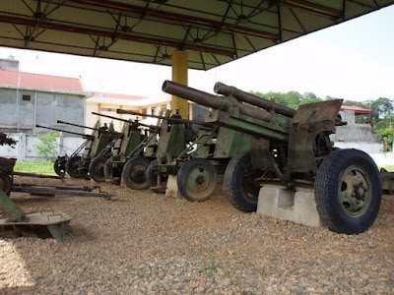
Some of the Viet Minh artillery manhandled through the mountains to Dien Bien Phu by General Giap’s soldiers on display at a museum in Dien Bien Phu

Slide 23
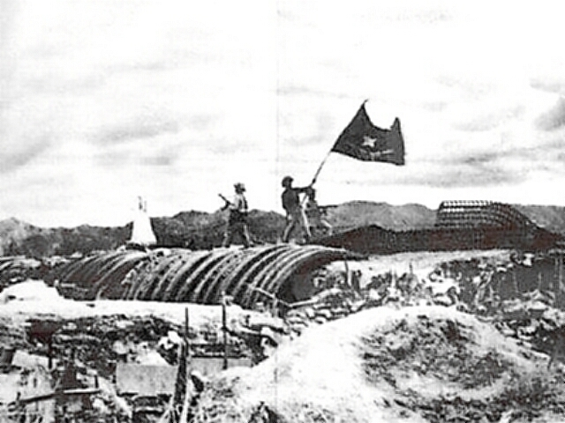
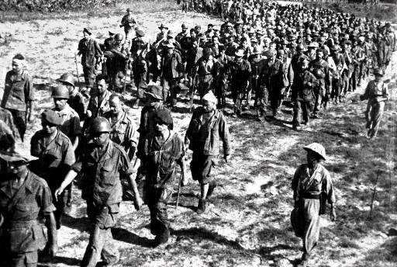
Victorious Viet Minh troops hoist their flag
French troops march into captivity

Slide 24
The Geneva Accords
The French setback at the Siege of Dien Bien Phu allowed Ho Chi Minh to negotiate a ceasefire from a favorable position at the Geneva Conference of 1954.
The colonial administration ended and French Indochina was separated at the 17th parallel by the Vietnamese Demilitarized Zone.
Communists controlled North Vietnam, and a government friendly to the US was established in South Vietnam

Slide 25
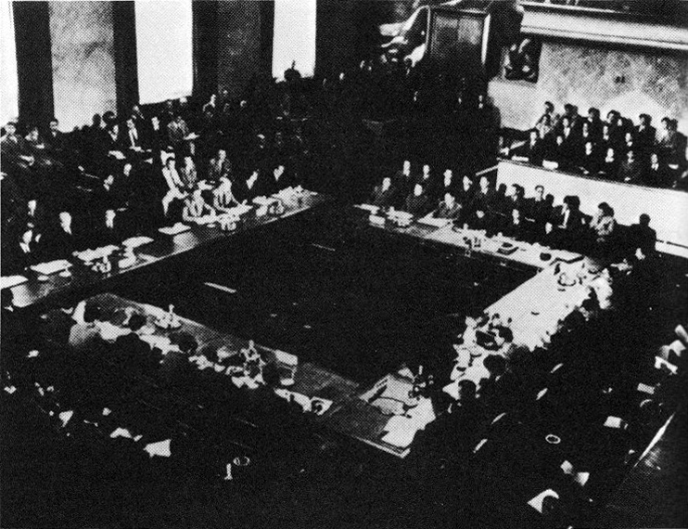
The Geneva Conference, 1954

Slide 26

SEATO
In 1954, the US and seven other countries formed the Southeast Asia Treaty Organization (SEATO) to stop the spread of communism in Southeast Asia
The US was thus able to provide economic and military aid to South Vietnam

Slide 27
Partition of Vietnam
The partition of Vietnam, with Ho Chi Minh's Democratic Republic of Vietnam in North Vietnam, and Emperor Bao Dai’s State of Vietnam in South Vietnam, was not intended to be permanent.
However, in 1955, the State of Vietnam's Prime Minister, Ngo Dinh Diem, overthrew Bảo Đại and proclaimed himself president of the Republic of Vietnam.
The Geneva Accords mandated nationwide elections by 1956, which Diem refused to hold, despite repeated calls from the North for talks to discuss elections.

Slide 28
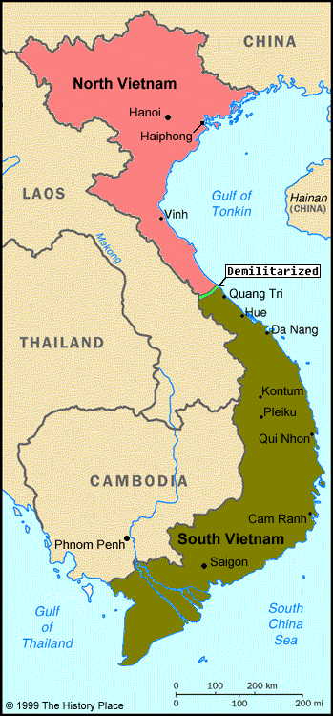
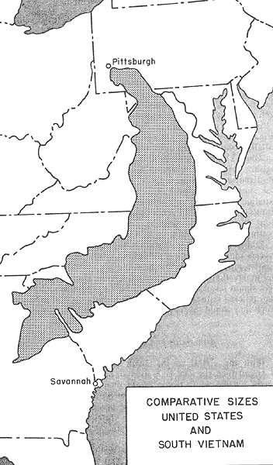

Slide 29
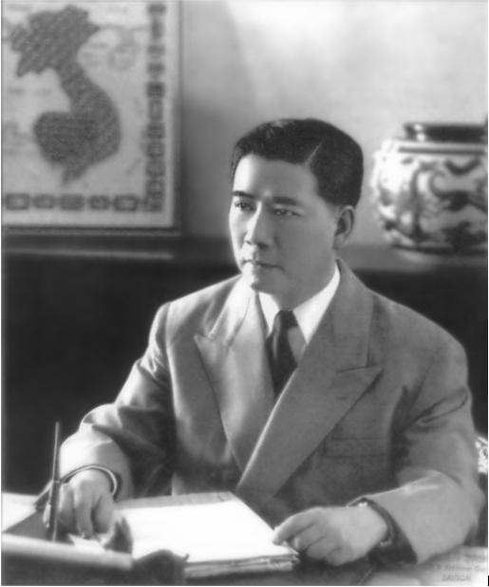
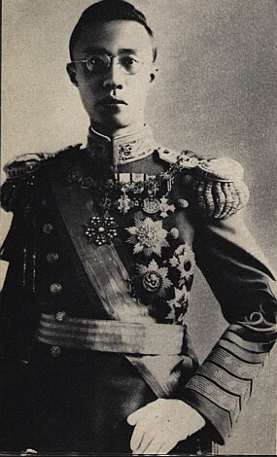
Bao Dai
Ngo Dinh Diem

Slide 30
Opposition to Diem
1957saw the establishment of the National Liberation Front (NLF), a communist organization dedicated to a united Vietnam
NLF guerilla fighter was known as Vietcong, or VC
Diem, a Roman-Catholic, signed anti-Buddhist legislation that angered Buddhists

Slide 31
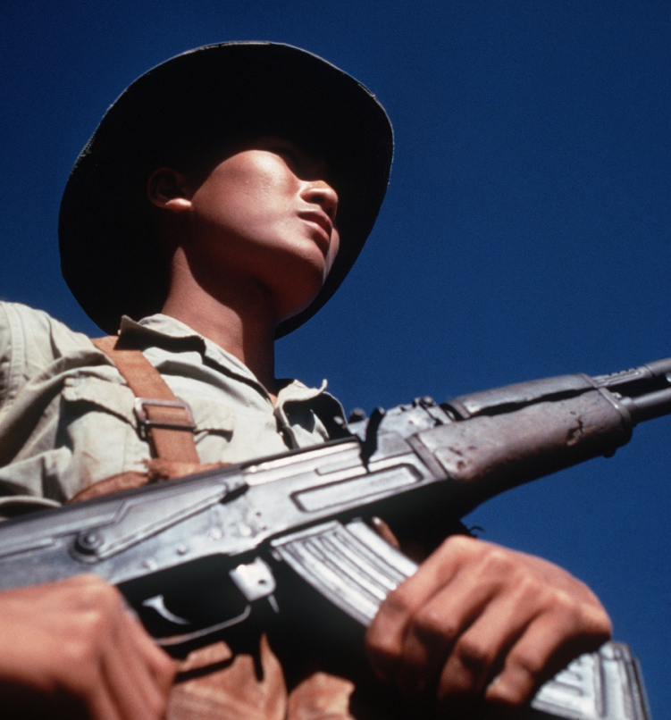
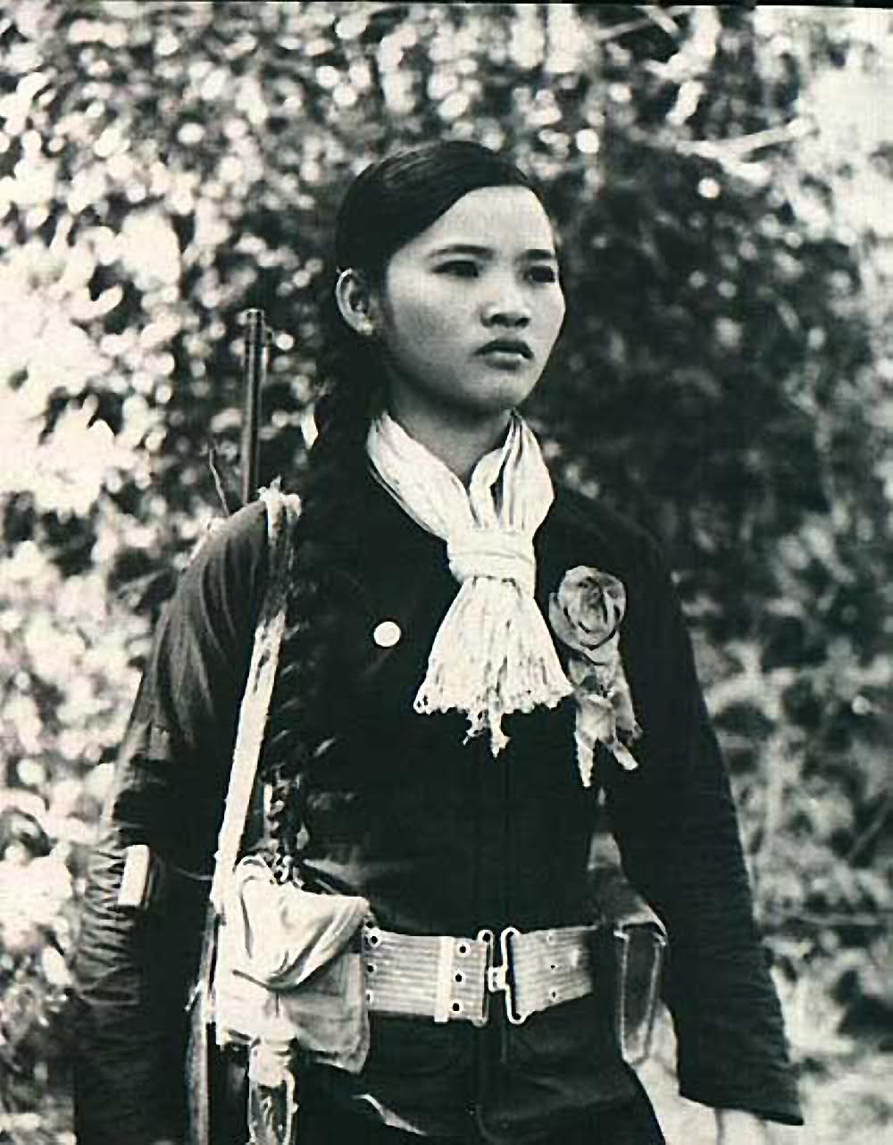
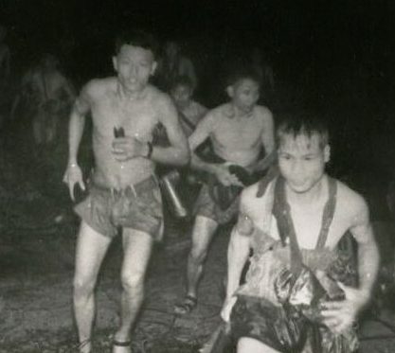
Vietcong guerillas

Slide 32
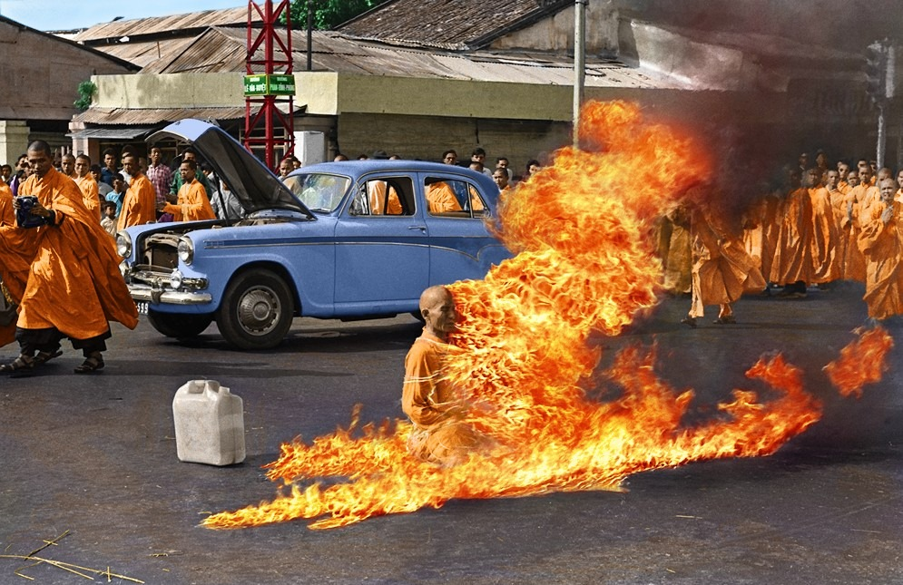
Buddhist monk Thich Quang Duc burned himself to death at a busy intersection in downtown Saigon to protest against the persecution of Buddhists by the government of South Vietnamese President Ngo Dinh Diem in 1963

Slide 33
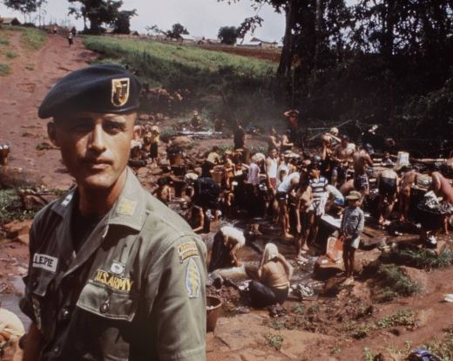
U.S. Involvement
In 1961, President Kennedy sent Special Forces (Green Berets) to advise the South Vietnamese Army (ARVN)
By 1963, more than 15,000 U.S. advisers were in Vietnam

Slide 34
Overthrow of Diem
Opposition to Diem continued to grow
The U.S. became aware of a plot to overthrow Diem by the military
President Kennedy chose to allow the coup to happen rather than help Diem
President Diem was overthrown and executed, along with his brother, on 2 November 1963.
Diem was followed by a series of corrupt military regimes that often lasted only months before being toppled by other military officers.
With South Vietnam paralyzed by instability, the communists began to gain ground

Slide 35
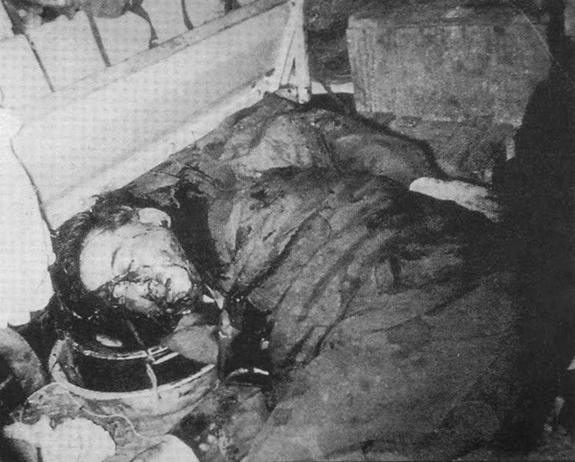
Diem assassinated

Slide 36
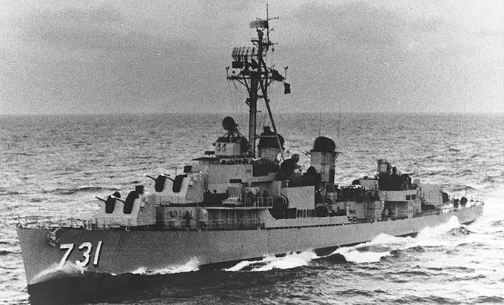
Tonkin Gulf Incident
On August 2, 1964, North Vietnamese gunboats attacked the American destroyer USS Maddox
This incident prompted President Johnson to order airstrikes on North Vietnam
He also asked Congress to authorize the use of force to defend U.S. troops

Slide 37
Tonkin Gulf Resolution
Congress passed the Tonkin Gulf Resolution
This allowed the President to use military force without declaring war
President Johnson was now able to escalate the war without going back to Congress for a formal declaration of war.

