Slide 1
Islamic Empires in Asia
Chapter 18
“The empire of the world…must be one, one faith and one kingdom. To make this unity there is no place in the world more worthy than Constantinople” – Mehmed the conqueror

Slide 2
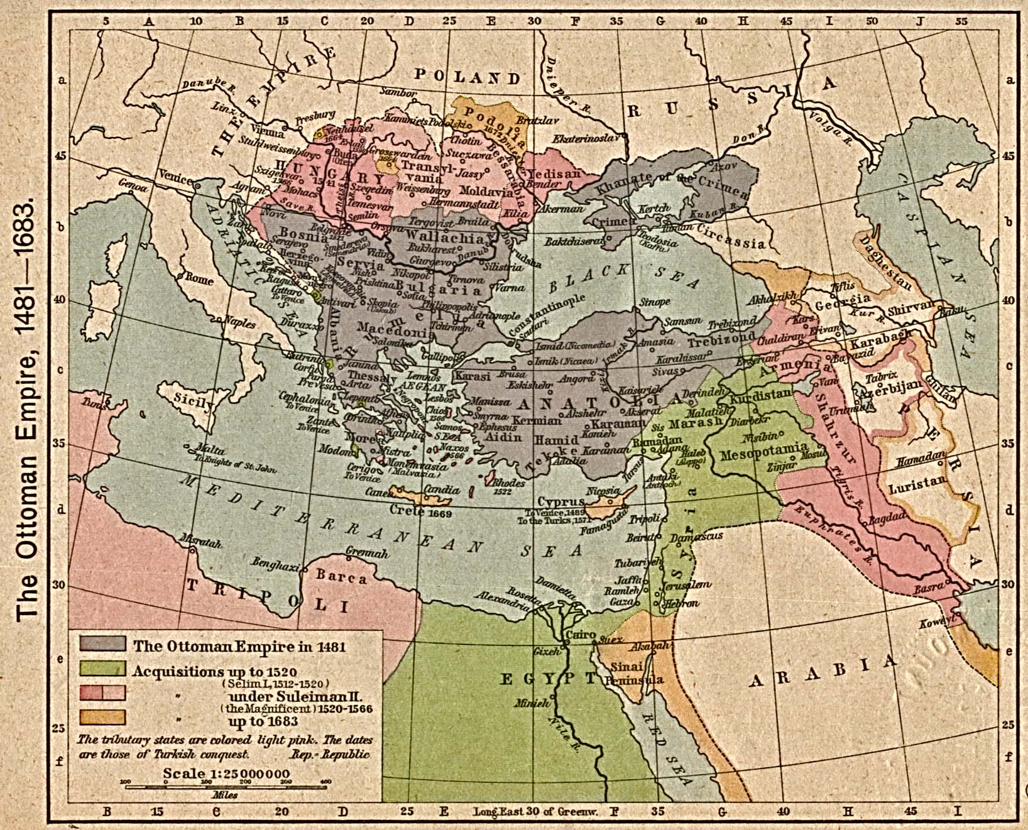
Ottoman Empire

Slide 3
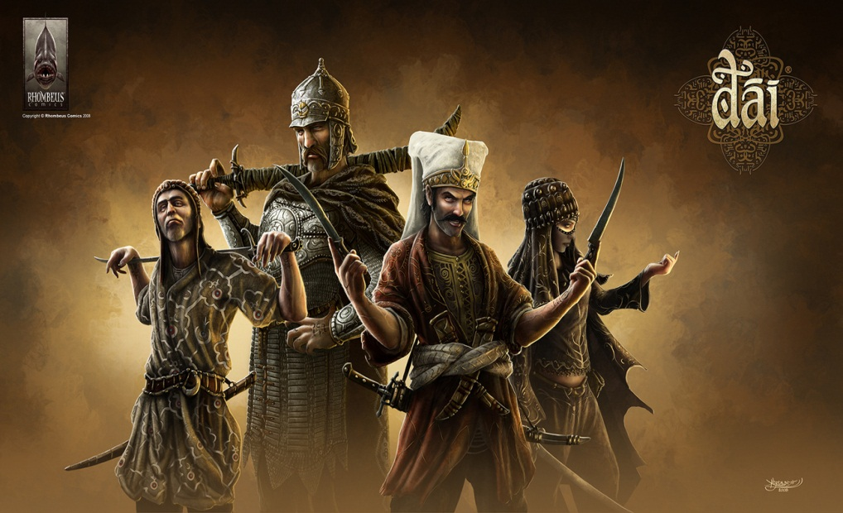
Rise of the Ottomans
Ghazis – Warriors for Islam
Anatolia (Modern Day Turkey)
  Osman – creates the Ottomans
  Sultan – one with power
  Gunpowder and cannons
  Compassion, tolerance

Slide 4
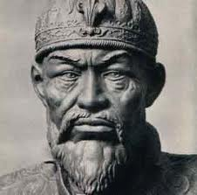
Timur – Timur the Lame
Restoration of Mongol Empire
Military genius & tactician
Burned Baghdad and won Battle of Ankara
  Slowed Ottoman advance
"Till the advent of Hitler, Timur stood forth in history as the supreme example of soulless and unproductive militarism“ – John Saunders

Slide 5
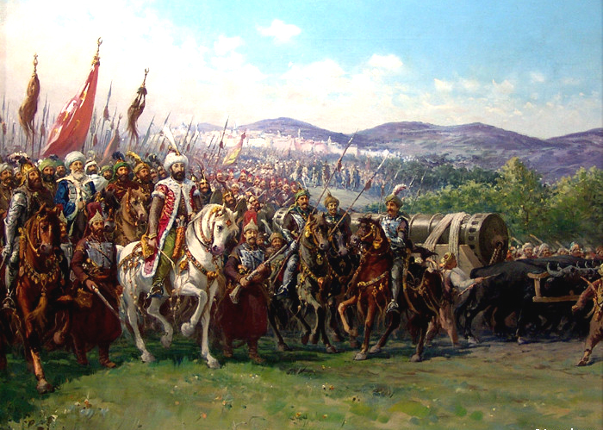
Recovery & Expansion
Murad II
    next period of expansion
  defeated the Venetians, invaded Hungary, and overcame an army of Italian crusaders in the Balkans
Mehmed II
  Took Constantinople in 1453 – renamed Istanbul
  Strategic importance east\west
  Opened the city to people various religions and cultures rebirth
Selim
  Persia, Syria, Palestine, North Africa.
  Mecca, Medina, and Cairo

Slide 6
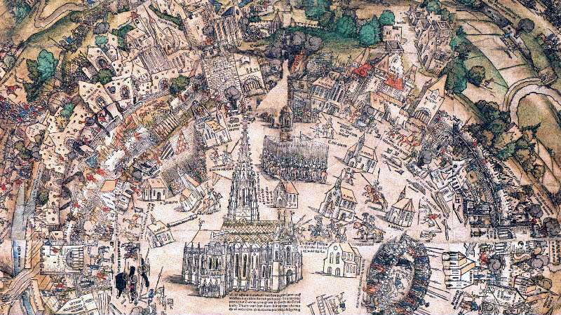
The Greatest Sultan
Suleyman – takes it to its height
  West (Europe) – “The Magnificent”
  East (Own) – “The Lawgiver”
    Reconstructed legal system
  Devshire System – Sultan’s army drafted captured Christians who were educated, converted, and trained to be soldiers
  Janissaries – elite force loyal to sultan only, Christians wanted to be a part of this
  Captured most of Hungary
  Island of Rhodes, Austria, North Africa

Slide 7
Millet System
Millets
  Separate legal courts for communities to rule under “personal law”
    Protected religious minority groups
  Own laws & customs – collected taxes
  Muslims: ethnicity did not matter
  Tolerance, expansion, growth, peace……

Slide 8
Decline of an Empire
Death of Suleyman – beginning of the end
  Rise of European states – France, Spain & Poland
Decline in 1600’s – 1700’s
  End of Silk Road – boat routes, safer, no middle man
  Internal power struggles led to corruption
  Janissaries rebelled
  1700’s: Crimean Peninsula (Black Sea Lands) to the Russians
  1798: France takes Egypt
  Restructuring failed by Sultans
  1923 – Turkey established as a Republic – End of the Empire

Slide 9
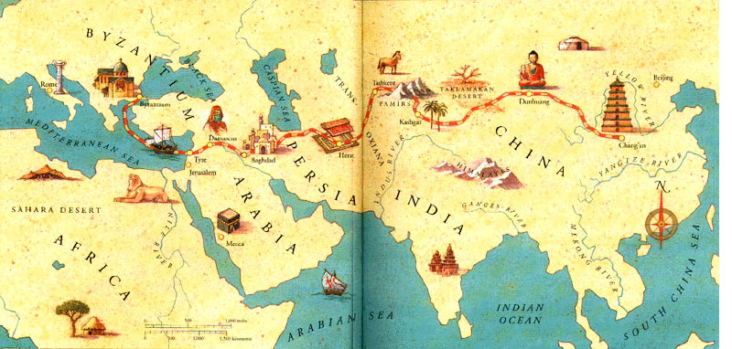
End of the Silk Road

Slide 10
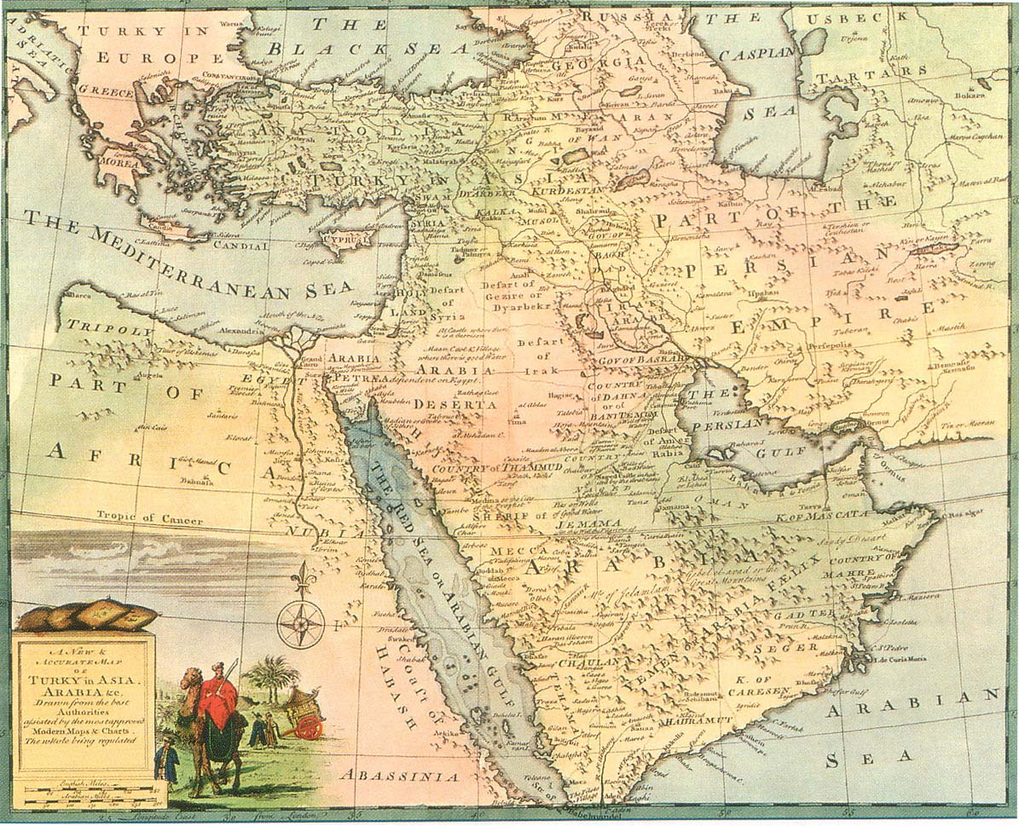
Safavid Empire

Slide 11
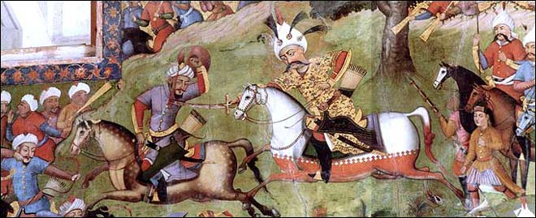
Safavid Empire
Current Day Iran
Safavids were Shi’ite
Surrounded by other empires and diverse\mixing of cultures
Isma’il:
  Iran and most of Iraq
  Shah – “King”
  Forced conquered peoples to convert to Shi’a or die
  State religion

Slide 12
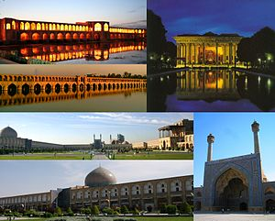
Shah Abbas the Great
Shah Abbas “the Great”
  Reformed military using Ottoman model
  Religious tolerance to entice Europeans to trade with them
Height of an Empire
  Government jobs based on merit and foreigners
  Created a flourishing city
  Improved manufacturing and foreign trade
    carpet weaving, ceramics
  Empire began a decline after Abbas’ death – ended 1736

Slide 13
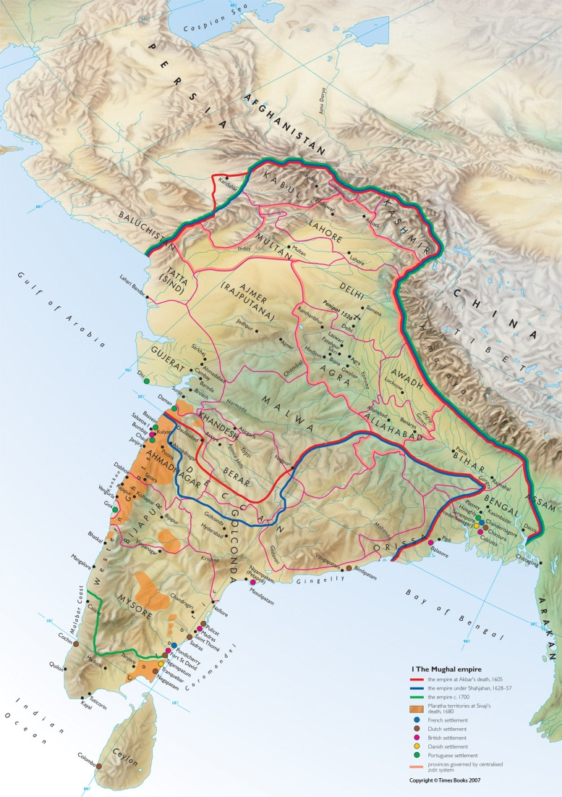
Mughal Empire in India

Slide 14
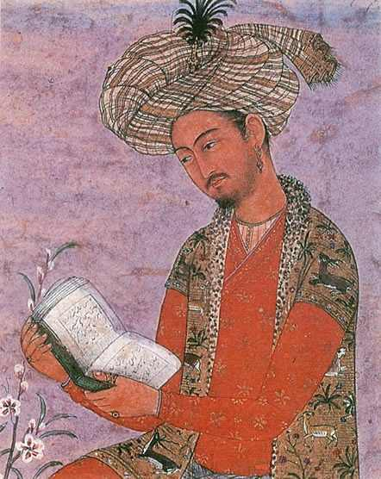
Origins
 | Rajputs | Babur
Who: | Indian warrior princes | Mughal leader
What: | Weakened power of sultans | Attacked Sultanate of Delhi, also defeated rajputs army
When: | 1500s | 1526
Where: | Delhi | Panipat
Why: | Gain Power | Build an Empire
How: | Challenged Delhi Sultans | Defeated Sultan in Battle

Slide 15
Akbar – Greatest of the Mughal
Gained support by including the Rajputs in government along with natives, foreigners, Hindus, and Muslims
Improved tax system – graduated tax
Cultural blending
Religious Policy
  Tolerant of all religions
  Repealed non-Muslim tax

Slide 16
Height of the Empire
Shah Jahan
  Vigorous ruler – put down rebellions – Delhi new capital
  Assassinated all of his rivals
  Hall of Private Audience – Jahan’s palace
  Taj Mahal – tomb for Jahan’s wife
  B/c of economic burden for construction & maintaining the army taxes were raised and people suffered

Slide 17
Sikh
Tried to unite Muslim & Hindu philosophies
  Recognize themselves as a distinct religion not a branch of either
One God, no idols, less rigid social system
Originally peaceful, did militarize in 1600s
Conflict with Aurangzeb

Slide 18
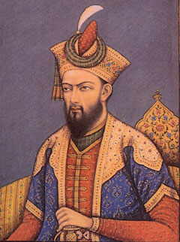
Aurangzeb
1657 – Aurangzeb takes power
  Jahan becomes ill – Aurangzeb kills older brother, imprisons father – becomes emperor
  Devout Sunni – strict morals, sensors monitored society
  Persecuted all non Sunni
  Restored tax on Hindu’s – destroyed Hindu Temples

Slide 19

Taj Mahal & Hall of Private Audience

