Slide 1
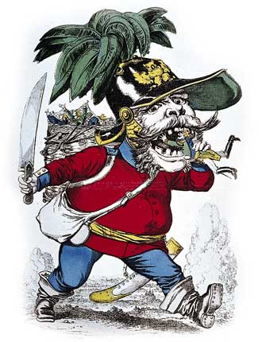
Opposition to Bismarck 25.3

Slide 2
Unrest in Austria:
Coping with Nationalistic Movements
Chapter 25.5

Slide 3
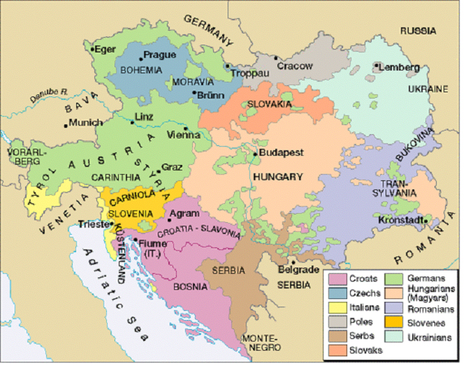
The Decline of the Austrian Empire
Status of Austria very poor:
  Lost HRE
  Italy
  Revolts broke out
    Hungary
  “The Last Straw”
    Lost 7 Weeks’ War

Slide 4

The Dual Monarchy
To save the empire, Austria gave in to Hungarian demands and created a Dual Monarchy (aka Austria-Hungary)
Led by Francis Joseph I
Strengths | Weaknesses
-Provided markets for ea. other (A- Ind. & H- Ag.) -Ended revolts | -Tariffs (A. wanted high taxes) -Ethnic divisions -Austria weak

Slide 5
Austria-Hungary’s New Focus
Wanted to control the Balkans
  Not an easy task:
    Needed to take away from Ottomans
    Balkan people wanted independence
    European countries also wanted to control Balkans (GB and Russia)

Slide 6
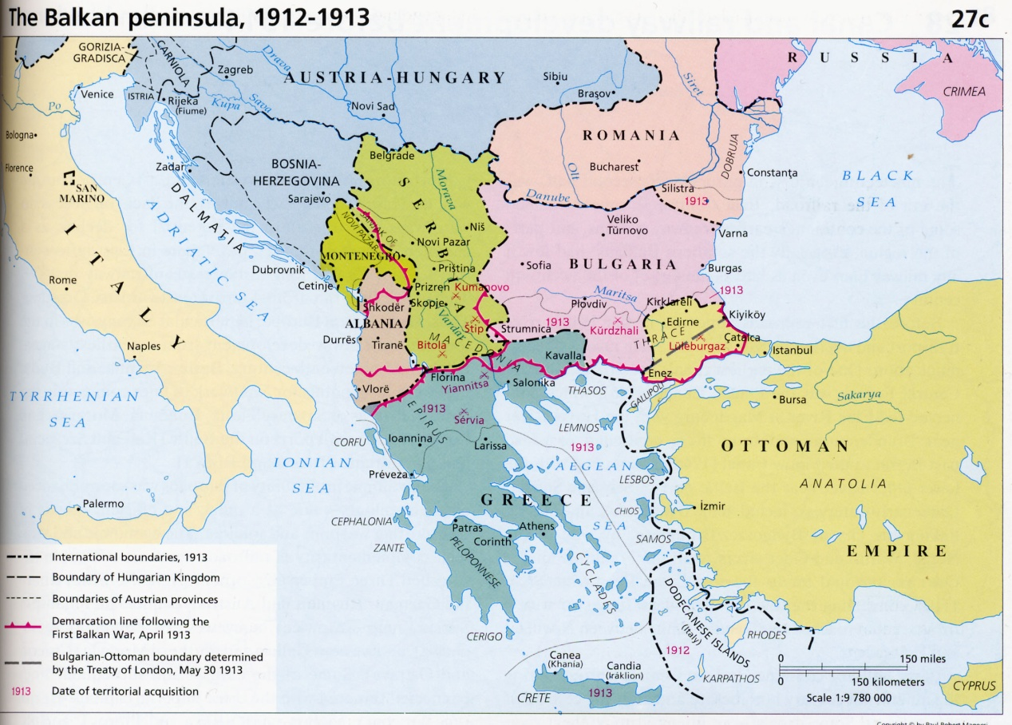
Dividing the Balkans
1875 Balkan revolts ended w/ Ottoman defeat
  Treaty of San Stefano
  Romania, Serbia, Montenegro, independence.
  Self-Rule to Bulgaria ( which Russia then occupied for years.
At the Congress of Berlin:
  GB , Russia, Ottomans given some terr.
  A&H governed Bosnia and Herzegovina
    Later A&H took B&H o/
Result:
  Ottoman Empire weak
  Balkan states resent A&H

Slide 7
Dividing the Balkans
At the Congress of Berlin:
  GB , Russia, Ottomans given some terr.
  A&H governed Bosnia and Herzegovina
    Later A&H took B&H o/

