Slide 1
Section 4 Lecture
Russian Nationalist movement

Slide 2
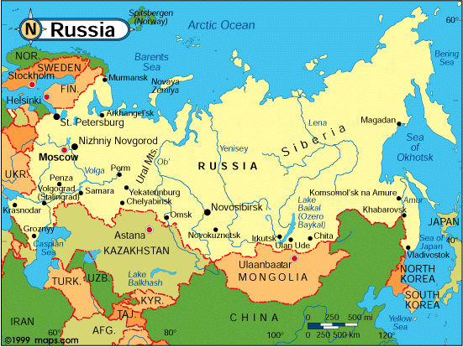

Slide 3
What geographical and cultural factors made Russia different from the rest of Europe? Why could Russia not industrialize like the rest of Europe?
Russia was virtually landlocked
Ports were blocked by ice for much of the year and exits from the seas were controlled by other countries
Conflicts with the Ottoman Empire erupted when Russia tried to gain ports along the Mediterranean
Russia was extremely diverse
Belorussians (white Russians in west), Ukrainians in agricultural south, Great Russians in north and central Russia
All these major groups spoke their own languages
There was a variety of minorities also
Asians, Poles, and Finns were frustrated conquered people who were tough to rule

Slide 4
What were Russia’s domestic and foreign policies?
Domestic
Czar ruled the empire as an Autocrat
One who holds absolute power
Nationalistic ideas begin to appeal to ethnic minorities in Russia; especially Poles and Finns
Russian movements to counteract nationalistic ideals:
Censored speech and press
Russification- program adopted by Czar Nicholas I that forced non-Russian peoples in the empire to use the Russian language, accept the Orthodox religion, and adopt Russian customs in place of their traditional ones

Slide 5
What were Russia’s domestic and foreign policies?
Foreign- two primary features
Increase Russian influence among the Slavic peoples of the Balkans
Promoted Pan-Slavism- union of all Slavic peoples under Russian leadership.
Expansion
Gain lands in the east from Asia
Gain lands to the south from the Ottoman Empire
Russia lost crucial territories to the Ottomans during the Crimean War during the 1850s (first major embarrassment for Russia)

Slide 6
What major reforms took place under Alexander II?
1861 Alexander II issued the Emancipation Edict- freed all serfs
Why?
Serfdom obstructed development by restricting the labor pool; factory owners would benefit if the serfs were freed
Other major reforms:
Reformed local government
Modeled civil and criminal courts after European courts
Expanded education
All reforms faced opposition from each end of the political spectrum
Conservatives worried about their noble privileges
Liberals thought reform movements were not enough

Slide 7
What were the reactions of Radical groups to Alexander II’s reforms?
Nihilists- (Latin for “nothing”) middle-class and upper class intellectuals who believed that a just society could be created only by building a completely new Russia. This meant abolishing the existing political, economic, and social structures
Terrorist attacks
Another radical group called Populists, argued that noble lands should be confiscated and divided equally amongst Russian citizens
When the government arrested many Populists, radicals turned to a terrorist movement called the People’s Will.
Alexander II was killed by a bombing attack in 1881

Slide 8
What were the reactions of Radical groups to Alexander II’s reforms?
Time of repression
Successors of Alexander II used every means possible to stamp out liberal/radical reforms
Jews were massacred in riots called pogroms
Repression only led to more liberal organization
1898
Terrorism increased
Social Democratic Labor Party was formed (socialist organization)

Slide 9
What happened during the Revolution of 1905? Why did it happen? Was it successful?
1904-1905 Russia was humiliated
Russia went to war with Japan over territories in China and Korea
To the surprise of the world, Japan beat the Russians
Russia’s loss exposed a government that was corrupt and inefficient, as well as oppressive
Discontented groups sprung into action
January 22, 1905-“Bloody Sunday”
Czar’s troops shot unarmed strikers on their way to deliver a petition to him.
Severe protesting and violence erupted
Czar issued the “October Manifesto”-promising individual liberties
Duma- Russian elected parliament was put into place

Slide 10
What happened during the Revolution of 1905? Why did it happen? Was it successful?
Failed for three reasons- Czar was able to dismiss the DUMA
Much of the army remained loyal to the czar
French alliance pledged allegiance to the czar
Revolutionary groups remained divided in their overall goals

Slide 11
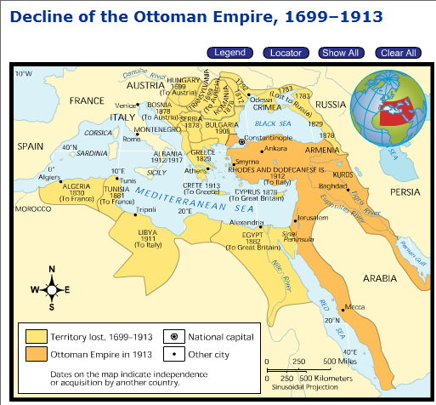

Slide 12
