Slide 1
Russian Revolution

Slide 2
WWI Review:
1. Who fought who? (Countries for Central and Allied Powers)
  Central Powers: Germany, Austria-Hungary, Bulgaria, Ottoman Empire
  Allied Powers: Great Britain, France, Russia, Italy…eventually the U.S.
2. What were the four MAIN causes of WWI?
  Militarism, Alliances, Imperialism, Nationalism
3. What sparked WWI?
  Assassination of Archduke Francis Ferdinand
4. How did the British plan to help the Russians? Did this plan work?
Battle of Gallipoli-Huge Failure

Slide 3
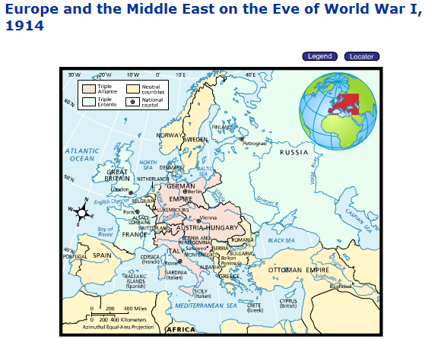

Slide 4
Review Concept: TOTAL WAR
The effects of Industrialism
  Men drafted into the armed forces
  Women work in the factories
  All resources of a nation go towards the war effort
  The entire nation seen as the “enemy”

Slide 5
Essential Questions:
What were the three separate (but related) phases of the Russian Revolution?
How did the outcome of these three events lead to an all out Russian Civil War?
What were the consequences of the Russian Civil War?

Slide 6
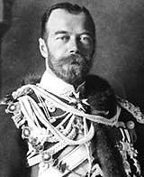
Pre-Revolutionary Russia
Only true autocracy left in Europe
No type of representative political institutions
Nicholas II became Tsar in 1884
Believed he was the absolute ruler anointed by God
Russo-Japanese War (1904)

Slide 7
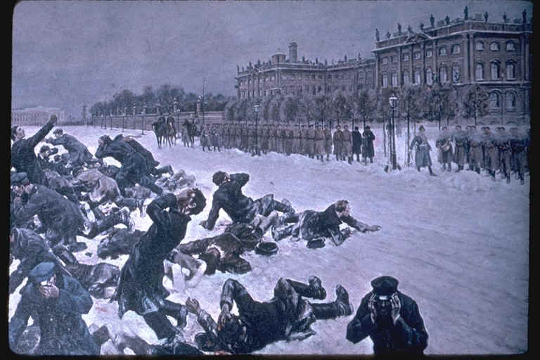
Phase One: The Revolution of 1905
Bloody Sunday-Czar’s troops shot unarmed strikers on their way to deliver a petition
October Manifesto-granted individual liberties and….
Duma- Russia parliament/ legislative body (1906)
Czar not removed:
  Army remained loyal
  French loaned money to Russia
  Revolutionary groups were deeply divided on goals

Slide 8
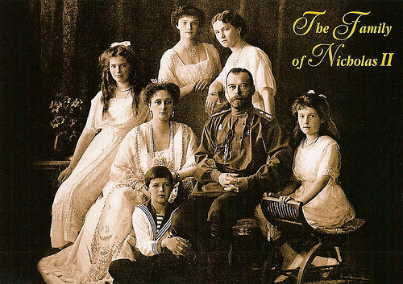
Conservatism Continues: 1905-1917
Tsar paid no attention to the Duma
Duma was harassed and political parties were suppressed
Nicholas was personally a very weak man
Tsar became even more out of touch with peasantry

Slide 9
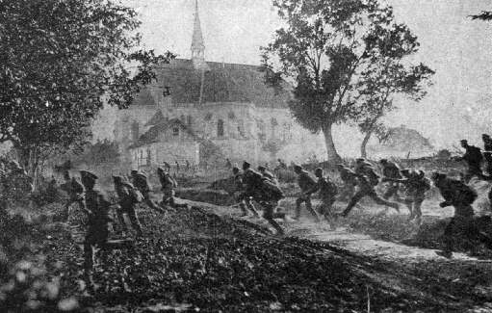
World War I 1914-1918
Russian death estimates are near 1.7 million people
Most died on the battlefield
A large number died because of disease and famine like conditions
The government was simply unable to cope with this “new kind of war”

Slide 10
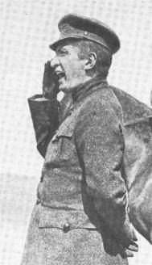
Phase Two: The March Revolution 1917
Origins: Food riots and strikes
Duma declared itself a Provisional Government on March12th
Tsar abdicated on March 17th
Alexander Kerensky was the new leader
Very Popular Revolution
The Petrograd Soviet (council) of Workers’ and Soldiers’

Slide 11
Review: What happened during the first two phases of the Russian Revolution?
Phase One
  Creation of the Duma (1905)
  Czar still in power
Phase Two
  March Revolution (1917)
  Czar steps down from power (abdicates)
  New Provisional government

Slide 12
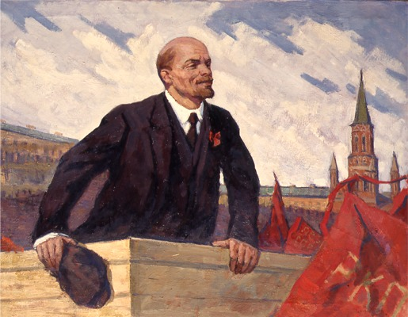
Petrograd Soviets
-Considered themselves socialists
Social Democratic Party (SDP)-Divided into two radical directions
Mensheviks
Bolsheviks
Originally in control of the provisional government
Major weakness: they wanted to continue WWI
More Conservative
Vladimir Lenin
“peace, bread, land”
Marxist
  Revolutionary socialist

Slide 13
Third Phase: October Revolution
Took place on November 7, 1917 (called October because of the difference in the Russian Calendar)
Lenin and the Bolsheviks overthrew the provisional government
Bolsheviks renamed themselves the Communist Party

Slide 14
Peace from WWI to Civil War
Treaty of Brest Litovsk- 1918 peace treaty Lenin’s new government signed with the Central Powers
Opponents of Lenin fought back by starting a civil war
Reds (Lenin and the Communists) vs. Whites (right winged, counterrevolutionaries)
To prevent any chance of the monarchy coming back to power, the communists executed the czar and his entire family
The Allies sent troops to Russia to support the Whites
By1922, the Communists won renaming Russia the Union of Soviet Socialists Republics..aka The Soviet Union

