Slide 1
Great Depression & The New Deal
1929-1941

Slide 2
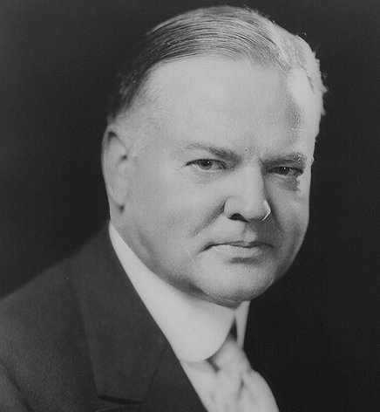
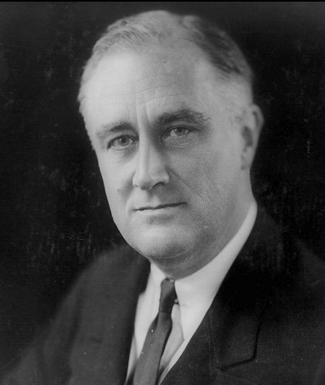
Presidents during the Great Depression
Herbert Hoover 1929-1933
Franklin D. Roosevelt 1933-1945

Slide 3
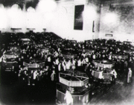
Causes of the Great Depression
1. Stock Speculation
  Buying stock when the price is low and selling it when the price rises in hopes of making a quick profit
  When stock market crashed many Americans were left with worthless stock

Slide 4

Causes of the Great Depression
2. Buying on the margin
  People were able to purchase stocks by paying as little as 10% of the stock’s value
  They then borrowed the rest of the money from the bank or the stock broker in hopes of repaying when the stocks increased

Slide 5
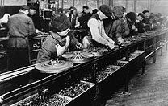
Causes of the Great Depression
Overproduction
-various industries kept up production even though there was not a demand from the market
-Examples: Automobiles, crops, construction
*Supply exceeded demand which made prices fall

Slide 6
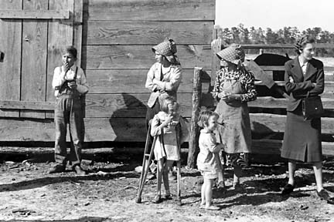
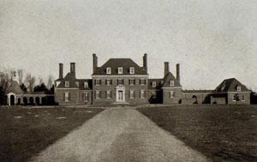
Causes of Great Depression
4. Uneven distribution of wealth
  “The rich got richer and the poor got poorer.”

Slide 7
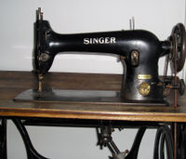
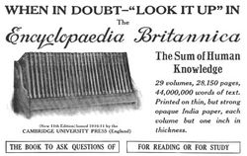
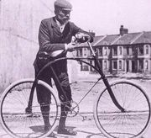
Causes of the Great Depression
5. Consumer Debt
  Americans were in debt due to installment buying in the 1920’s for household and farming goods

Slide 8
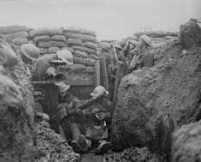
Causes of the Great Depression
6. International Debt
  U.S. lent millions of dollars to the Allies in WWI and those countries were not able to repay loans

Slide 9
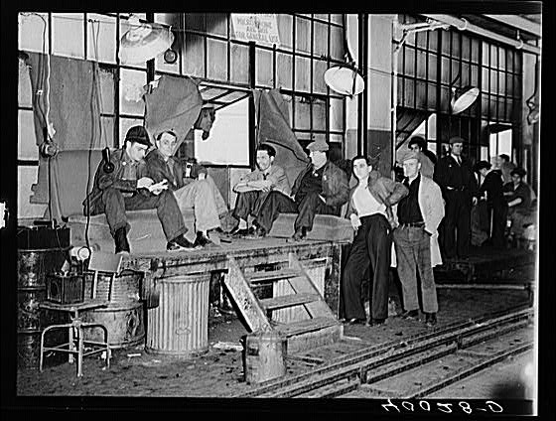
Causes of the Great Depression
7. Lack of government regulation of businesses and the stock market

Slide 10
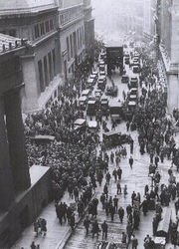
Causes of the Great Depression
8. Stock Market Crash-October 29, 1929-Black Tuesday
  The spark that began the depression
  16 million shares of stock were traded
  By the end of 1929, stock price losses exceeded that of the cost of WWI
Crowd outside of Wall Street on Black Tuesday

Slide 11
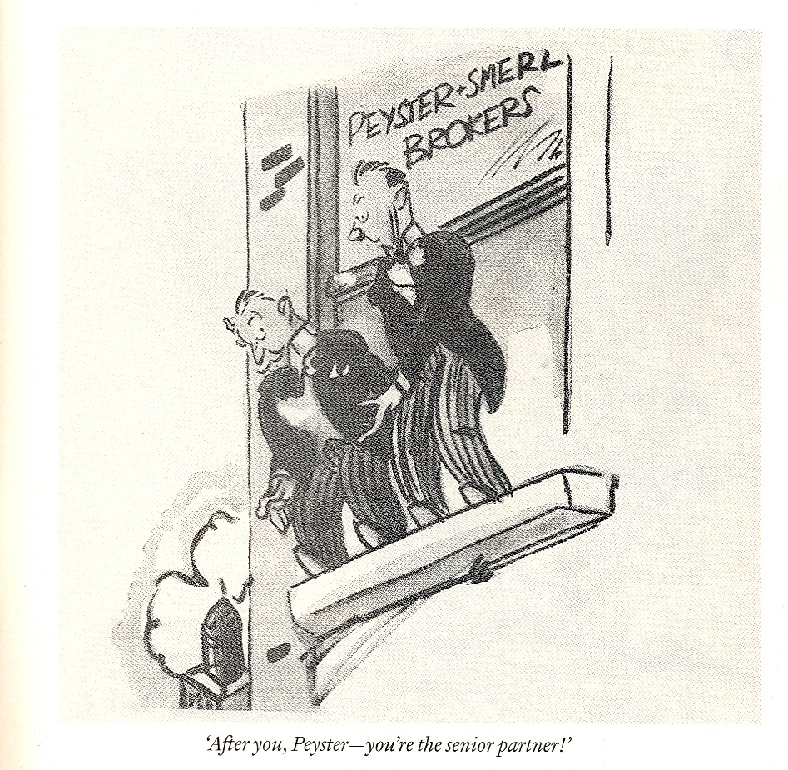

Slide 12
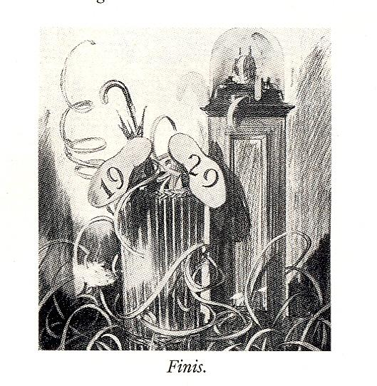

Slide 13
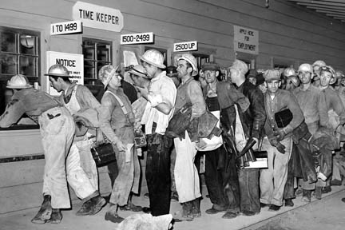
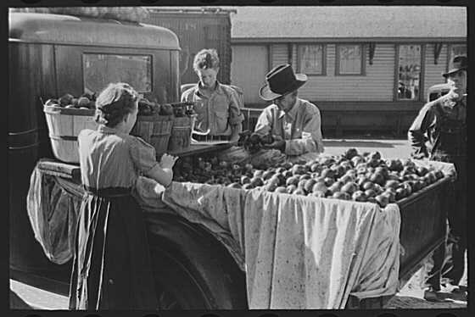
Effects of the Great Depression
Effects on society
  25% of the workforce were unemployed at its peak
  Wages were as low as $.10 per hour
  Blacks often first fired
  Women who worked for less than men were often retained
  Many sold produce on the street

Slide 14
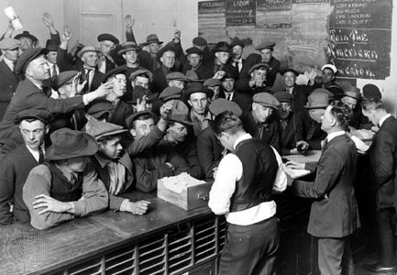
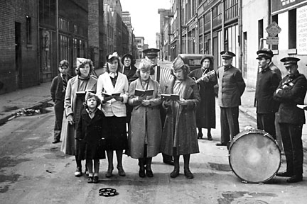
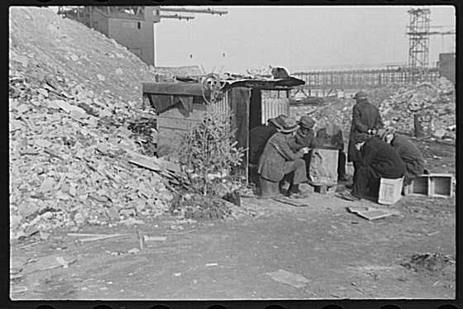
Effects of the Great Depression
Effects on Cities
  Cities tried to provide relief with Red Cross and Salvation Army
  Breadlines were common
  Hoovervilles
  Poverty and crime spread throughout US
Job Bureau
Salvation Army
Hooverville with Christmas Tree

Slide 15
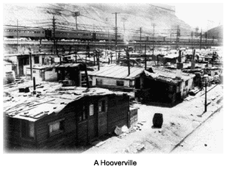
Effects of the Great Depression

Slide 16
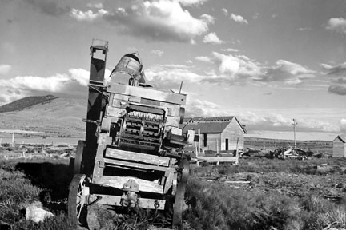
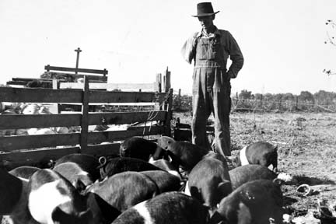
Effects of Great Depression
Effects upon farming
  Farmers had more than they could sell-prices dropped
  Farmers could not afford mortgages and many “lost the farm”

Slide 17
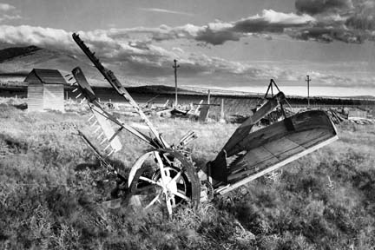
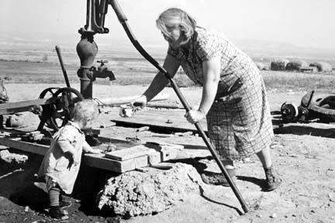
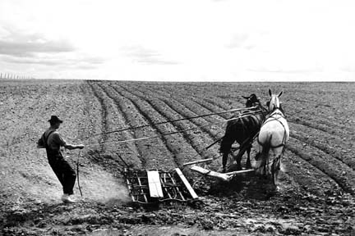
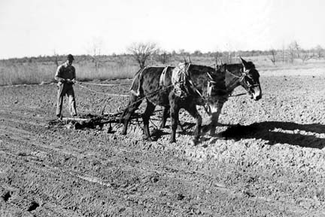

Slide 18
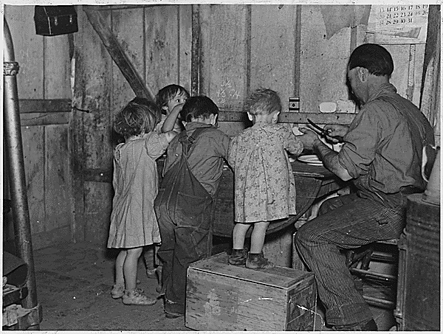
Effects of Great Depression
Effects of families
  Families moved in together
  Divorce rates rose
  Women made their own bread, soap, clothes
  Families rented out rooms of their houses
Christmas dinner in Iowa, 1935

Slide 19
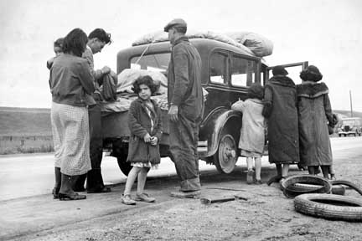
Effects of Great Depression

Slide 20
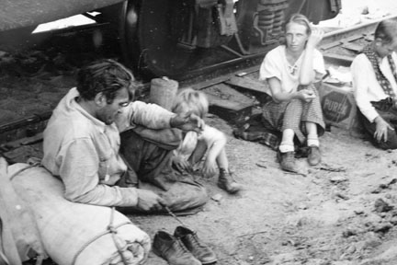
Effects of Great Depression

Slide 21
Effects of Great Depression

Slide 22
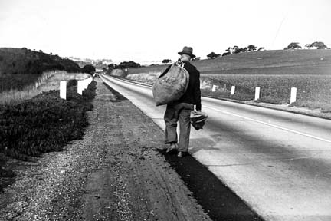
Effects of Great Depression

Slide 23
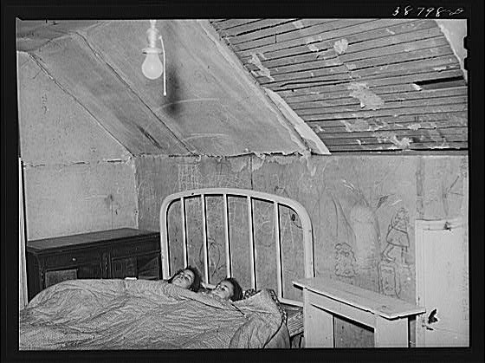
Effects of Great Depression

Slide 24
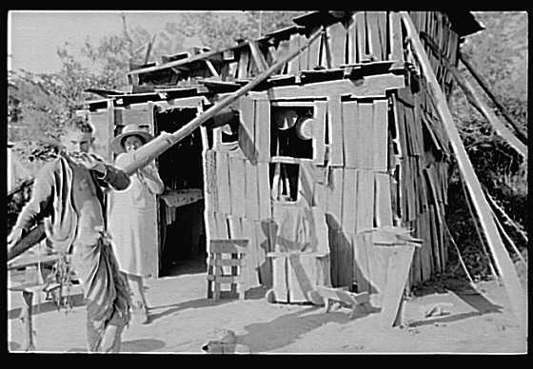
Effects of the Great Depression

Slide 25
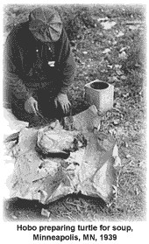
Effects of the Great Depression

Slide 26
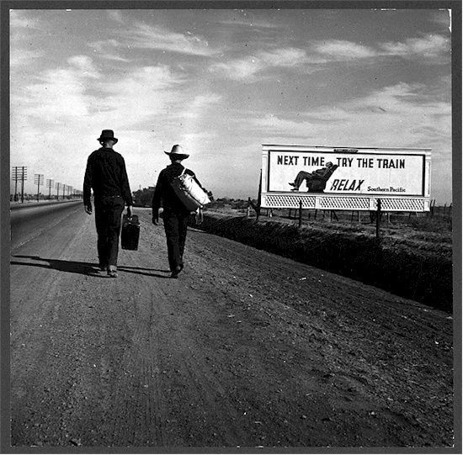
Effects of the Great Depression

Slide 27
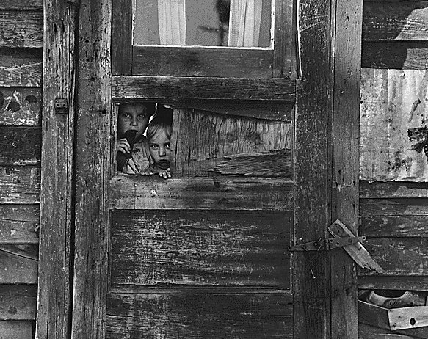

Slide 28
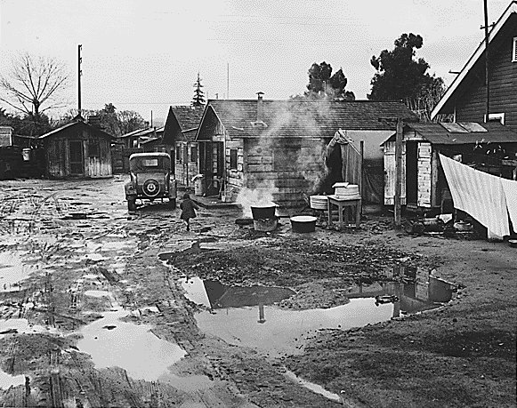

Slide 29
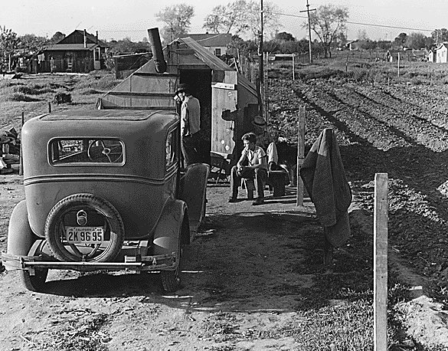

Slide 30
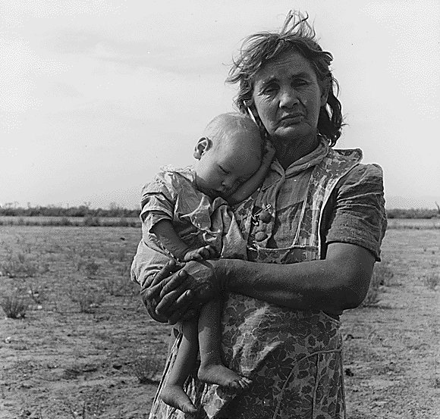

Slide 31
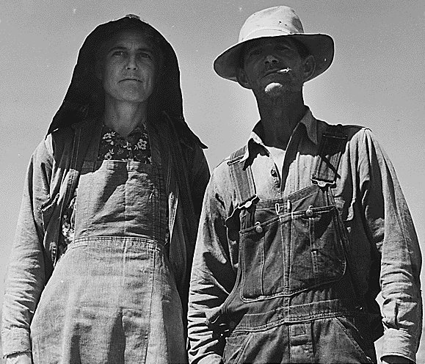

Slide 32
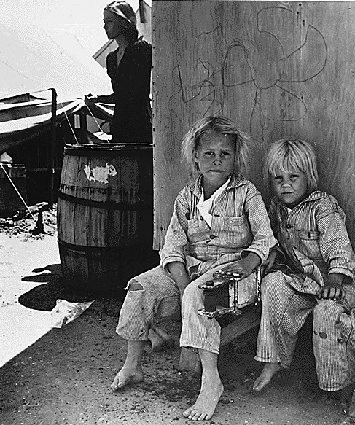

Slide 33
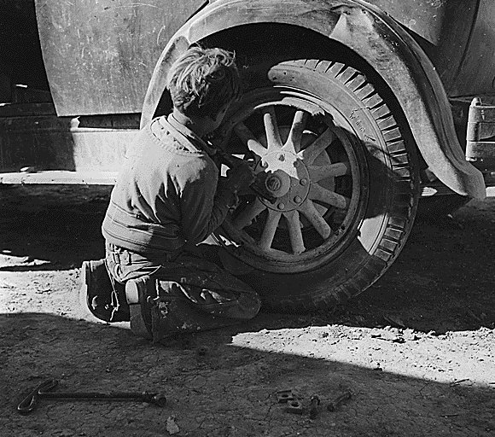

Slide 34
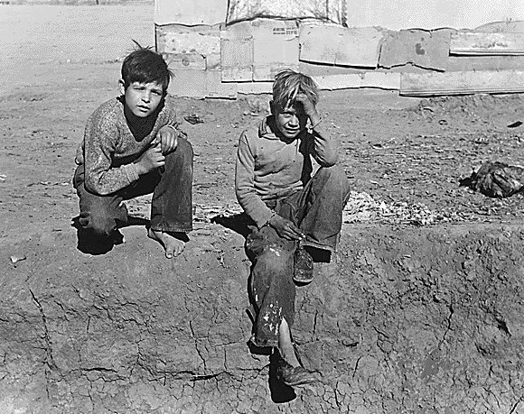

Slide 35
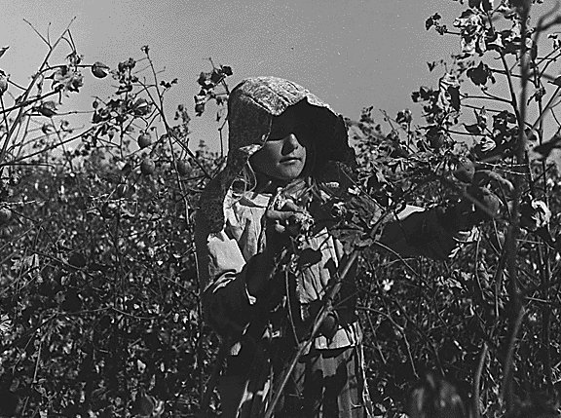

Slide 36
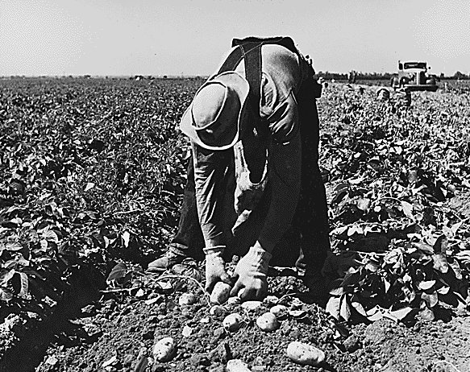

Slide 37
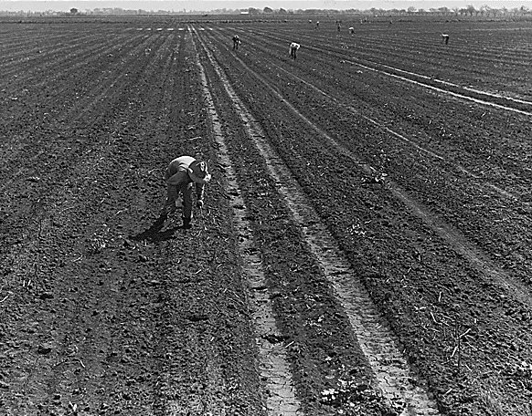

Slide 38
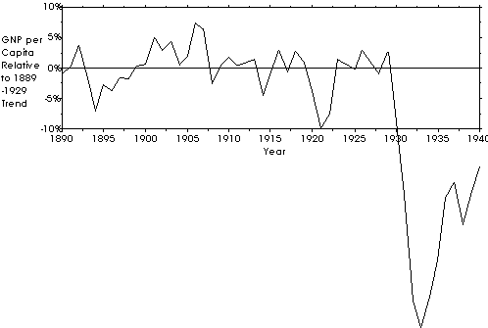
Effects of the Great Depression
Effects on the Economy
  Gross National Product fell from $103 billion in 1929 to $56 billion in 1933
  GNP is all of the goods and services produced in a year

