Slide 1
Chapter 26:
The Cold War
Notes:
1

Slide 2
Section 1:
Origins of the Cold War
Notes:
2

Slide 3
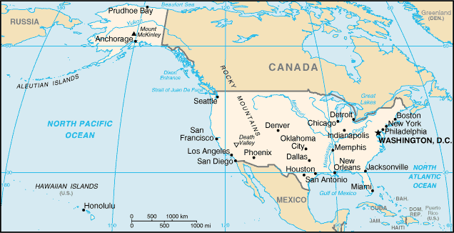
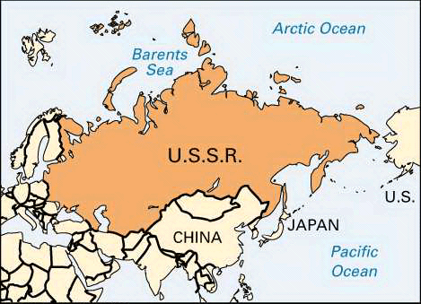
United States v. Soviet Union
Had been Allies against Germany in WWII
  The enemy of my enemy is my friend
America: Capitalist
Soviet Union: Communist
The two countries did not agree on most things
VS.
Notes:
3

Slide 4
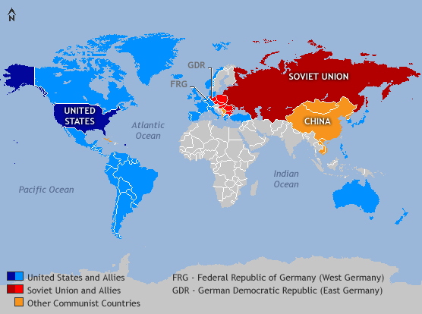
Notes:
4

Slide 5
Leaders
Truman: American President
  He went to a conference in Potsdam as the newest member of the Big Three
  Becomes angry and frustrated
    Soviet Foreign Minister Molotov
Stalin: Communist leader of Soviet Union
  Wanted Communism to control all countries in his power; thought capitalism was wrong
Notes:
5

Slide 6
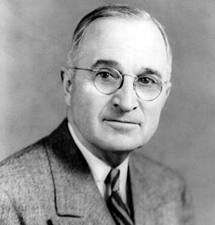
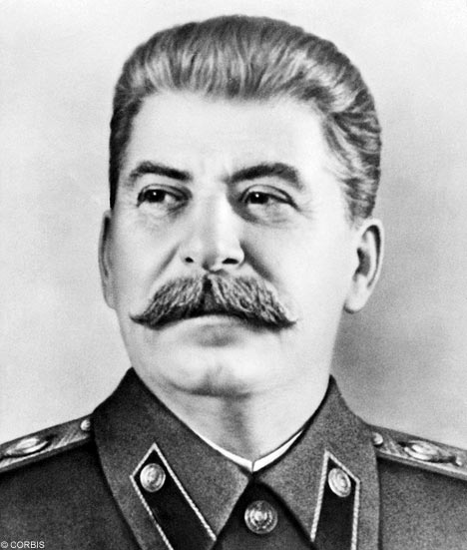
Stalin
Truman
Notes:
6

Slide 7

United Nations
A group of representatives from many countries who worked to keep peace between countries
The U.S. and U.S.S.R. ended up using the UN to promote their ideas to other countries and it made the Cold War worse
General Assembly
Security Council
  USA, USSR, Great Britain, France, China
    Veto power
Notes:
7

Slide 8
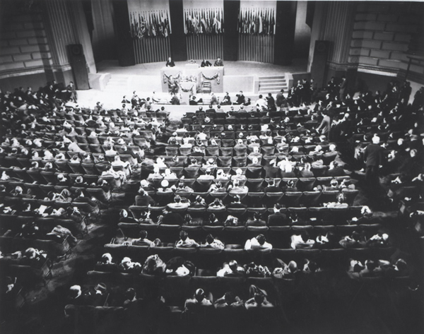
UN, 1945
Notes:
8

Slide 9
Potsdam Conference
July 1945
Meeting between major countries involved in WWII
Stalin refused to allow democracy in countries he controlled
Truman knew that there would be trouble between the U.S. and U.S.S.R.
This was the start of the Cold War

Slide 10
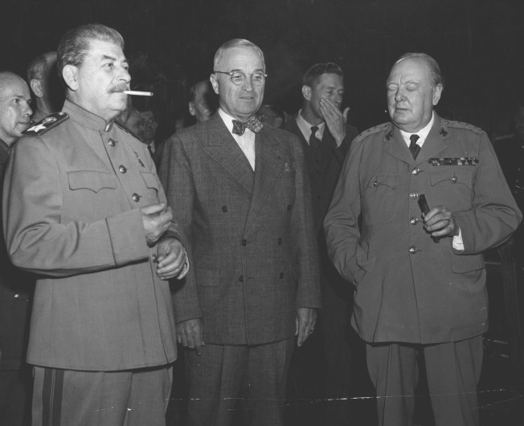
Stalin
Truman
Churchill
Notes:
10

Slide 11
Tension Mounts
Satellite nations: countries where Stalin set up communist governments controlled by the S.U.
  Albania, Bulgaria, Czechoslovakia, Hungary, Romania, and Poland
Stalin said that Communism and Capitalism could not work together and another war was inevitable
Truman suggested containment: stopping the spread of communism to other countries
“Iron Curtain”: the division between communist eastern Europe and capitalist western Europe
Notes:
11

Slide 12
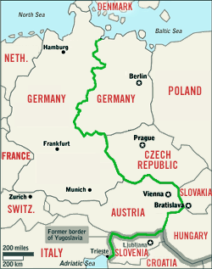
Notes:
12

Slide 13
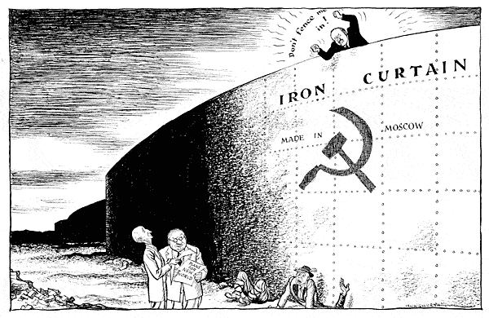
Notes:
13

Slide 14
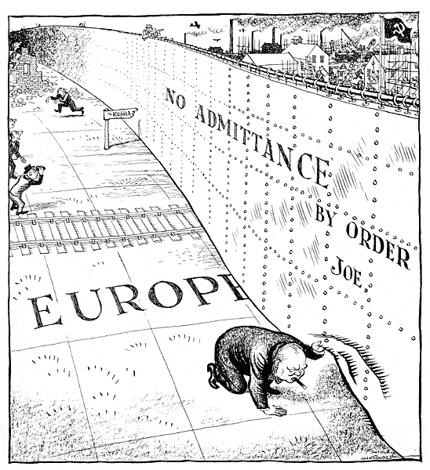
Notes:
14

Slide 15
US Aims vs. Soviet Aims in Europe
Create a new world order: all countries to have self-determination
Gain access to raw materials and markets
Rebuild stable gov’ts in Europe and new markets for American goods
Reunite Germany so it would be more productive
Encourage communism in other countries
Rebuild eastern European countries hurt during the war
Control eastern Europe to balance US power in western Europe
Keep Germany divided so it would not get too powerful again
Notes:
15

Slide 16
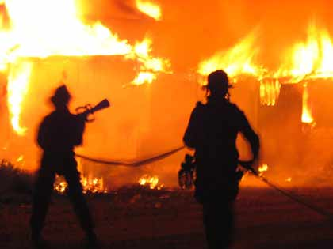
Containment
US foreign policy during the start of the Cold War
Objective?
George Kennan
  The Long Telegraph
Notes:
16

Slide 17
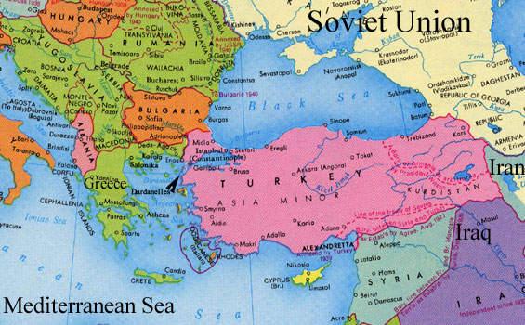
Truman Doctrine
US gave money to Greece and Turkey so they could fight off any attempt at a Communist take-over
Notes:
17

Slide 18
Marshall Plan
plan to give aid to any country whose people were suffering from poverty after the war
1946-1947:
  a terrible winter made things even worse for people who were struggling to rebuild after WWII
Results?
Notes:
18

Slide 19
US and USSR fight over Germany
Germany was split into zones
Stalin closed off all access to the city
Berlin Airlift: 327 days of British and American planes flying over Berlin and dropping supplies to the people stuck in the city (food, fuel, medicine, Christmas presents, etc.)
By May 1949, Soviet Union admitted defeat and lifted the blockade
Notes:
19

Slide 20
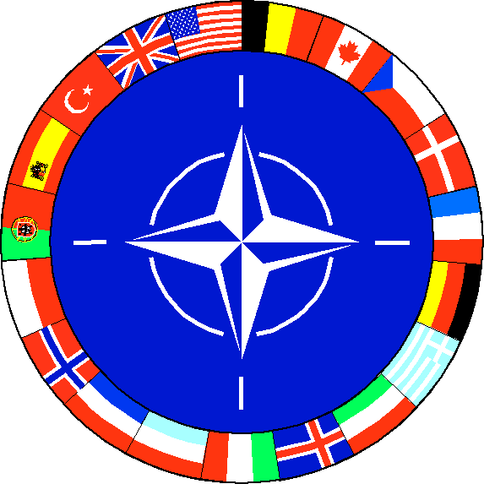
NATO
North Atlantic Treaty Organization
Belgium, Denmark, France, Great Britain, Iceland, Italy, Luxembourg, the Netherlands, Norway, Portugal, United States, and Canada
A military alliance:
  All these countries agreed that they would defend each other if one was attacked
Greece, Turkey, and West Germany joined in the 1950s
Notes:
20

Slide 21
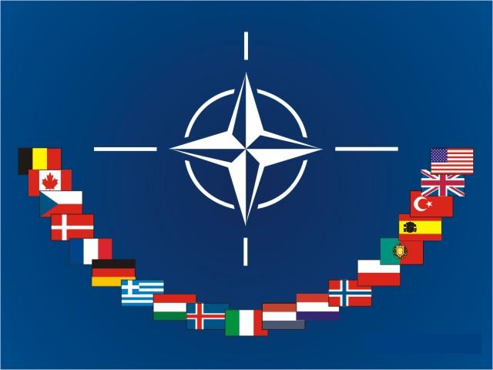
Notes:
21

Slide 22
NATO
It had a standing army of 500,000 troops so other countries did not want to attack members of NATO
Notes:
22

Slide 23
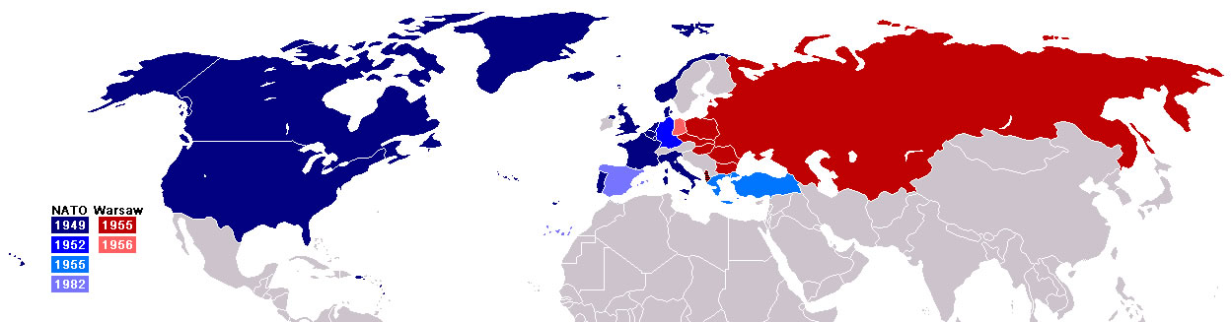
Warsaw Pact
Soviet Union responds to NATO
  creates the Warsaw Pact-
    a military alliance with satellite nations in Eastern Europe

Slide 24
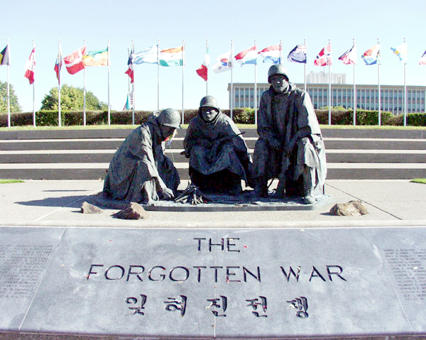
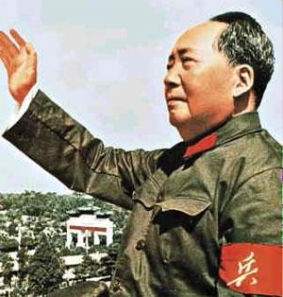
The Cold War
Heats Up
Section 2
Notes:
24

Slide 25
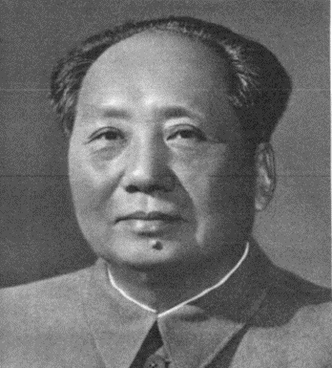
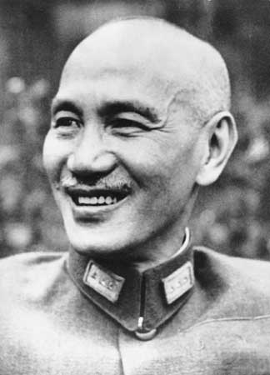
China Becomes a
Communist Country
Chiang Kai-shek
Mao Zedong
The nationalists led by Kai-shek fled to Taiwan;
America and UN reaction?
Notes:
25

Slide 26
Communist Advances
Truman announcement
  Scary thought for Americans
    Hiroshima or Nagasaki on American soil???
Americans advancements in nuclear weapons
  hydrogen bomb- many times more destructible than the atomic bomb
1952 hydrogen bomb tested and declared US the worlds leading nuclear power
FIRST HYDROGEN BOMB TEST
People were planning how to survive a nuclear attack! (bomb shelters)
DUCK AND COVER

Slide 27
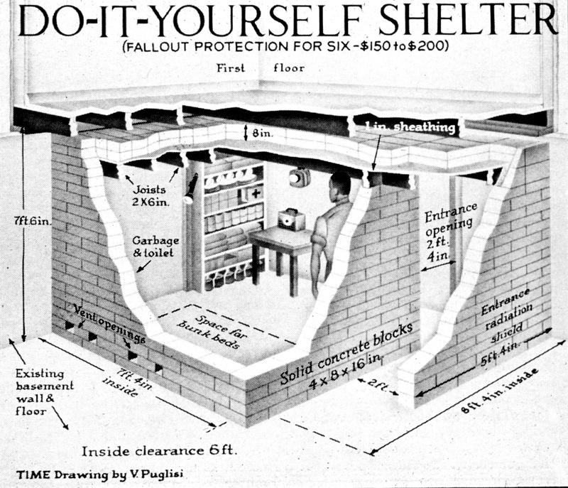
Bomb Shelter

Slide 28
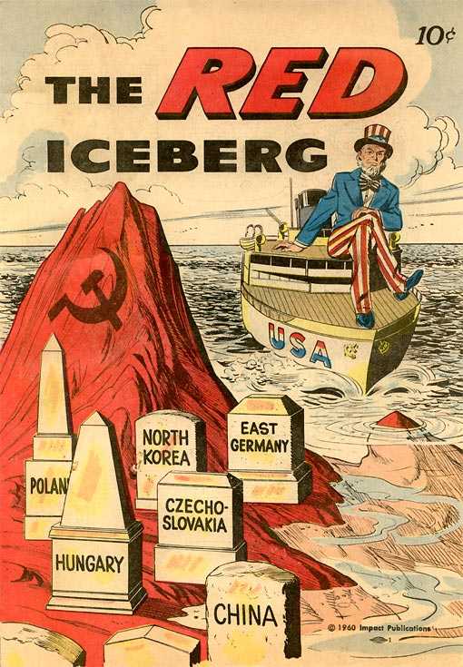
The Cold War at Home
A new Red Scare- many people had joined the communist party but with increasing distrust in Stalin many people quit
People who had been remotely involved in a communist party were swept up in the wave of persecution
Loyalty Program- Truman headed this program so that all employees hired by the federal government were to be investigated with suspicion of overthrowing the government

Slide 29
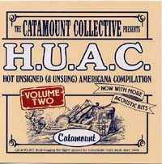
HUAC
House Un-American Activities Committee- investigate disloyalty of Communist infiltration of government agencies and the Hollywood movie industry b/c movies had strong influence of the public
The Hollywood Ten-

Slide 30
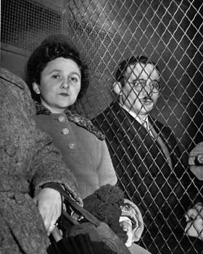
Spies
A real communist threat in the United States
Alger Hiss- high ranking government official convicted of perjury for lying in slander case.
Julius and Ethel Rosenberg
  convicted of espionage and executed in 1953.

Slide 31
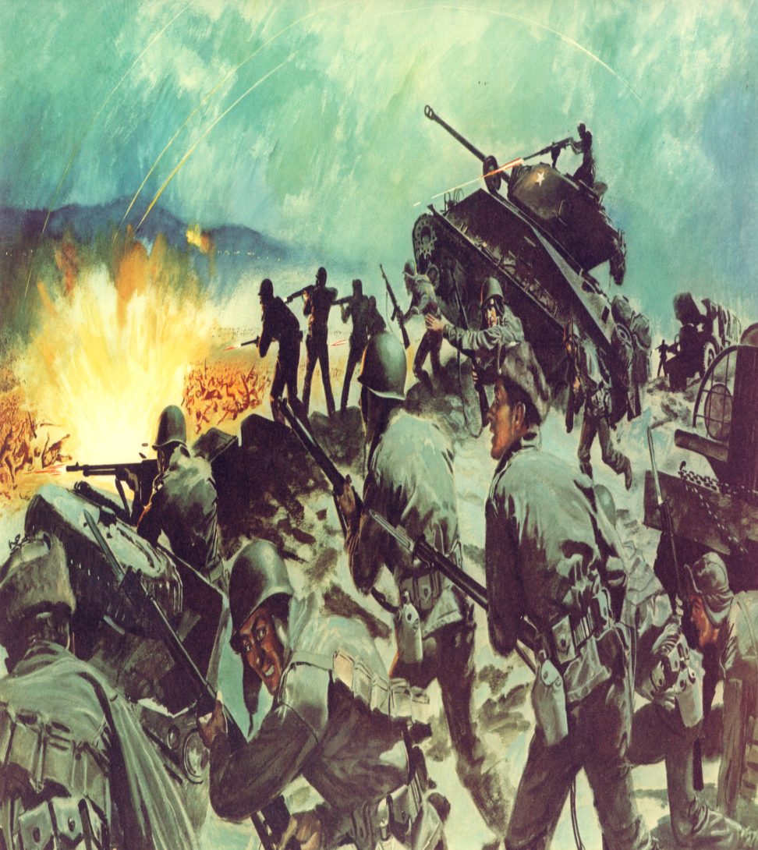
Korean War
South Korea- had a pro-American government formed (US occupied)
North Korea- had a Communist regime (USSR occupied)
June 25th 1950- Korean War broke out when North Korean troops streamed across the 38th parallel-
North Korea was aiming at unification by force
Short History of War

Slide 32
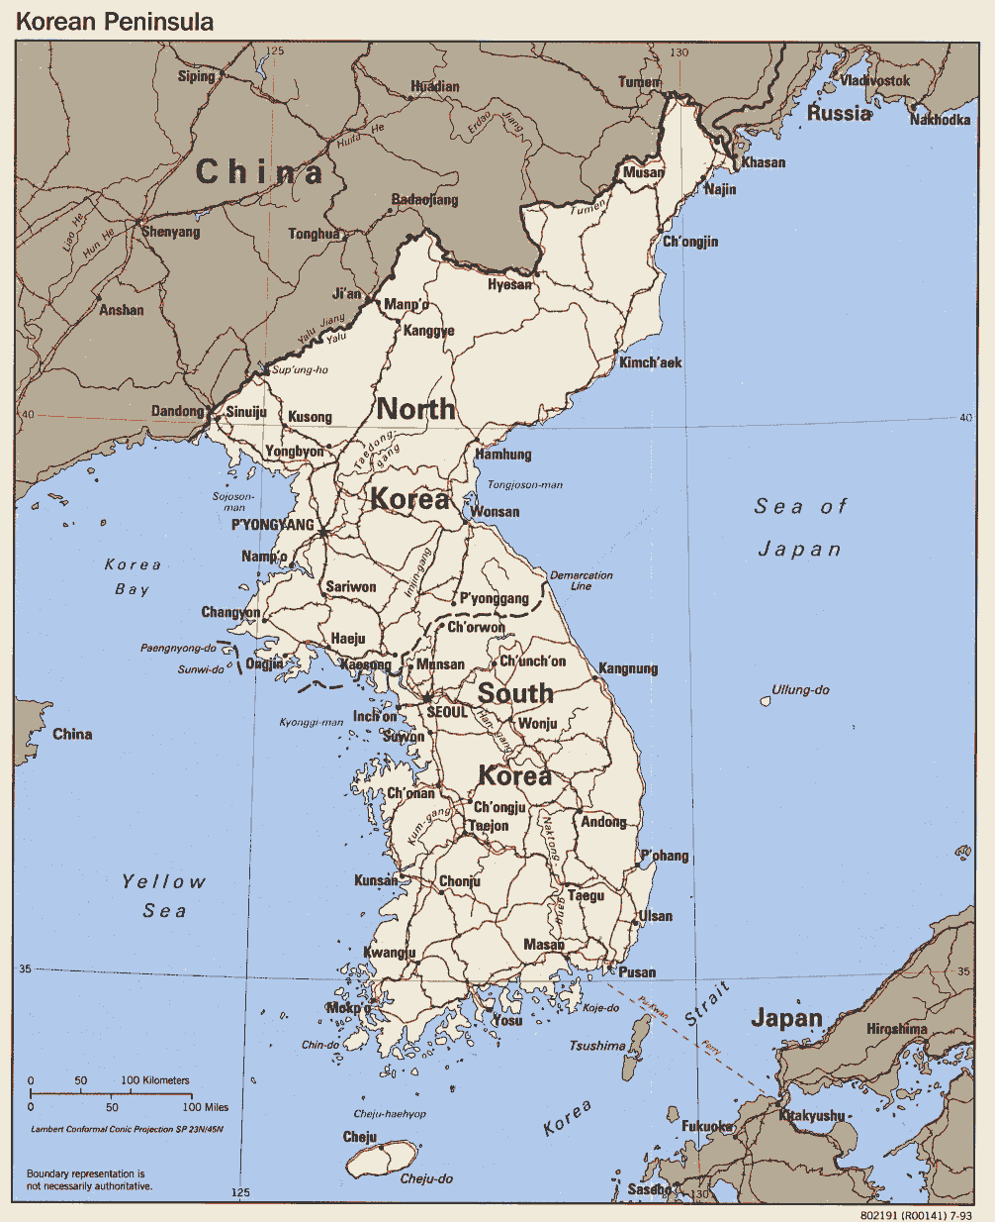

Slide 33
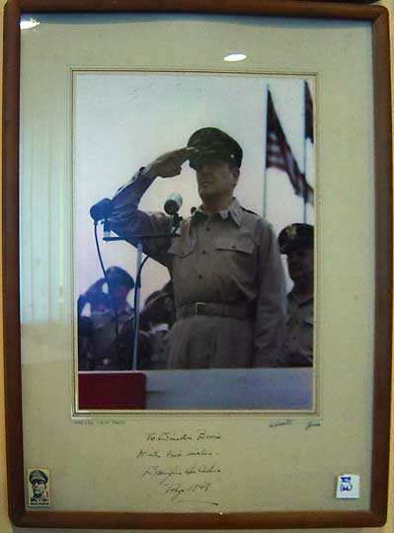
Douglas MacArthur
Anti-communist general chosen to lead UN forces in Korea by Truman
MacArthur helped establish Japan’s new democratic constitution
Successful in implementing democracy in South Korea
Disliked by politicians but loved by the public and military!

