Slide 1
Protestant Reformation

Slide 2
Causes of the Reformation
Social:
  Renaissance: Values of humanism and secularism (People question the church)
  Printing Press: Spread ideas critical of Church
Political:
  Monarchs challenged Church power\authority
  Pope a foreign leader
Economic:
  a) kings jealous of Church wealth
  b) sick of paying taxes to Church
Religious:
  Church worldly and corruption not spiritual
  Scarcely read, marriage, drank, gambling)
  indulgences
People expected more from the Church

Slide 3
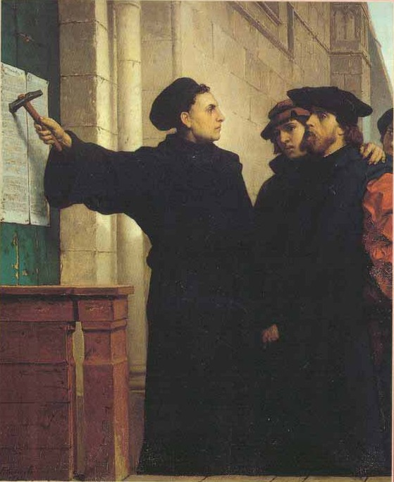
Martin Luther
Monk and teacher
Against the selling of indulgences
95 Theses: formal statements attacking
“pardon merchants”
  Post on the church door
  Copied and printed
  Known all over Germany
  Beginning of Reformation: religious reform

Slide 4
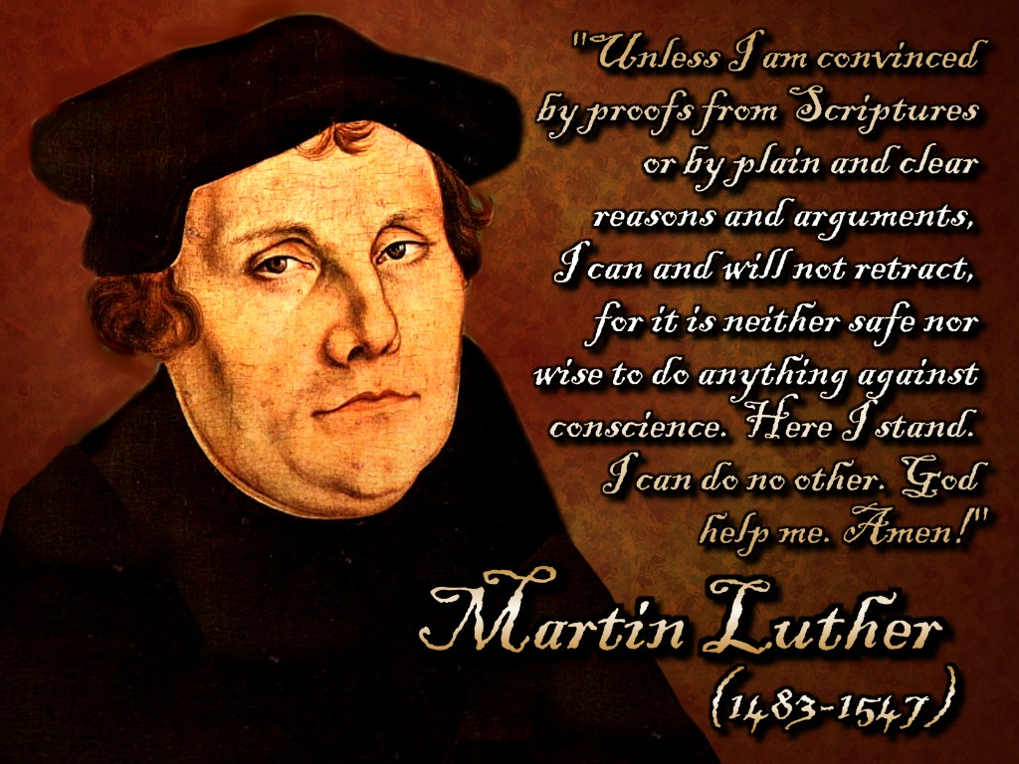
Luther’s Teachings
Three main ideas:
  Salvation=faith in God’s forgiveness
  Bible the authority
    Pope and Church=false authorities
    No need for priests to interpret Bible
Emperor’s Opposition
  Luther put on trial due to Pope Leo X
  Edict of Worms: Luther outlaw (No food or shelter)
  a) Luther excommunicated
  b) Prince Frederick of Saxony: disobeys and helps for a year
    c) Lutherans

Slide 5
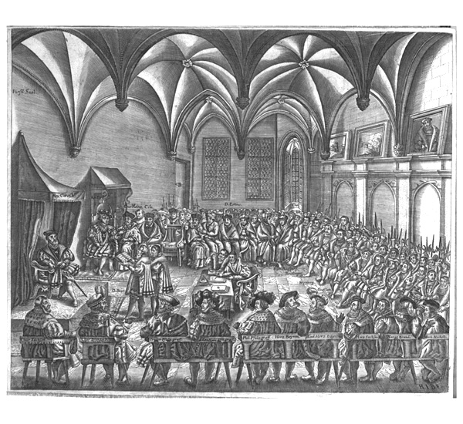
Germany at War
  German princes support Lutheranism
  Excuse for independence from Charles V
  Some support Pope and agree to join forces
  Protestants: support Luther and signed protest
  Against agreement.
  Peace of Augsburg: Ruler would decide religion in state.

Slide 6
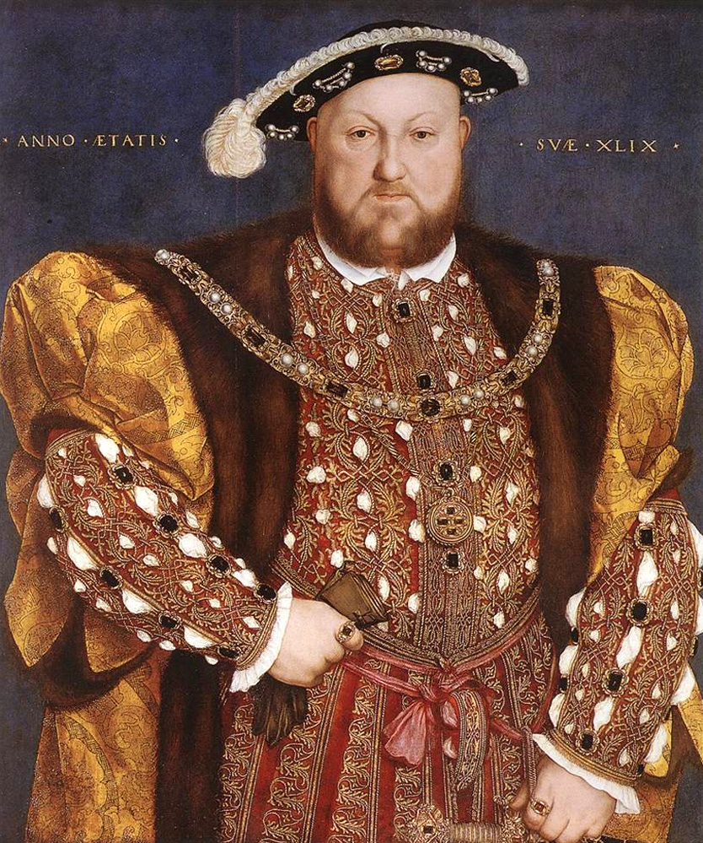
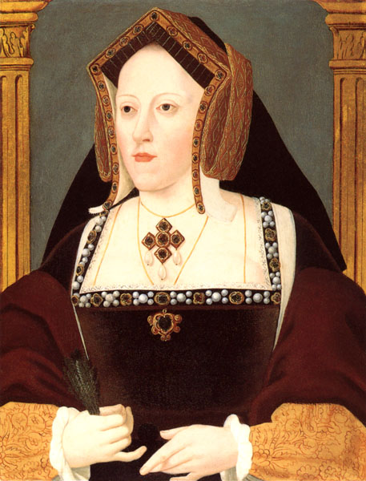
Henry VIII
King of England (1509): Catholic
“Defender of the Faith”
Wanted a son
Wife does not deliver a son so he wants a divorce
Asks Pope for divorce but Pope says no - illegal

Slide 7
Reformation Parliament
  Henry VIII asks Parliament to end pope’s power (Reformation Parliament)
  Act of Supremacy: recognize the divorce and accepting Henry, not the pope as head of England’s church.
    Start of the Anglican Church:
  After Henry VIII dies:
    Edward: 9 years old and had adult advisers (Protestant Reforms)
    Mary returned religion rule to pope and becomes known as Bloody Mary
    Elizabeth returns her kingdom to Protestantism (Anglican Church)-only legal church in England.

Slide 8
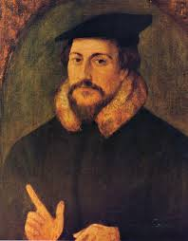
Calvinism
Calvin wrote “Institutes of the Christian Religion” Calvinism
  Predestination: God chooses who to save and he has known since
  the beginning of time.
  2. Theocracy: Government was controlled by religious leaders
John Knox: Returned to Scotland and used Calvin’s ideas
  Presbyterians: Group of laymen such as elders or
  presbyters govern each community church.

Slide 9
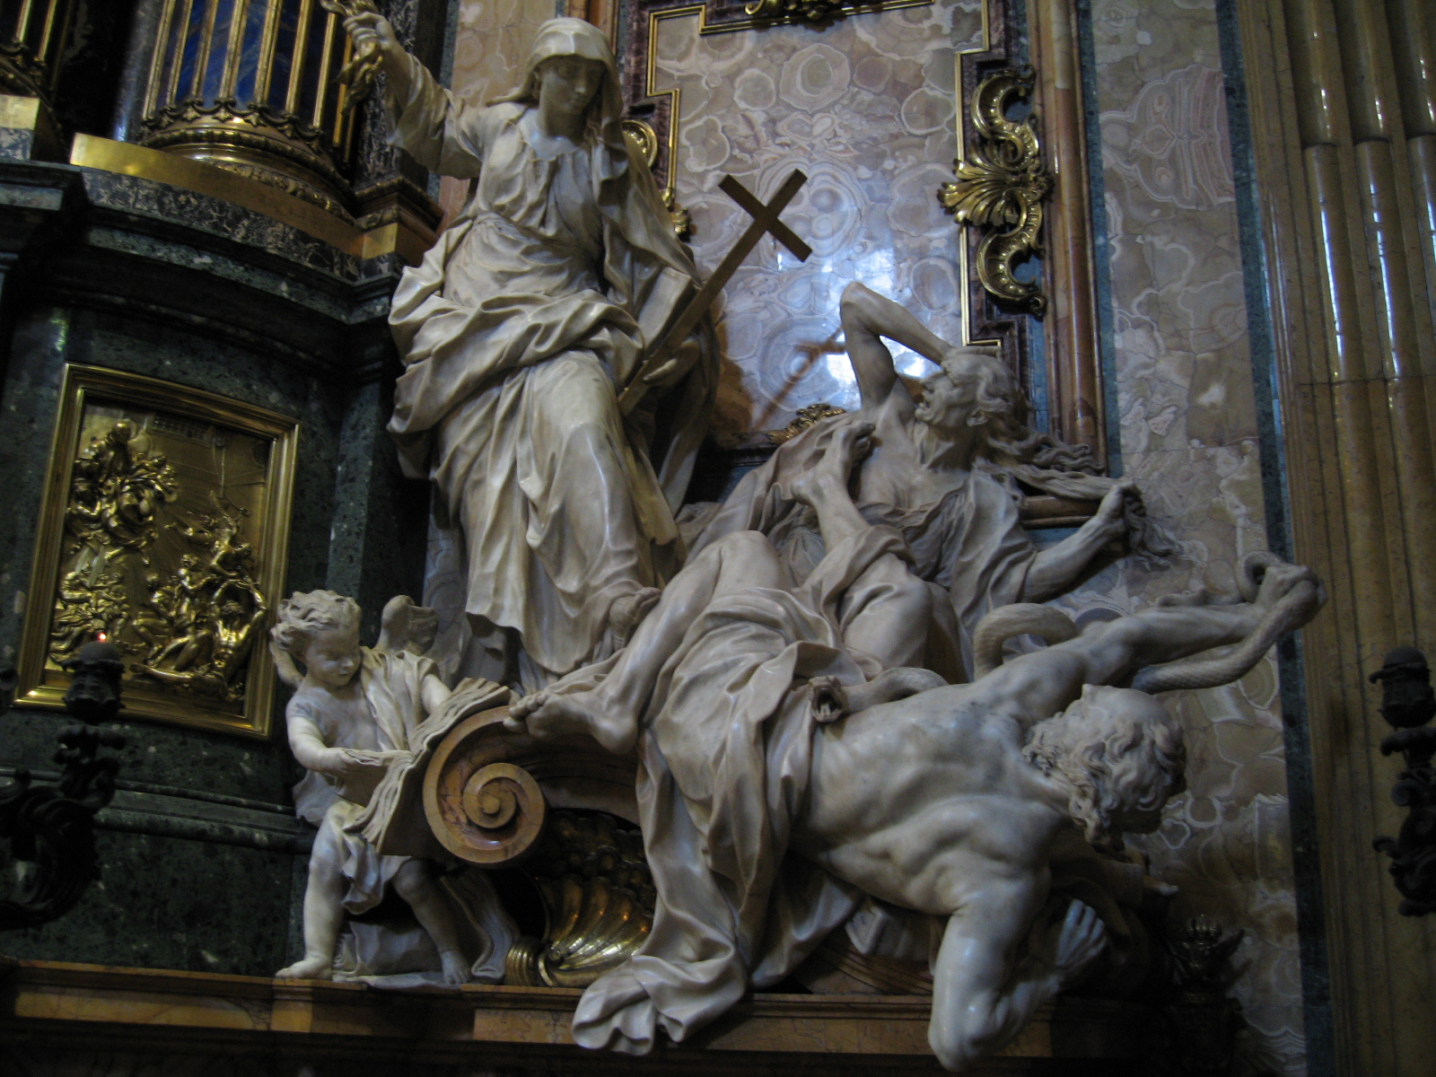
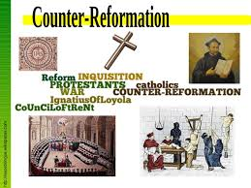
Catholic Reformation
Movement of the Catholic Church to reform itself
Millions remain loyal to Catholic Church
Once Referred to as the Counter Reformation

Slide 10

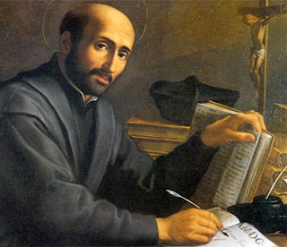
Ignatius of Loyola
Injured in a war
  Thought about his past sins and about the life of Jesus (Cleansed his soul)
Wrote “Spiritual Expectations”
  Day by day plan of meditation, prayer, and study
  Followers were called Jesuits
  Focused on three activities:
    Founded schools throughout Europe
    Convert non-Christians to Catholicism
    Stop spread of Protestantism

Slide 11
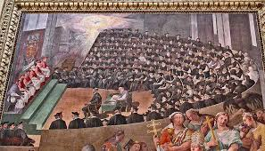
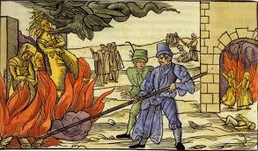
Reforming Popes
Two popes take lead in reforming the Church:
  Paul III: takes Three steps in doing so
    Directs council of cardinals to investigate indulgences and other abuses
    Approved the Jesuit order
    Inquisition to seek out heresy
    Council of Trent: bishop and cardinals agreed on
      Church interpretation of Bible was final
      Faith and good works for salvation
      Bible and Church religion were equal for Christian life
      Selling of indulgences were banned
  Paul IV: carried out council’s decrees
    Index of Forbidden Books:
      Books forbidden b/c of danger to Catholic faith
      Burned books in bonfires

