Slide 1
Chapter 21 section 5
The Parliament Limits and the English Monarchy

Slide 2
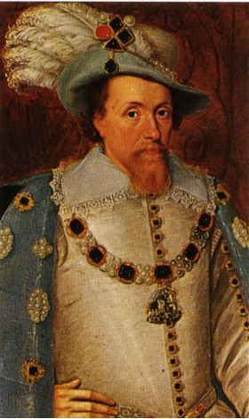
Pre-Civil War England: Life After Elizabeth I
James I (Stuart Dynasty):
  Chosen by Elizabeth I as new King of England
    Very intelligent, but lacked common sense in financial and diplomatic matters
  Strongly believed in the Divine Rights of Kings
  Supported the Anglican Church (AC)
    His support of AC caused problems with Puritans
      B/C Puritans wanted to “purify” AC of Catholic practices
      To get back at James I the Puritans in Parliament made it difficult for him to raise $ and make alliances

Slide 3
Parliament
House of Lords
House of Commons
Gentry: Landowners
Burgesses: merchants and professionals
Nobles
Clergy

Slide 4
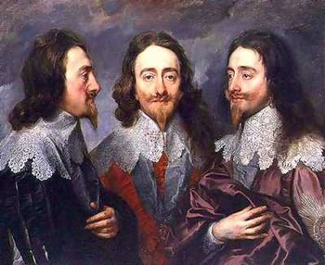
England Ripe for a Civil War
Charles I:
  Son of James I
  Believed in Divine Right of Kings
  Out of Touch with his people and politics
  Major problems = Parliament, Religion, Scotland, Ireland

Slide 5
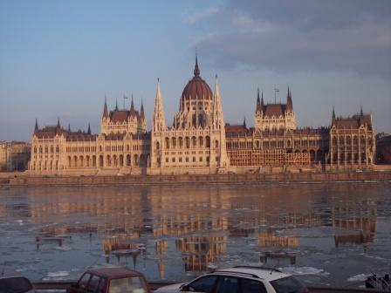
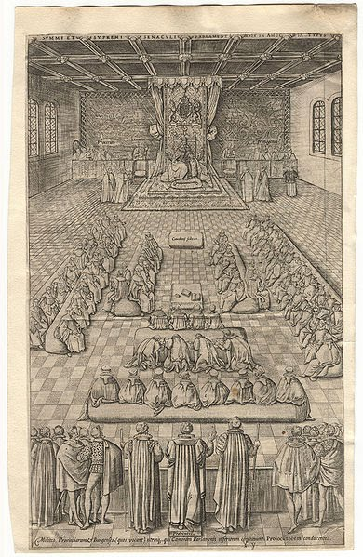
Why Parliament Hated Charles I
Forced people to loan him $ and imprisoned those that didn’t
Ignored the Petition of Rights, which protected peoples liberties
Refused to call Parliament into session for 11 years!

Slide 6
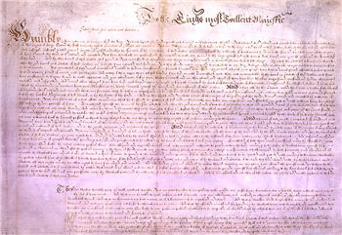
Petition of Rights
King could not tax without parliament agreement.
King could not declare martial law
King could not board soldiers in private homes during peacetime.
King could not imprison a person without a specific charge.

Slide 7
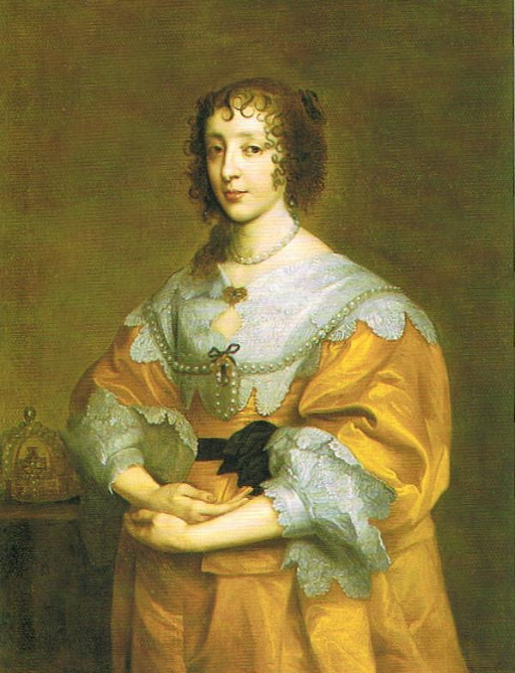
Religious Problems
Charles I supported the Anglican Church
  English Puritans hated b/c ceremonies TOO Catholic
He also married a French Catholic princess

Slide 8
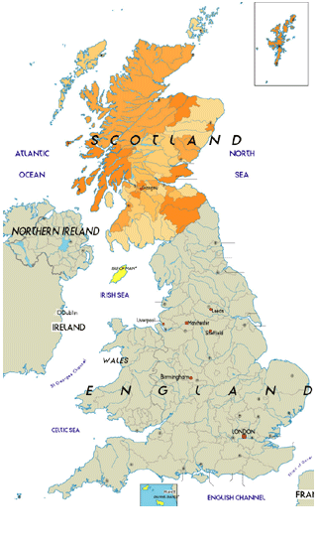
Why Scotland Hated Charles I
Charles I tried to force Anglican practices on Scottish Presbyterians
  Scottish were very anti-catholic, felt rights were violated

Slide 9
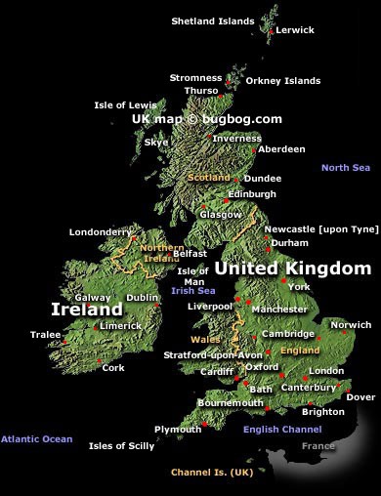
Why Ireland Hated Charles I
England took Irish land
The Irish were given few rights and freedoms
Treated Irish Catholics very badly, forced into labor

Slide 10
Countdown to Civil War…10, 9, 8, 7, 6, 5, 4…
3. 1640 Scotland Rebels
2. Charles I forced to call Parliament into session to raise $ to put rebellion down
  This Parliament is called Long Parliament b/c met on and off for 20 years
  Long Parliament’s main goal WAS NOT to get Charles I more $, but to CURB KINGS ABSOLUTE POWER
1. 1641 Ireland Rebels
  Needed BIG Army to put down Irish rebellion
  Parliament and Charles I argued over who should lead BIG Army – neither compromised
1642 English Civil War Begins!!

Slide 11
Charles wanted money to put down the rebellion in Scotland.
Parliament said NO!!
Instead Puritan-controlled House of Commons ended the King’s power to dissolve Parliament.
It passed a law that Parliament must meet at least every three years.
It kept the king from raising taxes on his own.

Slide 12
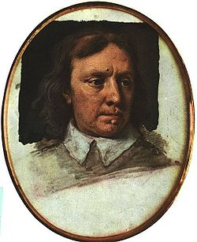
Oliver Cromwell

Slide 13
What were the supporter of the king called?
  Cavaliers
What were the supporters of Parliament called?
  Roundheads
Who was the Leader of the Roundheads?
  Oliver Cromwell

Slide 14
What is a Commonwealth?
  Republican Form of Government
What title did Oliver Cromwell take?
  Lord Protector
What was the name of the 1st written constitution in England?
  Instrument of Government 1653
  Cromwell dies in 1658 his son tries to carry on the same rule but is not as strong.

Slide 15
Charles II takes over in 1660- called the Restoration.
Habeas Corpus- Latin meaning “to have the body” – gave prisoners rights along with a fair trial.
1685 – Charles II dies- Who is going to inherit the throne?? A Catholic?

