Slide 1
Matter and Measurement
Chapter #1

Slide 2
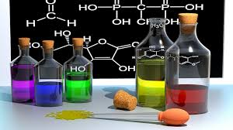
What is Chemistry?
The study of the properties of substances and the changes they undergo.

Slide 3
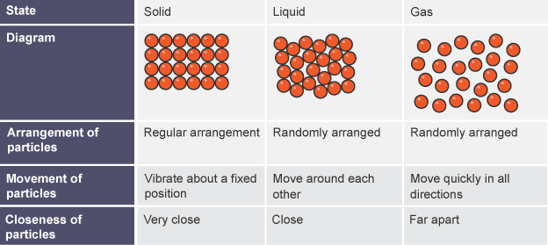
Matter
Anything that has mass and takes up space.
Three states of matter: solid, liquid and gas.

Slide 4
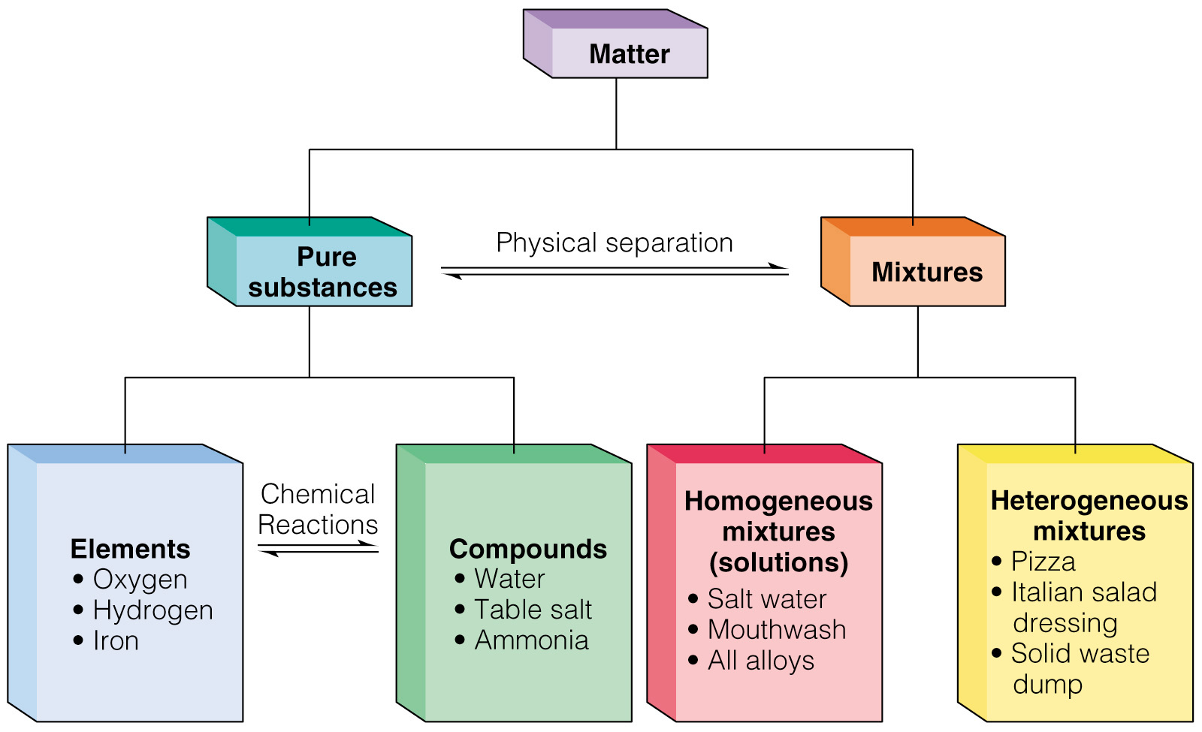

Slide 5
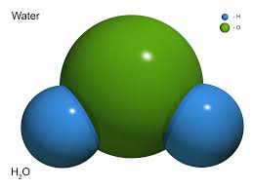
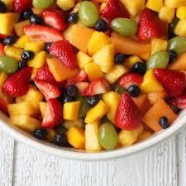
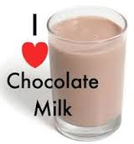
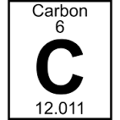
Types of Matter
Pure Substance: composition does not vary from sample to sample.
  Elements: made of only one type of atom (listed on P.T.)
    Iron (Fe)
  Compounds: made of more than one type of atom.
    Water (H₂O)
Mixtures: one or more substance physically combined.
  Homogenous (Solution): uniform throughout
    Sugar Water
  Heterogeneous: not uniform throughout.
    Granola

Slide 6
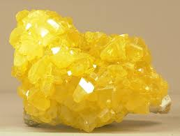
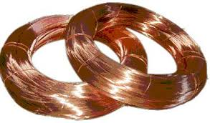
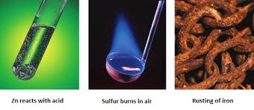
Properties of Matter
Physical Properties
  Property that can be observed by the five senses without a chemical reaction.
    Intensive: do not depend on the amount of matter present
      Examples: color, melting point, density
    Extensive: do depend on the amount of matter present (measurements)
      Examples: mass, length, volume
Chemical Properties
  Property that shows how a substance reacts.
    Examples: flammability

Slide 7
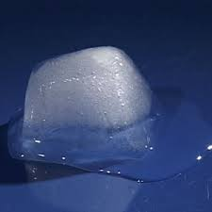
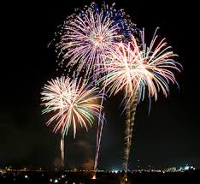
Physical and Chemical Changes
Physical Change
  A change that occurs that does not change the composition of the substance.
    Examples: cutting, phase changes
Chemical Change
  A change that occurs that creates a new substance with new properties.
    Examples: burning, baking,

Slide 8
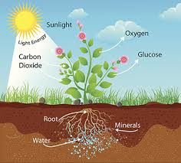
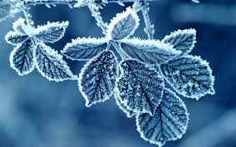
Give it some thought….
Which of the following is a physical change and which is a chemical change?
  Plants use carbon dioxide and water to make sugar
  Water vapor in the air on a cold day forms frost.

Slide 9
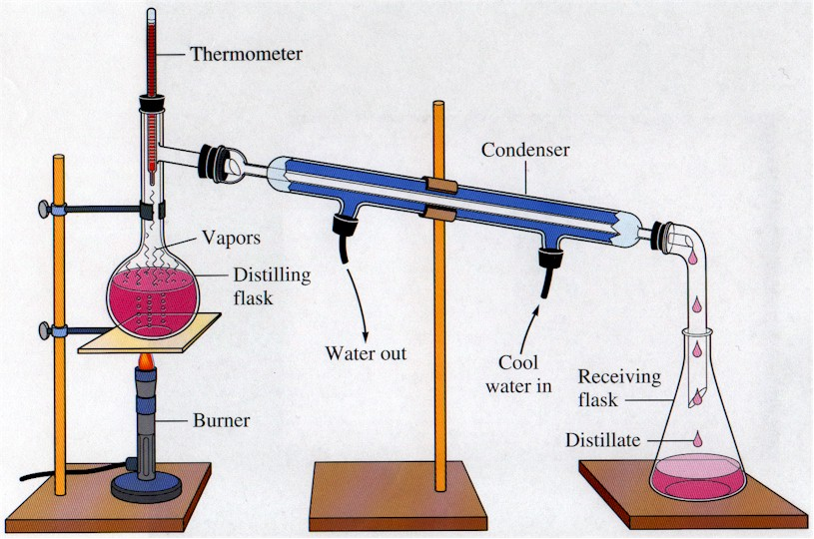
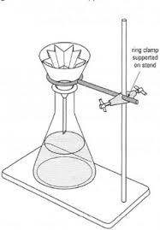
What are some ways that you can separate a mixture?
Filtration
Physically separating it.
Distillation
And many other ways!

Slide 10
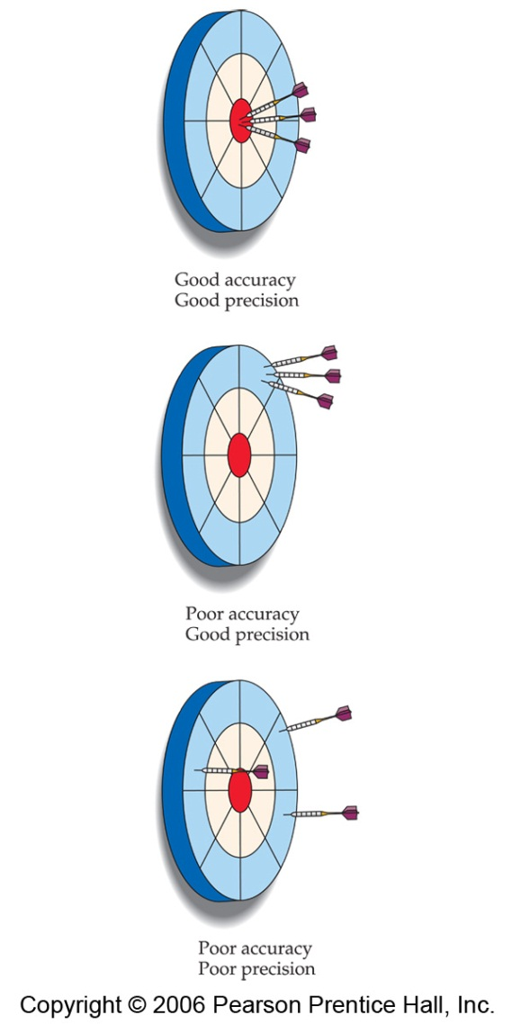
Accuracy versus Precision
Accuracy refers to the proximity of a measurement to the true value of a quantity.
Precision refers to the proximity of several measurements to each other.

Slide 11
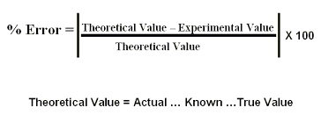
Percent Error

Slide 12
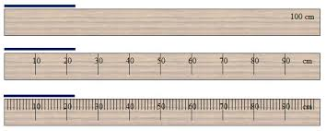
Measuring with Significant Digits
What is the measurement of the line of each of the rulers?

Slide 13
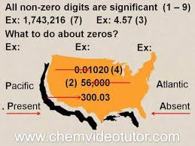
Significant Figures
The term significant figures refers to digits that were measured.
When rounding calculated numbers, we pay attention to significant figures so we do not overstate the accuracy of our answers.
Use the Atlantic/Pacific Rule:

Slide 14
Determine the Number of
Significant Figures:
21.45 m
6084 g
.000125 cm
1100 km
1100.0 L
100. mg

Slide 15


Calculations with Significant Figures
When addition or subtraction is performed, answers are rounded to the least significant decimal place.
When multiplication or division is performed, answers are rounded to the number of digits that corresponds to the least number of significant figures in any of the numbers used in the calculation.

Slide 16
Practice on Addition and Subtraction
Ex) 20.42 g + 7.9764 g + 102.3 g = ____________________________ Reported Answer = _______________________
1) 15.002 cm + 24.1104 cm = ________________________________
2) 22.35 kg – 0.154 kg = __________________________________
3) 100.0 g – 23.73 g = __________________________________
4) 2.030 mL – 1.870 mL = ___________________________________

Slide 17
Practice on Multiplication and Division
Ex) (6.221 cm)(5.2 cm) = ____________________________
Reported Answer = ____________________________
1) 75.246 g / 6.33 mL = _____________________________
2) (16.00 cm)(2.5 cm)(3.66 cm) = ___________________________
3) (3.24 m)(7.00 m) = ____________________________
4) 710 m / 3.0 s = _____________________________

Slide 18
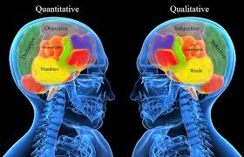
Types of Measurement
Qualitative
  Observation that do not include measurements
  Ex) color, odor, texture, state of matter
Quantitative
  Data that can be measured
  Ex) mass, volume, density, length, time

Slide 19
Units of Measurement
SI Units (Systeme International d’Unites)
 | Physical Quantity | Name of Unit | Abbreviation
* | Mass | Kilogram | kg
* | Length | Meter | m
* | Time | Second | sec (s)
* | Temperature | Kelvin | K
* | Amount of Substance | Mole | mol
 | Electric Current | ampere | A
 | Luminous Intensity | candela | cd

Slide 20
Some Common Measurements

Slide 21
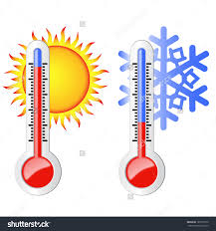
Temperature
  A measure of the average kinetic energy of particles in a sample
Temperature Conversions-
  K = °C + 273.15
  °C = (°F - 32) / 1.8
  °F = (1.8)(°C ) + 32

Slide 22
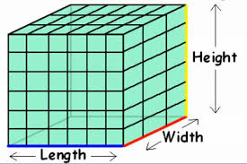
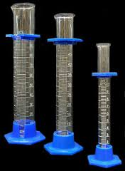
Volume
Cube: length x width x height (length)³
Other units: mL, L
Important Conversions to remember:
  1 mL = 1 cm³
  1 L = 1 dm³

Slide 23
Beginning Metric Conversions
1 cm = 10⁻² m (100 cm = 1 m)
1 mm = 10⁻³ m (1000 mm = 1 m)
15 m = ________ cm
15 m³ = ________cm³

Slide 24
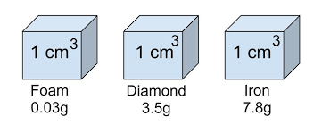
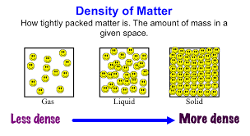
Density
Density = Mass/Volume
All substances have a values for density at a given temperature and pressure.
The density of water is 1.00 g/mL
Derived Units: Units that are combined
  Examples: g/mL, cm³

Slide 25
Challenge!
Find the thickness of a piece of aluminum foil to the correct number of significant digits in cm.
Some important information:
  The Density of Aluminum is 2.70 g/cm³.
  You will turn in:
  Data Table
  Calculations (Remember Sig. Figs.!)
  The thickness of the foil is __________________ cm.

Slide 26
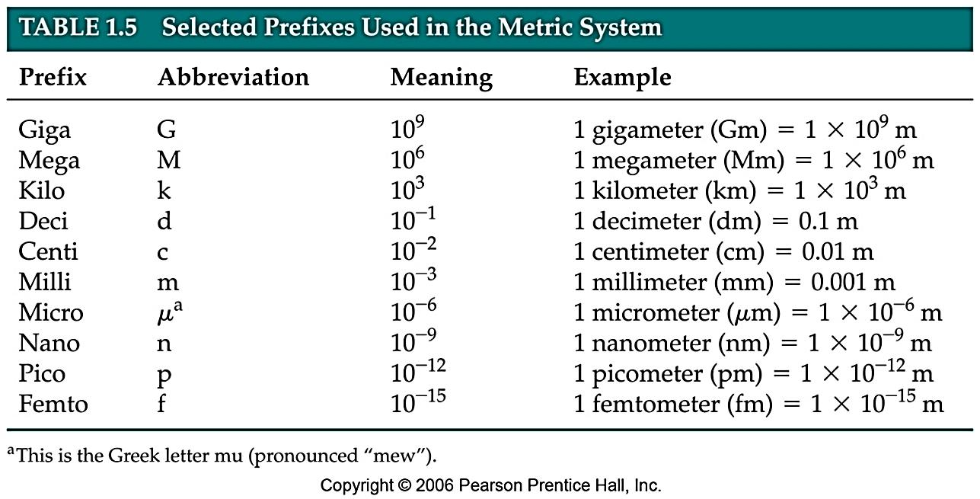
Metric Conversions

Slide 27
