Slide 1
Acid –Base Titration:

Slide 2
Titration
In this technique a known concentration of base (or acid) is slowly added to a solution of acid (or base).
The analyte- is the solutions being evaluated and is of unknown concentration.
The titrant is the solution of known concentration used to determine the concentration of the analyte.

Slide 3
Titration
A pH meter or indicators are used to determine when the solution has reached the equivalence point, at which the stoichiometric amount of acid equals that of base. [H₃O⁺]=[OH⁻]

Slide 4
pH Indicators
pH indicators- are organic compounds that behave like a weak acid-conjugate base pair.
Each of these compounds have a unique color transition when it undergoes a specific pH change.
Understanding these color transitions can be useful in monitoring pH change during titration.
Here’s a fun application of pH indicators!

Slide 5
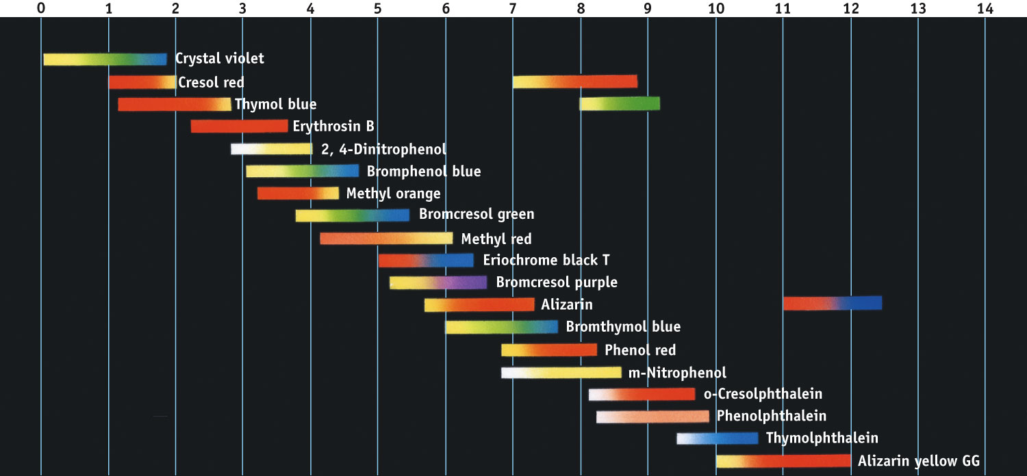
Common Acid-Base Indicators and color change based on pH
Fig. 18-10, p. 828

Slide 6
Titration of a Strong Acid with a Strong Base
From the start of the titration to near the equivalence point, the pH goes up slowly.

Slide 7
Titration of a Strong Acid with a Strong Base
Just before (and after) the equivalence point, the pH increases rapidly.

Slide 8
Titration of a Strong Acid with a Strong Base
At the equivalence point, moles acid = moles base, and the solution contains only water and the salt from the cation of the base and the anion of the acid.

Slide 9
Titration of a Strong Acid with a Strong Base
As more base is added, the increase in pH again levels off.

Slide 10
Titration of a Weak Acid with a Strong Base
Unlike in the previous case, the conjugate base of the acid affects the pH when it is formed.
At the equivalence point the pH is >7.
Phenolphthalein is commonly used as an indicator in these titrations.

Slide 11
Titration of a Weak Acid with a Strong Base
At each point below the equivalence point, the pH of the solution during titration is determined from the amounts of the acid and its conjugate base present at that particular time.

Slide 12
Titration of a Weak Acid with a Strong Base
With weaker acids, the initial pH is higher and pH changes near the equivalence point are more subtle.

Slide 13
Titration of a Weak Base with a Strong Acid
The pH at the equivalence point in these titrations is < 7.
Methyl red is the indicator of choice.

Slide 14
Titrations of Polyprotic Acids
When one titrates a polyprotic acid with a base there is an equivalence point for each dissociation.

Slide 15
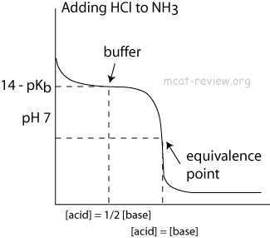
Sample Titration Curves:
Weak Acid/Strong Base
Weak Base/ Strong Acid

Slide 16
Weak Polyprotic Acid/Strong Base

