Slide 1

Welcome to
New Jersey City University
Admissions/Financial Aid/EOF
Workshop

Slide 2

Get to Know NJCU
Founded……………………………1927
Enrollment…………………………8,283
Average Class Size………………19 students
Campus Locations…………………Main Campus, Jersey City
School of Business, Harborside JC
Monmouth County, Wall Township
Middlesex County, Middlesex CC
47 Bachelor’s degree programs, 30 Master’s degree programs, and 2 Doctoral degree programs

Slide 3
NJCU Rankings
#1 - US News & World Report:
Best Public School in NJ for Ethnic Diversity
#1 - Nursejournal.com:
The Best RN to BSN Nursing Program
#2 - Schools.com: Best Colleges in New Jersey
#7 - Washington Monthly:
“Best Bang for the Buck” in the Northeast

Slide 4
NJCU Academic Majors
Accounting
Art
Biology
Chemistry
Computer Science
Criminal Justice
Early Childhood Education
Earth and Environmental Science
Economics
Elementary & Secondary Education
English
Finance
Fire Science
History
Management
Marketing
Mathematics
Media Arts
Modern Languages
Music, Dance and Theater
Nursing*
Philosophy and Religion
Physics
Political Science
Professional Security Studies
Psychology
Sociology and Anthropology
Special Education
Women’s and Gender Studies
+ Over 40 Minor Programs!
*Nursing requires an RN degree

Slide 5
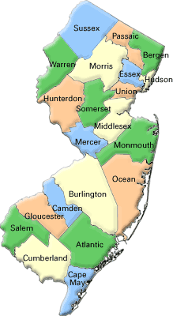

Expanding our Footprint
Main Campus & Harborside, Jersey City
Middlesex, Edison
Monmouth, Wall Township

Slide 6
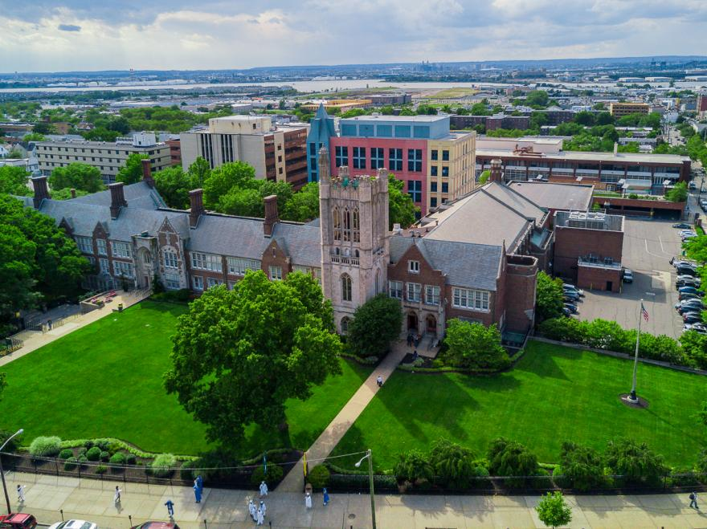
Main Campus

Slide 7

Science Building

Slide 8
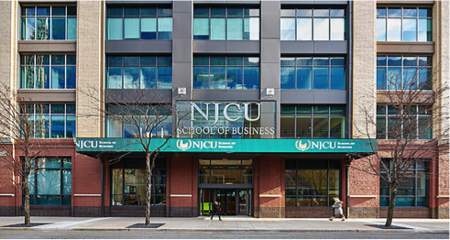

School of Business

Slide 9

West Campus Village Residence Hall

Slide 10

West Campus Village

Slide 11
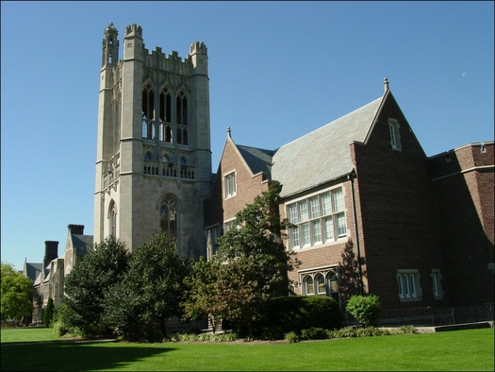
NJCU Missions to Access and Affordability
Merit Scholarships
Freshman
Transfer
Honors
Debt Free Promise Program
EOF
File your FAFSA

Slide 12
Applying to NJCU
First Year Students
Transfer Students
Submit the application
Njcu.edu/Apply
Common APP
High School transcripts
Sat / ACT test scores
SAT Optional
SAT’s are required for a merit based scholarship
Submit the application
njcu.edu
College transcripts from all institutions attended

Slide 13

Financing Your Education
New Jersey City University believes that money should not be an obstacle to higher education, and our student financial aid programs are designed to help students manage tuition costs. Our comprehensive needs-based student aid program makes higher education a reality for many students – in fact, 80% of our undergraduate students receive financial aid.

Slide 14
Important Dates
Investing in Your Future
October 1, 2020 – 2021-2022 FAFSA Filing Begins
February 2021 – New student award letters
March 1, 2021 – NJCU Priority FAFSA 2021-2022 filing deadline
July (1st week) 2021 – 1st Fall 2021 Billing Notice
September 15, 2021 – FAFSA HESAA Filing Deadline to receive TAG
October 1, 2021 – 2022-2023 FAFSA Filing Begins
November 1, 2021 – 2021-2022 State Verification Deadline

Slide 15
Tuition and Fees
Investing in Your Future
2020-2021 | In-State | Out-of-State
Tuition | $12,676.90 | $22,827.8
Fees | $170.70 | $170.70
Total | $12,847.60 | $22,998.50
*Breakdown of tuition and fees are posted on the NJCU website*
https://www.njcu.edu/admissions-aid/tuition-fees

Slide 16
2020-2021 Dormitory Costs (per semester)
Investing in Your Future
West Campus Village - Double | $5,177.25
West Campus Village - Single | $5,796.20
Vodra & CO-OP Double | $4,118.60
Vodra - Single | $5,177.25
*Meal plans cost $2,351.30 (per semester)*
www.njcu.edu/housingscholarship

Slide 17
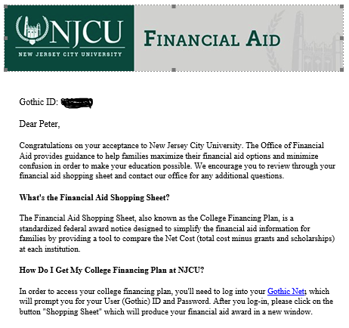
Financial Aid Award Notification
For the 2021-2022, students will receive an email that you’ve been packaged for the academic year.
Students must select the Gothic Net link in the email to access their Financial Aid Shopping Sheet

Slide 18
APPLY FOR FINANCIAL AID
Application Process
Create FSA ID and Password
https://fsaid.ed.gov/npas/index.htm
Complete the Free Application for Federal Student Aid (FAFSA)
https://fafsa.ed.gov/
NJCU Federal School Code: 002613
Review your Student Aid Report (SAR)
Review your Financial Aid Awards package
Complete a Master Promissory Note & Loan Entrance Counseling
https://www.njcu.edu/admissions-aid/financial-aid/how-apply

Slide 19

Financial aid NJ DREAMERS
The New Jersey Alternative Financial Aid Application allows NJ Dreamers enrolled in eligible New Jersey colleges and universities to apply for state financial aid.
Who should complete this application?
Complete this application if you are not a United States citizen or eligible noncitizen and meet all of the following criteria;
Attended a New Jersey high school for at least three (3) years
Graduated from a New Jersey high school or received the equivalent of a high school diploma in New Jersey
Registered for Selective Service (male students only)
Are able to file an affidavit stating that you have filed an application to legalize your immigration status or will file an application as soon as you are eligible to do so
https://www.hesaa.org/Pages/NJAlternativeApplication.aspx
Deadline: September 15, 2021

Slide 20
Investing in Your Future
Avoid Common FAFSA Errors
Leaving blank fields
Listing an incorrect Social Security Number or driver's license number
Failing to use your legal name
Entering the wrong address
Entering the wrong federal income tax paid amount
Listing Adjusted Gross Income (AGI) as equal to total income from working
Incorrectly filing income taxes as head of household
Listing marital status incorrectly
Listing parent marital status incorrectly
Failure to list both parents if they live together
Failure to report unborn children
Failing to count yourself as a student
Failing to register with Selective Service
Forgetting to list the college
Forgetting to sign and date

Slide 21
NJ Debt Free promise grant
New Jersey residents who are admitted to NJCU from high school and attend full-time, with a family household income of $65,000 or less, will be offered a scholarship in lieu of having to take out a loan (after federal and state financial aid is awarded).
To apply, students must be admitted to NJCU and submit the Free Application for Federal Student Aid (FAFSA) by March 1. Students remain qualified for the program each year, if they submit a FAFSA, are in good academic standing, are full-time each semester.

Slide 22
Federal Direct Loans
Direct Subsidized Loan
$3,500 to $5,500
Current Fixed Interest Rate 2.75%
Direct Unsubsidized Loan
$2,000 to $7,000
Current Fixed Interest Rate 2.75%
Direct Parent Plus Loan
Current Fixed Interest Rate 5.3%
Up to Cost of Attendance

Slide 23
Federal and State Grants
Federal Pell Grant
Up to $6,345
Tuition Aid Grant
Up to $6,874
Federal Supplemental Education Grant
$400 to $600
NJ Stars II
Up to $2,500
Educational Opportunity Fund (EOF)
$1,300 commuting students
$1,550 dormitory students

Slide 24
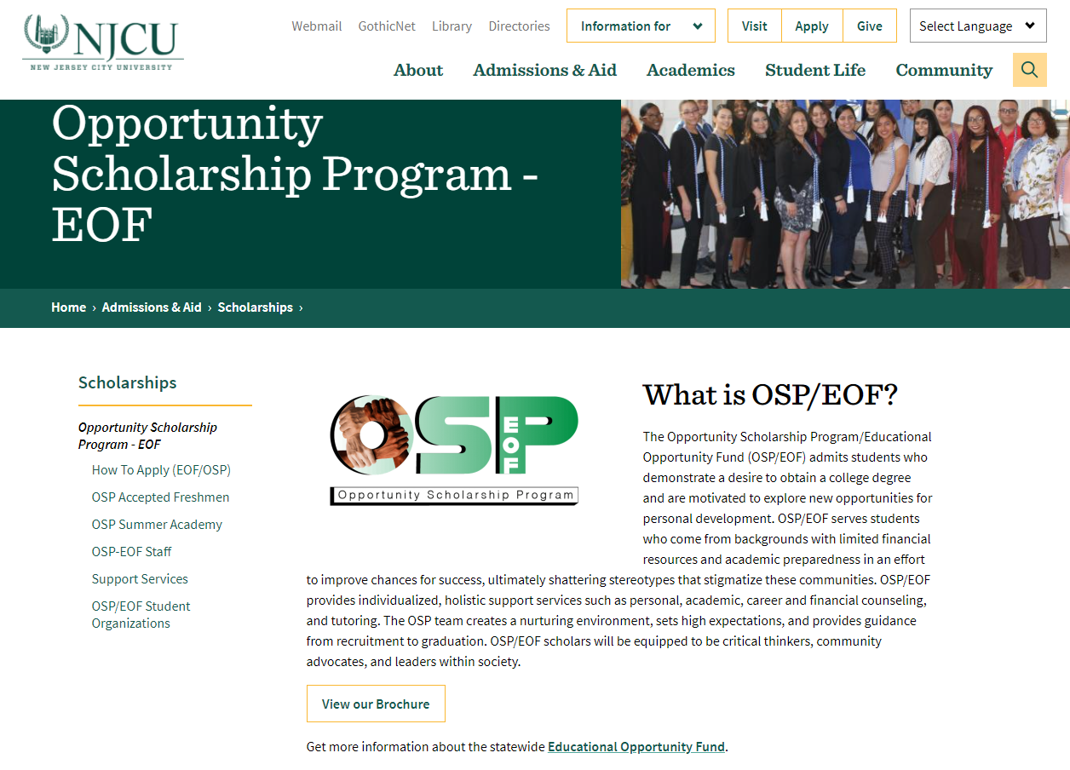

Slide 25
Please visit NJCU.EDU
For more information
Contact:
Undergraduate Admissions
admissions@njcu.edu
Text: 201-800-6855
Financial Aid Office
financialaid@njcu.edu
Phone: 201-471-6079
EOF/OSP
osp@njcu.edu
Phone: 201-200-3355

Slide 26
Thank You for Joining us Today!
Investing in Your Future

