Slide 1
Nationalism in Europe
Chapter 25

Slide 2
1500-1600
-Renaissance
-Reformation
-Scientific Revolution
-Exploration
-Absolutism
-Spain World Power
1600-1700
-Colonization of New World
-Mercantilism
-Industrial Revolution Begins
-Absolutism
-England World Power
-English Civil War
1700-1800
-Age of Enlightenment
-American Revolution
-French Revolution
1800-1900
-Age of Napoleon
-Congress of Vienna
-Life Centered Around Factory System
-Rise of Capitalism and Socialism
-Rise of Nationalism
-Rise of Imperialism
1900-2000
-WWI
-WWII
-Cold War
-Nat. Movements Worldwide
-1st Gulf War

Slide 3
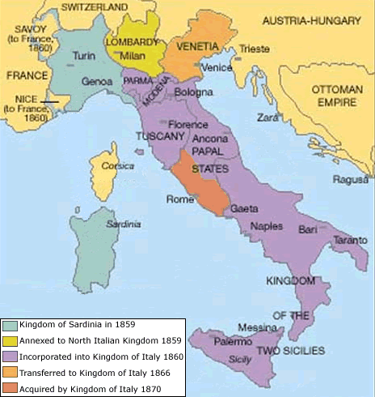
Unification of Italy
Liberals & Nationalists
  Risorgimento – nationalist movement “resurgence” – liberation & unification
  Carbonari – secret society dedicated to the Risorgimento
  Guiseppe Mazzini – Young Italy movement – “neither pope nor king, but a republic”
Affiliation: | Form of Gov’t | Candidate
Liberals | Republic | Camillo Benso di Cavour / Sardinian Parliament
Conservatives | Federation of Italian States ruled by Pope | King Victor Emmanuel II

Slide 4
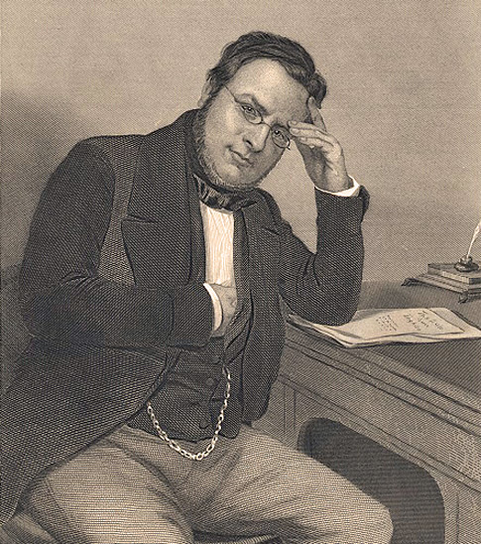
Cavour’s Sardinia
Chief Minister
  Reorganized and Strengthened the Army
  Est banks, factories & railroads to improve trade
  Believed in separation of church & state
    Tried to reduce influence of church in politics even Jesuits
Sided with France & GB during Crimean War = increased political influence
1858 created secret alliance with Napoleon III against Austria

Slide 5
War with Austria
At 1st all went as planned
  Lombardy liberated by French & Sardinian forces
  Tuscany, Modena & Parma liberated and annexed into Sardinia
Napoleon III feared Prussia
  Signed armistice with Austria
  Gave Lombardy to Sardinia and Venetia to Austria
  Tuscany, Modena & Parma go back to Austria
  France gets Nice and Savoy
Tuscany, Modena, Parma & Romagna back to Sardinia after revolts

Slide 6
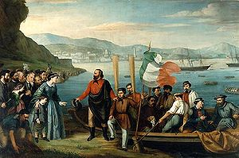
Garibaldi & the Thousand
Giuseppe Garibaldi led the push to unify the Kingdom of Two Sicilies
  1860 Garibaldi & his “Expedition of the Thousand” invade and capture Sicily then the capital of Naples
Cavour sent an army to stop Garibaldi on his way to Rome
  Feared Garibaldi would supplant Victor
  Sardinia annexed the Papal states
  Garibaldi promised to support the King and unification in return for the Governorship in Naples - denied

Slide 7
Finally Unification
Series of Events:
  1860 Plebiscites for national unity except Venetia & Rome
  1861 Meetings in Turin make Victor Emmanuel II king of Italy
  1866 Italy gains Venetia in war with Austria
  1870 Rome votes to unify with Italy
  1871 Rome becomes capital
Problems
  Little experience with self gov’t
  Cultural divides
  Industrial North vs. Agricultural South
  Poor standard of living
  Labor problems

Slide 8
The Zollverein
Economy 1st Step in German Unification
  Junkers – aristocratic landowners (tradespeople, intellectuals, financers and manufacturers) convinced Prussian King to abolish tariffs within territories
1834 German states create the Zollverein (customs union) – No Austria
  Drove down prices – created uniformity (weights, measures, currency)
  Industrialization spread – free market, protection from competition

Slide 9
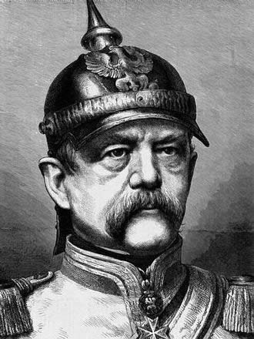
Bismarck & Prussian Strength
1861 William I becomes King of Prussia
Otto von Bismarck appointed to head of cabinet
  Built the Prussian army
  Opposed democracy & the idea of parliament
  State not the people should hold authority
  Prussia’s destiny was to unify Germany
  Opposed by Prussian parliament – collected taxes w/o approval

Slide 10
Wars of Unification
Danish War
  Two duchies, Schleswig & Holstein under Danish rule (separate from Denmark)
  King Christian IX tried to annex both for Denmark
  War b/w Denmark and Austria & Prussia broke out
  Treaty gave Schleswig to Prussia & Holstein to Austria
Seven Weeks War
  Provoked Austria into war
  Used tech to advantage (train, telegraph & modern weapons)
Treaty of Prague
  Dissolved German Confederation
  Holstein to Prussia – Venetia to Italy
  North German Confederation – Northern German states & Prussia
  Prussian King head – state had self gov’ts – dominated the legislature of Confed

Slide 11
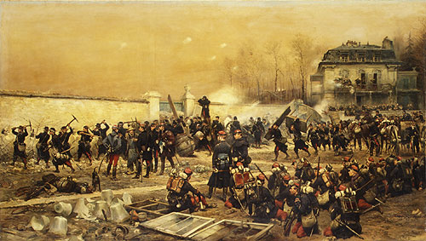
Franco-Prussian War
Bismarck baits France to war with a fake telegram
  Southern German states united against the French
  Defeated France in a few months
  France lost Alsace & part of Lorraine – paid an indemnity
German Empire is Formed
  Jan 18th 1871 – Hall of Mirrors @ Versailles German Empire declared
  All German states, Prussia except Austria – Berlin capital
  King William I – Emperor, Bismarck Chancellor

Slide 12
Formation of the German Empire
Federal Gov’t – 25 German States
  National Defense, Foreign Affairs, Commerce
  Local gov’t – police, taxes, education
  Kaiser = emperor – appointed Chancellor & commanded military
    Defensive war on own – offensive war w/legislature
  Legislature – 2 Houses
  Bundesrat – upper house. 58 appointed members
  Reichstag – lower house, legislative assembly, 400 members (elected)
    Limited in power – couldn’t effect any liberal or democratic change
  Prussian interests strongly represented in German constitution

Slide 13
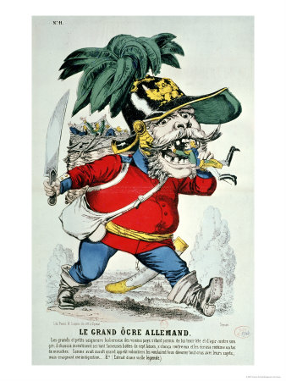
Bismarck’s Opposition
Political Parties formed opposing Bismarck’s ideas
  Reps in Prussian legislature were conservative
  System was rigged for upper class
Kulturkampf “culture struggle” – regulated Catholicism
  Expelled Jesuits – forbade political expression from pulpits
  Clergy must be German and educated in German schools
  Diplomatic relations were broken w/Vatican
  Bismarck eventually needs the Catholics – reestablished relationships
  Ended in failure in 1887

Slide 14
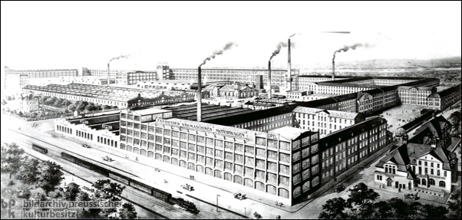
Industrial Development
German Gov’t promoted industrial development
  Rich stores of natural resources (coal & iron)
  Gov’t managed railroads – created a system of canals
  Industry had best tech available to industrialize
  Money & banking laws are standardized
  Post office centralized
  Encouraged cartels
  High-tariff policy – keep out foreign competition

Slide 15
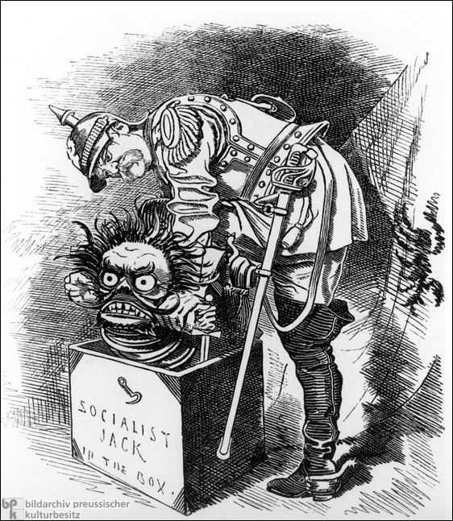
Socialism in
Germany
Cartels = bad work environments
  Called for gov’t ownership of major industries
  1869 Social Democratic Party (SDP) – urban workers
  Used the Reichstag as a pulpit
Bismarck used all of his power to fight socialism
  Blamed assassination attempts on Social Democrats
  Emperor & Bundesrat dissolved the Reichstag
  Banned public meetings of Socialists
  Prohibited newspapers, books or pamphlets spreading socialism

Slide 16
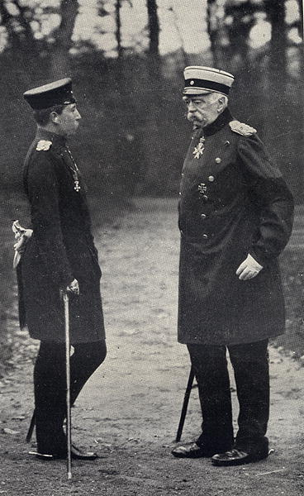
Bismarck’s End
Bismarck caves to appease Socialists
  1883 – workers received insurance against sickness & accidents paid for by employers
  Limited working hours, holidays & pensions for disabled & retired
Enter William II – Exit Bismarck
  1888 William II becomes emperor (conservative absolutist)
  Bismarck had too much power – Chancellorship reduced
  1890 Bismarck resigns after William II denied a new constitution
  William II takes Germany to new prestige by the 1900s

Slide 17
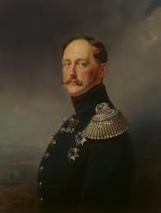
Russian Domestic
& Foreign Policies
Russia was ruled by a Czar or Autocrat
Liberalism in the 1800’s receives harsh treatment from Czars
  Censored speech & the press
  Rejected demands for a constitution
  Czar Nicholas I (1830’s) “Russification” movement
    Non-Russians – Speak Russian, become Orthodox & assimilate to Russian Customs
Foreign Policy: 2 Primary Features
  Pan-Slavism – union of all Slavic people under Russian leadership
  Expansion: East into Asia, South to the Ottoman Empire stopped by the Crimean War

Slide 18
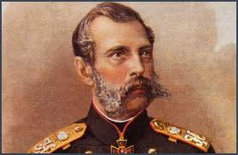
Alexander II
& Reform
Emancipation Edict of 1861
  Alexander II – serfs are free
  Compensated nobles for land which peasants could buy from gov’t
  Free serfs = poor serfs & cheap labor for cities
Local Governments
  Zemstvos – provincial & county councils
  Nobels, middle class, & peasants could vote
  Levy taxes, controlled public health, education, public assistance and works
Court System
  Modeled after European Civil/Criminal courts
  Created court of appeals and local justices of the peace
  Limited the power of the secret police
  Press had greater freedom & expanded education
  Military service from 25 – 6yrs

Slide 19
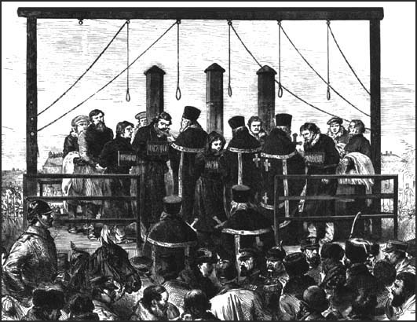
Radical Reactions
Nihilists Unite! – (build a new Russia = only just society)
Terrorist Attacks
  Populists – live among peasants as teachers & doctors – seize noble lands and split it
  People’s Will – Terrorist group, assassinated Alexander II 1881
Time of Repression
  Liberal reform ended – Alexander III & Nicholas II ended liberalism
  Censorship, church control, educational control, spies, imprisonment & exile – revived “Russification”
  Pogrom raids on Jews
  1898 Social Democratic Labor Party formed

Slide 20
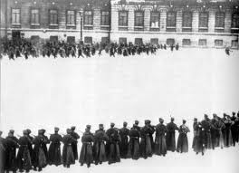
Revolution of 1905
1904-05 War with Japan over Chinese & Korean Territory
  Humiliating defeat – exposed gov’t corruption & inefficiency
January 22, 1905 – “Bloody Sunday”
  Czar troops shot unarmed strikers delivering a petition to the Czar
  Working strikes, street fighting (Non-Russian), Military mutinies
October Manifesto (Nicholas II)
  Promised individual liberties
  Duma – Russian Parliament
  Autocracy continued – 1907 Laws rigged Duma for large land owners
Failure for 3 Reasons
  Army remained loyal
  French lent money to Russian Gov’t
  Too much division amongst revolutionary groups

Slide 21
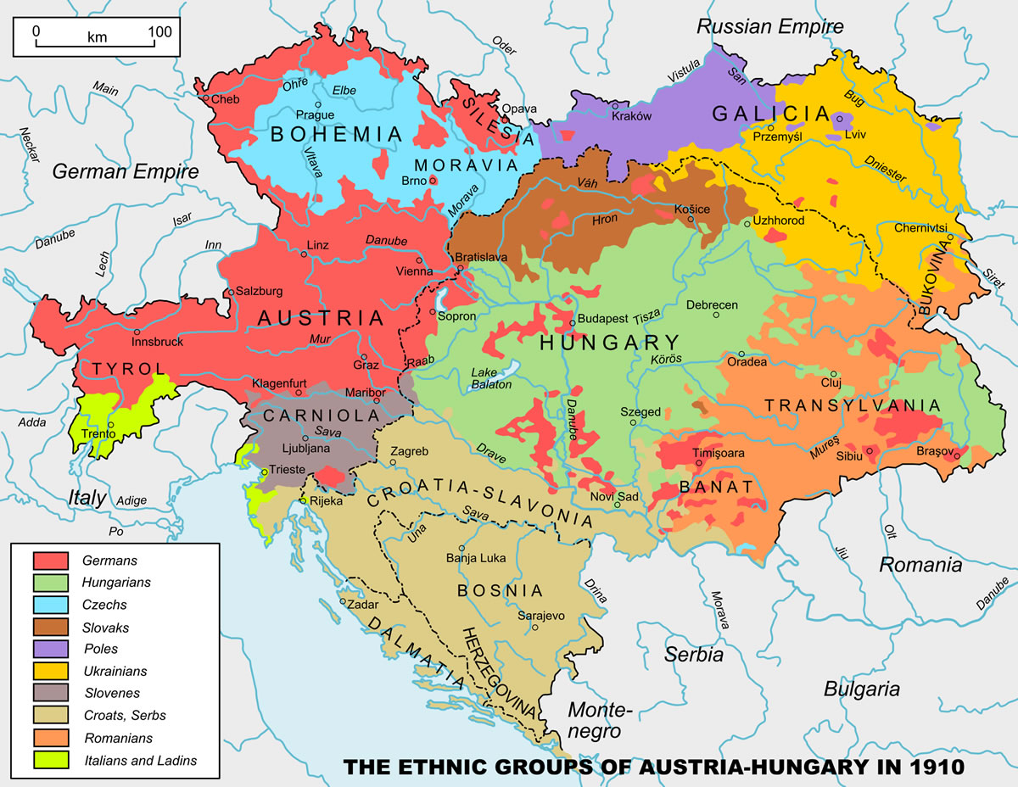
Austria-Hungary Diversity

Slide 22
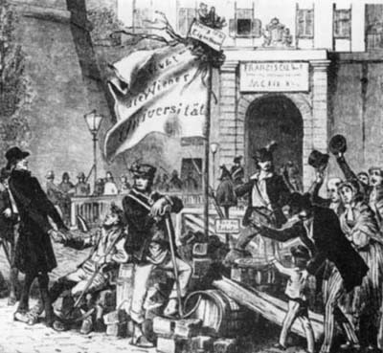
Austrian Unrest
“The Paris revolution has illuminated the obscurity of
our position like a thunderbolt.”
Hungary resented Austrian rule
  Magyars – nomadic warriors from Russia & Romania 900s
  Different language, separate culture – same nationalist ideals!
Hungarian revolt for independence in 1848
  Led by Lajos Kossuth – “responsible governor president”
  Ended by Czar Nicholas I - 1849

Slide 23
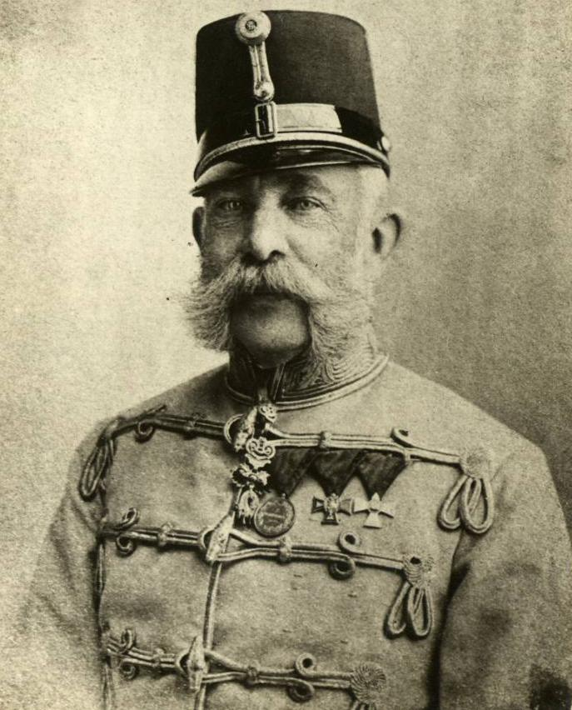
Formation of the
Dual Monarchy
1867 – Austria-Hungary becomes a Dual Monarchy
  Francis Joseph I – Emperor of Austria & King of Hungary
  3 Ministries controlled war, finance & foreign affairs
  Each had its own parliament Aus: Vienna Hung: Budapest
  Great economic agreement
Not all problems were solved!
  Austria wanted high tariffs for goods
  Division by nationalities remained, different cultures & language
  Minorities still wanted self gov’t
7 Weeks war defeat led A-H to the Balkans

Slide 24
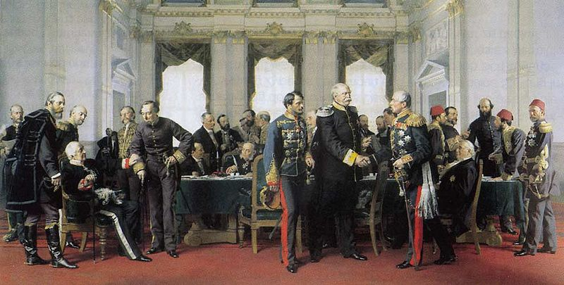
Congress of Berlin
Treaty of San Stefano 1878
  Romania, Serbia & Montenegro are independent
  Bulgaria self rule (Aegean Sea access) Russia then occupied
Congress of Berlin 1878
  Bulgaria self-gov’t but reduced in size – stayed in Ottoman Emp
  Austria governed Bosnia & Herzegovina but can’t add as territory – broke in 1908
  Great Britain occupied Cyprus – Naval base est

Slide 25
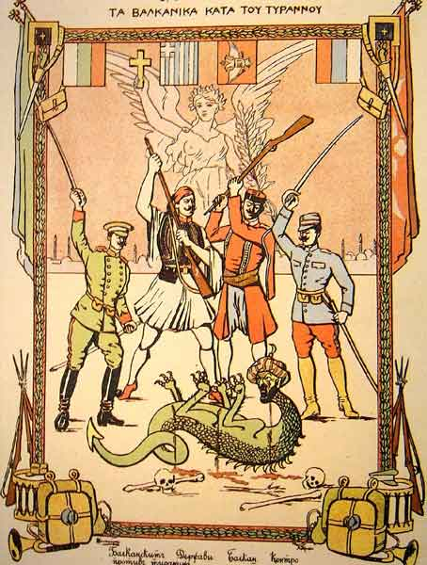
Balkan Wars
1912 & 1913 Two wars b/w Balkans & Ottoman Emp
  Balkan League – Bulgaria, Serbia, Greece & Montenegro
  Balkans won but disputes over land division led to a second war
  Serbia, Greece, Montenegro, Romania & Ottoman Emp vs. Bulgaria
  Bulgaria loses, territory shrunk & aligned w/Austria
  Ottoman Empire included only Constantinople by 1913

