Slide 1
Colonial Conflicts Chapter 6

Slide 2
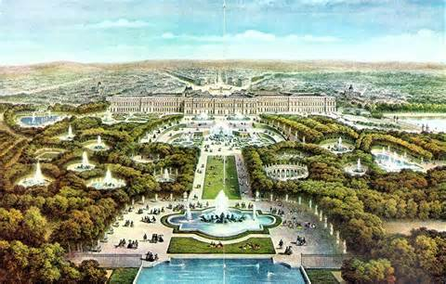
Edict of Nantes
Peace and Stability
1608 Quebec & St. Lawrence River
Huron (French) vs. Iroquois (British)

Slide 3
Why Not Colonize?
Cold Canada
No economy\No Need
Autocratic
No religious refuge

Slide 4
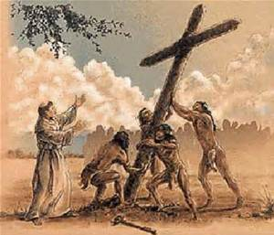
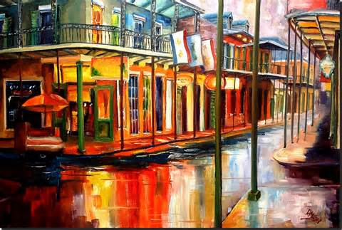
Why Colonize?
Louis XIV
Beaver Fur
Jesuit Missionaries
La Salle – Detroit, New Orleans, and Illinois

Slide 5
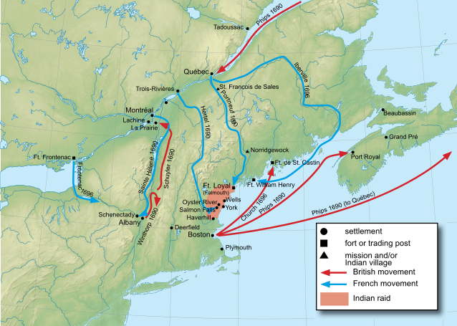
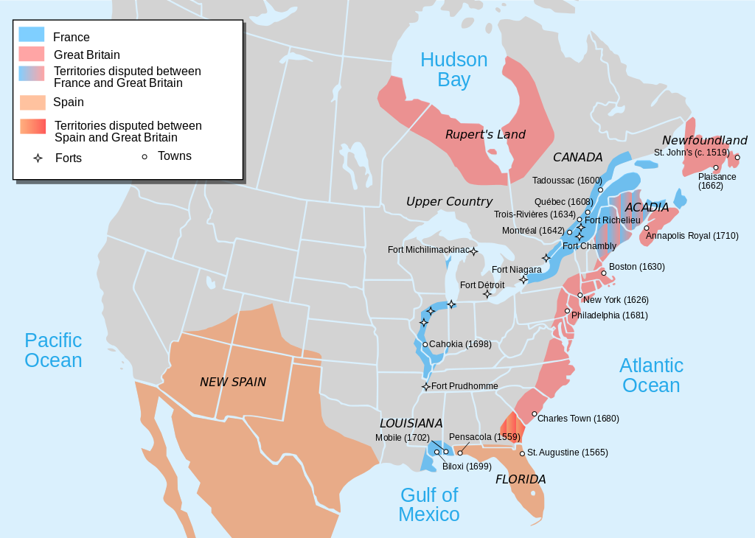
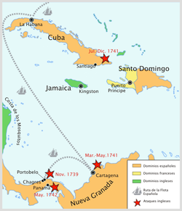
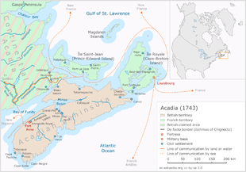
France\Spain vs. England
King William’s War
Queen Anne’s War
Salutary Neglect
War of Jenkin’s Ear
King George’s War
Fortress of Louisbourg\St. Lawrence

Slide 6
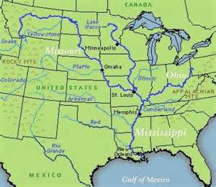
Ohio River Valley
British West
French South
Who’s land is it?????
Acadians - Cajuns

Slide 7
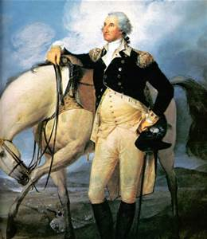
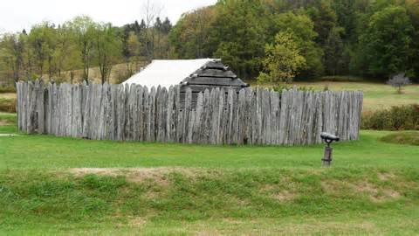
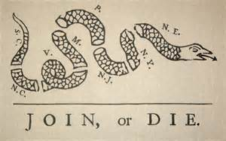
Fort Necessity
French and Indian War
Seven Years War
Albany Congress – allies and unity
Ben Franklin\Pennsylvania Gazette
General Braddock\Fort Duquesne\Yikes!!

Slide 8
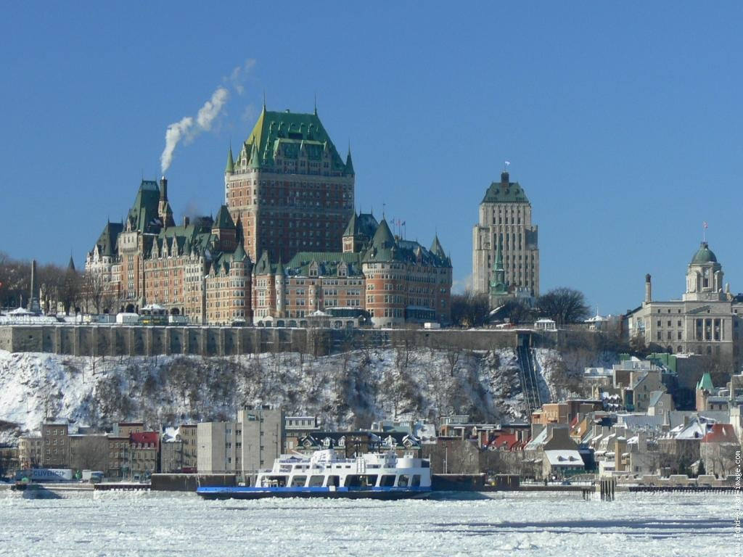
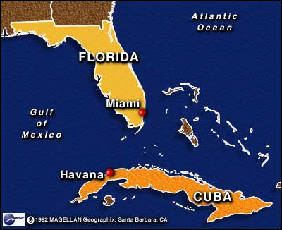
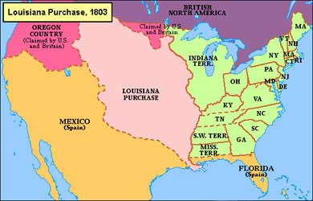
William Pitt – Great Commoner\Organizer of Victory
Louisbourg – HUGE Victory
Battle of Quebec\General Wolf\#1
France loses
Spain Gains
Spain Exchange

Slide 9
Outcomes of the French Indian \ 7 Years War
Colonial Army – confidence, experience, & leadership
The British Army is human to
British arrogance towards colonial soldiers
British: How can colonists not support cause??
Colonial disunity – profit, distance, religion, ethnicity, government, disputes & what is in it for me
Colonial unity – campfires
NO FRANCE!! NO SPAIN!!!!
No Native American politics

Slide 10
Pontiac’s Uprising 1763
Pontiac attacks western outposts
Blankets with smallpox
Soldiers protect the west
Everyone rushes west
Proclamation of 1763 – no west
King – control the Native American situation
Colonist – not fair, we earned it, it is owed us, we are doing it!!!
DON’T TALK BACK

