Slide 1
Renaissance & Reformation
Chapter 17
An outpouring of creativity that began in the 1300’s and changed the course of Western Civilization.

Slide 2
What was the Renaissance?
Rebirth of thought
Ancient Greek & Roman traditions & teachings
Architecture, science & medicine
Education, Philosophy & Government
Art & Literature
How do you think?
Critical approach – question everything!
Why the humanities are important
Grammar, Literature & History
How do we get better?

Slide 3
Where did it start?
Italy 1300’s
Why Italy?
Ancient ruins reminded Italians of greatness
Geography
Wealth
New cultures means new information
Asia, Africa & the Byzantine
Thirst for knowledge

Slide 4
Economic Influence
Trade & Industry
Florence, Milan, Naples, Rome & Venice
Citizens were wealthy and educated
Wealthy Merchants & bankers
Wealthy became patrons of the Arts

Slide 5
Renaissance Thought
Education Important/Critical Approach
Admiration for Individual Achievement
Should Lead a Meaningful Life
Renaissance Thought
Supporting the Arts
Belief in Human Dignity

Slide 6
1st Clash of Science & Religion
Catholic Church dominated
Was a major stabilizing force
Control aspects of daily life
Birth, Marriage, Death
More people educated = more conflict between science & religion
Do not have to depend on Church’s teachings

Slide 7
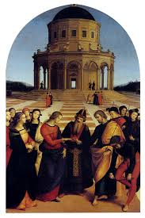
Renaissance Art & Artists
Medieval vs. Renaissance
Perspective: brought realism to paintings
Depth on canvas – distance
Da Vinci – 1452-1519
Architect, engineer, painter, sculptor & scientist
Renaissance Man
Used science in paintings
Last Supper & Mona Lisa
Marriage of the Virgin by Raphael

Slide 8
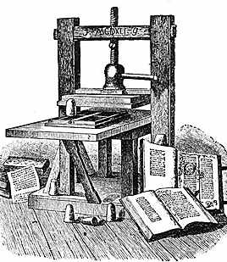
Northern Renaissance
Copying books:
Chinese Block and Word prints
Used to copy works
Replaced Hand copying
Johannes Gutenberg – 1450
Printing press (Mainz, Germany)
Used to print entire books
1st was Bible
Spread throughout Europe – spread ideas and education
Books become cheaper

Slide 9
Beginnings of Protestantism
Reformation: religious revolution in western Europe
Income connected to salvation
Indulgences: pardons for punishment from sin
Originally a reward
German states: no restriction to sale of indulgences

Slide 10
Martin Luther
Monk
Revelation: good deeds don’t matter
Inner faith in God only thing that matters
“Justification by grace through faith”
95 Theses – 1517
Public challenge of indulgences

Slide 11
Major issues with the Church
Bible is sole religious authority
Ceremonies could not make up for sins
Popes & Bishops could not tell people what to believe
Priests no role in salvation
1520: Pope Leo X declares Luther a heretic
Excommunicated

Slide 12
Charles V (Holy Roman Emperor)
Orders a trial in 1521
Diet of Worms: Luther an outlaw
Banned printing and sale of his works
Frederick the Wise (German Prince)
Hides Luther
Luther translates Bible to German

Slide 13
Spread quickly – German princes establish Lutheran states
Charles V: 1546 sent armies against Protestant princes
Peace of Augsberg 1555:
German rulers could establish any religion for their state
Subjects didn’t like it they could move

Slide 14
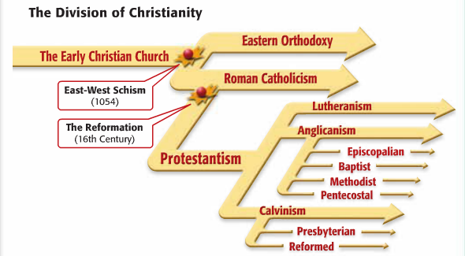
New Sects Develop
New religious groups – no organized churches
No authority, discipline, membership or rules
Gathering of like minded individuals w/preacher

Slide 15
New Religions
Anglican Church – England Henry VIII
England leaves church b/c Henry wants a divorce
Parliament passes new church of England – King as the head
Married 6 times – 1 surviving son Edward VI (dies young)

Slide 16
John Calvin – Switzerland
1536 – The Institutes of the Christian Religion
Faith in the Bible
Predestination – God already decided who will be saved
“The elect” – community followed highest moral standards
Geneva – theocracy: government ruled by religious with god’s authority
Outlaw on Vices

Slide 17
The Spread of Calvinism
Hugenot:
French nobility that converted to Calvinism
1/3 became Calvinists
Civil War – Hugenots vs. Catholics 1562
1598 Henry IV – Edicts of Nantes
Freedom of worship / political rights
Puritanism – form of Calvinism

Slide 18
The Counter-Reformation
Counter (Catholic) Reformation
Attempt to return the church to emphasizing spirituality
Clarify church doctrine
Campaign to stop Protestantism
Pope Paul III 1534-1549
Inquisition – question “heretics”
Keep Catholics in the church
Pope Paul IV
Index of Forbidden Books
Books that were harmful to faith and morals

Slide 19
Council of Trent
1545 Church Leaders meet in
Trent
Met during 3 periods from
1545 – 1563
End abuses of indulgences
Discipline within the clergy
Emphasized the need for ceremonies
Salvation comes from ceremonies & faith
People must depend on priests because God grants forgiveness through the church
Every person has free will

Slide 20
Soldiers of the Counter-Reformation
Society of Jesus (Jesuits)
Ignatius de Loyola – founder 1534
1540 Pope Paul III recognizes Jesuits as an official order
Most effective in spreading Catholicism
Stressed education – Founded Schools
Combined humanist values w/Catholic doctrine

Slide 21
Results of Religious Upheavals
1530’s – mid 1600’s
Religious wars in France, Germany, Netherlands & Switzerland
Interest in Education
Jesuits - schools
Protestants study the bible
Reading and literacy
Governmental Power Increases
Rulers took responsibility
Papal powers decreased

