Slide 1
The Great Depression & Rise of Totalitarianism
Chapter 28

Slide 2
End of Prosperity
Postwar prosperity turned to depression by end of 20’s
Farmers in Africa, Australia, India, New Zealand, NA & SA increased production for Europe
American farmers took loans for capital goods
1918 demand for crops and prices dropped – debt crisis

Slide 3
Protectionism
Global Economies led to economic nationalism
Protectionism: nations tried to protect foreign industries from competition by limiting trade
Est tariffs on import of goods – failed policy
Americans loaned $$$ to Europeans to purchase American goods

Slide 4
Speculation
Market Speculation – stock market investments
1920’s buying on margin – borrow money to purchase stock
Value rose – stock sells loans are repaid, value falls – loans aren’t repaid
October 29, 1929 – Black Tuesday
NYSE panic’s in face of economic downturn – run on the NYSE
Bank runs started as investors confidence fell
Thousands of banks, farms, factories and individuals forced into bankruptcy

Slide 5
The Great Depression
NYSE Crash beginning of the 10 year Depression
Prices, wages fell & unemployment soared
1932 30 million unemployed worldwide – poverty amidst productivity
Economic nationalism made the depression harder to recover from
Great Britain tried giving low interest loans to industry – raised tariffs
France stayed away for a few years – when hit led to political instability
1933 alone 3 changes of govt’
Destroyed the Weimar Republic in Germany

Slide 6
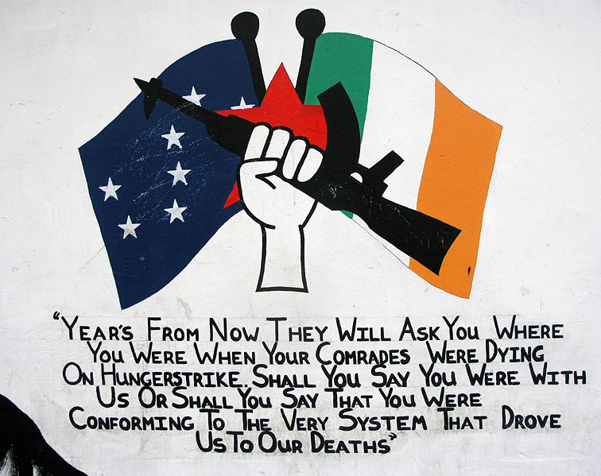

Slide 7
Ireland
1800’s Nationalists demand self rule
1914 independence not met – promised self rule post WWI
Easter Rising: April 24, 1916 revolt – Irish leaders executed
1918 Sinn Fein – Irish seats in Parliament
Declared themselves rep gov’t for Irish Republic
Irish Republican Army (IRA)
1922 Settlement – divided Ireland in 2
Catholic Ireland (South) self-governing free state (British Subjects)
Protestant Ireland (North) remained in the UK
Not all were happy – civil war continued
1949 Irish Free State becomes independent

Slide 8
Fascist Dictatorships
Benito Mussolini & Italy
Socialist -> Extreme Nationalist during WWI
Created the Fascist Party – Nationalistic & Militaristic
Relied on dictatorship & totalitarianism – opposed democratic principles
1st Followers
Soldiers, Wealthy landowners, Manufacturers & lower middle class
Cooperation b/w labor & management to restore the Italian economy
Communism | Fascim
Appealed to the working class | Upper & Middle Class
Society w/o Social Classes | Preserve current class system
Communal Property | Private Property

Slide 9
Mussolini’s Rise to Power
Black Shirts’ removal of Socialists
Broke up strikes, intimidated voters & drove elected officials from office
October 1922 Black Shirts meet in Rome
Purpose: Defend Italy from Communism
Reaction: Parliament (Liberals) ask for Martial Law – Cabinet resigns
Resolution: Mussolini becomes Premier & heads a coalition gov’t
In Office: Dictatorship in process
Appointed Fascists in the central gov’t
Election Law: Party w/most votes = 2/3 of seats in lower house

Slide 10
Mussolini’s Gov’t
1925 “Head of Gov’t”
Controlled Ministry of War
Controlled Gov’t policy through Grand Council of Fascist Party
Dictatorship has arrived!
Opposition parties disbanded
No Basic Freedoms: press, speech & trial by jury
Gov’t controlled labor unions
Strikes illegal
Italy becomes a police state

Slide 11
Corporatism
Italy becomes a Corporatist State
Representation based on area of economic activity
Major areas: agriculture, commerce, manufacturing & transportation
Rep’s of gov’t met with labor & management to set wages, prices & working conditions
Unions & Business leaders expected to work with Mussolini’s gov’t & each other for the state

Slide 12
Weimar Republic
1920 German Constitution drafted
German Federal Republic – Weimar Republic
Traitor’s to German interest (Treaty of Versailles)
Faced unemployment & hyperinflation
Gave up control of major industrial lands
Reparations = Hyperinflation
1922 – 50,000 Reichmarks (Marks) : 1 U.S. Dollar
1923 – 1,000,000,000,000 : $1
1924 – 4,200,000,000,000 : $1
Rentemark’s were created at the end of 1923 4.2 Rentemark’s were = $1
Beer Hall Putsch
1923 attempt to overthrow the republic – Hitler Led

Slide 13
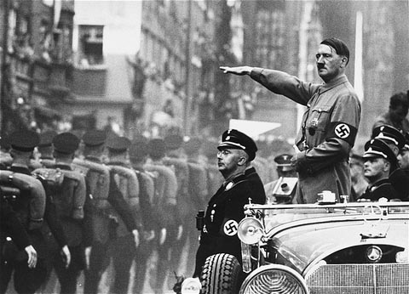
Nazi Party & Hitler
Nazi – National Socialist German Worker’s Party
Nationalistic, anti-Semitic & Anti-communist
Hitler head of Party 1921
1927 Anti-Semitic ideology transformed into active discrimination
Promised to repeal the Treaty of Versailles
Restore Germany’s military power
Buiild a “Greater Germany”
Believed Germans were racially superior (Aryans)
Blamed Jews for Germany’s problems
Threatened the purity of the Aryan race
Hitler eliminated political opponents via political skills and violence

Slide 14
Nazis in Power

Slide 15
Hitler in Power
January 1933 Hitler appointed Chancellor
Used private Nazi army to strong arm members of Reichstag
Der Fuhrer – The Leader
Turned Germany into a police state (no unions, opposition parties or papers)
Gestapo used to profile “inferior races”
Third Reich
Third “Empire” of Germany
1930’s secretly rebuilt military
1936 moved troops to the Rhineland – violated ToV
1936 Rome-Berlin Axis: Alliance w/Mussolini

Slide 16
Russia Under Lenin
1917 Russia taken by Communists
1922 Russia -> Union of Soviet Socialist Republics
USSR divided into 15 separate political republics in a federal union
1918-1921 Vladamir Lenin is the leader (Russian Civil War b/w Whites & Reds)
Lenin’s War Communism
Nationalized Industry – keep food and weapons stocked
Didn’t work – production was down since WWI
Collapse & Social disorder started

Slide 17
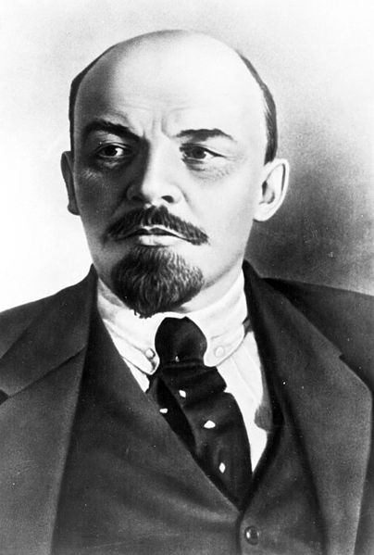
War Communism

Slide 18
New Economic Policy
War Communism Failed – NEP new approach
Gov’t controlled: Heavy industry, communication, transportation & the credit system
NEP married the Public and Private Sectors (Free Enterprise)
Buy, sell & trade farm products
Small business among peasants was permitted
Nepmen: Soviet middlemen – traded domestic goods & materials w/manufacturers
Agriculture Changes to collectivization
Revolution – Wealthy farmland given to peasants
Collective farms created: pooled land where people worked in groups
Shared machinery

