Slide 1
Colonies (1607-1754)

Slide 2
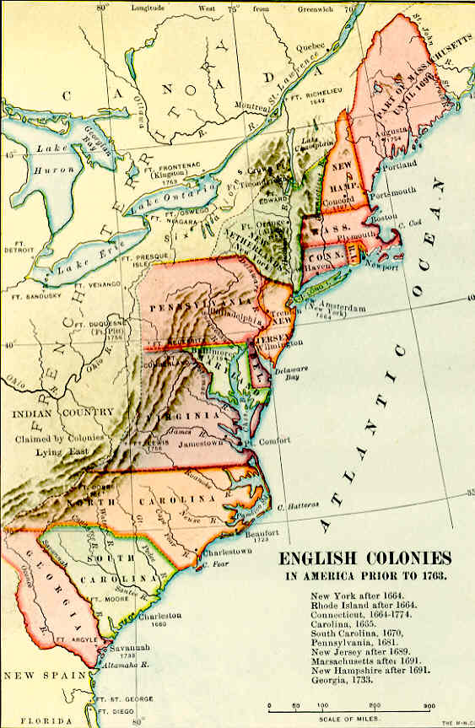
Brief Background History
Arrival
Colonization from European countries in 17th and 18th centuries
The “13 Colonies” are controlled by British
Very diverse ethnically, religiously, politically
First colonization efforts
Jamestown- think video
Plymouth- think pilgrims
What motivates the colonists?
Opportunity
Money!!! The most important colors are green and gold!

Slide 3
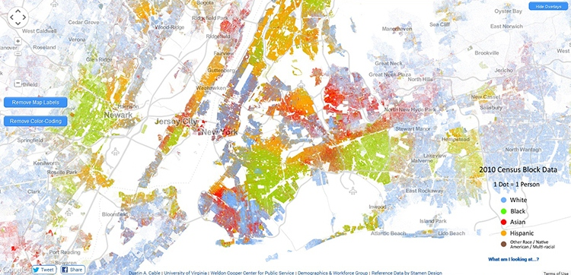
Diversity Today
Notes:
http://dictionary.reference.com/browse/ethnicity

Slide 4
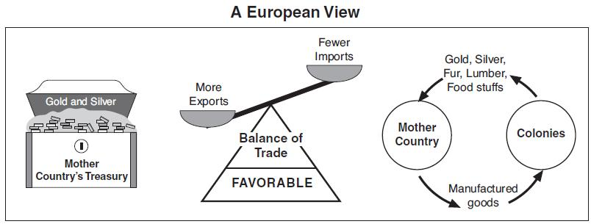
Characteristics of the Colonies
Mercantilism
Definition- country should obtain as much gold and silver ($$$) as possible
Process
Use colonies for their raw materials
Sell colonists English products made from colonial materials
Force colonies to only trade with England
Money flows within England and colonies, NOT to competitors
Maintains a favorable balance of trade
England did not enforce policies!

Slide 5
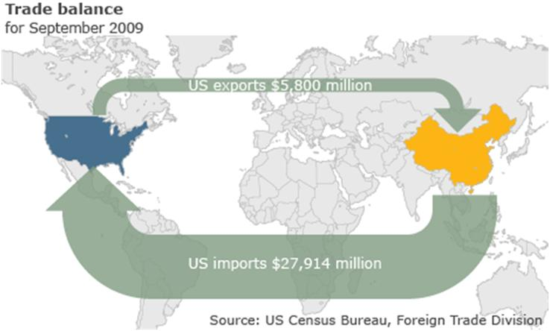
Balance of Trade Today

Slide 6
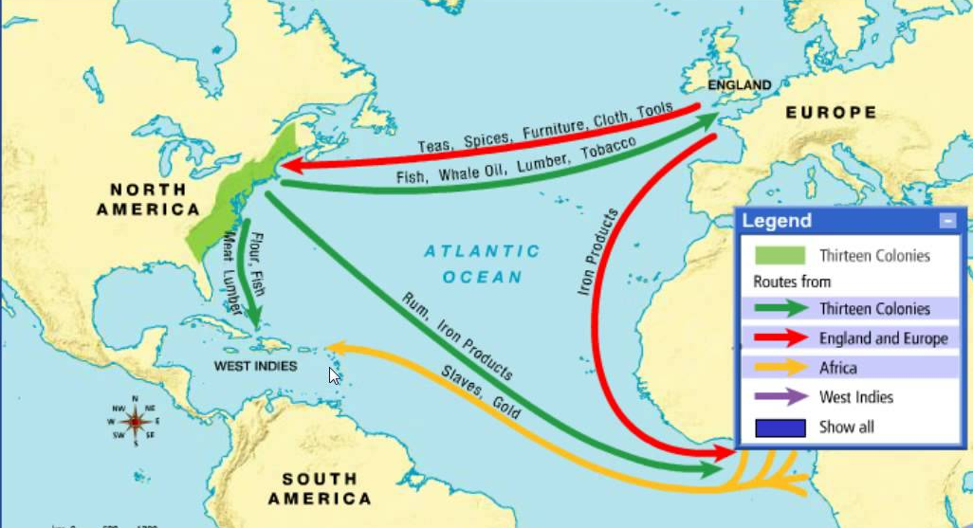
Characteristics cont.
Religious escape/conflict
Anglican Church (Church of England) not welcoming of others, colonies are opportunity to practice what you want… to a point
Trouble with Native Americans
Jamestown
King Phillip’s and Pequot Wars
Rise of Slavery
Triangular Trade
Middle Passage

Slide 7
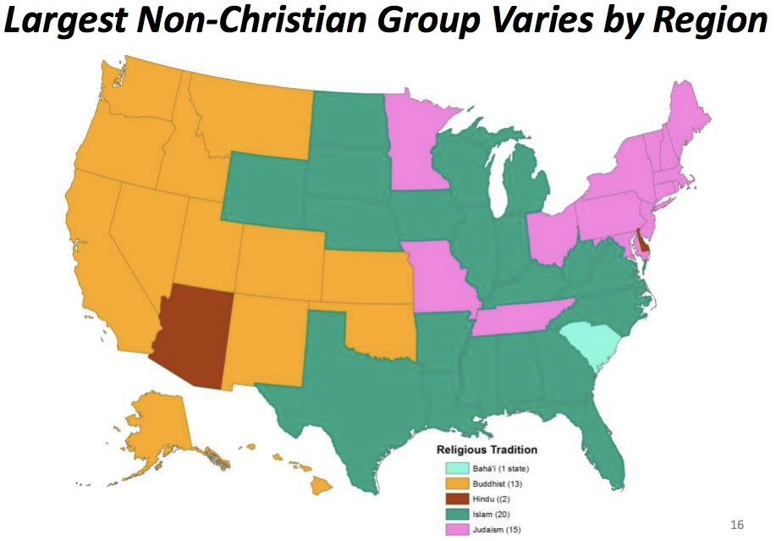
Religious Intolerance Today

Slide 8
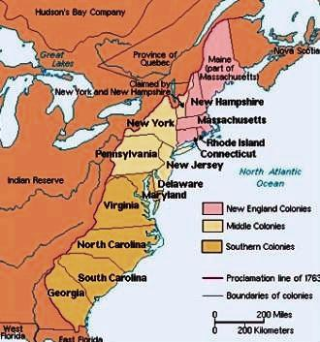
Regions
New England Colonies
Massachusetts (Plymouth & Massachusetts Bay), New Hampshire, Connecticut, Rhode Island
Middle Colonies
New York, Delaware, New Jersey, Pennsylvania
Southern Colonies
Virginia, Maryland, North Carolina, South Carolina, Georgia

Slide 9
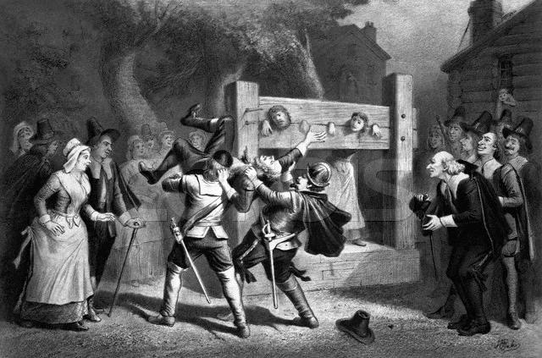
New England

Slide 10
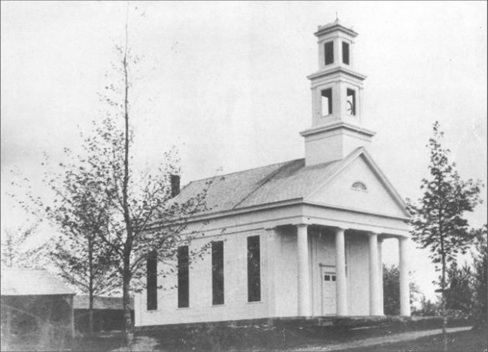
New England
Social
Puritans (MA & NH)
Wanted to separate from England
worshiped in congregations
Separatists (CT & RI)
Colonies with more religious tolerance
Political
First self government- Mayflower Compact
Strict society, took care of one another
Proprietary Colony- in MA, Puritans had full governing rights
Economic
Small individual farms and trade

Slide 11
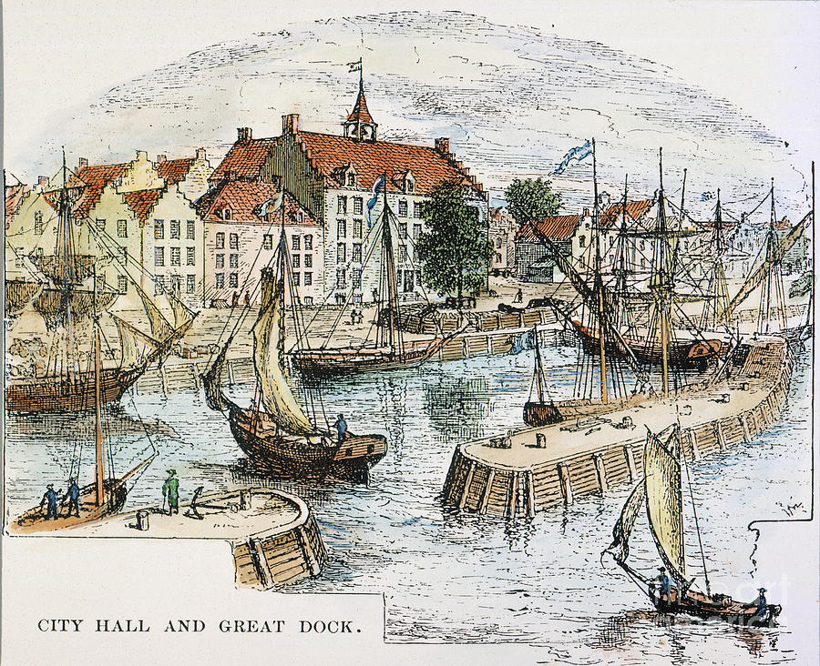
Middle Colonies

Slide 12
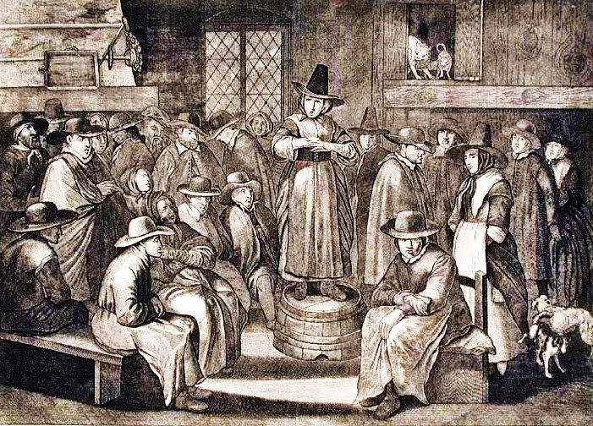
Middle Colonies
Social
Very diverse- Dutch settled initially, British envied prosperity
Over 18 different languages spoken
Religious tolerance (ex. William Penn and Quakers in PA)
Haven for people of all backgrounds (PA)
Political
Took over by British in mid-1600s
Royal Colony (NY & NJ)- very loyal to crown
Economic
Center of trading (think geography)
New Amsterdam/Manhattan
Artisans, printers, merchants
Rich farming communities

Slide 13
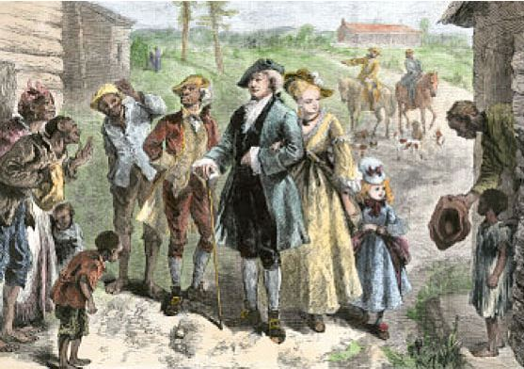
Southern Colonies

Slide 14
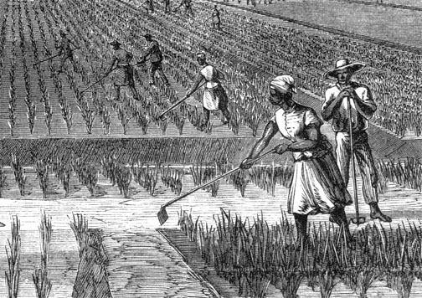
Southern Colonies
Social
Tolerance for many individuals
Maryland- Catholics
Georgia- jailed English settlers
Rise of a rich gentry (planter class)
Political
Joint-stock company- private investors establish a colony (ex. Jamestown)
Bacon’s Rebellion- VA settlers want more role in gov’t
Economic
Staple crops- especially tobacco
Early slave trade and indentured servitude

Slide 15
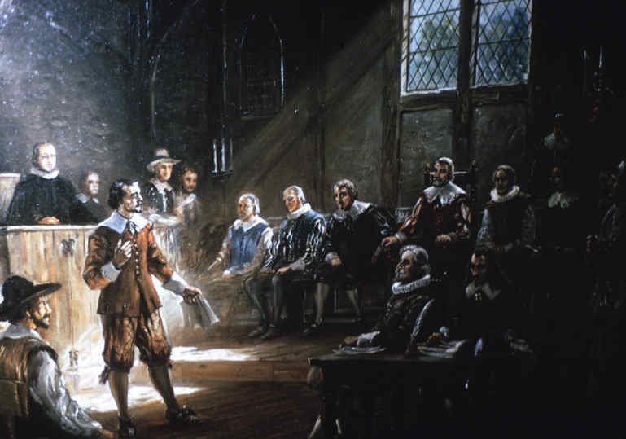
Colonies by 1754
Self-government
From start, England allowed colonial governor and legislature to make rules
Eventually, legislatures have more power (democracy/republican attribute)
As treatment gets worse, legislatures get angrier
Salutary Neglect
For most of colonial period, England had rules for colonies but did not enforce them
England stops neglecting, starts enforcing, and anger ensues

Slide 16
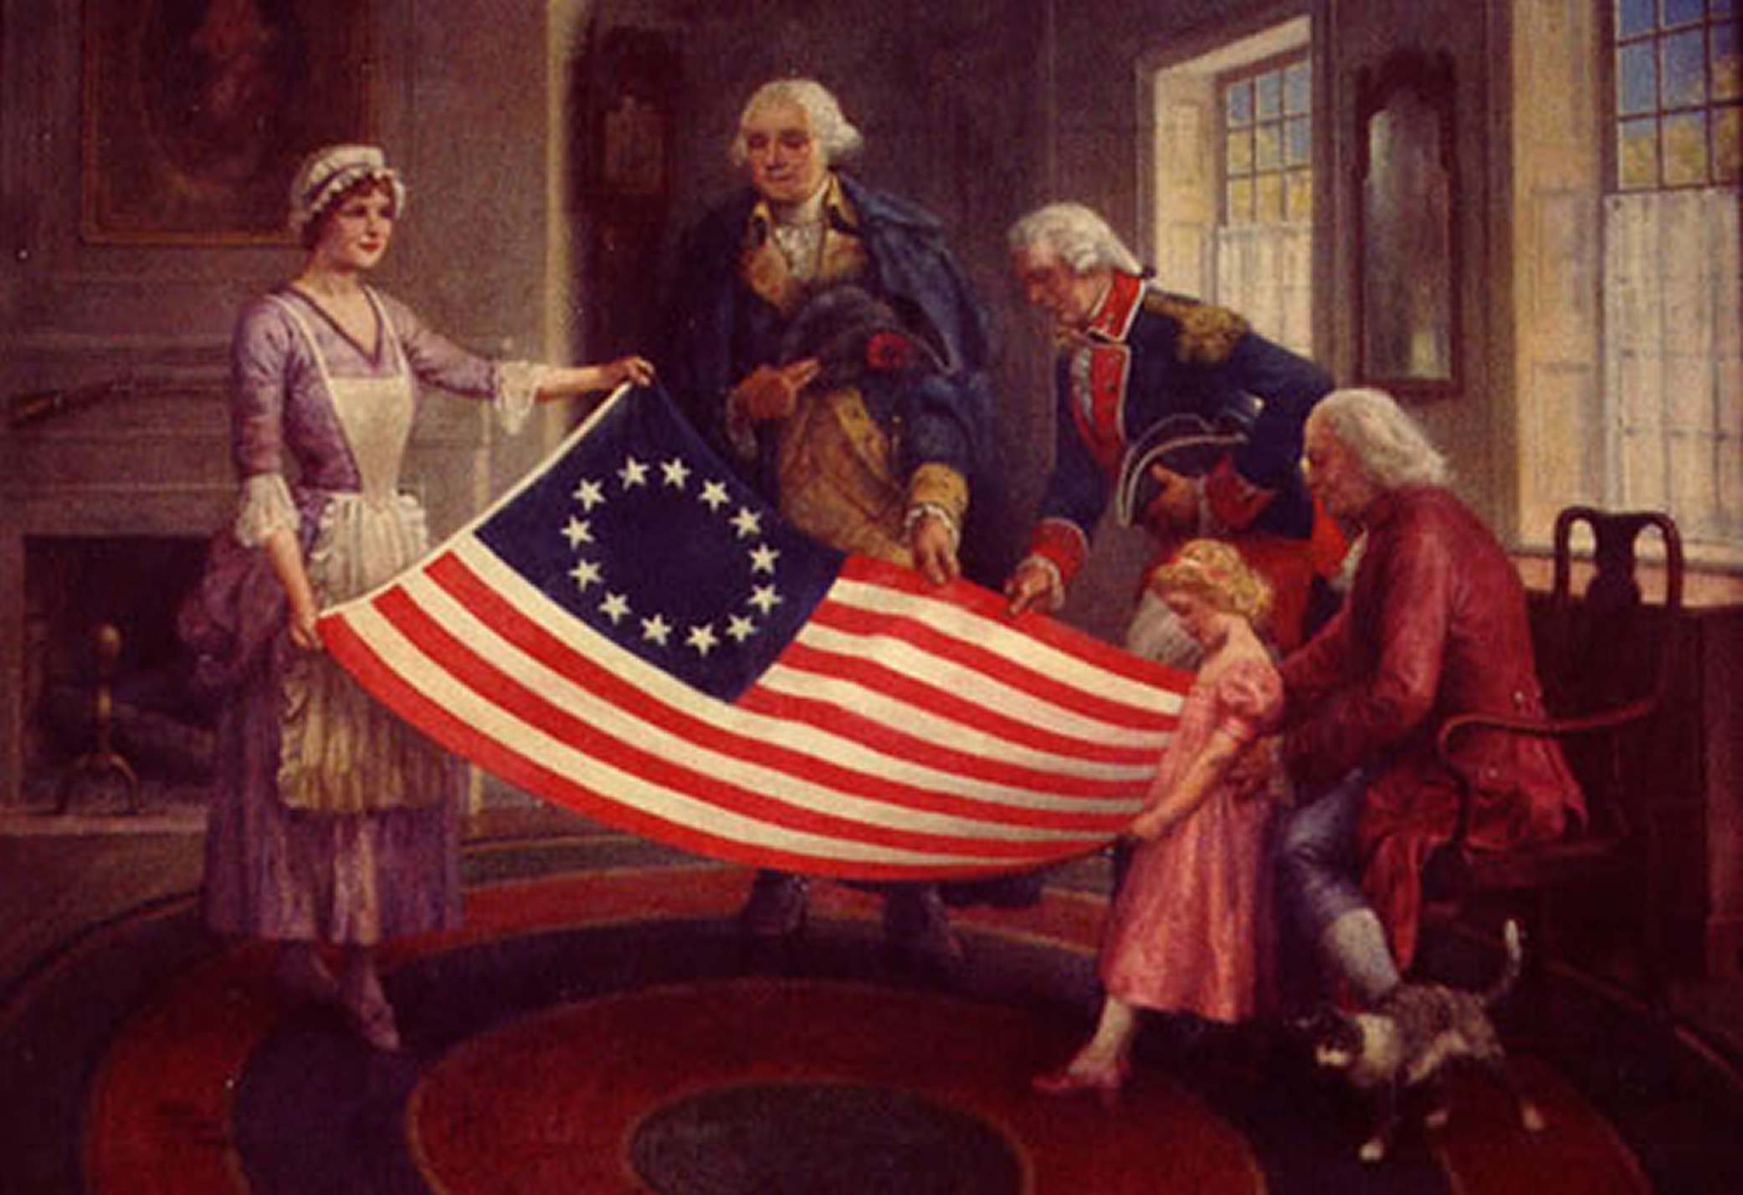
Colonies by 1754 cont.
Westward Expansion
More immigration= more diversity
Greater population= geographic expansion
French settlers and Native Americans dislike colonial expansion
British vs. French rivalry will lead to conflict
Will colonists want to be involved?
Or will colonists be upset?

