Slide 1
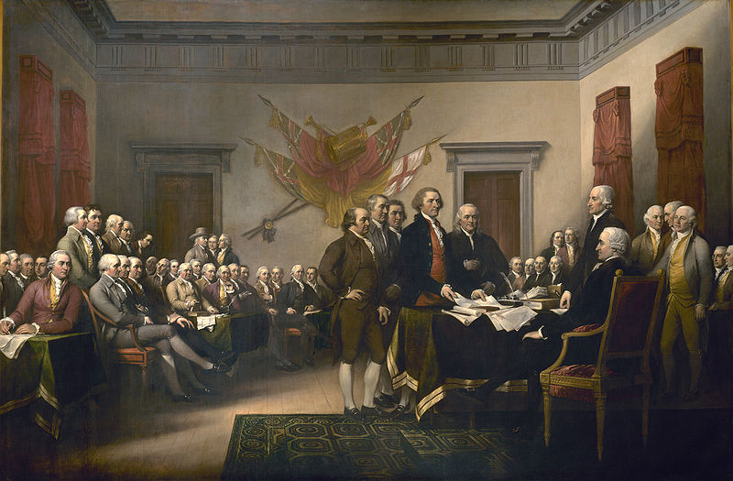
“We must all hang together, or assuredly we shall all hang separately.”

Slide 2
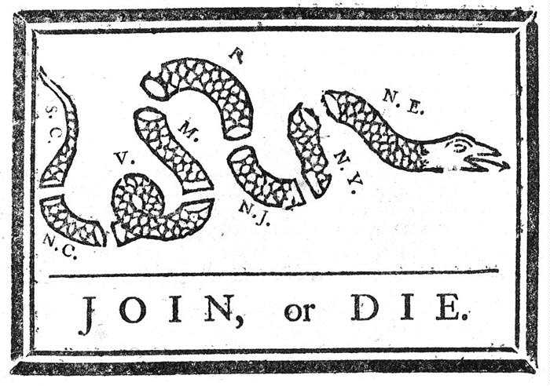
The History of Colonial Unity!
“We shall all hang together, or we shall all hang separately!”
- Ben Franklin July 4, 1776

Slide 3
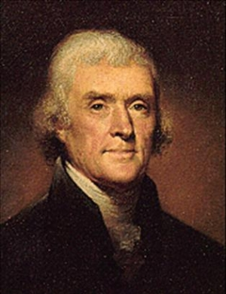
The Declaration and Slavery??
He has waged cruel war against human nature itself, violating its most sacred rights of life and liberty in the persons of a distant people who never offended him, captivating & carrying them into slavery in another hemisphere or to incur miserable death in their transportation thither. This piratical warfare, the opprobrium of infidel powers, is the warfare of the Christian King of Great Britain. Determined to keep open a market where Men should be bought & sold, he has prostituted his negative for suppressing every legislative attempt to prohibit or restrain this execrable commerce. And that this assemblage of horrors might want no fact of distinguished die, he is now exciting those very people to rise in arms among us, and to purchase that liberty of which he has deprived them, by murdering the people on whom he has obtruded them: thus paying off former crimes committed again the Liberties of one people, with crimes which he urges them to commit against the lives of another

Slide 4
Declaration of Independence Greatest break up letter ever written!
1) Introduction-
Q: What are the three basic purposes? THREE KEY WORDS (Verbs)!!
A: Dissolve, Assume, Declare
2) philosophical/ beliefs statement: LOCKE!!!!
Q: Who should govern? WHY? To what ends?
A: Government created by the consent of all men
A: Natural rights given to them by god
A: Overthrow when consent of governed is lost!
3) Why we fight? – List of grievances….why we don’t like you!
“I got 27 problems but a Brit ain’t 1!!!!”
Read the 27 grievances AND try to list actual acts of Parliament /KING next to at least 3…USE YOUR NOTES FOR REVIEW!!!
4) Official Declaration-
Q: What does all this “declaration” business mean? In plain English, what is this section stating?
A: It’s over!
DEFINE ALL 17 KEY definitions for homework!!

