Slide 1
World War I & The Russian Revolution
Chapter 27

Slide 2
Setting the Stage for War
M.A.I.N. – 4 Factors
Militarism (glorification of military strength)
As rivalries grew so did militaries
Alliances
Three Emperors League: Germany, Russia & Austria-Hungary
Triple Alliance: Germany, Italy & Austria-Hungary
Triple Entente: Great Britain, France & Russia
Imperialism
Balkans became an area of intense conflict
Nationalism
Conflict over Africa & Asia almost led to war previously

Slide 3
System of Alliances
Type of Alliance | Countries Involved | Reason for Joining
Three Emperor’s League | Germany, Austria-Hungary & Russia | Germany – Isolate France Diplomatically & Keep Russia Neutral
Reinsurance Treaty of 1887 | Germany & Russia | Three Emperor’s League broken b/w Russia & Austria-Hungary
Triple Alliance | Germany, Italy & Austria-Hungary | Isolate France, German allies on East & South
Triple Entente | Great Britain, France & Russia | France saved Russia from crisis Great Britain afraid of German naval build up

Slide 4
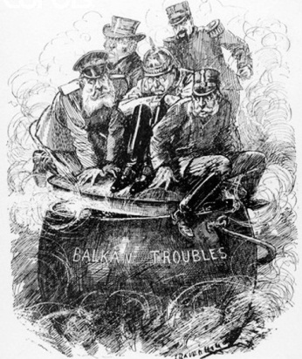
Balkan “Powder Keg”
June 28th 1914 – “Powder Keg”
Archduke Francis Ferdinand & Wife – Assassinated in Sarajevo
Gavrilo Princip – Serbian Nationalist Assassin
Austria-Hungary’s Ultimatum to Serbian Gov’t
1) Serbian Gov’t must suppress all Austro-Hungarian opposition groups
2) Dismiss school teachers & ban books that did not support A-H
3) Dismiss Gov’t officials who spoke out against A-H
4) A-H officials must be able to participate in assassination trials
Serbia Accepts 3 of 4
Offered to submit to International Court – denied
A-H declared war July 28th

Slide 5
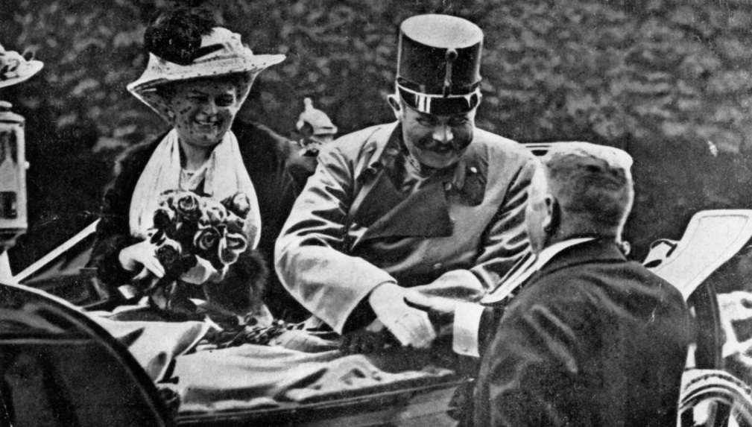
European Mobilization
Russia Supported Serbia via mobilization
Germany demanded Russia stop or face war
August 1st 1914 Germany declared war on Russia – 2 days later France
1839 Belgium guaranteed neutrality
August 4,1914 Germany marched into Belgium – bringing Great Britain into the war
Late August 1914 – Japan enters war (GB & France)
German possessions in China & Pacific
Total War
All resources allocated to war (Both alliances were in except Italy)
Italy stayed out – AH were aggressors not in terms of alliance
May 1915 – Italy makes secret alliance with GB, France & Russia
German Recruits – Ottomans & Bulgarians
Controlled the Dardanelles – stopped Russian Black Sea Fleet & supply chains

Slide 6
A New Kind of War

Slide 7
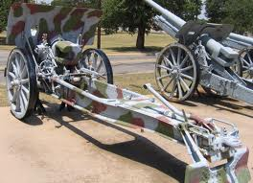
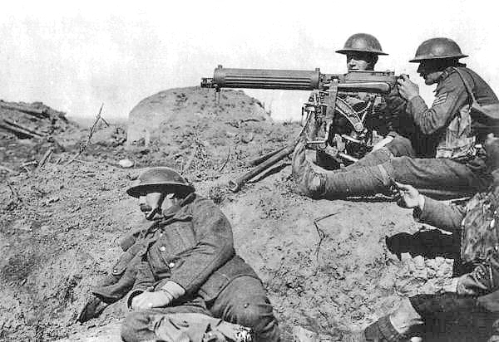
A New Kind of War

Slide 8
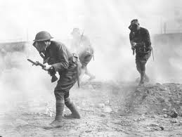
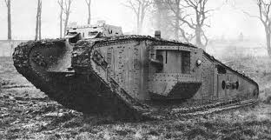
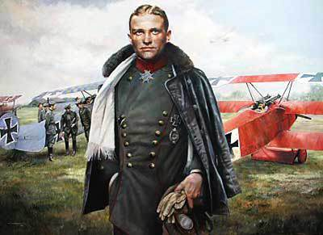
A New Kind of War

Slide 9
A New Kind of War

Slide 10
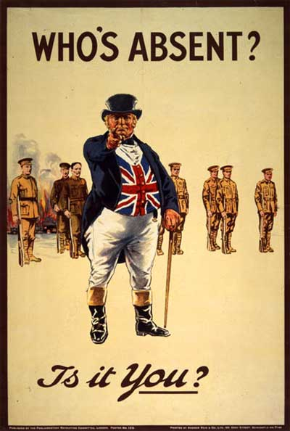
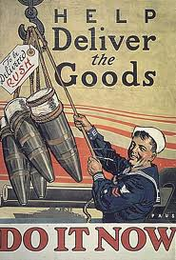
Propaganda

Slide 11
Early Years of the War
Two Front War
Battle of Marne turning point for allies – Saved Paris
Turned into a war of attrition
Attempts at Gallipoli a failure for allies
Lusitania Sinks – Precursor to war
Woodrow Wilson warns Germany – Jutland keeps German navy in port
Propaganda affects big business which affects the war!
Zimmerman telegram
Unrestricted sub warefare
Russian revolution
April 6, 1917

Slide 12
Lenin & The Bolsheviks
Provisional Gov’t until a Constitutional Assembly elected
Petrograd Soviet Workers’ & Soldiers’ Deputies – socialist reform seekers
2 Factions fought for control of the “Soviets” Mensheviks & Bolsheviks
Vladimir Lenin – Bolshevik leader, Marxist
“Peace, Bread & Land”
Organized October Revolution – 1917 (control of Russia)
Turned Russia into a constitutionally socialist state
Bolsheviks → Communists
Ended war – Peace w/Germany March 1918 – Brest Litovsk
Civil War broke out in Russia b/w Whites & Reds
Reds – European socialist revolutionaries
Whites – Right-wing counter revolutionaries

Slide 13
The Terms of Peace
Wilson’s 14 Points
6 General Points – 8 Country Specific – Postwar plan for peace
1) No Secret Treaties
2) Freedom of the seas for all nations
3) Removal of all economic barriers, such as tariffs
4) Colonial claims restructured for fairness to both Imperialist powers & ppl
5) Reduction of national armaments
6) “General Association of States” – international policing force

Slide 14
Central Powers Defeated
Summer 1918 – Last Major German Offensive – Paris
End of May: 37miles outside of France – US arriving each day
Germans stopped @ Chateau-Thierry under French Marshal Ferdinand Foch (FAWSH)
July-September: Allied Counter Attack Pushed Germans back
Bulgaria surrenders end of Sept – Ottomans followed suit
October: Habsburg empire ceases in A-H
Stopped fighting separated gov’ts
November: Wilson tells Germany we’ll only deal with “Real Gov’ts of People”
Kaiser Wilhelm II gives up throne – German republic announced
November 11th 1918 – German armistice
Treaty of Brest-Litovsk cancelled
Gave up large part of fleet (all subs) & munitions
Release all war prisoners
Allies occupy German territory west of the Rhine

Slide 16
Paris Peace Conference
January 1919 Allied Meeting in Versailles (Big 4)
U.S. – Woodrow Wilson
Britain – Prime Minister David Lloyd George
France – Prime Minister Georges Clemenceau
Italy – Prime Minister Vittorio Orlando
Allies wanted to dictate the peace settlement
France: security against Germany, Alsace-Lorraine (Border east of Rhine), Saar Valley
Italy: Tirol & cities of Fiume & Triest
Belgium: Small portions of Germany along border
Great Britain: Germany’s African colonies & destruction of Navy
Japan: German pacific

Slide 17
Trust Issues
2 Schools of Thought for Peace
Wilson: fair peace settlement, not too harsh, prevent future wars
Europe: hatred towards Germany, punish and pay reparations
Secret treaties still in play
France: only way to guarantee security is to break up Germany

Slide 18
Treaty of Versailles
May 1919 – German Republic Terms of Treaty
Admit guilt to starting war
Pay reparations alone
Alsace-Lorraine returned to France
Belgium increased borders (small German territories)
Could not fortify the Rhineland
Poland restored as an independent nation – Polish Corridor (Baltic Sea)
Port of Danzig becomes a free city – League of Nations
No draft
Army no larger than 100k
Could not manufacture heavy artillery, tanks or military airplanes
Few warships, no subs

Slide 19
With Peace Comes Turmoil
Peace treaties create new problems
Austria & Hungary – National Self-Determination (14 Points)
New boundaries did not match natural ethnic divisions
3 Million Germans in Czechoslovakia
Hungarians in Romania
Polish Corridor inhabited by Germans (“root of the next war”)
Armenian Genocide resumed in 1920

Slide 20
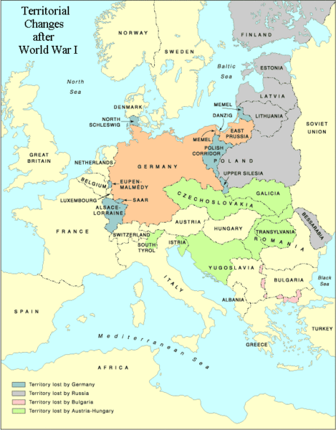
Turmoil Ctd
Bulgaria – territory to Greece lost access to Aegean Sea
Ottoman Empire – left with just Turkey
Palestine, Transjordan, Syria & Iraq all form – Britain & France admins for League of Nations
Dardanelles remained w/Turkey – could not be fortified & under itl control
Russia – Isolated from Allies
Finland, Estonia, Latvia & Lithuania become independent

Slide 21
League of Nations
2 Main aims:
Promote international cooperation
Keep peace among nations by settling disputes & reducing armaments
No war over disputes – submit to World Court, sanctions for breaking diplomatic relations
3 Agencies to conduct business
Assembly: representatives of all member nations – one vote per nation
Council: peacekeeping body, 9 member nations (5 permanent, remaining rotate)
Secretariat: represented civil service of the league, est archives
Work closely w/World Court (The Hague, Netherlands)
Determine cases involving international law

Slide 22
League of Nations
Mandates
League responsible for overseas colonies of defeated countries until “ready for independence”
Colonies became mandates (ruled by the gov’t of an “advanced” nation)
Ruling nation – prepare people for independence
U.S. Senate – Vetoes Joining the League
Americans were wary of leagues powers, unhappy with treaty language, afraid of new war due to peace keeping commitments

