Slide 1
Italian Renaissance

Slide 2
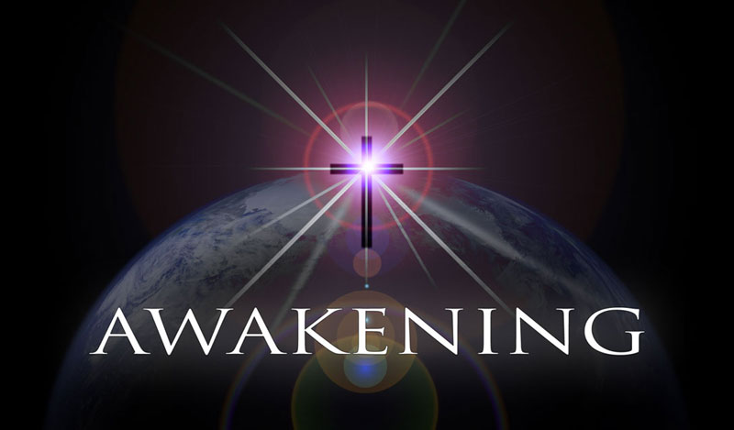
Era of Awakening
Movement began in Italy that would alter how Europeans would view themselves and world.
Renaissance meaning
Rebirth
Philosophical and artistic movement
Medieval Scholars had studied ancient history and tried to bring everything they learned into harmony with Christian Teachings.
Era when the movement flourished
A new emphasis on the Power of Human Reason developed.

Slide 3
Causes
Renaissance started in
Italy
Why?
Reminded Italians of Roman glory
Scholars preserved Greek and Roman learning
Trade helped Italians learn about Arab and Africa achievements in science and medicine.
Wealth spreads throughout cities
Florence, Medici family: bankers than rulers of city-state
Lorenzo de Medici: patron of the arts
Mantua, Isabella d’Este: fills palace with paintings and sculptures of finest Renaissance artists.

Slide 4
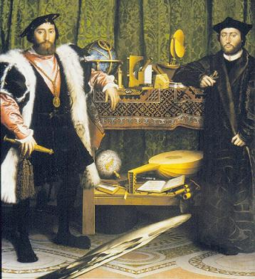
Humanities
Humanists:
People who specialized in either Greek and Roman literature to study grammar, history, poetry, and rhetoric.
Some turned to Jewish teachers to learn:
Hebrew
Language of the Bible
Studied classical manuscripts
Many Catholics:
Remain committed to Christian
Teachings.

Slide 5
Writers
Francesco Petrarch
Sonnets to Laura
Greatest love poems in literature
Studied classical education:
Study of ancient Greek and Roman literature
Niccolo Machiavelli
Wrote the essay “The Prince”
Ruler should worry about power and political success
Looked up to Romans as models (this is why he is humanist)
Better to be feared or loved?
Baldassare Castiglione
Published “Book of the Courtier”
Setting is Urbino, Italy (where Castiglione lived)
Uses real people in fictional conversations
Manners of society

Slide 6
Focus was on the individual, fame, fortune, legacy, make money and spend money
Shift from a focus on the spiritual to the worldly
Man was to enjoy his time on earth but still be a good Catholic
This shift was reflected in the study of the humanities and art
Due to an increase of trade, a middle class begins to emerge
Cities become bigger and we see a small shift from agrarian to a trading society
Cities nurture the Renaissance

Slide 7
Artists
Stressed world beyond everyday life
Formal figures to stress religious concerns.
Realistic scenes and images
Perspective painting:
Painting more lifelike, distant objects smaller (illusion of depth on flat canvas).
Giotto
Fly on the painting so realistic
“Nativity, The Birth of Jesus” “The Last Judgement”
Leonardo Da Vinci
Engineer, painter, sculptor, and scientist.
“The Last Supper” “Mona Lisa”
Used Math for space on paintings, science to make realistic images of humans.

Slide 8
Artists cont.
Michaelangelo
“Sistine Chapel” located in Vatican
“David”
Design of “St. Peter’s Basilica”
Rafael
Pope hires him to help beautify Vatican
“School of Athens” “Transfiguration”
“Madonna paintings (Virgin Mary)”
Titian
“Assumption of the Virgin”
Sense of drama and rich colors

Slide 9
Giotto
Nativity Scene

Slide 10
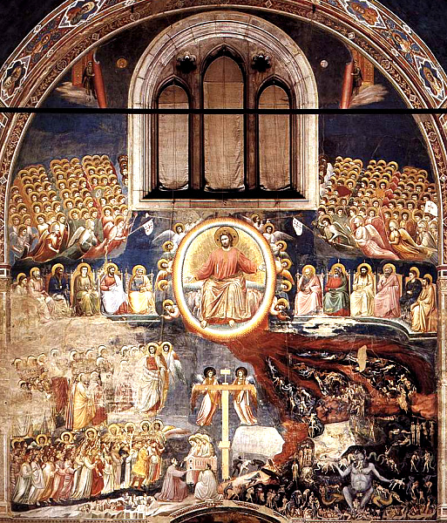

Slide 11
Last supper
Leonardo da vinci

Slide 12
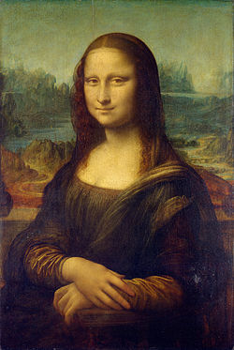

Slide 13
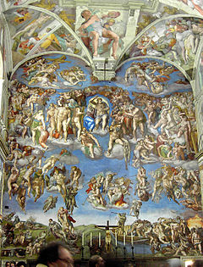
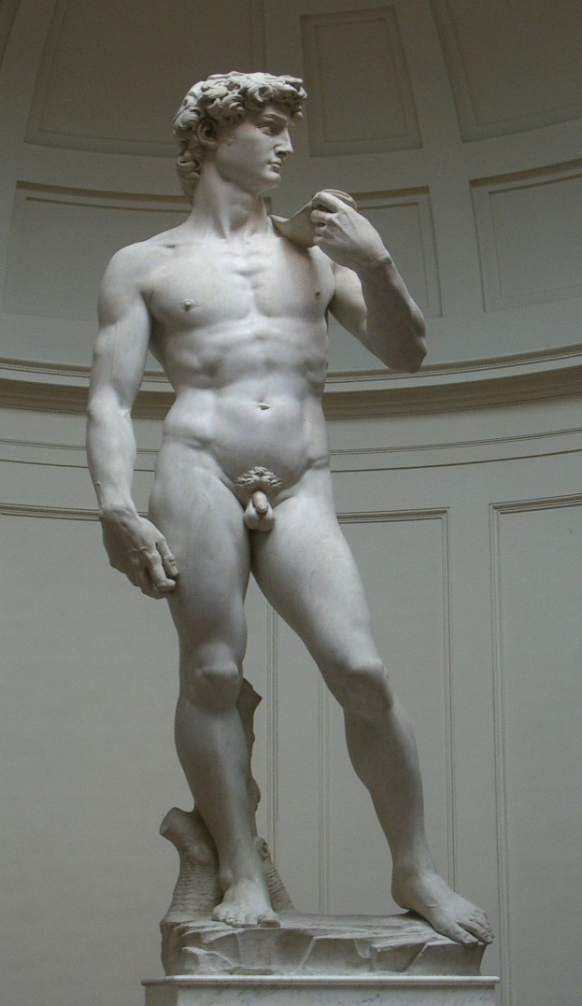
Michelangelo

Slide 14
Rafael
School of athens

Slide 15
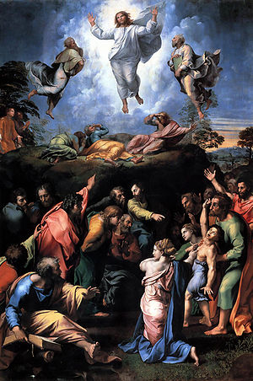
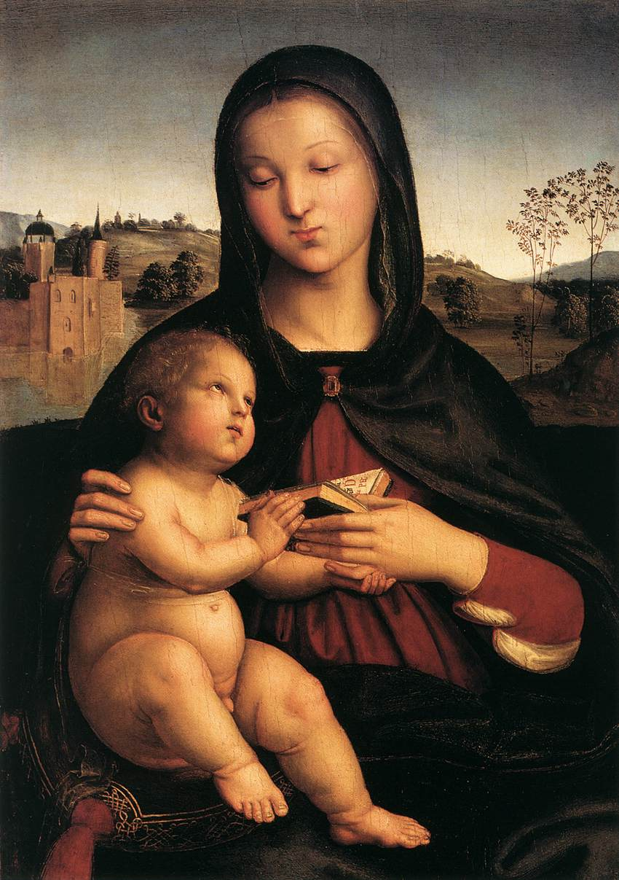
raphael
Transfiguration Madonna

Slide 16
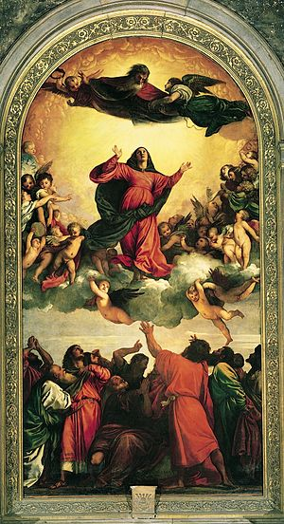
Assumption of the virgin: titian

Slide 17
Northern Renaissance
Where:
Many ideas carried from Italy to Germany, Netherlands, France, and England.
As increased commerce created new wealth and more people could afford higher education, many universities were established.
New Process called – Printing- also helped spread Renaissance ideas.

Slide 18
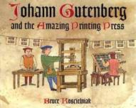
Gutenberg of Mainz, Germany
In 1450, Gutenberg became the first European to use moveable type to print books
The bible was the book he would copy first
Books can be massed produced thus becoming cheaper and affordable to more people
Vernacular – common man’s language thus they can read the Bible without the priest’s interpretation, people have their own interpretation and begin to challenge the church, the role of priests is slowly changing
Scribes were not happy
Some people liked hand-copied manuscripts better

Slide 19
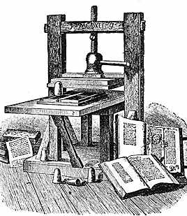
The impact of the Printing Press did not slow down.
By 1475 printing presses operated in England, France, Germany, Italy and serveral other European Nations!!!!
This help spread new Humanist ideas to a large audience quickly!

Slide 20
Northern Renaissance Writers
Erasmus- a Dutch scholar – his most famous work was called The Praise of Folly.
In his book he criticized: fasting, pilgrimages to religious shrines, and even the church’s interpretation of the Bible.
Thomas More- an English Humanist wrote the Book Uptopia, became very popular.
His book condemned governments as corrupt and agrued that private property only led to conflicts.
King Henry VIII of England, had him put to death when he would not recognize that he was the supreme head of the church.

Slide 21
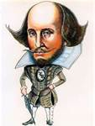
William Shakespeare
Shakespeare stands out as leading literary figure of the time.
His ability to transform well-known stories into dramatic masterpieces was one of his great qualities.
Hamlet – The Moody
Romeo and Juliet- 2 Young Lovers
Macbeth- Trajedy

Slide 22
Northern Ren. Artists
Northern Europeans were studying Italian master painters at this time.
In Flanders a group of painters developed their own style.
This group start the Flemish School.
They are credited to perfecting certain techniques of painting in oil and canvas.
Strong interest in facial expressions.
Perspective was also being utilized by the Germany artists of the time.

Slide 23
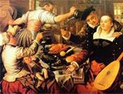
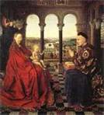
Flemish Art

