Slide 1
Unrest in Austria: Coping with Nationalistic Movements
Chapter 25.5

Slide 2
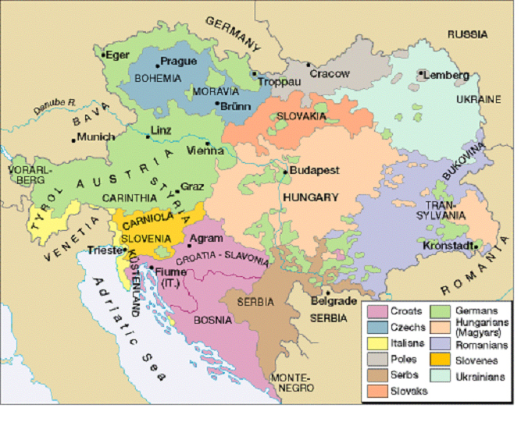
The Decline of the Austrian Empire
Status of Austria very poor:
Lost HRE
Italy
Revolts broke out
Hungary
“The Last Straw”
Lost 7 Weeks’ War
Notes:
HRE was dissolved by Napolean
What happened between Austria and Italy??
The seven weeks war-what is it?
Who were the revolts inspired by?

Slide 3
The Dual Monarchy
To save the empire, Austria gave in to Hungarian demands and created a Dual Monarchy (aka Austria-Hungary)
Led by Francis Joseph I
Strengths | Weaknesses
-Provided markets for ea. other (A- Ind. & H- Ag.) -Ended revolts | -Tariffs (A. wanted high taxes) -Ethnic divisions -Austria weak
Notes:
Francis Joseph I was the Emperor of Austria and King of Hungary
The dual monarchy had three ministries that controlled war, finance, and foreign affairs
Each had separate parliments
Their markets provided for each other

Slide 4
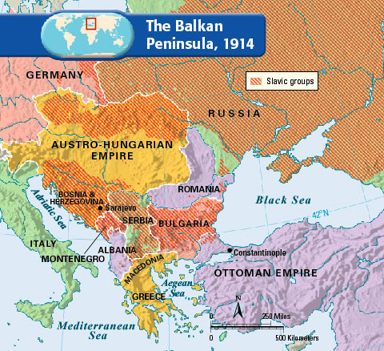
Austria-Hungary’s New Focus
Wanted to control the Balkans
Not an easy task:
Needed to take away from Ottomans
Balkan people wanted independence
European countries also wanted to control Balkans
Notes:
Which European countries do you think would want control of the Balkans?? Russia/Great Britain

Slide 5
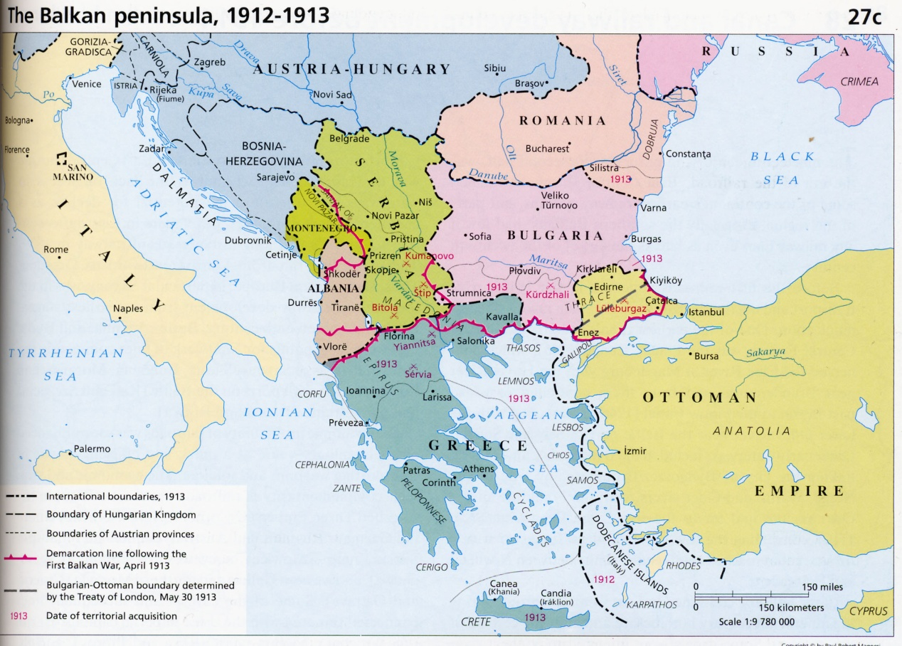
Dividing the Balkans
1875 Balkan revolts ended w/ Ottoman defeat
Treaty of San Stefano
Romania, Serbia, Montenegro, independence
Self-Rule to Bulgaria which Russia then occupied for years
Notes:
Russia backed the Balkans
Treaty of San Stefano-granted independence to Romania etc…

Slide 6
Dividing the Balkans
At the Congress of Berlin:
GB , Russia, Ottomans given some territory
A&H governed Bosnia and Herzegovina
Later A&H annexed
Result:
Ottoman Empire weak
Balkan states resent A&H
Notes:
Ottoman empire is weak-by 1913 they controlled only the city of Constantinople and enough land to control the passage from the Black Sea to the Mediterranean Sea

Slide 7
Dividing the Balkans
Balkan League
Bulgaria, Montenegro, Greece, Serbia
Balkan League declared war on the Ottoman Empire and won
Led to a 2nd war between Ottoman Empire, Serbia, Greece, Montenegro, Romania and Bulgaria
Bulgaria gets annihilated
Tensions in the Balkans continue to grow

