Slide 1
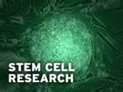
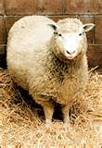
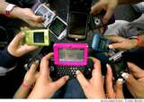
The Scientific Revolution Should people fear new ideas?
Chapter 16

Slide 2
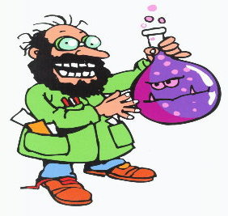
What is the Scientific Revolution?
Beginning of modern science
Scientists said:
Challenge ALL accepted knowledge
ONLY believe if it is tested and proven
Use experiments to reveal ALL the laws of nature

Slide 3
Why did the Scientific Revolution happen?
While the Greeks, Romans, Muslims and early Renaissance men used reason…
THEY NEVER RAN EXPERIMENTS!
Based understanding on assumptions and illusions

Slide 4
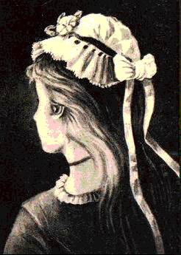
Illusions vs. Conclusions

Slide 5
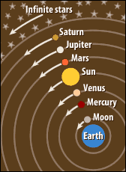
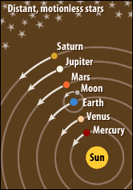
Geocentric vs. Heliocentric
Ptolemy
Copernicus

Slide 6
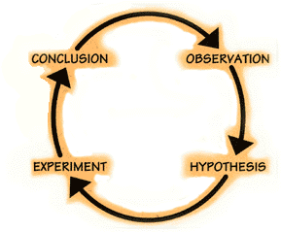
The Scientific Method

Slide 7
Truth is not known at the beginning of inquiry but at the end, after a long process of investigation.

Slide 8
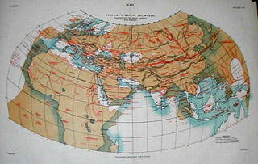
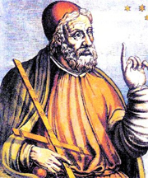
Improvements in Technology
Mapmaking-
Understood world was round
Added Africa and Asia
Looked to west, across Atlantic, for quick route to Asia
Ptolemy

Slide 9
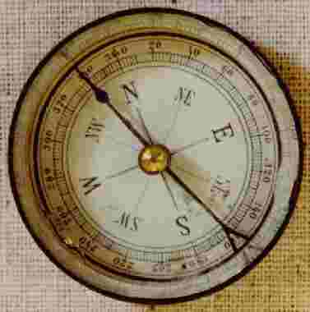
Improvements in Technology
Navigation-
Compass- pointed north
Astrolabe- plot course of latitude to determine nearness to land

Slide 10
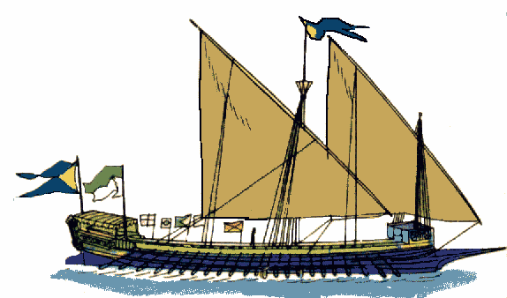
Improved Technology
New Ships
Longer and larger, sails changed, and ruder moved from side to rear
Much faster and could sail against the wind

Slide 11
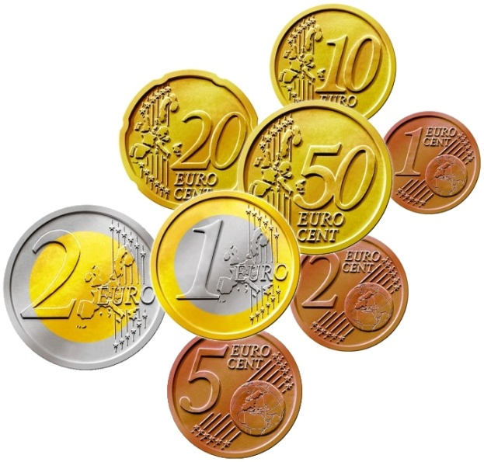
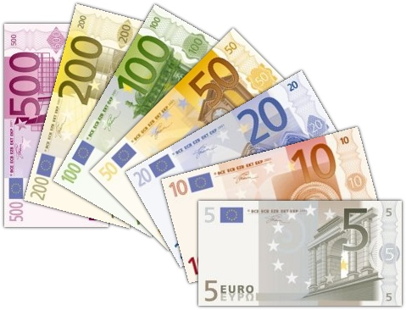
Commercial Revolution
Improvement of business-
Standardized System of Money- money had fixed value
Joint Stock Companies- financed exploration

Slide 12
Mercantilism
A country should do ALL it could to increase country’s wealth
2 ways to get Wealth:
Mine gold and silver (home or away)
2. Create a Favorable Balance of Trade - sell more goods then buys
Tariffs on imports
Grant Subsides to promote exports
Imperialize/Colonize
Show Me The Money!!!

Slide 13
Factors
Technological Advances
Economic Changes
Mercantilism
Social Changes
Influences on Exploration
Long sea voyages possible and safer
Funded exploration
Made nations want colonies for gold, silver, and raw materials
O/ crowding and persecution gave people reasons to settle in colonies

Slide 14
Was the age of exploration a blessing or a curse?

Slide 15
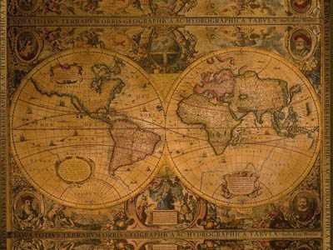
The Columbian Exchange
Movement of plants, animals, peoples, and diseases b/w the “Old World” (Europe, Africa, Asia) and “New World” (Americas).

Slide 16
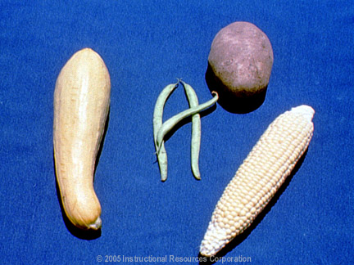
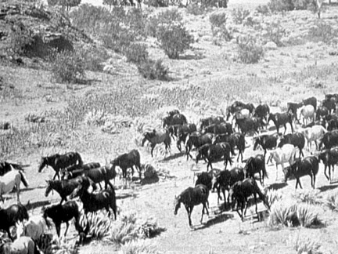
Food and Animals

Slide 17
Where is that item from?

Slide 18
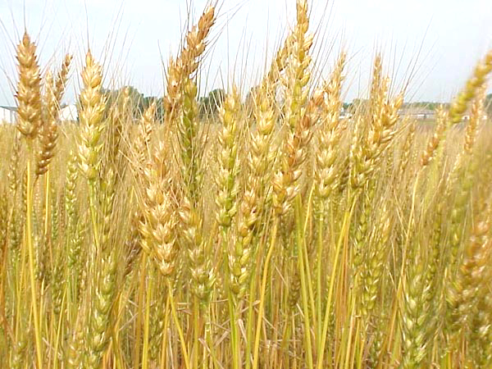
Wheat?

Slide 19
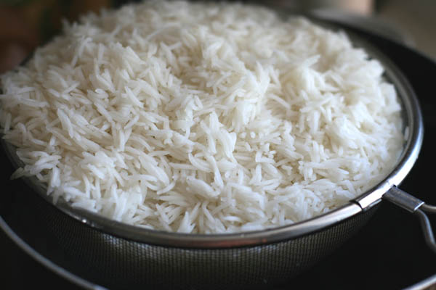
Rice?

Slide 20
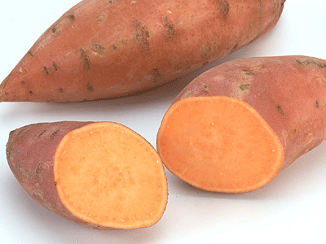
Sweet Potato?

Slide 21
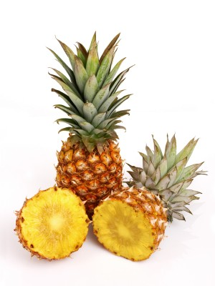
Pineapple?

Slide 22
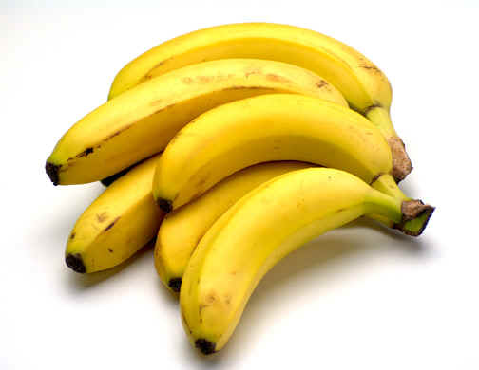
Banana?

Slide 23
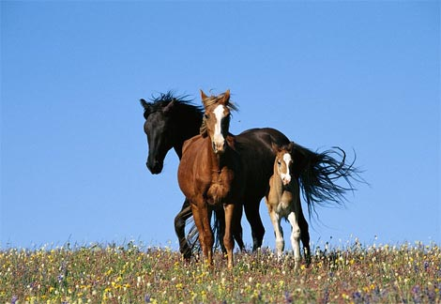
Horses?

Slide 24
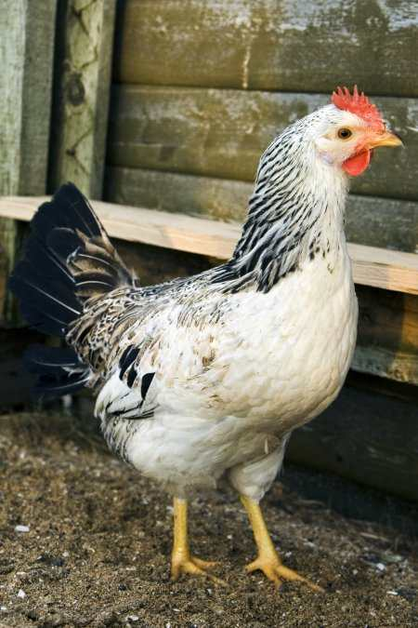
Chickens?

Slide 25
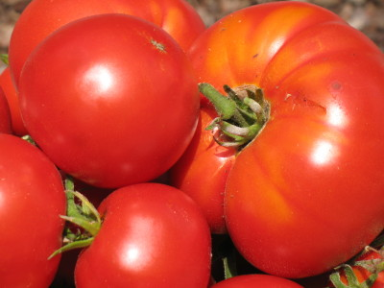
Tomatoes?

Slide 26
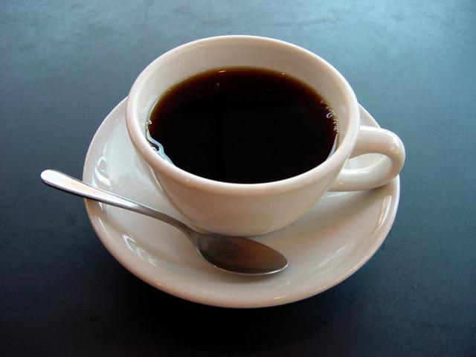
Coffee?

Slide 27
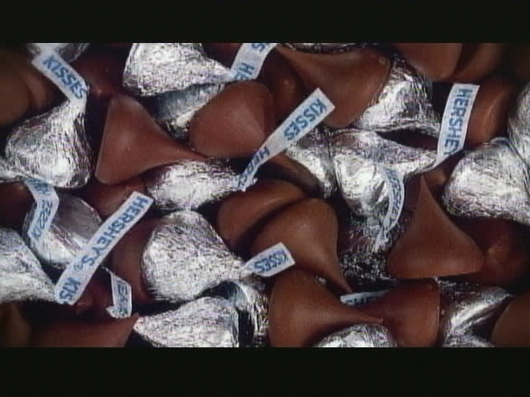
Chocolate?

Slide 28
That item is from…
Old World | New World
Wheat Rice Banana Horse Chicken Coffee | Sweet Potatoes Pineapple Tomatoes Chocolate

Slide 29
5-6 Groups
Sarah, Spence, Joel
Priyanka, Baldwin, Isaiha
Sam, Amalie, Troy, Heaps
Olivia, Vanessa, RJ, Jesse
Tiffany, Jake, Alix, Phillip
Devon, Nicole, Wall, Brian

Slide 30
7-8 Groups
Kacie, Ashley, Chantall, Stenichy
Syd, Julie, Cameron, Toby, Emily
Andrew, Corey, Morgan, Brian
Nicolette, Kathryn, Rob, Valerie

Slide 31
17-18 Groups
James, Carmella, Jenny
Hope, Ace, Chelsea
Andie, Kirsten, Hollywood
Dana, Swartz, Maroney, Pellechio
Jimmy, Tad, Ali
Parker, Alexis, Ray

Slide 32
Was the age of exploration a blessing or a curse?

Slide 33
Doc. 1: Columbus
“In order to win the friendship and affection of that people,
and because I was convinced that their conversion to our Holy Faith would be better promoted through love than through force,
I presented some of them with red caps and some strings of glass beads which they placed around their necks,
and with other trifles of the insignificant worth that delighted them and by which we have got wonderful hold on their affections.”

Slide 34
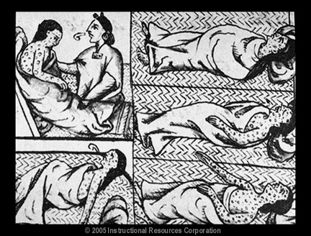
Doc. 2: Diseases

Slide 35
Diseases
Old Word | New World
Bubonic Plague Chicken Pox Cholera Influenza Leprosy Malaria Measles Scarlet fever Small pox Typhoid Typhus Yellow fever | Syphilis Yaws

Slide 36
Doc. 3: Economics
“…It also is our desire that the Indians live in community with the Christians, because they then will help each other cultivate and settle the island, take out the gold, and bring profit to Spain.
Therefore, we command you, our governor, to compel the Indians to associate with the Christians.
The Indians should work on the Christians’ building, mind the gold, till the fields, and produce food for the Christians.
This the Indians shall perform as free people, which they are, and not as slaves.
Also, see to it that the Indians are well treated, with those who become Christians better treated than the others.
Do not consent or allow any person to do them any harm or oppress them.”

Slide 37
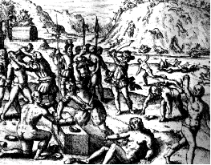
Doc. 4: Treatment of Natives
" Loss of hand because gold quota not met" Commissioned by B. De Las Casas

Slide 38
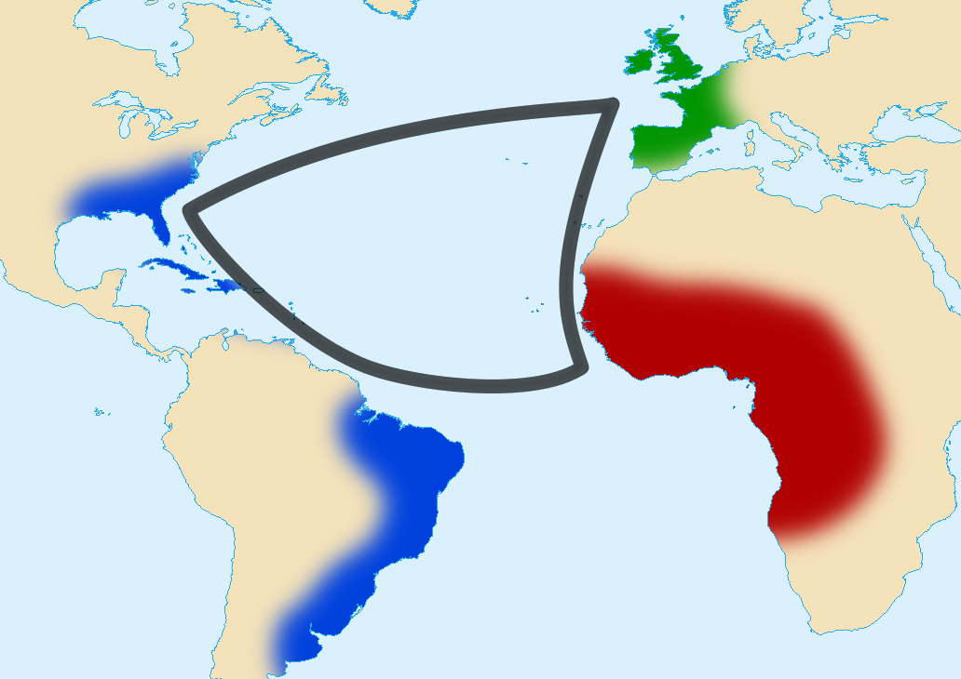
Triangular trade

Slide 39
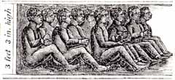
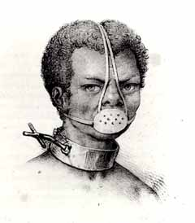
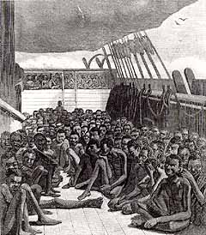
The Middle Passage

