Slide 1
The Rise and Fall of Napoleon Bonaparte
Chapter 21 section 4 & 5

Slide 2
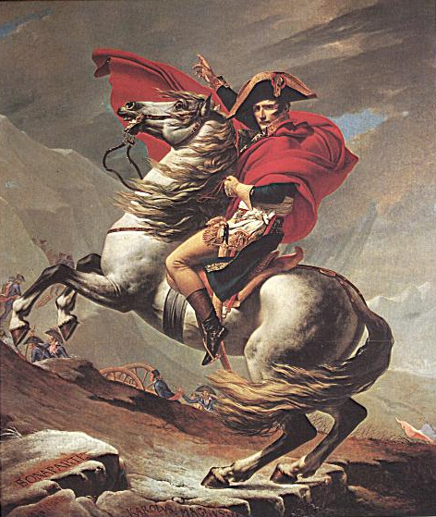
Napoleon
“He did not hate any more than he loved; for him nothing existed but himself… Neither pity, nor religion, nor attachment to any other idea whatsoever, could [deflect] him from his principal direction.”
Great military leader
Very ambitious & energetic
Age of Napoleon 1799-1814

Slide 3
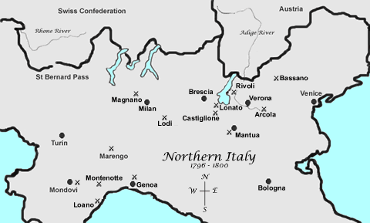
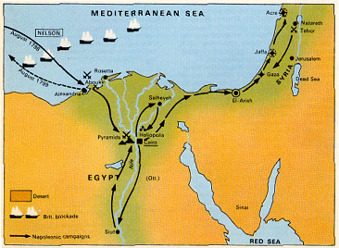
Napoleon’s Rise to Power
Early Campaigns:
Italy
Defeated Austrians
Gained N. Italy
Egypt
Initially won land battles
But British destroyed French Navy
Napoleon left army & returned to France a “hero”

Slide 4
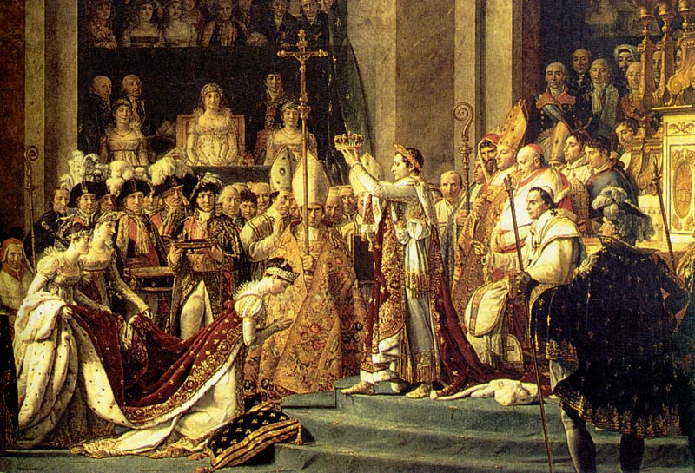
Napoleon Seizes Power
1799 Napoleon stages coup d'état; Becomes First Consul
1802 he made himself “Consul for Life”
1804 he crowned himself “Emperor”

Slide 5
Napoleon’s Government
As Emperor, Napoleon:
Controlled army & navy
Appoint or dismiss officials
Made new laws
Legislative Branches
Practiced the procedure called Plebiscite
Vote yes or no; No debate

Slide 6
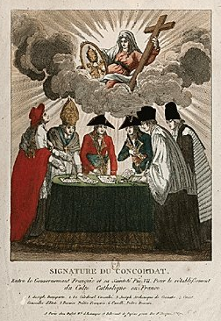
Accomplishments in Government
Napoleonic Code
French law code
Bank of France
Public Education
Concordat
Agreement w/ Pope
France mostly Catholic, but religiously tolerant

Slide 7
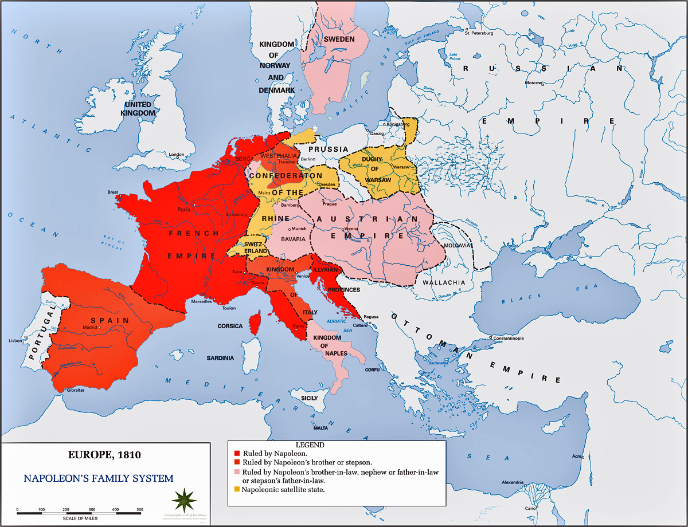
Napoleons Europe

Slide 8
Napoleon’s style of government has been called rule for the people, but not by the people. Should freedom be limited to preserve national security?

Slide 9
Holding on to Power…

Slide 10
Continental System
Blockade of British Isles
No allies of France allowed to trade w/ Britain
Why created:
Britain & allies start war w/ France
France defeated allies; But couldn’t defeat British Navy
Continental
System

Slide 11
Maintaining Control: Reorganization of Europe
Abolished HRE
Made family members monarchs of conquered countries
Abolished feudalism and serfdom
All new territories given Napoleonic Code

Slide 12
The Beginning of the End…

Slide 13
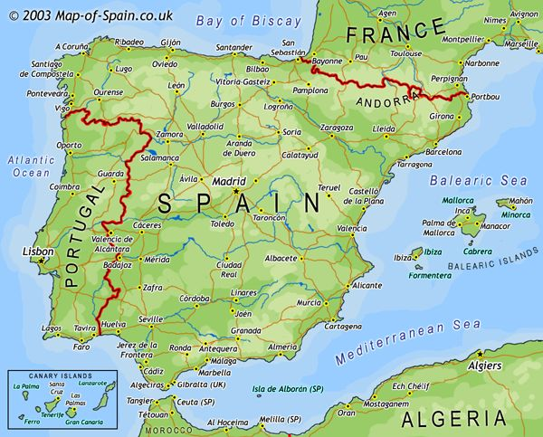
The Peninsular War 1808-1814
War in Iberian Peninsula
France vs. Britain/Portugal/Spain
Why:
Portugal ignored Cont. System
Napoleon invaded Port., then Spain, & took both over
Napoleon made bro. Joseph, King Port. & Spain
Britain drove Joseph off throne

Slide 14
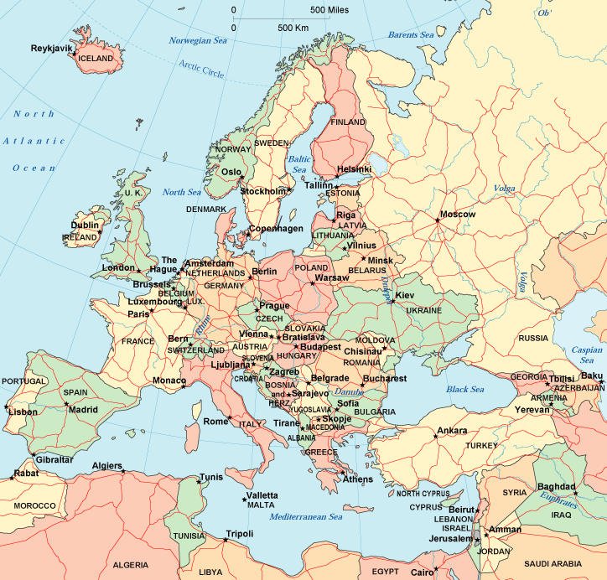
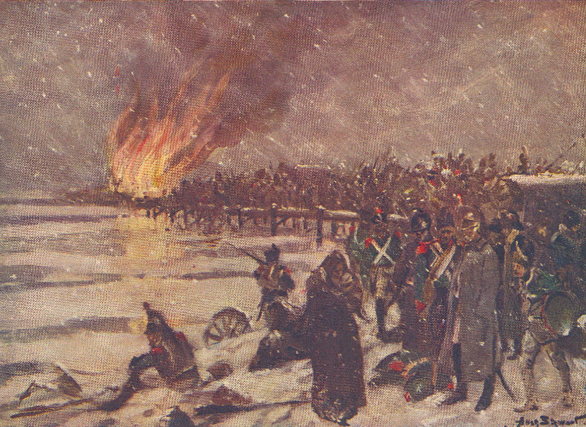
Problems in Russia
1812 Russia ignores Cont. System
Napoleon invaded Russia, but campaign ended in disaster
Russians defeated Napoleon using scorched-earth policy

Slide 15
“I made a mistake attacking Russia. I thought the whole world would be behind me. Everybody turned against me… One shudders when one thinks of Russia… She overflows on you if you lose; she retires back into the ice banks if you win… and I tried [to attack her] stupidly…” ~Napoleon

Slide 16
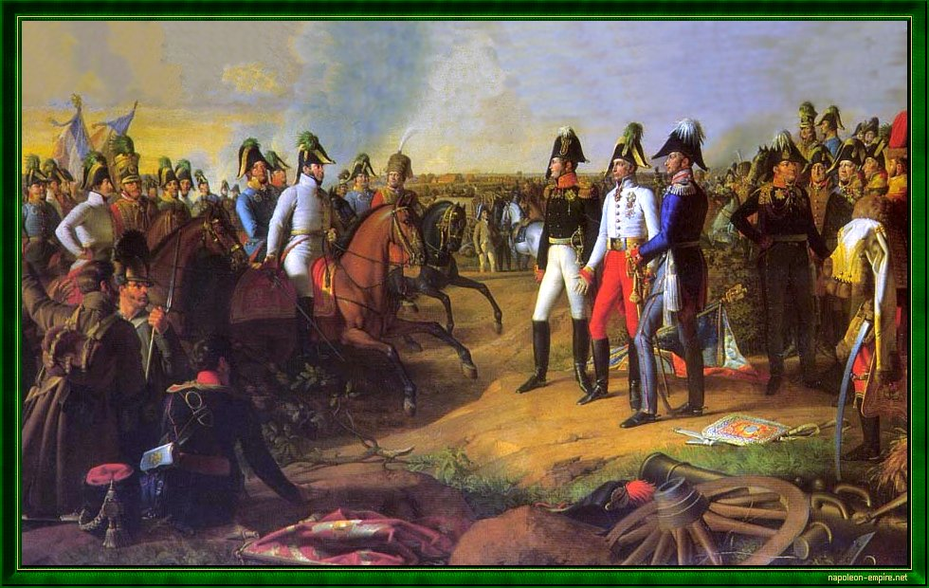
Napoleons 1st Defeat: The Battle of Leipzig

Slide 17
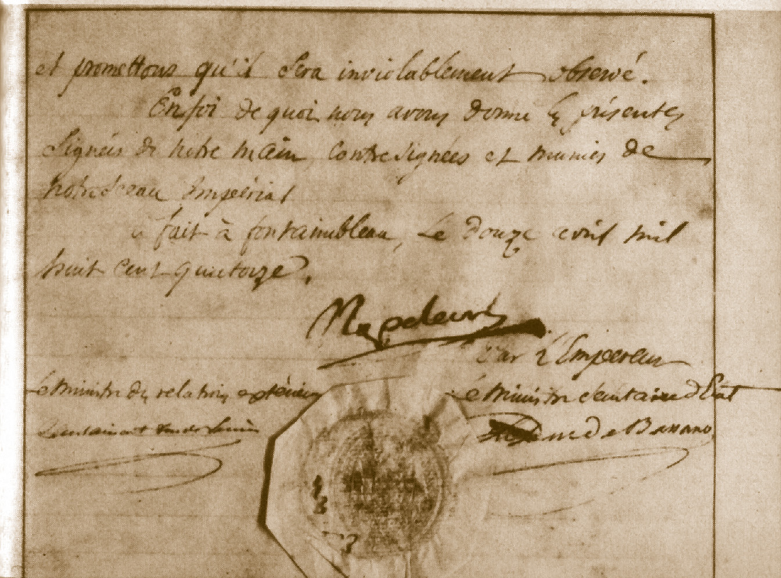
Napoleon Abdicates

Slide 18
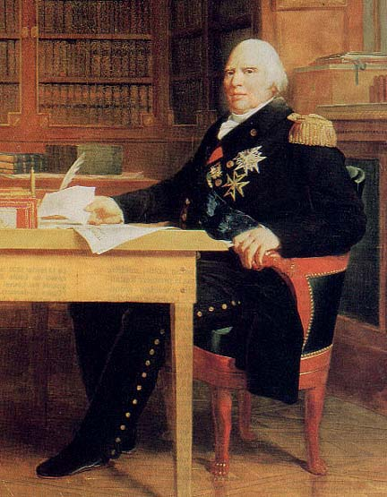
The Bourbons Return: Louis XVIII (18th)

Slide 19
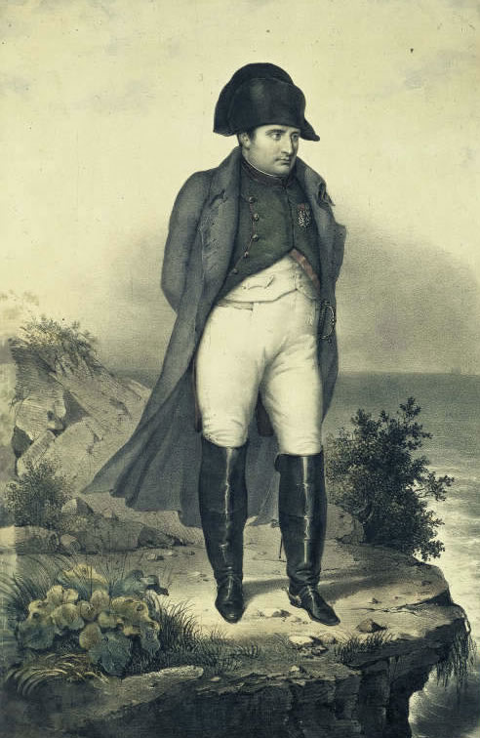
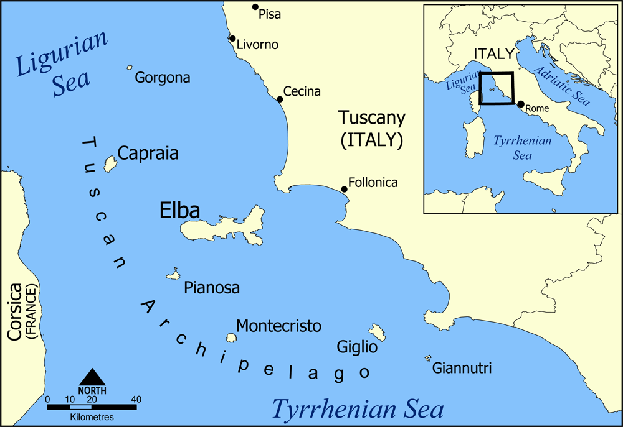
Napoleon is Exiled to Elba

Slide 20
To Be Continued…

Slide 21
Guess Who’s Back…

Slide 22
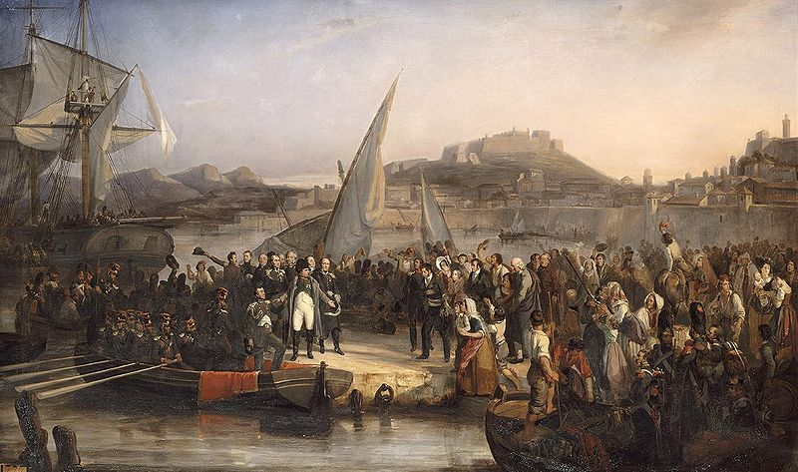
Napoleon’s “100 Days”

Slide 23
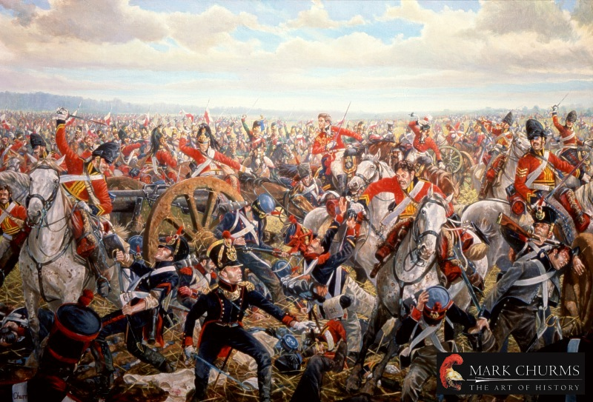
Napoleons Final Defeat: The Battle of Waterloo (#7)

Slide 24
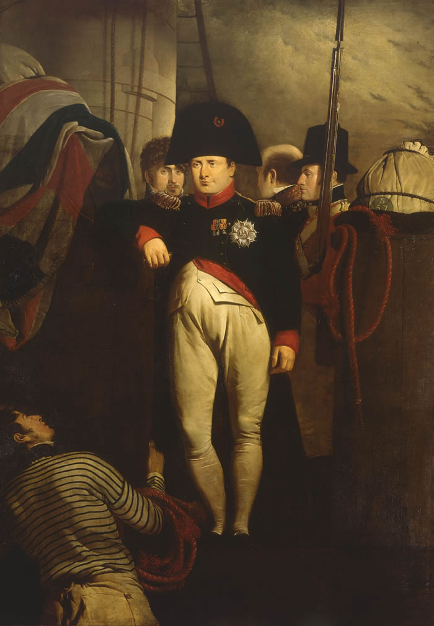
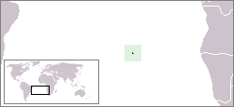
Napoleon on his Final Exile to St. Helena

Slide 25
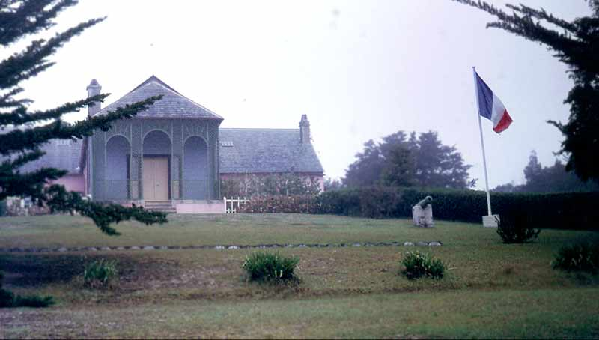
Napoleon’s Residence in St. Helena

Slide 26
Napoleon’s Tomb

Slide 27
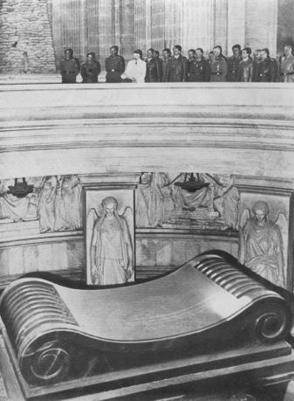
Hitler Visits Napoleon’s Tomb (1940)
“That was the greatest and finest moment of my life.”
~Hitler

Slide 28
Enlightened Despot
The term 'Enlightened Despot" was given to rulers during the Enlightenment period that used their power and influence to better the lives of their people. Rulers, such as Catherine the Great and Joseph II did this through religious tolerance, abolition to serfdom and more. Napoleon embodied this same (moral) quality in the sense that he used his status and power during the Revolution to bring out and surface Revolution ideals and help his people.

Slide 29
A Return to Peace
Having defeated Napoleon, the major European powers wanted to restore order, keep the peace, and suppress the ideas of Revolution.
Delegates throughout Europe came to Vienna, Austria to have a conference about the future of Europe.
Most decision-making authority rested with Great Britain, Austria, Prussia, and Russia.

Slide 30
A Return to Peace
The Congress of Vienna
Countries that suffered most, are paid back
Restore balance of power
Concert of Europe- international rule via agreement
Restore all former ruling families to power, all decisions would follow the Rule of Legitimacy.
Big Idea:
Make Everything the Way it Use to Be!

Slide 31
Age of Metternich
= Age of Reactionaries
People who…
Oppose change
Fear liberalism
Stop nationalism
Quadruple Alliance is agreed on in 1815
Russia, Prussia, Great Britain, and Austria
Holy Alliance urged by Czar Alexander of Russia- promising to rule as Christians.
Was Metternich successful in stopping change, liberalist ideas, and nationalism?

Slide 32
The Age of Metternich
For 30 years after the Congress of Vienna, Prince Metternich of Austria influenced European politics. (1818- 1848 approx.)
Believed in a absolute monarchy, suppressing freedom of speech, press.
His aim was to prevent war or revolution.
GB was not supporting these views.
GB did not join the Holy Alliance.

Slide 33
Was Napoleon a Revolutionary or a Tyrant?

Slide 34
Every General, Needs A, Loyal Aide, Noting Constant, Daily, Chores…

