Slide 1
The Gathering Storm and Outbreak WWII
Chapter 30.1.2

Slide 2
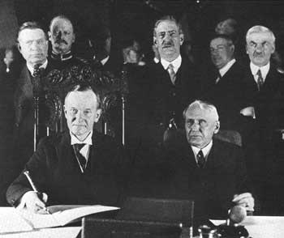
1928 The Kellogg-Briand Pact
War made illegal!
60 nations sign

Slide 3
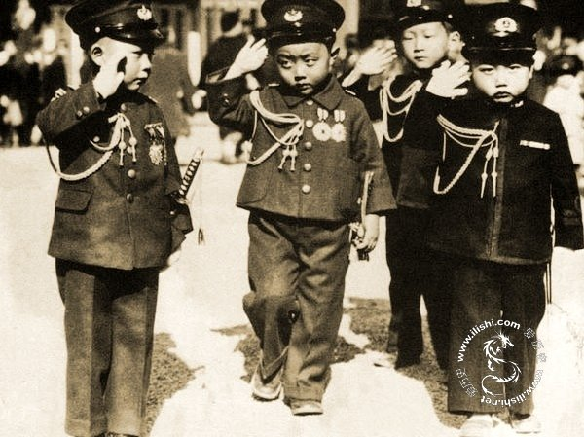
1931 Japan becomes Military State
Notes:
Liberal prime minister gets shot
Fake chinese military attack in Manchuria and they use it as an excuse to take over China.
League of Nations condemns Japan’s actions so they withdrawal
Lack of physical reaction encourages Japan to keep imperializing

Slide 4
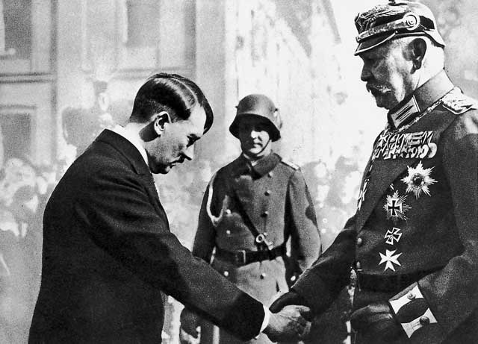
1933 Hitler becomes Chancellor

Slide 5
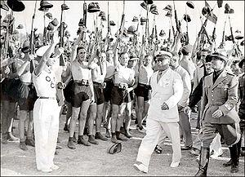
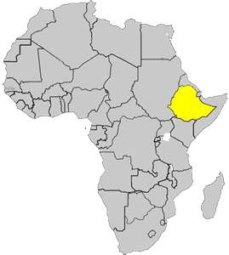
1934 Italy invades Ethiopia
Notes:
Mussolini to power in 1922
Border dispute Ethiopia looked to L of N but they had no army
What were some of the “weapons” that the league of nations had the power to use?

Slide 6
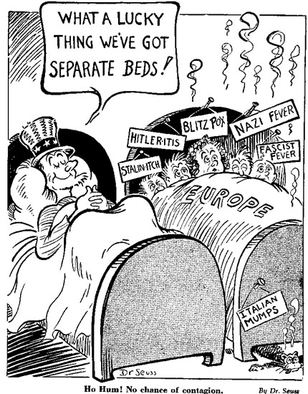
1935 American Neutrality Acts
America vows to stay neutral in future wars
American Isolationism
Couldn’t…
Give loans
Sail on ships
Have ships enter
Any warring countries!

Slide 7
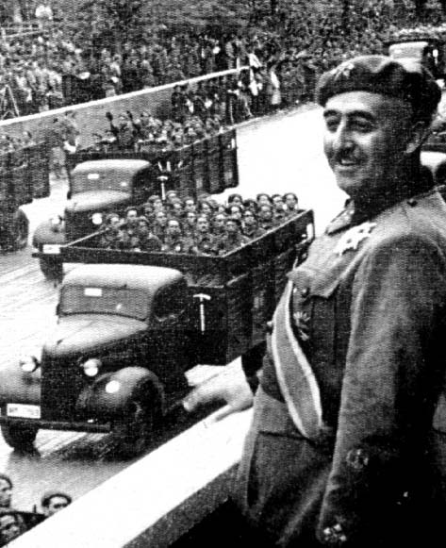
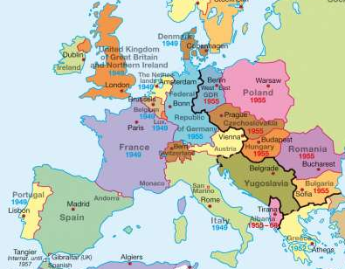
1936 Spanish Civil War
B/w:
Nationalist
Fascist Falange Party
Leader Francisco Franco
Loyalists
Supp. of Republic
Dress Rehearsal WWII
Hitler & Mussolini supp. Nationalists
GB, France, US supp. Loyalists
Nationalists Win!!!

Slide 8
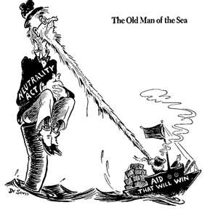
1937 Am. Neutrality Acts Renewed
Notes:
Cash and Carry policy- sell to belligerent nations but no arms

Slide 9
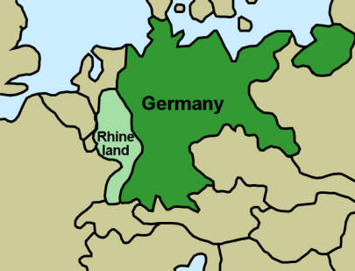
1936 Hitler invades Rhineland

Slide 10
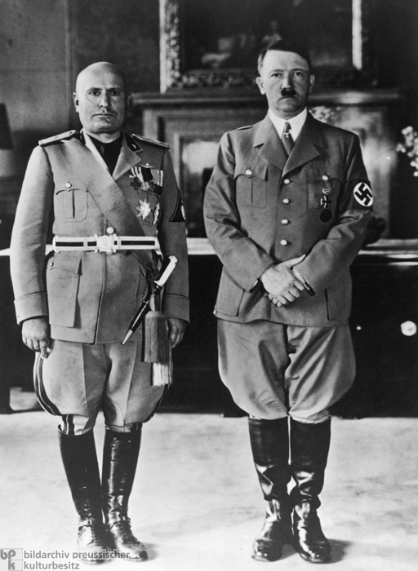
1936 Rome-Berlin Axis

Slide 11
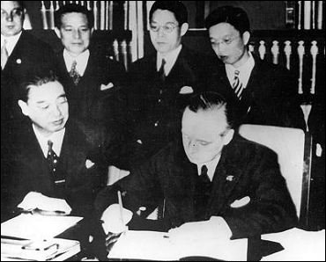
1936 Anti-Comintern Pact
Comintern-organization designed to spread communism throughout the world
Pact b/w Germany and Japan to stop spread of communism
Italy signs later
Axis powers all allied!

Slide 12
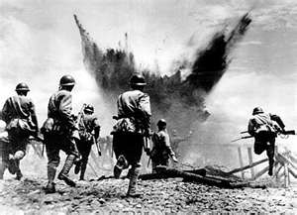
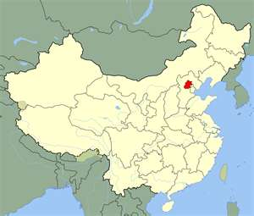
1937 Japan captures Beijing

Slide 13
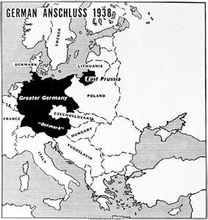
1938 Germany annexes Austria “The Anschluss”
Notes:
An shloos
Austrian leader agreed to a union-regretted it-said the people should vote-Hitler refused-wanted to flex his muscles\
No actions by the League of Nations-GB and France send protests
Austria ruled Germany for 600 years remember

Slide 14
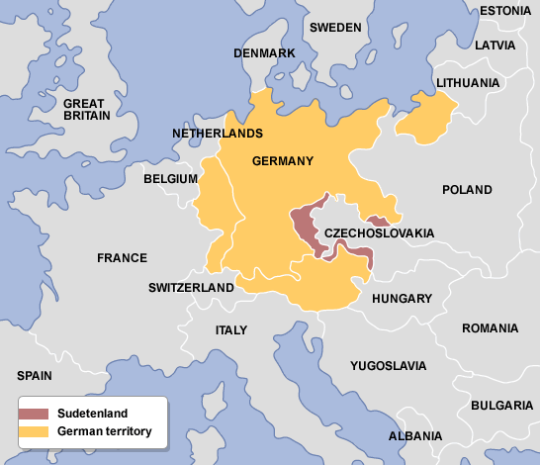
1938 The “Sudetenland Crisis”
NW Czechoslovakia
Home of 3 million Germans
Nazi’s start riots, so Czech. est. martial law
Result…Hitler invades Sudetenland
Notes:
They now control the heart of Europe and they have a common border with their ally Italy
What current event does this “Crisis” sound like?

Slide 15
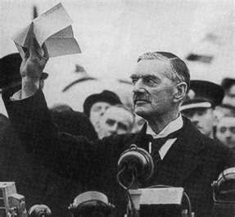
1938 Munich Conference
Who?
GB – Neville Chamberlain
F – Edouard Daladier
Hitler & Mussolini
What?
Conference of Appeasement
Gave Hitler Sudetenland; Hitler promise not to take anything else
Notes:
They were hoping to keep the peace by accepting the demands of the agressor

Slide 16
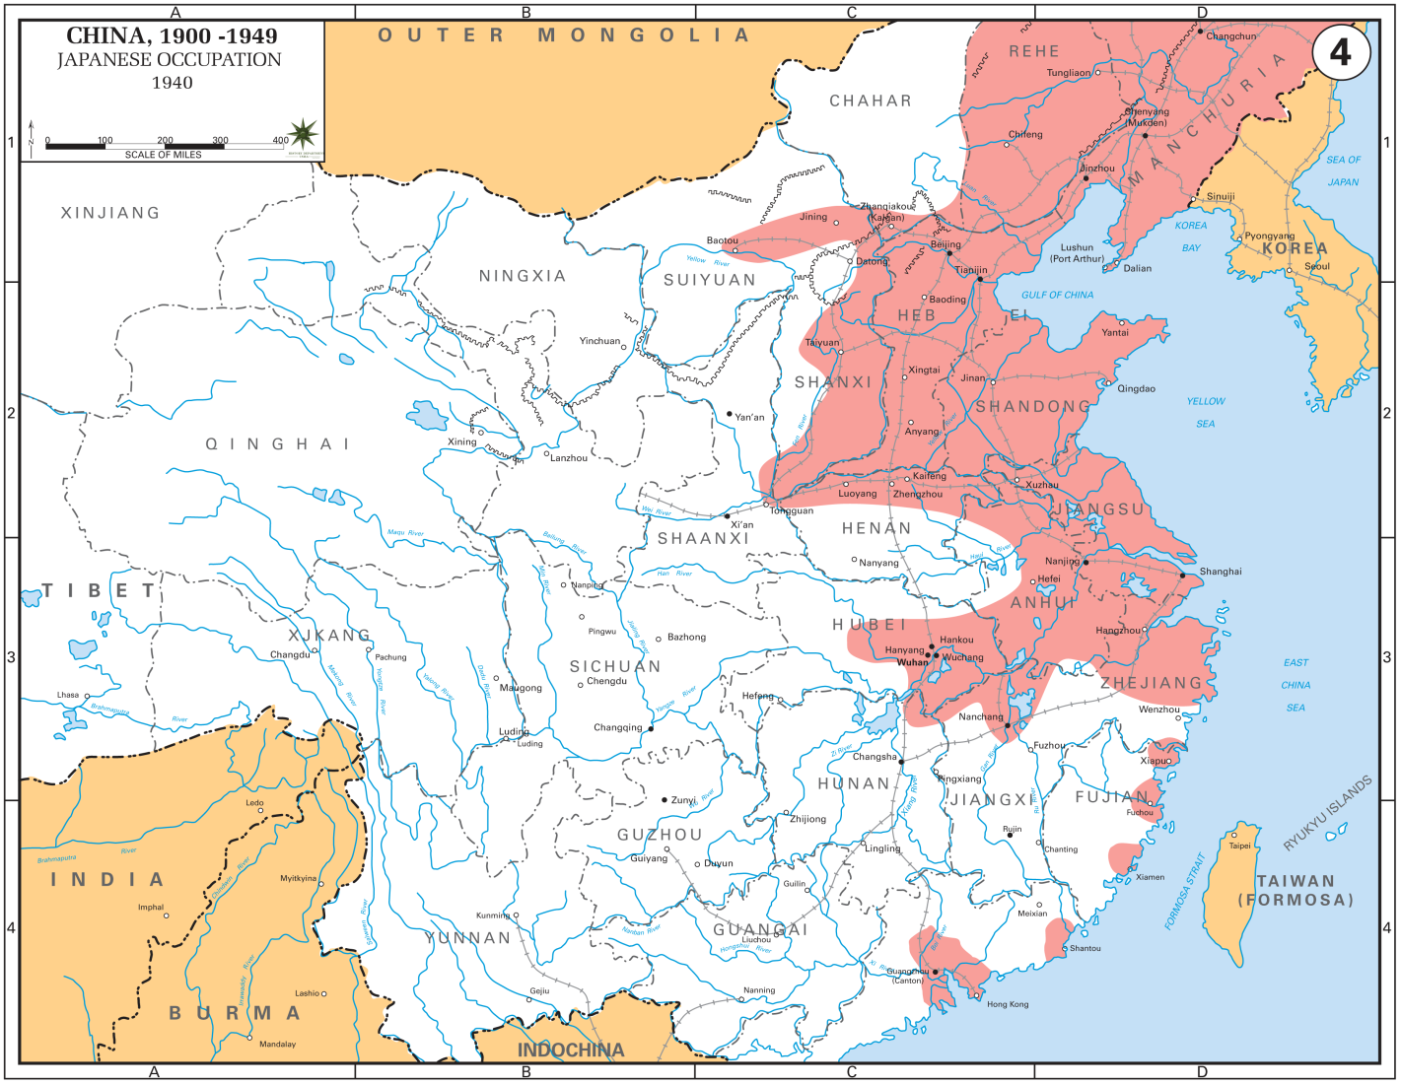
1939 Japan controls ¼ China

Slide 17
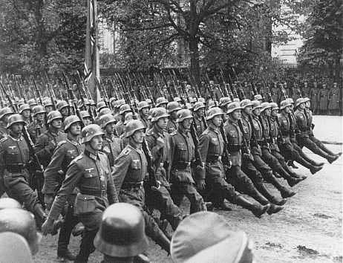
1939 Germany invades Czech.
Notes:
Forced GB and France to hasten their re-arming
They agree to come to the defense of Poland if Hitler invades
They are both afraid of the military strength of Hitler

Slide 18
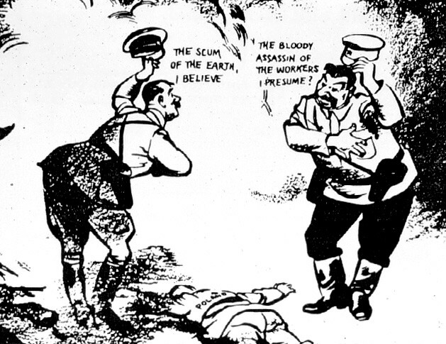
1939 Nazi-Soviet Pact
Notes:
Germany and the Soviet Union would never attack each other
Bought time for both sides to prepare to fight each other essentially

Slide 19
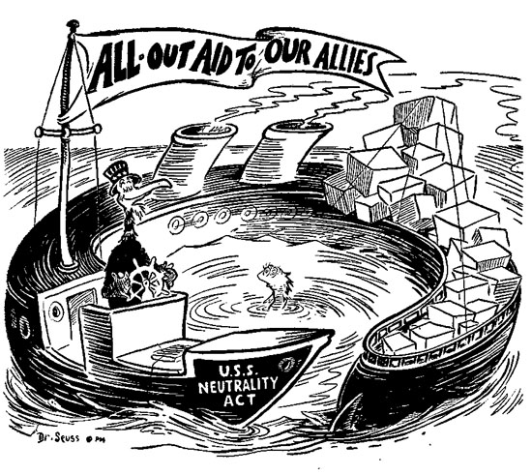
1939 Am. Neutrality Acts Renewed

Slide 20
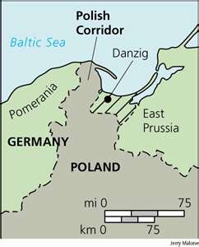
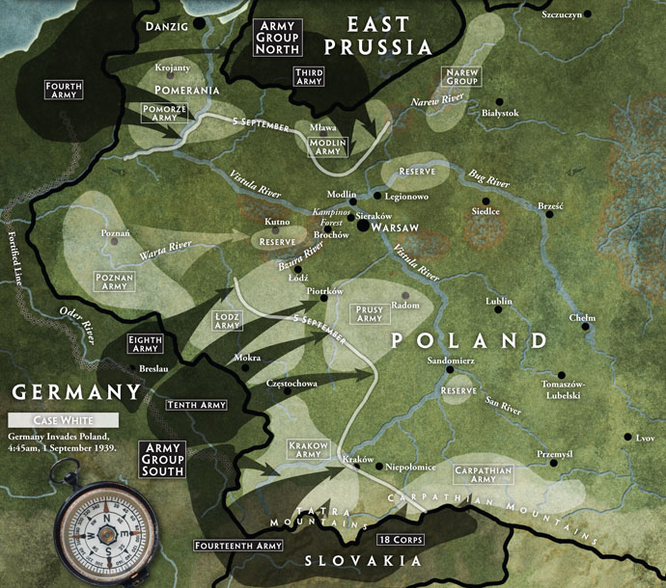
Sept. 1st 1939 Germany invades Poland
Hitler annexes Port of Danzig then invades Poland
Blitzkrieg
Lightening fast war
WWII Begins????

Slide 21
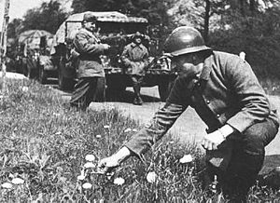
1940 Phony War Ends

Slide 22
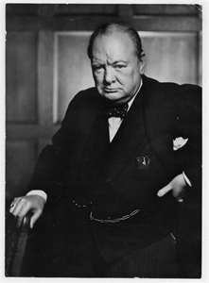
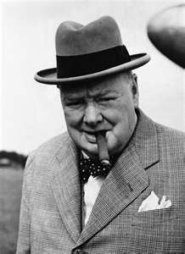
1940 Churchill becomes Prime Minister GB

Slide 23
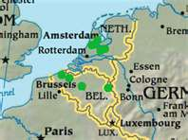
1940 Germany Invades Low Countries

Slide 24
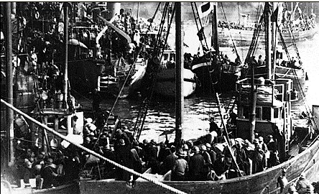
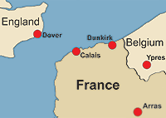
1940 Dunkirk Evacuation
Allies successfully escaped advancing Germans
Hitler missed his opportunity!!
300,000 troops were saved. ( French, Brits,).

Slide 25
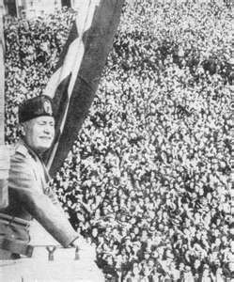
1940 Italy Declares War on GB and France

Slide 26
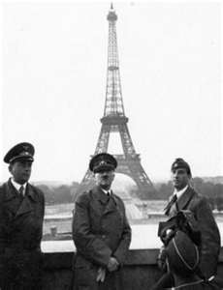
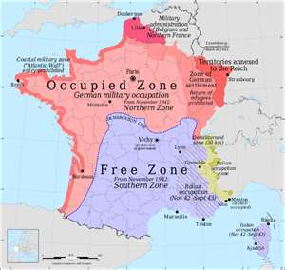
1940 Hitler takes Paris, France

Slide 27
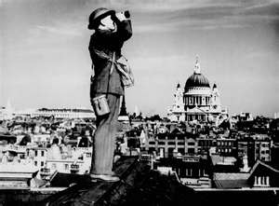
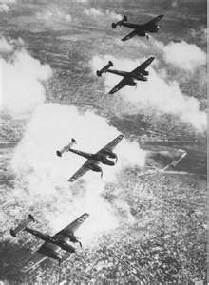
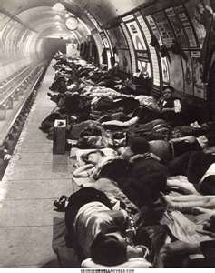
1940 Battle of Britain
German bomb raids on GB by Luftwaffe
GB’s Royal Air Force (RAF) defended country

Slide 28
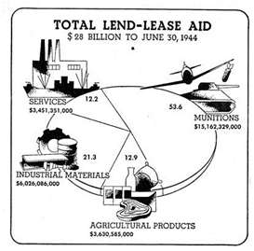
1941 America’s Lend Lease Act
U.S. gave war materials to GB on credit

Slide 29
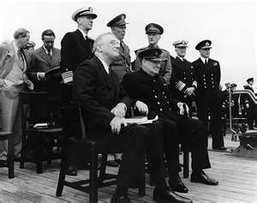
1941 Atlantic Charter
Document of democratic goals b/w FDR and Churchill

Slide 30
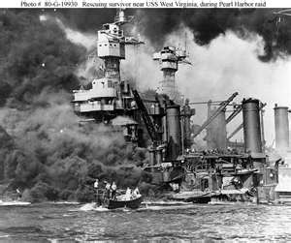
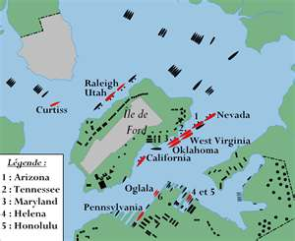
Dec. 7, 1941 Pearl Harbor

Slide 31
Atrocities of WWII

Slide 32
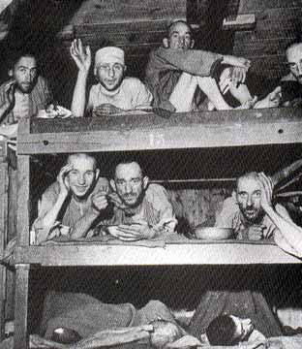
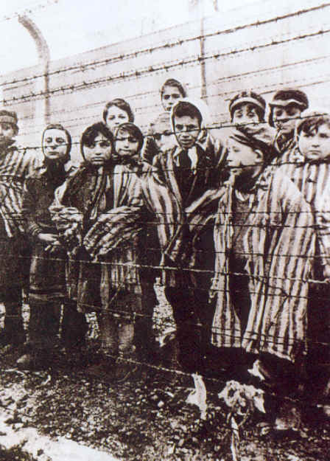
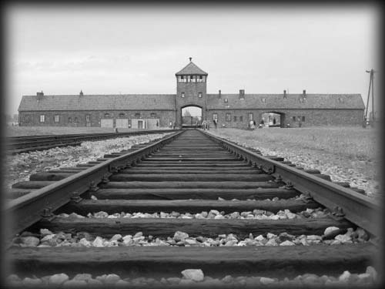
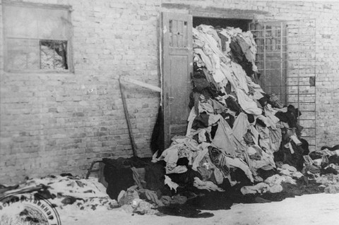
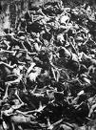
Never Again?

Slide 33
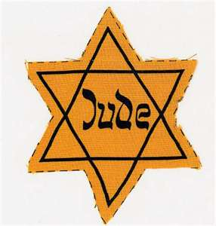
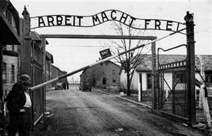
The Holocaust: “Never Again”
Shop boycotts and Legal assaults
Emigration
Nuremberg laws
Kristallnacht
Ghettos
Genocide
Mass shootings
Final Solution = Gassing of Jews

Slide 34
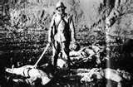
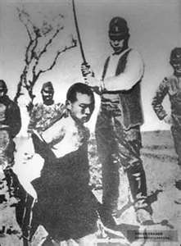
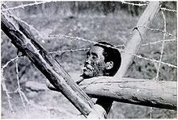
Rape of Nanking
Dec. 1937
300,000 dead in 6 weeks
Japan denies genocide to this day

Slide 35
8 Steps Genocide
Classification
Symbolization
Dehumanization
Organization
Polarization
Preparation
Extermination
Denial

Slide 36
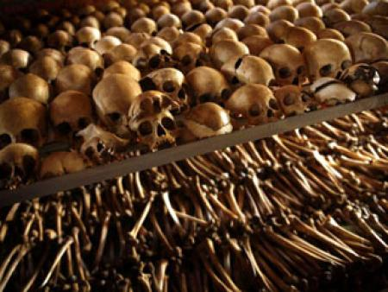
Rwandan Genocide

Slide 37
Rwandan Genocide
1994
800,000 dead o/ course 100 days
Hutu killed Tutsis & moderate Hutu

