Slide 1
The Atlantic world
Chapter 20

Slide 2
Spanish in the Americas
Heavy competition for trade in Asia
Sponsored Christopher Columbus’s journey - 1492
Sailed west across the Atlantic in search of an alternate trade route to Asia
Never reached Asia - he landed on an island in the Caribbean
Thought he has reach India thus called locals Indians
Several colonies were founded in the following years

Slide 3
Interactions with Locals
Aztecs – Cortes (Mexico)
Montezuma II, gave Cortes some gold
Cortes was unsatisfied, wanted more
Incas – Pizarro (Peru)
Atahualpa was captured, ransomed, and killed
Mayans – (Yucatan and Guatemala)
Advantages for Spanish:
Spanish had superior weaponry
Enlisted the help of various native groups
European disease - killed millions of locals

Slide 4
By the middle of the 1500s:
New Spain (Mexico and parts of Guatemala), Central and South America and the Caribbean
Many Spanish men married native women
Encomienda: natives farmed, ranched, or mined for Spanish landlords
Landlords were the rights to the natives’ labor from Spanish authorities.
Supposed to act fairly and respect the workers - many abused the natives and worked them to death, especially in mines
1513 – Florida
1540s – Arizona, New Mexico, Texas, Oklahoma, and Kansas
Brazil (Portuguese) - Sugar plantations

Slide 5
Catholic Priests
Spread Christianity in the Americas
They also pushed for better treatment of Native Americans.
Priests spoke out against the cruel treatment of natives (criticized the encomienda system)
Some suggested use of African Slaves instead
Various attempts by natives to rebel and stop Spanish expansion failed

Slide 6
North America
Competition for territory
Still attempting to find a quicker path to Asia
The Treaty of Tordesillas – no longer being followed
French – North East, Canada
Created trade networks – Fur Trade
English – Set up colonies
Virginia: Jamestown (Tobacco)
Massachusetts: Plymouth - Pilgrims; Massachusetts Bay - Puritans
Dutch - New York, Hudson River, Manhattan Island - New Netherland
Trade: Dutch West India Company, but few colonists - opened its doors to a variety of people (Germans, French, Scandinavians, and other Europeans)

Slide 7
1600s –
French: Haiti, Guadeloupe, and Martinique
English: settled Barbados and Jamaica
Dutch: captured what are now the Netherlands Antilles and Aruba from Spain
Cotton and sugar plantations – needed labor – often relied upon slaves
Mid 1600s –
English took control of New Netherland from Dutch (renamed it New York)
English Colonies expand
Mid 1700s –
French and Indian War

Slide 8
Relationship With Native Americans
French and Dutch: Lower levels of tension and conflict
Interested primarily in trade
English: Higher levels of tension and conflict
Wanted to colonize
Religious differences
King Philip’s War: 1675 – Massachusetts
Hundreds died
Diseases decimated populations

Slide 9
Slave Trade: Why did people want slaves?
Slavery in Africa Slavery had existed in Africa for centuries
Wasn’t highly prevalent
The spread of Islam changed this: an increase in slavery and the slave trade
In most African and Muslim societies:
Slaves had some legal rights and an opportunity for social mobility
A few slaves even occupied positions of influence and power
Some served as generals in the army
In African societies slaves could be freed – for example marrying into the family they served

Slide 10
1400s - first Europeans explore Africa during the 1400s (Portuguese)
At first - more interested in getting gold than African slaves
Then they colonized the Americas - native peoples were dying by the millions
Reasons African Slaves were sought after:
Many Africans had been exposed to European diseases and had built up some immunity
Many Africans had experience in farming and could be taught plantation work
Africans were less likely to escape because they did not know the area
Their skin color made it easier to catch them if they escaped

Slide 11
Atlantic Slave Trade becomes a Massive Enterprise
Between 1500 and 1600 nearly 300,000 African Slaves were bought/sold
Over the next 100 years that number reached almost 1. 3 million
Spain: Caribbean and the American mainland
By 1650 nearly 300,000 Africans on Spanish plantations and in gold and silver mines
1600s Portuguese: Brazil dominated the European sugar market
Increased demand for labor
More than 40 percent of all Africans brought to the Americas went to Brazil
By 1870 Europeans had brought about 9. 5 million African Slaves to American Continent

Slide 12
More colonies – higher demand for cheap labor – more slaves
Millions of Africans died during transport – estimated at 20%
Triangular Routes – the trade route connecting Europe, Africa, and the Americas
Slaves in the American Colonies:
English had transported nearly 1. 7 million Africans to their colonies in the West Indies
Nearly 400,000 Africans were sold to Britain’s North American colonies
Slave population steadily grew
By 1830 around 2 million slaves were in the U.S.
England abolished the slave trade in 1807

Slide 13
After arriving:
Most were sold at auctions
Worked in mines, fields, or as domestic servants
Often very brutal conditions
Lifelong and hereditary status
Slaves did calmly accept their treatment
Made themselves less productive by breaking tools, uprooting plants, and working slowly
Thousands ran away
Some slaves were involved in violent rebellions
Huge impact on development on involved countries
Their expertise, especially in agriculture
Their culture: art, music, religion, and food
Descendants

Slide 14
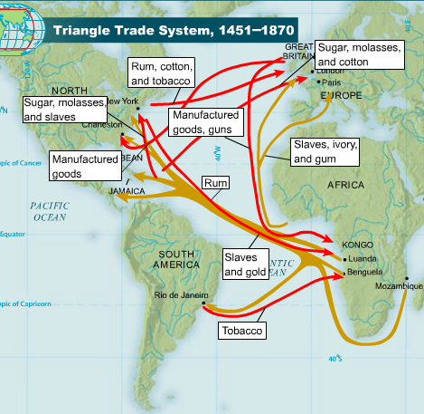

Slide 15
Columbian Exchange
Exchange of items between the Americas and Europe
This included:
People (Voluntary or Forced)
Gold/Silver
Crops
Livestock
Diseases
Begins of Global trade
Increased availability of trading partners
Improved access to trade
Merchants grew richer, could reinvest in their own businesses

Slide 16
New World
or
Old World?
 | Plant, Animal, and Disease | Where did it originate? | Impact
Animal
Animal
Animal
Plant
Plant
Plant
Disease
Disease
Horse
Old World
Allowed Native Americans to shift to a nomadic lifestyle
Provided new food source for Europeans
Turkey
New World
Chicken
Old World
Provided new food source for New World inhabitants
Tomato
Staple of Italian cuisine today, world wide use
New World
Maize
New World
World’s most important cereal crop (plant with edible seeds)
World staple crop; failure of Irish crop lead to massive American migration
Potato
New World
First outbreak after 1492 believed to have killed more than 5 million Europeans
Syphilis
New World
Smallpox
Old World
Devastated Native populations who were not resistant

Slide 17
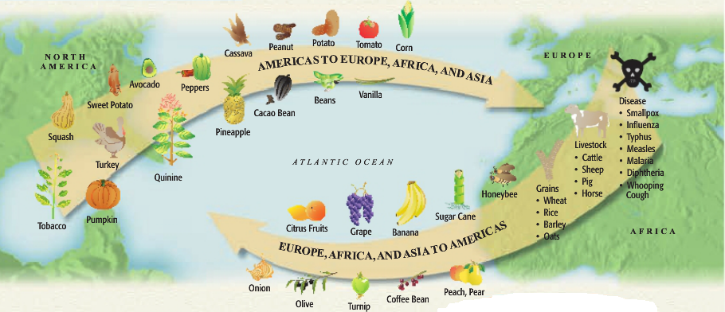

Slide 18
Capitalism: an economic system based on private ownership and the investment of resources for profit
Inflation: the steady rise in the price of goods – more people want an item so less is available
The joint-stock company: Similar to a modern-day corporation
Investors buy shares of stock in a company - uses their money for a common purpose
Throughout the 1500s and 1600s the focus was on American colonization
Expensive to establish overseas colonies
Many risks - many ships never completed the trip
Many investors, means lower risk to individual if it fails and shared profit if it succeeds

Slide 19
Mercantilism: A country’s power depended on its wealth, so a country should become as wealthy as possible
Obtain as much gold and silver as possible
Establish a favorable balance of trade where country sells more goods than it buys
Goal was to become self-sufficient - not dependent on other countries for goods
Raw materials from colonies are sent to parent country – goods from parent country sold in colonies

Slide 20
Increased growth of towns and cities
Some merchants became very wealthy
Increased the wealth of European nations
A lot of Europe’s population still lived in rural areas
Majority of Europeans remained poor
Mercantilism contributed to the creation of a national identity

