Slide 1
The Age of Absolutism 1500-1800
Chapter 19

Slide 2
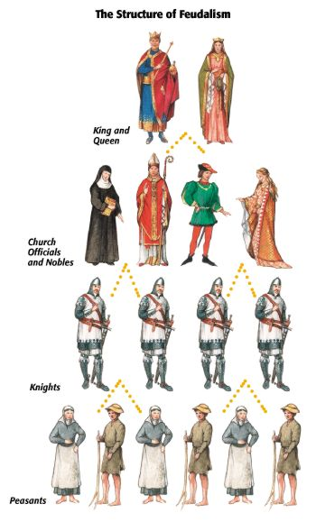
What affect did the Reformations have on the rest of Europe?
-Old feudal system to New ABSOLUTE Monarchies
-Feudalism to ABSOLUTISM
-Increase in the power of the national government; decrease in the power of the pope

Slide 3
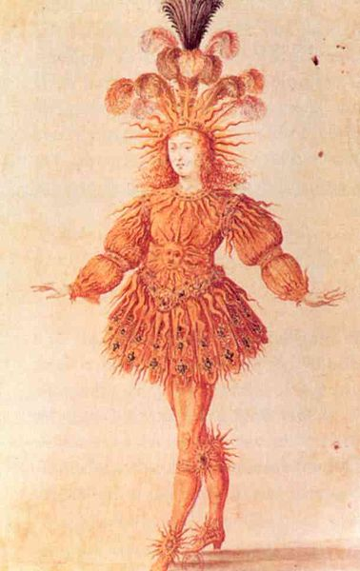
What is Absolutism?
King unlimited power
Only listens to God
Used power to unify & expand nation
Today Absolute ruler = Dictator

Slide 4
What caused Absolutism?
A need to maintain order, defend realm & regulate econ. b/c…
Decline Roman Catholic church’s power
Chaos caused by Protestant Reformation
Mercantilism created huge amount of wealth

Slide 5
Justifications for Absolutism
Religious:
DIVINE RIGHT -God gave right to rule
Political:
People are inherently evil; strong ruler needed to control masses

Slide 6
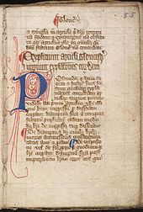
Was every country of Europe Absolutist?
No!!!!
Great Britain was different!
How?
King John was handed the Magna Carta 1215 by the Nobility
Great Charter, English document that made law the supreme power and became a cornerstone of constitutional government.

Slide 7
Magna Carta Continued…
King John agreed not to
collect any new or special taxes without the consent of the Great Council, a body of important nobles and church leaders who advised the king.
not to take property without paying for it.
not to sell, refuse, or delay justice.
The king also agreed to let any accused person be judged by a jury of his or her peers.
John's acceptance of Magna Carta meant that the king—like his subjects—had to obey the law or face revolt and overthrow. Magna Carta made the law the supreme power in England!!!

Slide 8
Formation of Representative government!
The practice of having members of the middle class meet with the clergy and the nobles in the Great Council remained. This representative body eventually became the English Parliament.
Over time Parliament was divided into two parts, called "houses." Nobles and the clergy made up the House of Lords, and knights and burgesses made up the House of Commons.
The early Parliament mainly served to advise the king, but it also had the right to refuse new taxes sought by the king. As England's centralized government grew, taxes were needed to help meet its ever-increasing costs. Parliament's power to accept or reject new taxes became more and more important.

Slide 9
First Step: individually read one section
1. Create essential questions!
A. Letter headings for green titles
Define each major definition
Use a bullet point for each main idea
DO NOT forget comments/ questions in the margins!

Slide 10
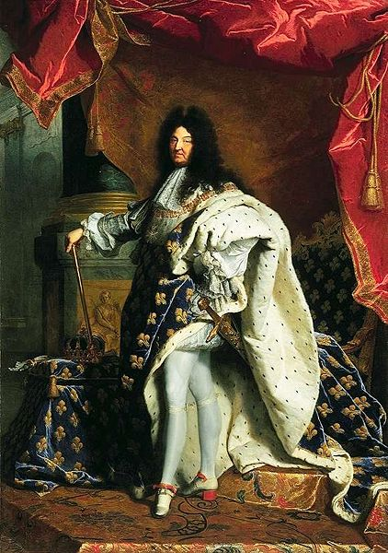
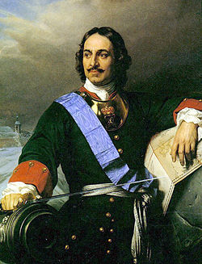
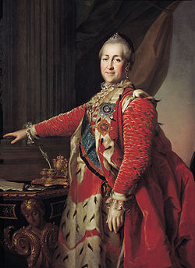
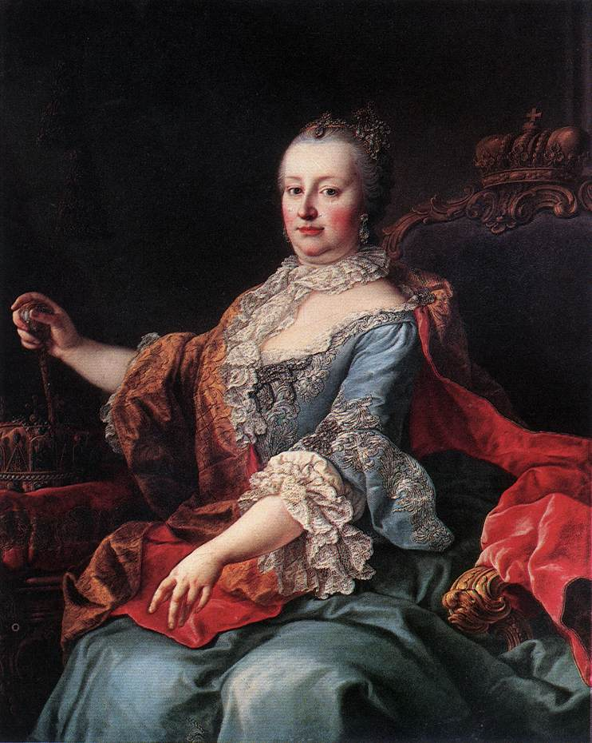
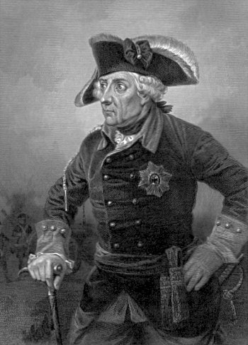
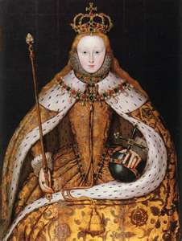
6 Absolute Monarchs We’ll Be Studying
Louis XIV
France
Peter the Great
Russia
Catherine the Great
Russia
Maria Theresa
Habsburg Austria
Frederick the Great
Prussia Germany
Elizabeth I
England

Slide 11
Your Assignment: Absolutism for “Dummies”

Slide 12
3-4 Groups
Louis XIV | Peter the Great | Catherine the Great | Maria Theresa | Frederick the Great | Elizabeth I

Slide 13
7-8 Groups
Louis XIV | Peter the Great | Catherine the Great | Maria Theresa | Frederick the Great | Elizabeth I
Julia Jacob Kerry | Adam Maggie Jonah | Sarah 1 Number 2 | Luke Brian Kayla | Jen Pelosi Ian Olivia | Sophie Stephen Mark

Slide 14
15-16 Groups
Louis XIV | Peter the Great | Catherine the Great | Maria Theresa | Frederick the Great | Elizabeth I
Agro | Brad | Alex | Shannon | Rachel | Hayley
Mike | Gaidos | Dillon | Lane | Charles | Amanda
Melissa | Kendall | Pedinoff | Proske | Perez | Tyler
Dan

