Slide 1
Stalin’s Russia

Slide 2
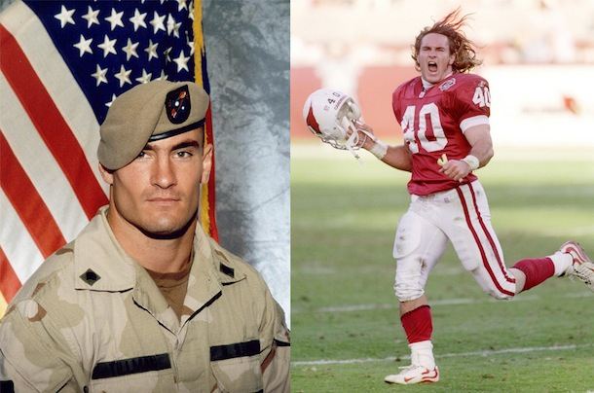
Propaganda in Modern Times
Can anyone think of an example of propaganda in modern times?
Pat Tillman
The news about Crimea
Notes:
Story was initially published that he was shot and killed by members of alQueda but as time went on the true story came out
Why would the story be published the way it was the first time?

Slide 3
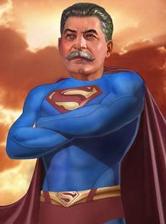
Life under Stalin
Strict & Censored
Secret police
Religion & art banned
Imprisonment &death to opposition
1934 Purge
Large scale elimination of enemies
1939
5 million… arrested, deported, imprisoned or dead
Estimated that Stalin was responsible for the deaths of 20-60 million people

Slide 4
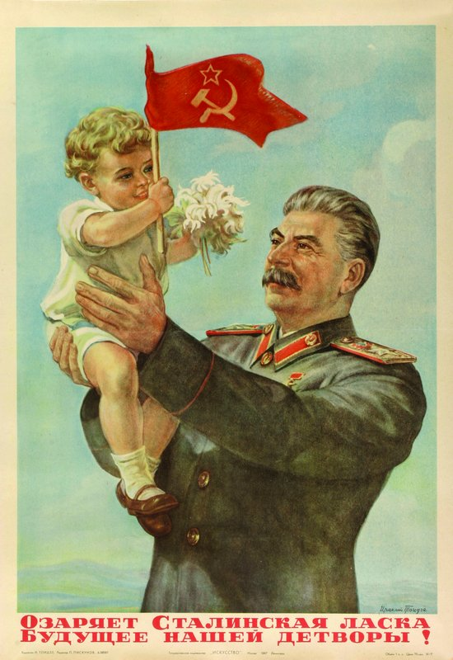
Life Under Stalin
Command Economy
Gov’t controls all aspects of economy
Five-Year Plan
Turn Soviet Union into modern industrial society
Double oil and coal output-triple steel output
Catapulted Russia to the status of a World Power
Industrialized a primarily agricultural society

Slide 5
Propaganda
As you analyze the propaganda handouts that I am passing out keep the following in mind:
What was Russia like at this time?
How did Stalin want to be portrayed?
What was Stalin’s goal for Russia? How would this get accomplished?

Slide 6
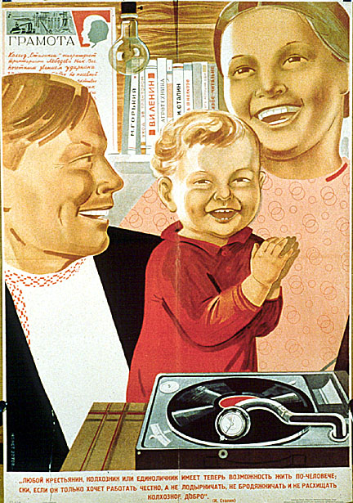
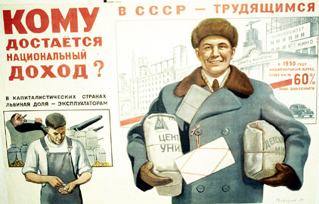
Stalin’s Propaganda
"Who receives the national income?" by Viktor Govorkov, 1950
“Peasants can live like human beings”
Notes:
It is titled: 'Peasants can live like a Human Being'.
Study the poster - can you see how it is promising people the following:
• enough to eat,
• adequate clothing,
• the latest consumer goods,
• electricity,
• education,
• happiness.
"Who receives the national income?" by Viktor Govorkov, 1950

Slide 7
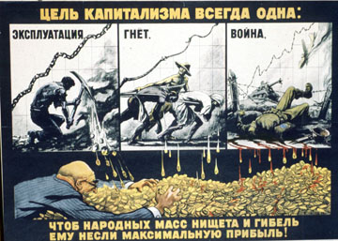
The goal of capitalism is always the same1953

Slide 8
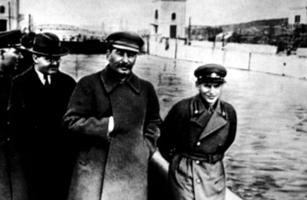
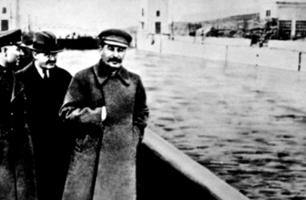
Stalin and Editing Photos
Nikolai Yezhov - commissar of water transport in Russia
Nikolai is replaced by the waters of the Canal…
Notes:
Stalin's bloody reign is not without certain irony. Nikolai Yezhov, the young man strolling with Stalin, is shot in 1940. It seems only fitting that when Yezhov is removed from the photograph he is replaced by the waters of the Moscow-Volga Canal. Yezhov was commissar of water transport

Slide 9
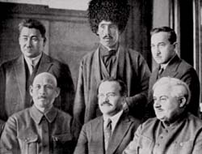
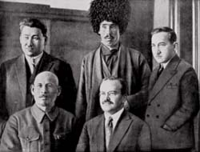
Uzbek Party leader was eliminated by a firing squad
Stalin has him removed from this picture and erased from history
Notes:
If you look close you can see how the gentlemen's suit has a painting/cartoonish look to it.

Slide 10
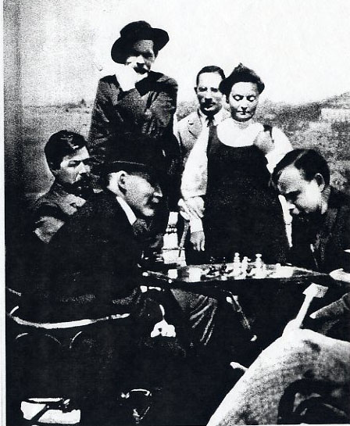
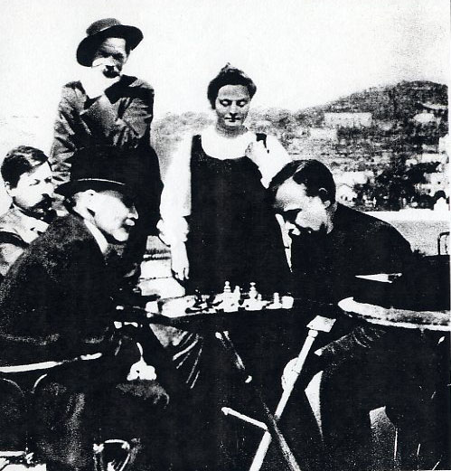
Lenin used photo editing as well
Here we see a photo of a Chess game where an individual is take out
Notes:
There was another person in this photo as well

Slide 11
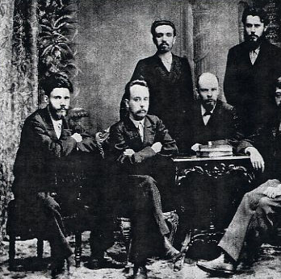
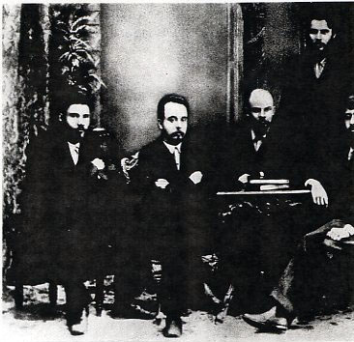
Notes:
Meeting in St. Petersburg in February 1897 with Lenin. Left standing is Alexander Marchenko. Along with the others Marchenko was exiled for 3 years in Siberia. Returning from exile in 1900 he abandoned revolutionary politics. In 1929 he was arrested, wrongfully accused of being a "wrecker," and executed in 1930. For 30 years he was air-brushed out of the photo whenever it was reproduced. In 1958 he was rehabilitated, at which time his presence was allowed to re-appear.

Slide 12
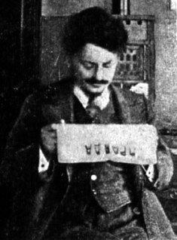
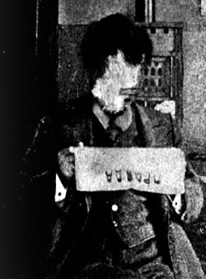
Trotsky reading a copy of Pravda……
The same picture with Trotsky slightly defaced

Slide 13
Closing Questions
As a citizen of Russia how do you feel after learning that Stalin has died?
Consider the positive and negative benefits Stalin had on Russia
Do you think that there is any propaganda used by the United States government?
Support your answers with examples and detail
Notes:
After watching Stalin: The Man of Steel, analyzing Russian propaganda, and listening to the stories behind edited Russian photos put yourself in the shoes of a Russian Citizen and answer the following questions:

