Slide 1
Section 2
From the Restoration to Glorious Revolution

Slide 2
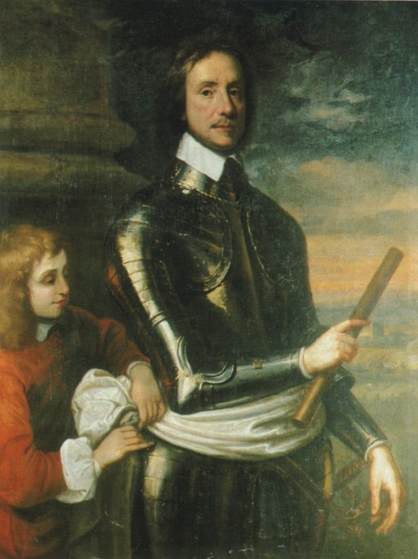
Review:
What is your thesis statement?
Remember that the essay is only on the chart!
What happened during the English Civil War?
Who fought who?
Who is Oliver Cromwell?
What was Rump Parliament?
Commonwealth (republic)
Tried to create a constitution
Second try created the Protectorate
Unpopular
Failed when Cromwell’s son lost control of the army

Slide 3
Next Step Restoration (Section 2)
What was the Restoration and what did Charles II do differently from his father?
Restoring the English Monarchy
Charles II avoided fights with Parliament when his policies met with opposition
Met opposition with two areas:
Trying to make an alliance with France to compete with the Dutch overseas
Trying to increase religious toleration of Catholics

Slide 4
Charles II Dies - James II comes to power
Worst possible replacement for Parliament
James II is Catholic
James II believed in Absolutism
Not as flexible with Parliament in comparison with Charles II
BIG QUESTION:
Who would succeed James II? Another Catholic?

Slide 5
Political Parties Debate the Question
TORIES
Tory means outlaw
Supported the Anglican Church
Wanted a monarchy, even if it is a catholic replacement
Whigs
Meant horse thief
Wanted to deny the throne to James II’s son
Wanted a strong Parliament

Slide 6
Solution for Parliament
Parliament looks to James II’s daughter Mary (Protestant)
Her husband William of Orange was Dutch
With Parliament’s permission, he lead the Dutch army to overthrow James II
James II fled to France
Glorious Revolution- bloodless transfer of power

Slide 7
Huge debate that transpired during this time period
Think about tonight…
What do you think people are like in the State of Nature?
If you take away government and law, what would people be like?
Think about huge crowds in public places.

Slide 8
Word of the Day: Social Contract
 | Give Up | Get | Obligations
Government (NY Yankees)
Citizens (Derek Jeter)
SOCIAL CONTRACT- an agreement by which people gave up their freedom to a powerful government in order to avoid chaos

Slide 9
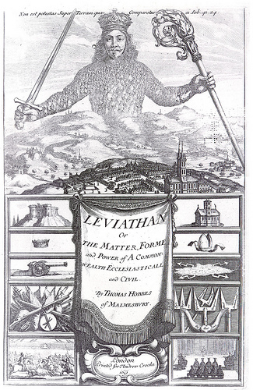
Leviathan- Thomas Hobbes

Slide 10
Thomas Hobbes
Wrote the Leviathan
Written as a reaction to what he saw during the English Civil War
Biblical Story about a sea monster
People were naturally cruel, greedy, selfish
If not controlled, they would fight, rob, etc.
To escape chaos- they enter into a social contract- people exchange individual liberty for group safety and social order
Best Government was Absolute Monarchy
“Dangers of Anarchy are far worse than the dangers of Tyranny”

Slide 11
John Locke
Wrote Two Treaties of Government
Argued that people were essentially good
Best government was limited and accepted by all
Rejected absolute monarchy
STILL BELIEVED IN THE SOCIAL CONTRACT
Gov has a responsibility to the people it governs
RADICAL IDEA
If a government fails its obligations to the people it governs, then the people have the right to overthrow it!!
SERIOUS IMPLICATIONS!!

