Slide 1
The renaissance

Slide 2
What was it?
Altered how Europeans would view themselves and world
1300s – 1600s
Renaissance meaning
Rebirth
Philosophical and artistic movement
Medieval Scholars had studied ancient history
tried to bring everything they learned into harmony with Christian Teachings
Era when the movement flourished
A new emphasis on the Power of Human Reason developed

Slide 3
The Renaissance Began in Italy - why?
Reminders of Roman glory – Ruins, Writings, Art etc.
Scholars preserved Greek and Roman learning
Trade helped Italians learn about Arab and Africa achievements in science and medicine
Small group with money, big impact
Wealth spreads throughout cities
Florence, Medici family: bankers than rulers of city-state
Lorenzo de Medici: patron of the arts
Mantua, Isabella d’Este: fills palace with paintings and sculptures of finest Renaissance artists.

Slide 4
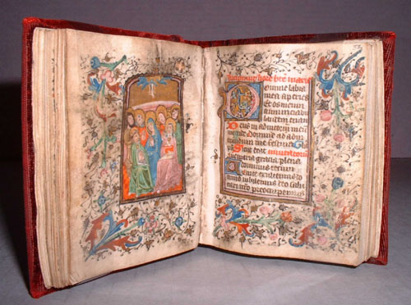
The Printing Press - What was it?
How were books copied/printed before?
Scribes were not happy
Some people liked hand-copied manuscripts better
Chinese Block Printing
In 1450, Gutenberg became the first European to use moveable type to print books

Slide 5
The bible - the first book he copied
Books can be massed produced
Thus becoming cheaper and affordable to more people
Books can be published in regional languages
Vernacular – common man’s language
Thus they can read the Bible without the priest’s interpretation
People have their own interpretation and begin to challenge the church, the role of priests is slowly changing
The impact of the Printing Press did not slow down
By 1475 printing presses operated in England, France, Germany, Italy and several other European Nations
This help spread new Humanist ideas to a large audience quickly

Slide 6
Philosophies of the era
Humanists:
People who specialized in either Greek and Roman literature to study grammar, history, poetry, and rhetoric
Humanism is:
an intellectual movement that focused on human potential and achievements
Studied classical manuscripts
Many Catholics:
Remain devote Catholics

Slide 7
Shakespeare 1564 - 1616
Stands out as leading literary figure of the time
His ability to transform well-known stories into dramatic masterpieces was one of his great qualities
Many famous works, still impacts modern writers/actors/etc.

Slide 8
Quick Summary:
Focus was on the individual, fame, fortune, legacy, make money and spend money
Shift from a focus on the spiritual to the worldly
Man was to enjoy his time on earth but still be a good Catholic
This shift was reflected in the study of the humanities and art
Due to an increase of trade, a middle class begins to emerge
Cities become bigger and we see a small shift from agrarian to a trading society
Cities nurture the Renaissance
Slowly expands northward, continues to develop and include new ideas

