Slide 1
Essential Question:
How did the Renaissance movement affect people’s view on the Catholic Church?
Focus on individual\humanists
Focus on secular
Enjoy life don’t need to suffer
Printing press ideas\Bible
Question and thirst for knowledge 2 + 2 = ?
Growth of nation states \ taxes and land
Pope foreign ruler \ taking money

Slide 2
Era of Reform
Reformation: religious revolution in western Europe
Income = salvation
Popes are warriors & politicians
Vices took precedence over morality
John Wycliffe and Jan Hus ask for reform but met with resistance

Slide 3
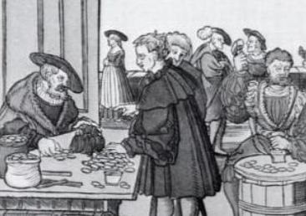
New Beginnings
1st Break – Germany
Core of HRE – 300 independent states
Vatican sent Johann Tetzel to raise $$
Indulgences: pardons for punishment from sin
Originally a reward
German states: no restriction to sale of indulgences

Slide 4
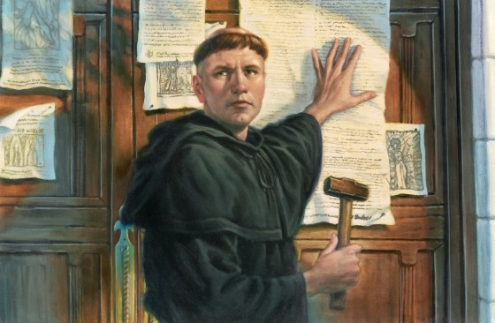
Martin Luther
Monk – search for salvation
good deeds and church ceremonies not needed
God’s forgiveness not the church’s
Bible the only authority not Church and priests
Everyone equal don’t need priests to interpret
95 Theses – 1517
Public challenge of indulgences

Slide 5
Break From the Church
1521 Pope Leo X declares Luther a heretic
Excommunicated
Charles V (HREmp) – Imperial Diet
Diet of Worms: Luther an outlaw
Banned printing and sale of works
Frederick the Wise (Elector of Saxony)
Hides Luther
Translates Bible to German
Peasants revolt against Catholic Church

Slide 6
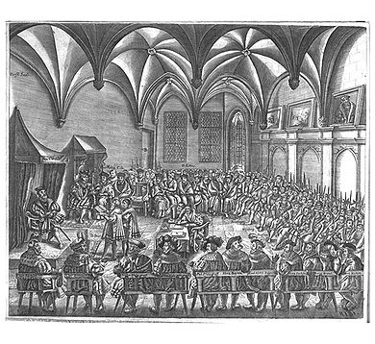
Protestantism
Spread quickly – German princes est Lutheran states
Charles V: 1546 sent armies against Protestant princes
Peace of Augsberg 1555:
German rulers could establish any religion for their state
Subjects didn’t like it they could move
French??

Slide 7
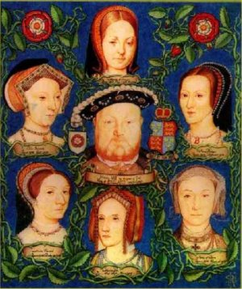
New Religions
Sects: new religious groups – no organized churches
No authority, discipline, membership or rules
Gathering of like minded individuals w/preacher
Anglican Church – England Henry VIII
England leaves church b/c Henry wants a divorce
Leave wife (Catherine of Aragon) for lady in waiting (Anne Boleyn)
Act of Supremacy new church of England – king as the head
Married 6 times – 1 son Edward VI
Creates religious turmoil\unrest

Slide 8
King Edward was 9 and regents were Protestant
Bloody Mary returns church to Catholicism and persecutes Protestants
Queen Elizabeth returns the church back to Anglican

Slide 9
Calvinism
John Calvin – Switzerland
1536 – The Institutes of the Christian Religion
Humans are sinful by nature
Faith in the Bible
Predestination – God already decided who will be saved
“The elect” – community followed highest moral standards
Geneva – theocracy: gov’t ruled by religious w/god’s authority model for others
Outlaw on Vices

Slide 10
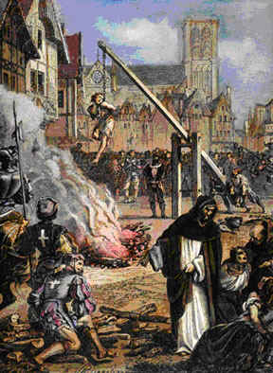
The Spread of Calvinism
Huguenot:
French nobility that converted to Calvinism
1/3 became Calvinists
Civil War – Huguenots vs. Catholics 1562
1598 Henry IV – Edicts of Nantes
Freedom of worship / political rights
Puritanism – form of Calvinism

Slide 11
John Knox Scottish preacher
Presbyters
Presbyterians
Mary Queen of Scotland Catholic

Slide 12
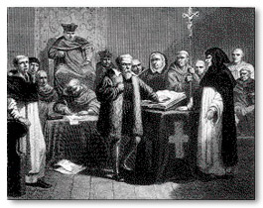
The Counter-Reformation
Counter (Catholic) Reformation
Attempt to return the church to emphasizing spirituality
Clarify church doctrine
Campaign to stop Protestantism
Pope Paul III 1534-1549
Inquisition – question “heretics”
Keep Catholics in the church
Pope Paul IV
Index of Forbidden Books
Books that were harmful to faith and morals

Slide 13
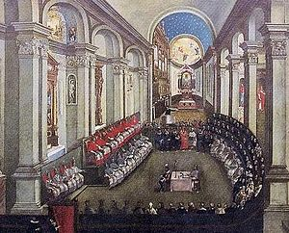
Council of Trent
1545 Church Leaders meet in Trent
Met during 3 periods from 1545 – 1563
End abuses of indulgences
Discipline within the clergy
Emphasized the need for ceremonies
People must depend on priests b/c God grants forgiveness through the church
Salvation comes from ceremonies & faith
Every person has free will

Slide 14
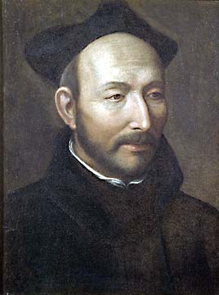
Soldiers of the Counter-Reformation
Society of Jesus (Jesuits)
Ignatius de Loyola – founder 1534
1540 Pope Paul III recognizes Jesuits as an official order
Followers Vows: chastity, poverty & obedience to the pope
Most effective in spreading Catholicism
Stressed education
Combined humanist values w/Catholic doctrine

Slide 15
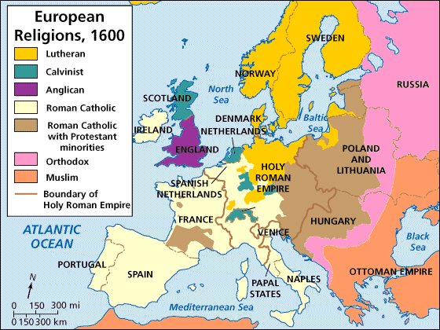
Results of Religious Upheavals
1530’s – mid 1600’s
Religious wars in France, Germany, Netherlands & Switzerland
Interest in Education
Jesuits worked to strengthen faith in school
Protestants believed people found the Christian faith by studying the bible
Reading and literacy become important
Gov’tal Power Increases
Gov’ts, like England, took responsibility for church leadership
Papal powers decreased

