Slide 1
CATHOLIC CHURCH
The Church was the center of man’s life and man was the center of the universe which everything revolved around.
Fall of the Roman Empire creates a power vacuum that the Church fills.
Role of the Church during the Middle Ages:
Government – hierarchy and Coronation
Law – lawyers, court, 10 Commandments, and ruler for warfare
Economy – masses and Saint’s days\bank and major land owners
Social Welfare – doctors, the poor, and orphans
Education – were educated and kept education alive, create universities
Record Keepers – birth, marriage, and death (promogeniture)

Slide 2
Essential Question:
How did the Renaissance movement affect people’s view on the Catholic Church?

Slide 3
Era of Reform
Reformation: religious revolution in western Europe
Income > salvation
Popes are warriors & politicians
Vices took precedence over morality
Humanists response:
Withdraw and rebuild

Slide 4
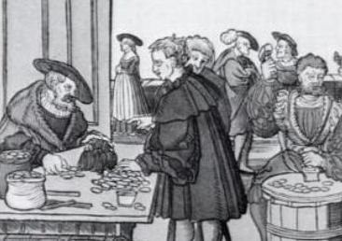
New Beginnings
1st Break – Germany
Core of HRE – 300 independent states
Vatican sent Johann Tetzel to raise $$
Indulgences: pardons for punishment from sin
Originally a reward
German states: no restriction to sale of indulgences

Slide 5
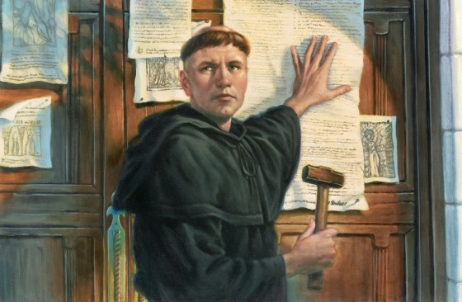
Martin Luther
Monk – search for salvation
Revelation: good deeds don’t matter
Inner faith in God only thing that matters
“Justification by grace through faith”
95 Theses – 1517
Public challenge of indulgences

Slide 6
Break From the Church
Major issues with the Church
Bible is sole religious authority
Ceremonies could not make up for sins
Popes & Bishops could not tell people what to believe
Priests no role in salvation
1521 Pope Leo X declares Luther a heretic
Excommunicated
Charles V (HREmp) – Imperial Diet
Diet of Worms: Luther an outlaw
Banned printing and sale of works
Frederick the Wise (Elector of Saxony)
Hides Luther
Translates Bible to German

Slide 7
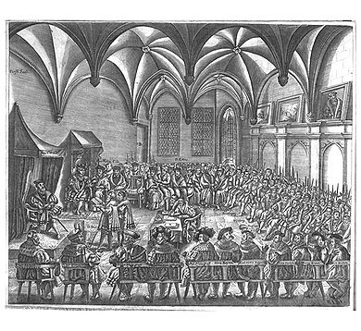
Protestantism
Spread quickly – German princes est Lutheran states
Charles V: 1546 sent armies against Protestant princes
Peace of Augsberg 1555:
German rulers could establish any religion for their state
Subjects didn’t like it they could move

Slide 8
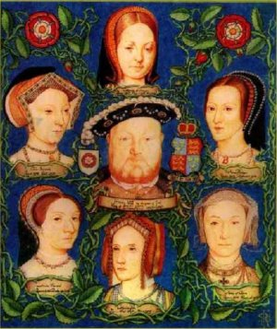
New Religions
Sects: new religious groups – no organized churches
No authority, discipline, membership or rules
Gathering of like minded individuals w/preacher
Anglican Church – England Henry VIII
England leaves church b/c Henry wants a divorce
Leave wife (Catherine of Aragon) for lady in waiting (Anne Boleyn)
Parliament passes new church of England – king as the head
Married 6 times – 1 son Edward VI

Slide 9
Calvinism
John Calvin – Switzerland
1536 – The Institutes of the Christian Religion
Faith in the Bible
Predestination – God already decided who will be saved
“The elect” – community followed highest moral standards
Geneva – theocracy: gov’t ruled by religious w/god’s authority
Outlaw on Vices

Slide 10
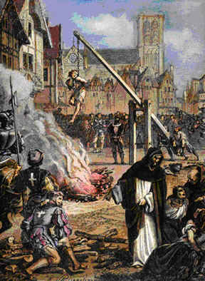
The Spread of Calvinism
Huguenot:
French nobility that converted to Calvinism
1/3 became Calvinists
Civil War – Huguenots vs. Catholics 1562
1598 Henry IV – Edicts of Nantes
Freedom of worship / political rights
Puritanism – form of Calvinism

Slide 11
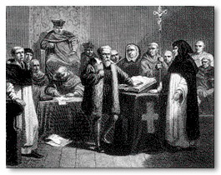
The Counter-Reformation
Counter (Catholic) Reformation
Attempt to return the church to emphasizing spirituality
Clarify church doctrine
Campaign to stop Protestantism
Pope Paul III 1534-1549
Inquisition – question “heretics”
Keep Catholics in the church
Pope Paul IV
Index of Forbidden Books
Books that were harmful to faith and morals

Slide 12
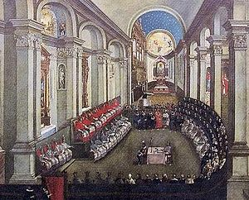
Council of Trent
1545 Church Leaders meet in Trent
Met during 3 periods from 1545 – 1563
End abuses of indulgences
Discipline within the clergy
Emphasized the need for ceremonies
People must depend on priests b/c God grants forgiveness through the church
Salvation comes from ceremonies & faith
Every person has free will

Slide 13
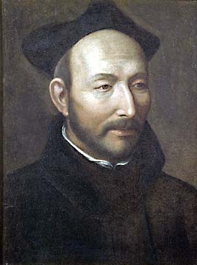
Soldiers of the Counter-Reformation
Society of Jesus (Jesuits)
Ignatius de Loyola – founder 1534
1540 Pope Paul III recognizes Jesuits as an official order
Followers Vows: chastity, poverty & obedience to the pope
Most effective in spreading Catholicism
Stressed education
Combined humanist values w/Catholic doctrine

Slide 14
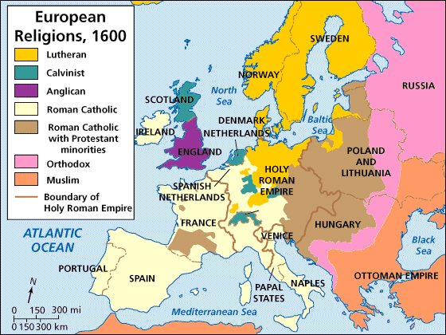
Results of Religious Upheavals
1530’s – mid 1600’s
Religious wars in France, Germany, Netherlands & Switzerland
Interest in Education
Jesuits worked to strengthen faith in school
Protestants believed people found the Christian faith by studying the bible
Reading and literacy become important
Gov’tal Power Increases
Gov’ts, like England, took responsibility for church leadership
Papal powers decreased

