Slide 1
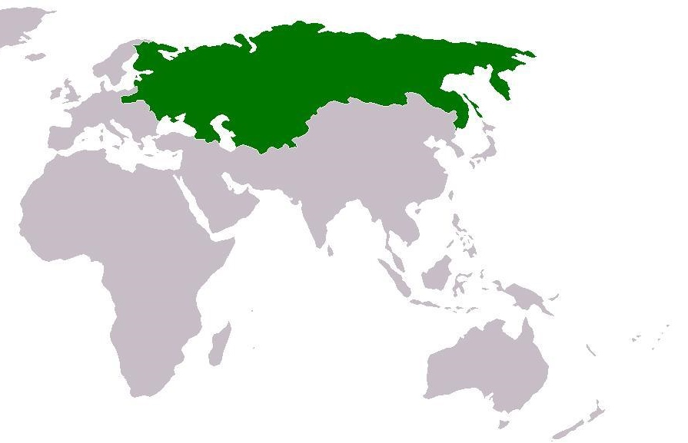
Reform and Revolution in Russia
Chapter 25 Section 4

Slide 2
Russia in the mid 1800s
Largest territory and population of any European Nation
Extremely diverse population
White Russians (West)
Ukrainians (South)
Great Russians
Industrial development lacking
Cold water trading ports
Notes:
Are these good or bad? How do you think they would affect ruling the country or unifying it?
The diversity of different ethnic, national, and religious groups made unification very difficult for Russia

Slide 3
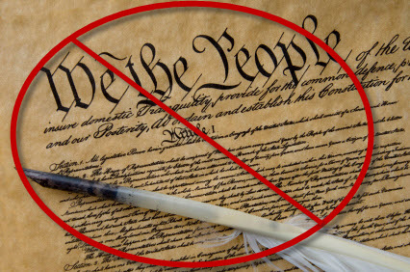
Domestic Policy in Russia
Liberal movements began to catch support in Russia
In response the Czars in Russia took harsh actions:
Censorship of speech and press
Rejected all calls in Russia for a constitution
“Russification”

Slide 4
“Russification”
Program that forced non-Russian people to:
Use the Russian language
Accept the Orthodox religion
Adopt Russian customs

Slide 5
Russian Foreign Policy
Pan-Slavism-the union of all Slavic peoples under Russian leadership
Especially in the Balkans
Serbia, Montenegro, Greece, ect.
Continued expansion into Asia and the Ottoman Empire
Will lead to a war with France, the Ottoman Empire and Great Britain
Notes:
Slavic people include :

Slide 6
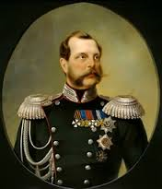
Alexander II
Issue of Serfdom inside Russia
A great nation should not own slaves
Hurt the labor pool in Russia
Emancipation Edict-liberated all the serfs in Russia
Alexander II decided it was better to liberate the serfs from above
Notes:
Serfs were tied to their owners not the land they were on
Negative because it was restricting the numbers of people that were in the Russian workforce-if you were a factory owner how would you feel about the emancipation or freeing of the serfs?
Why?
The emancipation act provided compensation for the nobles who lost serfs by allowing them to sell land to their freed serfs for high prices
The land was usually too small for the serfs to make enough money to pay the nobles which forced the serfs to leave and find work elsewhere-factories

Slide 7
Alexander II Liberal Reforms
Law passed in 1864 that allowed local governments to elect zemstvos
Zemstvos-local councils were elected by the nobles, the middle class, and peasants
Reformed the courts-reduced corruption and delays
Reorganized the military-service terms reduced from 25 years to 6 years
Notes:
Even through three classes of people were able to vote the elections were still skewed so that nobles and rich taxpayers had the majority say in what the Zemstvos did. Zemstvos were able to control taxes, public health, education, and assistance for the poor.
With the passage of all of these reforms how to you think the classes in Russia are feeling?

Slide 8
Radical Movements Backlash
Several radical movements were formed in protest of the liberal reforms that Alexander II was enacting
Examples of these groups include:
Nihilists-society could only be fixed with new Russia
Populists-wanted land and assets redistributed
People’s Will-populist movement that took to violent actions to try to get the government to accept their demands
Notes:
Their main goal was to get Alexander II to stop the liberal reforms he was passing
People’s will used terrorism-assassination attempts against Alexander II-the second bombing ended up killing him
Nihil- Latin word that means nothing – they wanted to abolish the existing political, economic, and social structures in Russia and start over again
Terrorism

Slide 9
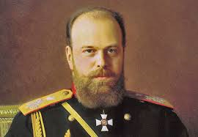
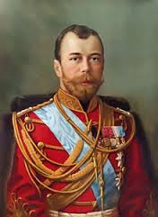
Time of Repression
Alexander III and Nicholas II were the next two rulers of Russia
Overturned liberal reforms
Used extreme censorship, control of religion, spies, and imprisonment/exile to control people
Pogroms were riots where Jewish villages were destroyed and their inhabitants murdered
Notes:
Progress of Alexander II was lost
The government did nothing to try to stop or prohibit these pogroms
How do you think Russians felt about this trip back to the old suppressed Russia?

Slide 10
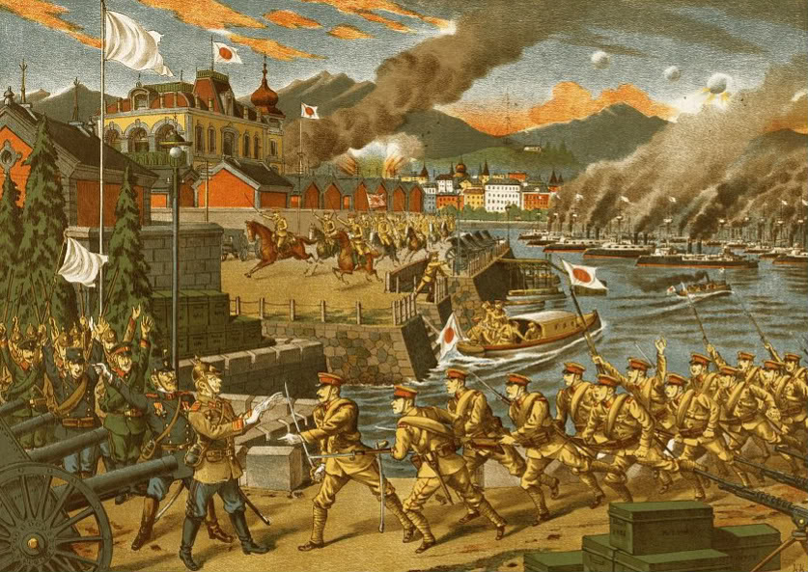
Russo-Japanese War
1904 and 1905 Russia went to war with Japan
Russia
loses
Notes:
Russian defeat? To Japan? Based off the size of the countries

Slide 11
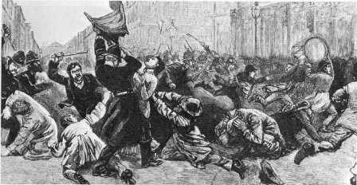
Bloody Sunday 1905
“Bloody Sunday”-Russian troops fired shots at a peaceful group of demonstrators
Mutinies in the Army and Navy
Notes:
The Duma was designed to give the people more say and influence in their country but it was controlled by the upper class

Slide 12
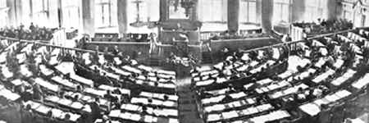
October Manifesto
Decree that was issued by the Czar in response to “Bloody Sunday”
Promised individual liberties
Created the Duma
An elected parliament
Notes:
The first Duma was elected on May 10th 1906
Although the Duma was supposed to give people more individual liberties it ends up becoming extremely conservative
Restrictions and laws were put into place that made put large land owners in power and they took it upon themselves to restrict the voting rights of other people

Slide 13
Reasons why the Revolution Failed
The majority of the army remained loyal
The French lent money to the Czar and Russian government
Revolutionary groups demands were all different
Notes:
Why is a loyal army so important?
French alliance led to monetary aid for Russia
Significance of different demands following the revolution?

Slide 14
Question
Why did attempts to liberalize the Russian government fail?

