Slide 1
When Did That Happen?
1500-1600
-Renaissance
-Reformation
-Scientific Revolution
-Exploration
-Absolutism
-Spain World Power
1600-1700
-Colonization of New World
-Mercantilism
-Industrial Revolution Begins
-Absolutism
-England World Power
-English Civil War
1700-1800
-Age of Enlightenment
-American Revolution
-French Revolution
1800-1900
-Age of Napoleon
-Congress of Vienna
-Life Centered Around Factory System
-Rise of Capitalism and Socialism
-Rise of Nationalism
-Rise of Imperialism
1900-2000
-WWI
-WWII
-Cold War
-Nat. Movements Worldwide
-1st Gulf War

Slide 2
Essential Questions
Did the reforms of the late 1800s and early 1900s help to fix the social problems caused by the Industrial Revolution?
Did the reforms of the late 1800s and early 1900s create new problems of their own?

Slide 3
On Our Way to WWI… M.A.I.N.
Nationalism
Imperialism
Alliances
Militarism

Slide 4
Italian Nationalism and Unification chapter 25.1

Slide 5
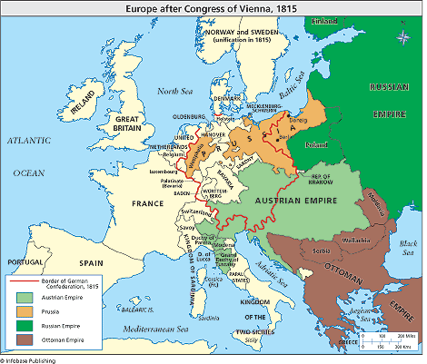
Europe after Congress of Vienna

Slide 6
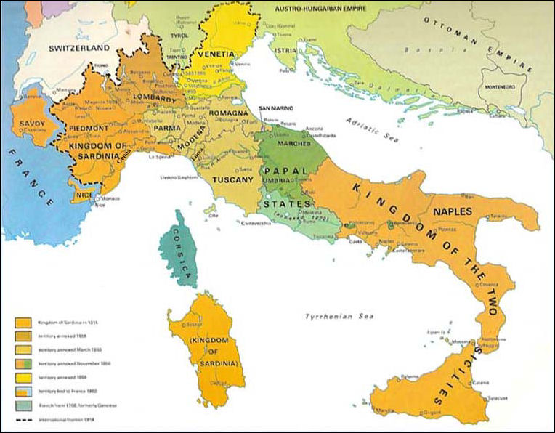
Factors Against Italian Unification
Italy divided into 9 states
Pope wanted control of Papal states
European countries didn’t want a strong Italy
Notes:
What year did the United States achieve unification/independence? 1776!
With Italy we are looking at almost 100 years later!
In the United States at this time Lincoln has been elected president and South Carolina has secede from the Union and the Civil War is looming in the near future. Argument could be made that it is not the

Slide 7
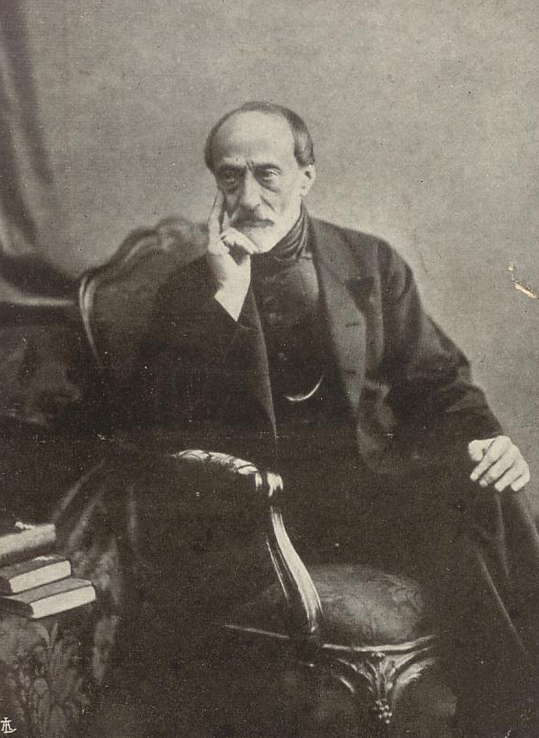
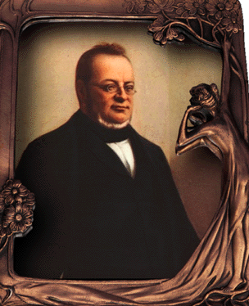
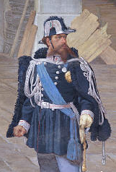
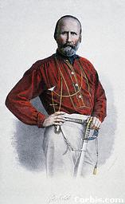
Factors For Italian Unification
Nationalism
Good Leadership
Mazzini “Heart”
Cavour “Brain”
King Victor Emmanuel II
“Leader”
Garibaldi “Sword”
Notes:
Nationalism- a feeling that people have of being loyal to and proud of their country often with the belief that it is better and more important than other countries
What do you make of the nicknames that are given to these Italians?

Slide 8
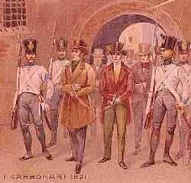
Steps Towards Unification
Risorgimento “resurgence”
Nationalist movement; wants unification
Carbonari “coalmen”
Secret society dedicated to Risorgimento
Young Italy Movement
Led by Giuseppe Mazzini “the heart”
Mazzini and the Youth movement insisted that they did not want “ Neither pope or king” but rather an Italian Republic .
Notes:
Nationalists could not work in the open. Why?
An example of one of these secret societies was the Young Italy Movement

Slide 9
Steps Towards Unification Continued…
In 1848 Nationalist groups overthrew Austrian rule in north and seized Rome
However, Nationalist gains were short lived…

Slide 10
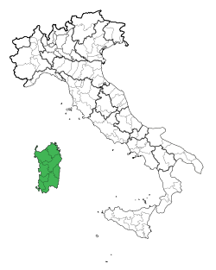
Steps Towards Unification Continued…
Sardinia (strongest Italian state)
King Victor Emanuel II “the leader”
Wanted end to Austrian influence in Italy
Count Cavour (Prime Minister) “the brain”
Strengthened industry, economy & army
Plotted with France against Austria
Notes:
Cavour was the one who actually ran the country
Where else have we seen this type of constitutional monarchy?

Slide 11
Steps Towards Unification Continued…
At first, war w/Austria followed plan
Sardinia and France fought Austria
But France backed out
B/c feared Austrian/Prussian Alliance
Sardinia forced to end war w/ Austria
Italian Independence seemed lost
Notes:
Napoleon III wanted to increase French influence and support the Italian Revolution
What are some reasons that you think Napoleon would want to support the Italians against the Austrians given that in general Europe did not want a Unified Italy?
A chance for France to try to control Italy because with Austria out Italy would essentially be more vulnerable again
Cavour was not oblivious to the French desire to control Italy after getting rid of Austrian influence but he was hoping that the expulsion of Austria would cause the Italian states to unify against the French as well
France and Sardinia agreed to giving France two French territories on the border of the two countries and even though France backed out of the war Sardinia still gave the French their territories

Slide 12
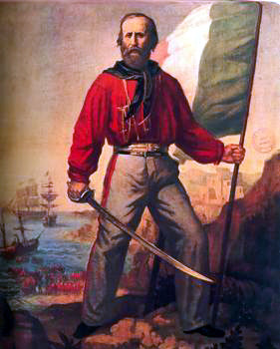
Steps Towards Unification Continued…
Giuseppe Garibaldi “the sword” & 1000 Red Shirts
Devoted to Italian freedom
Led 1000 men and liberated 2 Sicilies
Then marched to Rome
But Cavour “the brain” stopped him
Garibaldi didn’t contest
King Emanuel II was voted King of Italy
Notes:
The 1000 men that garibaldi led were nicknamed the 1000 red shirts
Why would Cavour stop him?
Garibaldi’s only request was to be the governor or Naples. King refused, why?

Slide 13
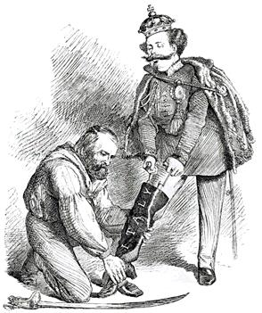
“Right Leg in the Boot at Last” A Unified Italy?

Slide 14
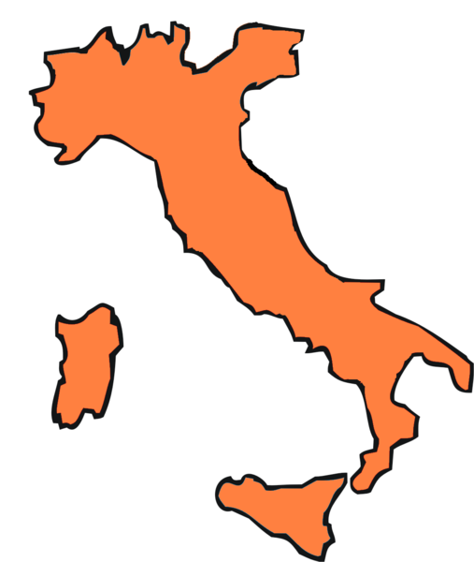
Problems w/ Italian Unification
Lack of experience w/ self-gov.
Regional diff.
Econ. Prob. (N=Industry; S=Agriculture)
Low stand. of living

Slide 15
Imagine that you are the Napoleon III and you have to decide whether or not to support Italy in their against Austria and for unification. Would you support the Italian Unification or not? Provide reasons why or why not.
Consider the following for your answer:
Expansion of France
Prussian Response

