Slide 1
Napoleonic Era
Chapter 21 Sections 4 & 5

Slide 2
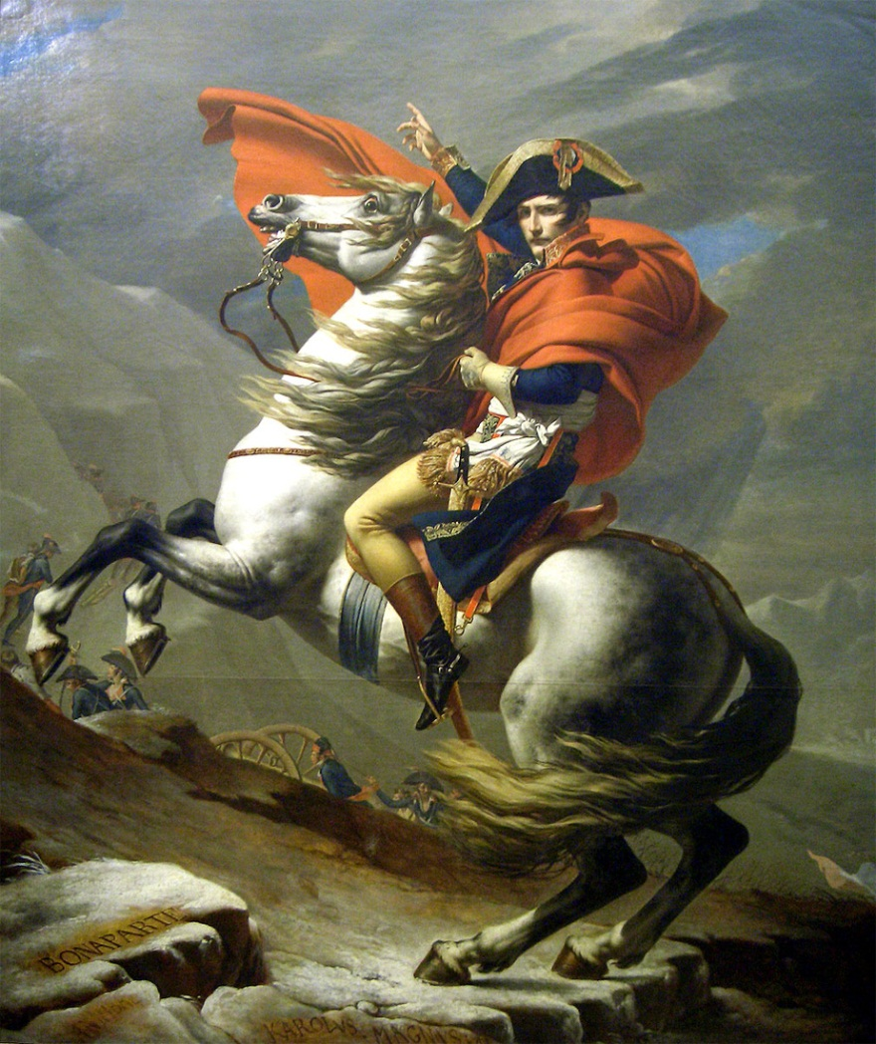
Rise of Napoleon
Born in Corsica
Was poor nobility
Defeats royalists from taking over National Convention
Defeats Europe forces
War hero

Slide 3
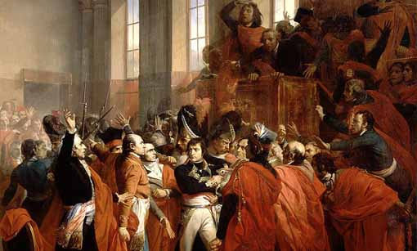
Perfect Storm
  France no leader
  Chaos and disorder
  Military forced most of the members to leave the legislature
  Staged a coup d’etat!
  Three consuls
  Plebiscite – dictator
  I saw the crown on the floor and picked it
  Crowned himself

Slide 4
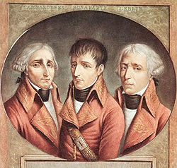
The Consulate
1st Five years of Napoleon’s Rule
  Reorganized gov’t to give himself unlimited power
  Commanded the Army/Navy
  Could appoint/dismiss most officials
  Propose laws – legislative bodies just approved/reject his decisions
  Kept most of the changes of the revolution

Slide 5
Accomplishments in Gov’t
Napoleonic Code – French Civil Code
  No privileges based on birth
  Freedom of Religion
  Gov’t jobs go to the most qualified
Est Bank of France
Public education – planned by National Convention
  High Schools, Universities & tech schools
  Elementary ed – controlled by churches & local gov’s
Concordat – allowed religious freedom
  Church gave up claims to property gov’t had seized and sold during Rev

Slide 6
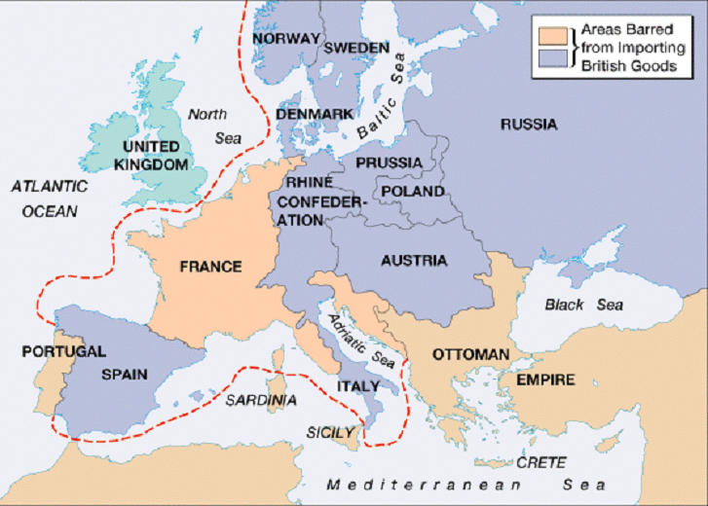
Napoleon As Emperor
1805 – Continental System
  Blockade of British Isles – Napoleon had control of most of EU

Slide 7
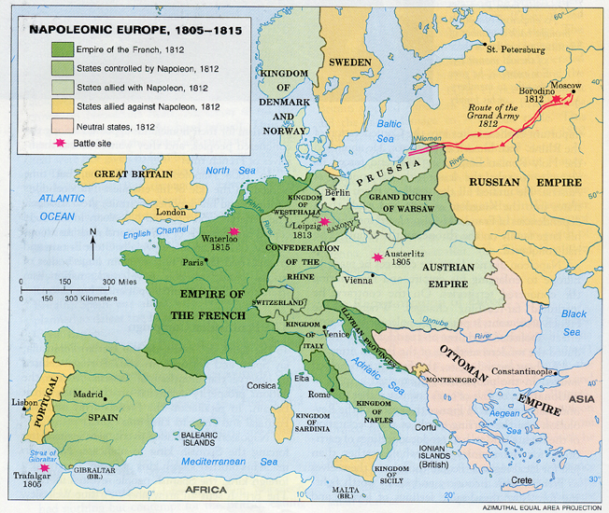
Reorganization of Europe
Members of family became Monarchs of conquered countries

Slide 8
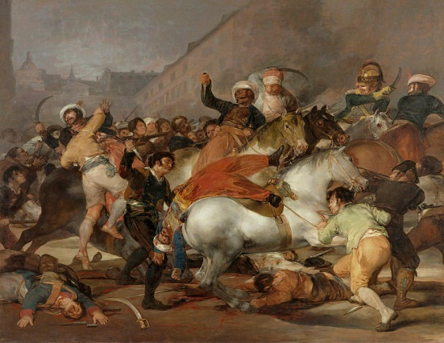
Peninsular War
War on Iberian Peninsula 1808-1814 – Spain, Portugal & GB
  1807 Portugal refuses the Continental System – econ relies on trade w/GB
  1813 Spanish w/GB help drive out Joseph Bonaparte
    New Constitution – limited monarchy (French Rev Ideas)

Slide 9
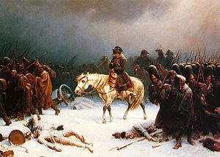
Napoleon’s Big Mistake
Battle of Trafalgar – British naval supremacy and Britain not invaded
1812 Russia started trading with GB again
  Napoleon built the Grand Army (600k) – marched on Russia
  Lured deep into the country – Russian’s used scorched-earth
  Retreated after the fall of Moscow/series of critical errors
  2/3 of Army died by Prussia – Russia & allies invaded France
1814 End of Napoleonic Era
  Napoleon retired to Elba, Italy
  Louis XVIII reinstated as monarch of France

Slide 10
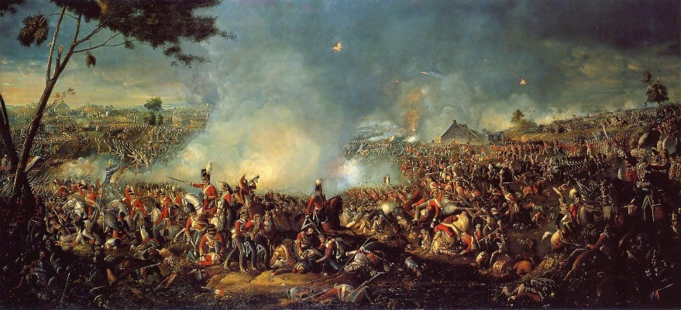
The Hundred Days
Napoleon Comes out of Retirement
  French were unhappy with Louis XVIII
  Napoleon escaped Elba, returned to France
  March 20 – Napoleon leads army to Paris – Louis XVIII flees to exile – Napoleon back in power
Showdown in Waterloo
  June 18, 1815 – Allies & France meet – Napoleon’s final defeat
  Monarchy restored again
  Napoleon sent to St. Helena – guarded for life – died 1821

Slide 11
Congress of Vienna
Congress of Vienna
  Congress of ambassadors from Europe – decisions made mostly by GB, Austria, Prussia & Russia
Principles of the Congress
  Countries who lost the most to Napoleon had to be repaid
  Balance of Power needed to be restored in Europe
  Decisions to follow rule of legitimacy, former ruling families should be restored to the throne
Compensation leads to disarray
  Netherlands – Austrian Netherlands back
  Austria - +2 northern Italian states
  Sweden – gets Norway (punishes Denmark for helping Napoleon)
  Prussia – territory along the Rhine River
  GB – Islands in the West Indies & Mediterranean
  France paid an indemnity ($$) to countries it caused dmg to
  Bourbon Monarchy restored in France, Spain & Kingdom of 2 Sicilies

Slide 12
Reactionary Alliances
Reactionaries – those who oppose change, want life to return to previous standard
  Napoleon increased nationalism – new groups wanted new gov’t
Quadruple Alliance
  Austria, GB, Prussia & Russia – continued previous alliance to prevent the end of Monarchy in Europe
  1818 France joins = Quintuple Alliance
  Czar Alexander urged leader to sign the Holy Alliance – rule as Christians
Concert of Europe
  Formed from these alliances – international governance by concert or agreement
  Maintain balance of power – effective until 1848

Slide 13
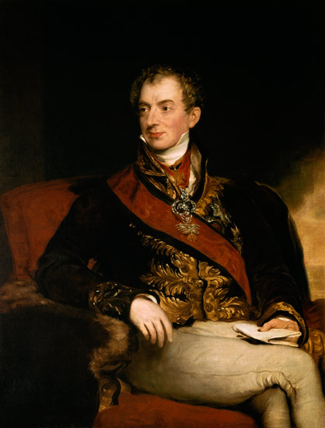
Age of Metternich
Prince Metternich – Austria
  Influenced EU politics for 30 yrs after Cong of Vienna
  Reactionary – believed in absolute monarchy
  Feared liberalism – revolutionary thinking, individual rights, rule of law
  For suppression of free speech & press
  Set up Austrian version of CIA to spy on revolutionaries
  System worked for a while but ended in 1829 with the Greek revolution

