Slide 1
Mexican Independence/Republic of Texas

Slide 2
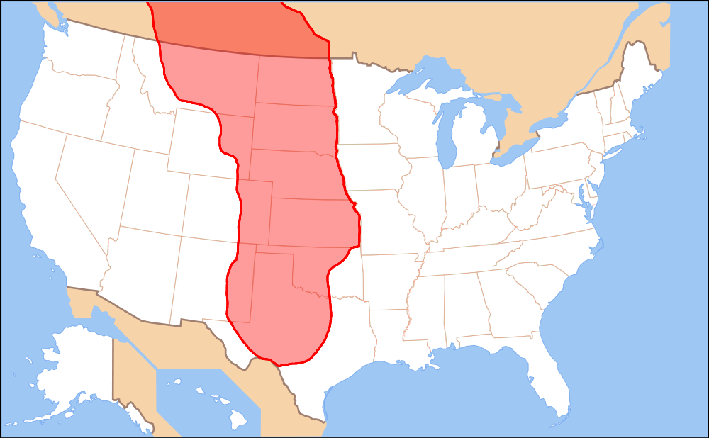
The Great Plains
Vast grassland between the Mississippi River and Rocky Mountains

Slide 3
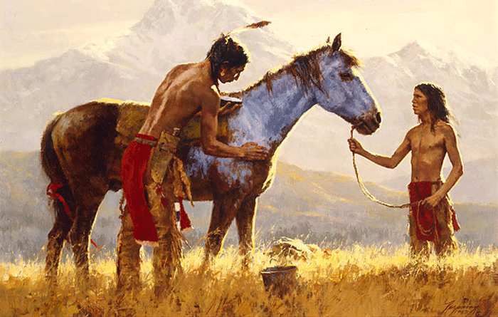
Plains Indians
Were nomadic- migrated from place to place instead of settling in one
Immensely impacted by Europeans- Horse
Horses-increased nomadism of Plains Indians, increased buffalo hunting, increased violence among Indians.
Disease-More European
traders=more European
diseases

Slide 4
Hispanic North America
Spanish had many colonies in the Southwest
Heart of North American empire was in Mexico
Established presidos (forts) along the coast of CA
Had towns in present day NM and TX
http://www.censusscope.org/us/map_hispanicpop.gif

Slide 5
1800’s-1820 Mexican Independence

Slide 6
Reasons for Independence
The Colonial legacy also allowed the Church to be owners of between 25% and 50% of the land and controlled most schools, hospitals, and charitable institutions.
They also enjoyed “fueros” which are special privileges which included the right to not be tried in civil courts (Acuna 2007:36).
Population of Mexico in 1810- Indians(3,676,281) 60% Criollos(1,092,397) 18% Mestizos(704,245) 11% Mulatoes(624,461) 10% Peninsulares(15,000) .3 Blacks(10,000) .2%

Slide 7
Beginning of the Revolution
In 1808, French Napoleon captured the Spanish monarchs and took over Spain.
Mexican Viceroy, Jose de Iturrigaray promised to keep Mexico under Spain’s rule until the monarchy could be restored.
Tension began to grow among criollos who wanted some changes in New Spain like
elimination of the fueros
more freedom of trade, and more diversification of the Colonial economy and the lower classes of Indians and peasants who were growing tired of oppression and inequalities.
Military leaders also enjoyed these fueros or special privileges.

Slide 8
Independence or Social Revolution?
-Father Miguel Hidalgo y Costilla (a priest from Dolores) gave “El Grito” on a Sunday on September 16, 1810
a call for the oppressed people of Mexico to rise against their Spanish rulers.
In less than two weeks the insurgent leaders had assembled thousands of rebels (between 70,000 and 80,000) and began a march on the industrial and mining center of Guanajuato.

Slide 9
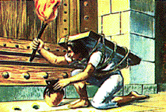
Guanajuato- El Bajio
They eventually captured the city and massacred hundreds of Spaniards in the granary and city (Alhondiga de Granaditas).
A legendary figure, named el pipila, helped the rebels capture the Spanish stronghold by covering his body with a block and reaching the doors and setting them on fire.
Less than a year after the revolt, he was captured and executed by a firing squad.

Slide 10
Jose Maria Morelos
Following his death, another priest, Jose Maria Morelos assumed command of the revolutionary movement. Like Hidalgo, he ordered an end to slavery and tribute. He pushed for reforms in government.
After Spain became free of French rule in 1814, the Spanish Crown was able to refocus of Mexico and sent more troops to press on the revolutionary movements. By the end of 1815, Morelos was defeated, captured, and executed.

Slide 11
Liberals
Conservatives
copy the reform governments like the United States.
sided with the French revolution that wanted to end these privileges and wanted to modernize the economy.
Wanted Mexico to exist very much the way it did during the Colonial Era with support for the Church and landed economic systems.
sided with the Church and mercantilism while Liberals

Slide 12
The Movement Continues
The Spanish government angered both liberals and conservatives in Mexico by being too liberal and forced both sides to agree on the criollo officer Agustin de Iturbide who crowned himself emperor of Mexico on September 28, 1821!
His monarchy experiment only lasted a few months because it had no popular base of support. He was overthrown by Guadalupe Victoria and in 1824 a new constitution was written.

Slide 13
Hispanic North America
War for Mexican Independence
Mexican people earned independence from Spain in 1821
Caused Spain to lose all of their territory in present-day CA, NM, and TX as well
New Mexican leadership allowed this territory to trade with the United States
Caused trade with U.S. to surpass trade with Mexico
Encouraged more Americans to move to territory
Established a blended Mexican/Spanish/Native American/American culture in this area- http://www.tolerance.org/blog/sorting-people-and-sorting-out-students
Creates a growing desire to become more involved with U.S.

Slide 14
Texas Revolution

Slide 15
Tejanos
In 1821, only about 4,000 Tejanos lived in Texas.
Tejanos are people of Spanish heritage who consider Texas their home.
The Spanish government tried to attract Spanish settlers to Texas, but very few came.

Slide 16
Moses Austin
An American, Moses Austin was given permission by the Spanish government to start a colony in Texas.
All the Americans had to do was follow Spanish laws.
Moses died in 1821, so his son Stephen tried to start the colony.

Slide 17
In 1821, Mexico won independence from Spain

Slide 18
Mexican Independence Changes Texas
The Mexican government told Stephen Austin his settlers would have to become Mexican citizens and members of the Roman Catholic Church, and learn Spanish.
Between 1821 and 1827, Austin attracted 297 families to his new settlement.

Slide 19
The success of Austin’s colony attracted more land speculators and settlers to Texas from the United States.
By 1830, the population had swelled to about 30,000,with Americans outnumbering the Tejanos six to one.

Slide 20
Rising Tensions in Texas
In 1829, the Mexican government outlawed slavery.
The settlers wanted to keep their slaves so they could grow cotton.
The Americans also didn’t want to learn Spanish or follow Mexican laws.
Very few settlers had converted to Catholicism.
In 1829, the Mexican government closed the state to further American immigration.
Texans had to start paying taxes for the first time.
Mexican president, General Antonio Lopez de Santa Anna sent more Mexican troops to Texas.
Texans began talk of breaking away from Mexico.
When Stephen Austin was jailed, the Texans did revolt.
Santa Anna led 6,000 troops to Texas to put down the revolt.

Slide 21
The Alamo
The first battle between the Texans and Mexicans took place at on old mission that was used as a fort.
It was called the Alamo.

Slide 22
The Fight for the Alamo
There were only 183 Texans guarding the Alamo.
The Mexican army had 1,800 men.
The Texans held the Alamo for twelve days.
On the thirteenth day, Santa Anna ordered his men to storm the fortress.
When it was over, all but five Texans were dead. The men not killed in the battle were executed by Santa Anna.
Texans were shocked by the slaughter at the Alamo and vowed to fight for their freedom.

Slide 23
Battle at San Jacinto
Santa Anna had over 300 more Texans executed at Golidad.
Texan general, Sam Houston gathered more troops, 800 in all.
It included Tejanos, American settlers, volunteers from the United States, and many free and enslaved African Americans.
They met Santa Anna at San Jacinto.
Their battle cry was, “Remember the Alamo!”
It was over in 18 minutes. More than half the Mexican army was killed.
Santa Anna was forced to sign a treaty giving Texas its freedom. With the Battle of San Jacinto,Texas was now an independent country.

Slide 24
General Santa Anna surrenders to General Houston

Slide 25
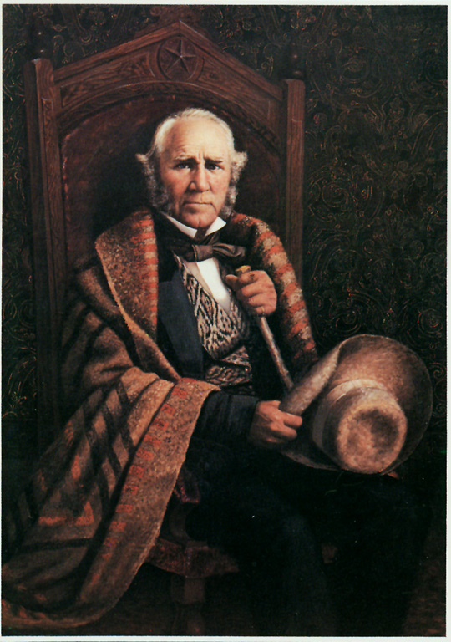
Lone Star Republic
Results
In 1836, Texas declared itself The Lone Star Republic.
American connection to the Republic of Texas
Trade with U.S is huge
Sam Houston was elected president.
Some Americans wanted Texas to be part of the U.S.
Some people were afraid of Texas becoming a slave state, others of war with Mexico.
Both would eventually happen.

Slide 26
